Slide 1
Enhancing Skin Cancer Detection
A Fine-Tuned ResNet50 Transfer Learning Framework with Decision Threshold Calibration
Belal Hossain • Nusrat Jahan
2023-2-60-010 | 2023-2-60-286
Department of Computer Science, East West University, Dhaka, Bangladesh
96.59%

Slide 2
AGENDA
Presentation Outline
01
Introduction & Motivation
06
Proposed Fine-Tuned ResNet50
02
Related Work
07
Threshold Calibration & Ablations
03
Dataset & Preprocessing
08
Explainable AI — Grad-CAM
04
Methodology — Framework Overview
09
Results & Benchmark Comparison
05
Backbone Screening (4 CNNs)
10
Conclusion & Contributions
2 / 20

Slide 3
01 · INTRODUCTION
Motivation & Problem Statement
Malignant and benign skin lesions can look very similar, but they need different medical treatment.
Skin lesion images can have many variations, such as differences in color, texture, shape, border, and lighting. Things like hair, shadows, and other image artifacts can also appear in the image. These variations make automatic classification more challenging for deep learning models.
Previous research used a hybrid approach to solve this problem. For example, the reference work used DarkNet53 to extract deep features, then WPCA for feature reduction, followed by Random Forest for classification. This approach achieved 88.01% accuracy, providing a useful benchmark for comparison.
Our objective is to develop a simpler end-to-end approach. Instead of extracting features and then using a separate classical machine-learning classifier, we fine-tune a CNN directly for the classification task. The main goal is to determine whether this directly fine-tuned CNN can achieve higher accuracy than the 88.01% benchmark while keeping the overall pipeline simpler.
3 / 20

Slide 4
02 · RELATED WORK
From Handcrafted Features to Deep Transfer Learning
Classical Approaches
Our Work: End-to-End CNN
Used handcrafted lesion features such as border, texture, and asymmetry.
These features were then classified using SVM, KNN, or Random Forest.
Main limitation: performance depends heavily on the quality of manually designed features.
We remove the separate feature extraction and classical ML stages.
A CNN is fine-tuned directly for benign vs. malignant classification.
We compare ResNet50, DenseNet121, MobileNetV2, and EfficientNet-B4 under the same evaluation protocol.
Deep Feature + Hybrid Classifiers
Recent studies use CNNs such as ShuffleNet, SqueezeNet, DarkNet53, and Xception to extract deep features.
These features are then reduced using WPCA and classified using Random Forest or SVM.
DarkNet53 + WPCA + Random Forest achieved 88.01% accuracy, which is used as our reference benchmark.
Explainability
We use Grad-CAM to visualize which parts of the lesion influence the model's prediction.
This helps us understand the model's attention, but it is not a clinical or causal explanation.
4 / 20

Slide 5
03 · DATASET
Skin Cancer: Malignant vs. Benign (ISIC / Kaggle)
Stratified train / validation / test partitioning (seed = 42)
Subset | Benign | Malignant | Total
Training | 1,152 | 957 | 2,109
Validation | 288 | 240 | 528
Official Test | 360 | 300 | 660
Total | 1,800 | 1,497 | 3,297
The official test set is held out entirely; only the training split is further divided 80:20 into train / validation.
Source: ISIC archive images distributed via Kaggle (“Skin Cancer: Malignant vs. Benign”).
5 / 20

Slide 6
03 · DATA PIPELINE
Preprocessing & Augmentation
1
2
3
4
Decode & Resize
Model-Specific Preprocessing
Train-Only Augmentation
Efficient Loading
Images decoded as RGB and resized to 300×300 px.
Each image is passed through the native preprocessing function of the selected CNN backbone.
Random horizontal and vertical flips applied only to the training split.
tf.data pipeline with training-only shuffling, parallel mapping, batch size 32, and AUTOTUNE prefetch.
6 / 20

Slide 7
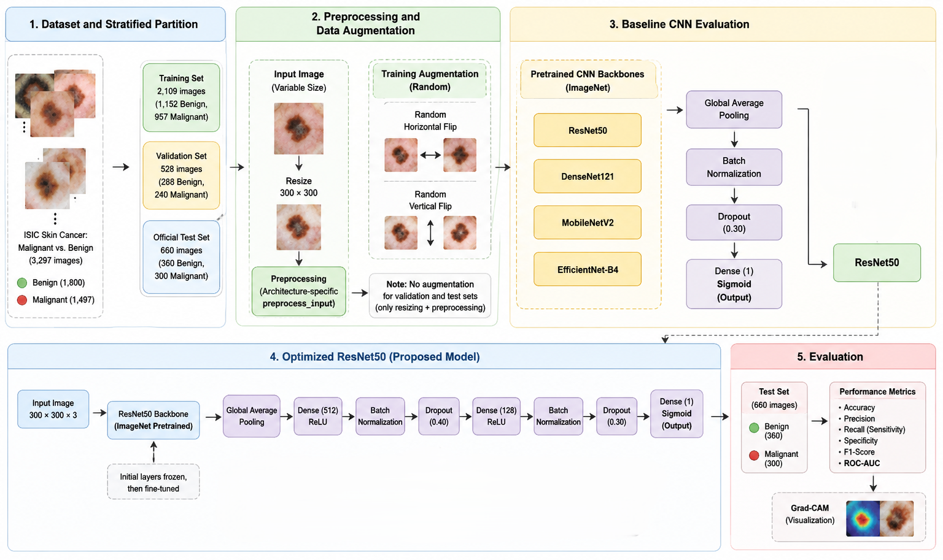
04 · METHODOLOGY
End-to-End Framework Overview
7 / 20

Slide 8
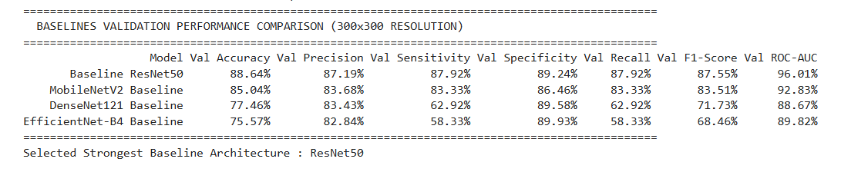
05 · BACKBONE SCREENING
Comparing Four Pretrained CNN Architectures
BEST
ResNet50
DenseNet121
MobileNetV2
EfficientNet-B4
Residual connections ease optimization of deep networks.
Dense connectivity promotes feature reuse across layers.
Lightweight inverted residuals & linear bottlenecks.
Compound scaling across depth, width & resolution.
88.48%
81.21%
84.85%
81.21%
Baseline Test Accuracy
Baseline Test Accuracy
Baseline Test Accuracy
Baseline Test Accuracy
Output Snapshot:
8 / 20

Slide 9
06 · PROPOSED MODEL
Fine-Tuned ResNet50 — Classification Head
Input
ResNet50
Backbone
GAP
Dense 512
Dense 128
Dense 1
300×300×3 image
ImageNet-pretrained
ResNet50 backbone
Global Average
Pooling
+ BatchNorm + ReLU
+ Dropout 0.40
+ BatchNorm + ReLU
+ Dropout 0.30
Sigmoid → ŷ (malignant
probability)
KEY DESIGN CHOICES
Global Average Pooling
Dropout Regularization
Sigmoid Output
Reduces feature dimensions an Makes the feature information simpler.
Dropout rates of 0.40 and 0.30 help reduce overfitting.
Produces the probability of the malignant class.
Backbone features are globally pooled and passed through two regularized dense blocks (512 → 128) before the final sigmoid output.
9 / 20

Slide 10
06 · TRAINING STRATEGY
Two-Stage Progressive Fine-Tuning
Stage 1 — Head Warm-Up
Stage 2 — Partial Fine-Tuning
ResNet50 backbone fully frozen
Only the new classification head is trained
Optimizer: Adam, learning rate = 1×10⁻³
Up to 15 epochs, EarlyStopping (patience = 4)
Best validation weights restored
Top 30 backbone layers unfrozen
The unfrozen layers and classification head are trained together.
Optimizer: Adam, learning rate = 2×10⁻⁵
Up to 15 epochs, EarlyStopping (patience = 6)
10 / 20

Slide 11
07 · DECISION CALIBRATION
Validation-Based Threshold Selection
Composite Objective
S(T) = 5·m(T) + 2·A(T) + F1(T)
A fixed 0.50 threshold may not be optimal after transfer learning.
Thresholds from 0.30 to 0.695 are tested in steps of 0.005 using validation data only.
For each threshold, Accuracy, Precision, Sensitivity, Specificity, and F1-Score are calculated.
The selected threshold is fixed before test evaluation; no test-set tuning is performed.
m(T) = min{ A(T), P(T), Se(T), Sp(T), F1(T) }
T* = argmax over T of S(T)
Gives more importance to the weakest metric while also considering Accuracy and F1-Score.
T* = 0.495
Selected threshold for the final Fine-tuned ResNet50.
Operating point ≈ 0.50)
Fine-Tuned ResNet50 for Skin Cancer Detection
11 / 20

Slide 12
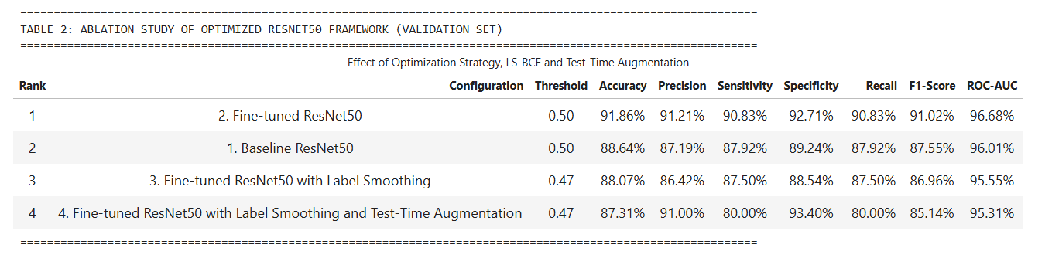
08 · ABLATION STUDY
Loss Function & Test-Time Augmentation
Label smoothing slightly reduces accuracy to 88.07% compared with the fine-tuned ResNet50 model.
5-view TTA increases specificity to 93.40%, but sensitivity drops to 80.00%, causing more malignant cases to be missed.
Conclusion: The fine-tuned ResNet50 with standard BCE provides the best overall balance and is retained as the final configuration.
12 / 20

Slide 13
08 · EXPLAINABLE AI
Grad-CAM: Visualizing Model Attention
Grad-CAM is applied to the final convolutional layer, conv5_block3_out.
Gradients from the malignant-class output are used to calculate the importance of each feature map.
The weighted feature maps produce a heatmap showing important image regions.
It is used for visual interpretation only, not as clinical proof.
αᵏᶜ = (1/Z) Σᵢ Σⱼ ∂yᶜ / ∂Aᵢⱼᵏ
Lᶜ = ReLU( Σₖ αᵏᶜ Aᵏ ) — Eq. (9)–(10)
Channel weights αᵏᶜ capture importance of each feature map for the malignant class yᶜ.
13 / 20

Slide 14
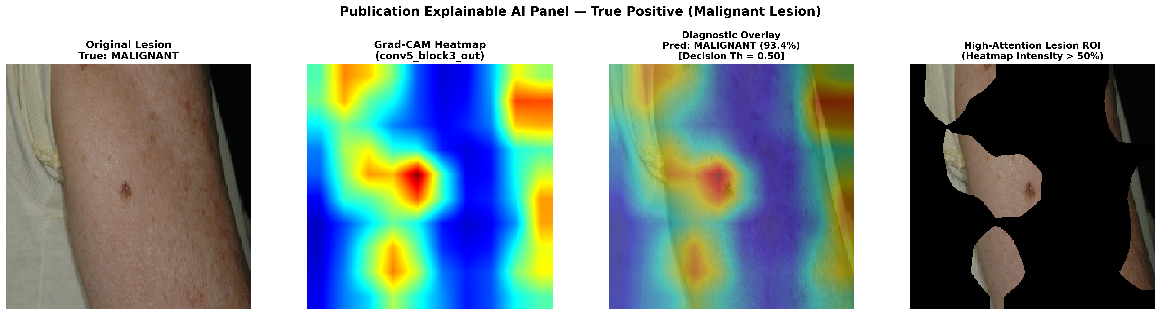
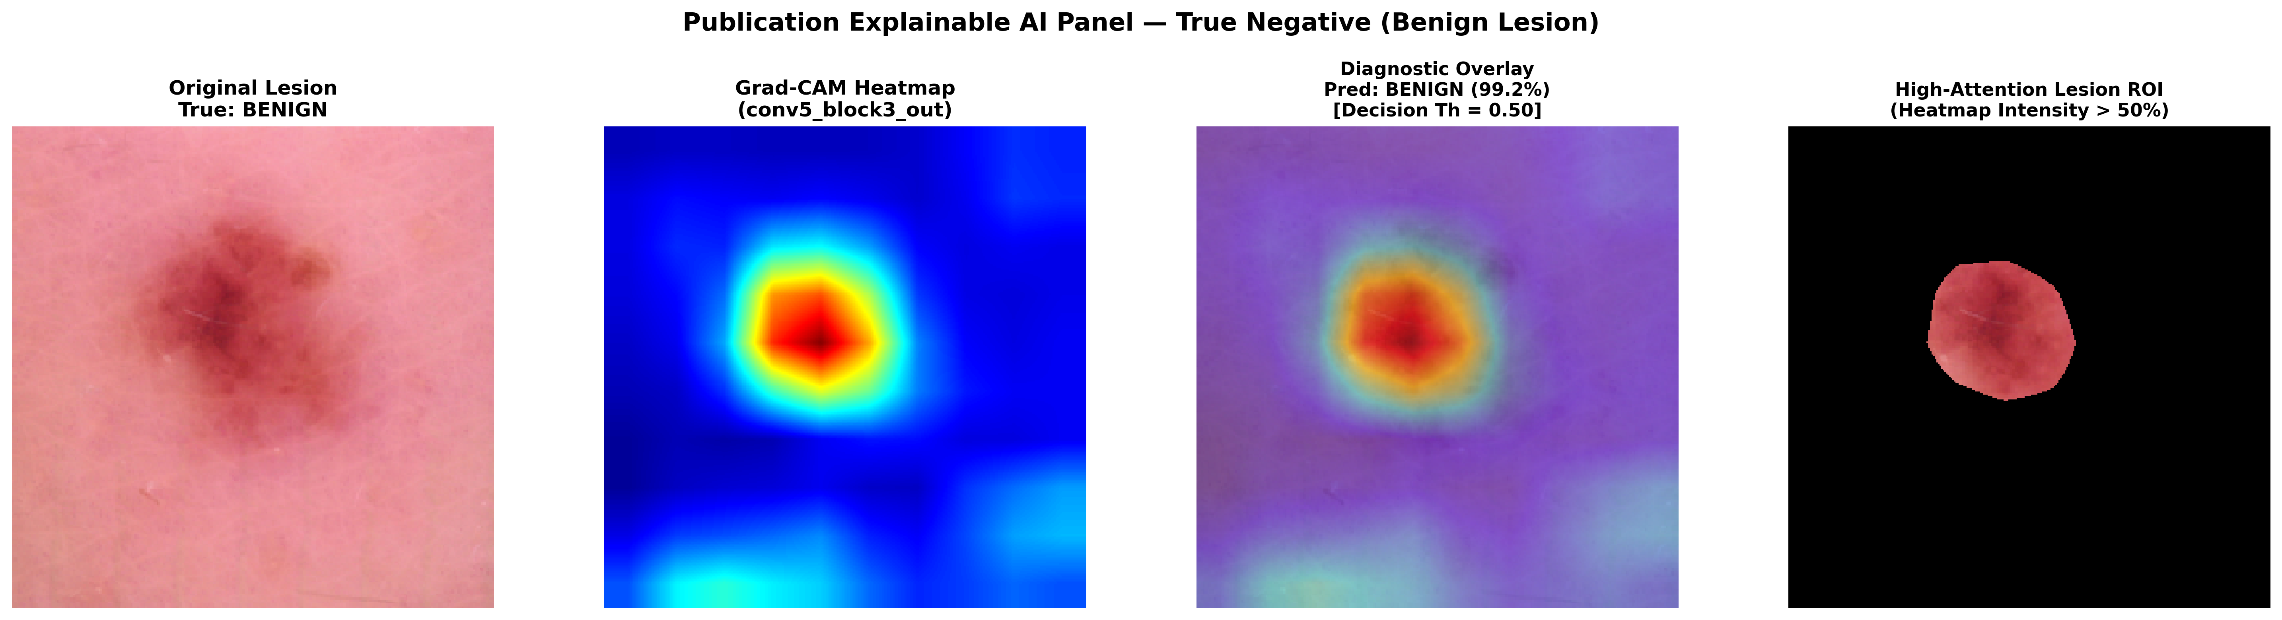
08 · EXPLAINABLE AI
Grad-CAM: Visualizing Model Attention
13 / 20

Slide 15
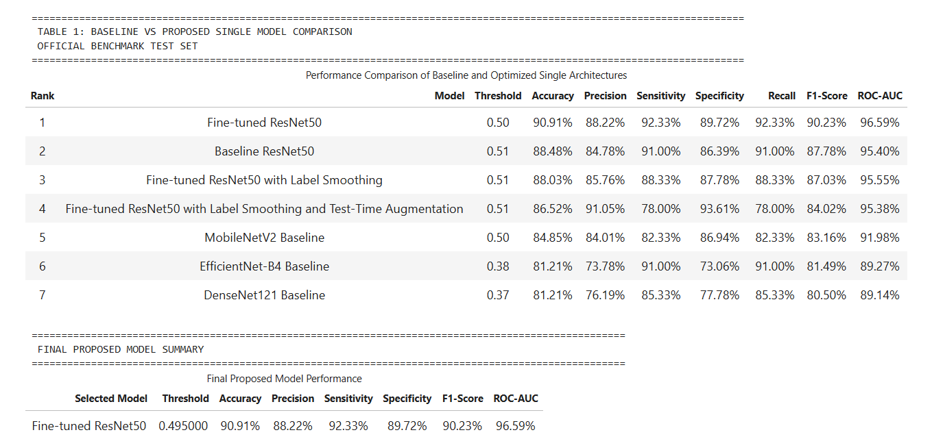
09 · RESULTS
Official Benchmark Test-Set Performance
14 / 20

Slide 16
09 · RESULTS
Official Benchmark Test-Set Performance
Model | T* | Acc. | Prec. | Sens. | Spec. | F1 | AUC
Fine-tuned ResNet50 | 0.50 | 90.91% | 88.22% | 92.33% | 89.72% | 90.23% | 96.59%
Baseline ResNet50 | 0.51 | 88.48% | 84.78% | 91.00% | 86.39% | 87.78% | 95.40%
FT ResNet50 + LS | 0.51 | 88.03% | 85.76% | 88.33% | 87.78% | 87.03% | 95.55%
FT ResNet50 + LS + TTA | 0.51 | 86.52% | 91.05% | 78.00% | 93.61% | 84.02% | 95.38%
MobileNetV2 Baseline | 0.50 | 84.85% | 84.01% | 82.33% | 86.94% | 83.16% | 91.98%
EfficientNet-B4 Baseline | 0.38 | 81.21% | 73.78% | 91.00% | 73.06% | 81.49% | 89.27%
DenseNet121 Baseline | 0.37 | 81.21% | 76.19% | 85.33% | 77.78% | 80.50% | 89.14%
14 / 20

Slide 17
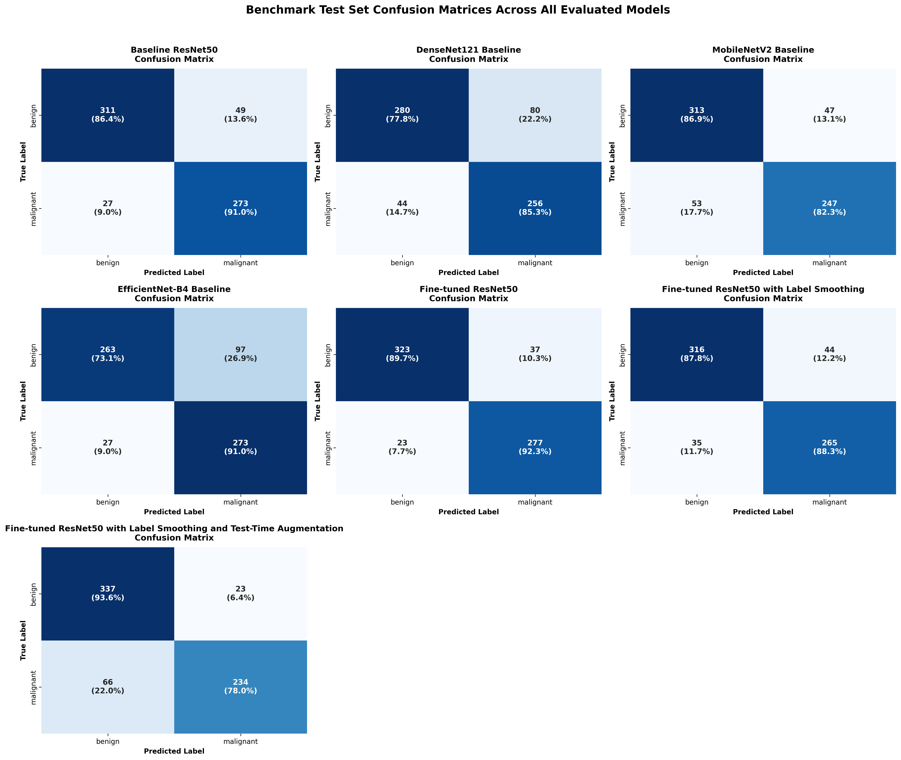
09 · RESULTS
Confusion Matrix — All Models
15 / 20

Slide 18
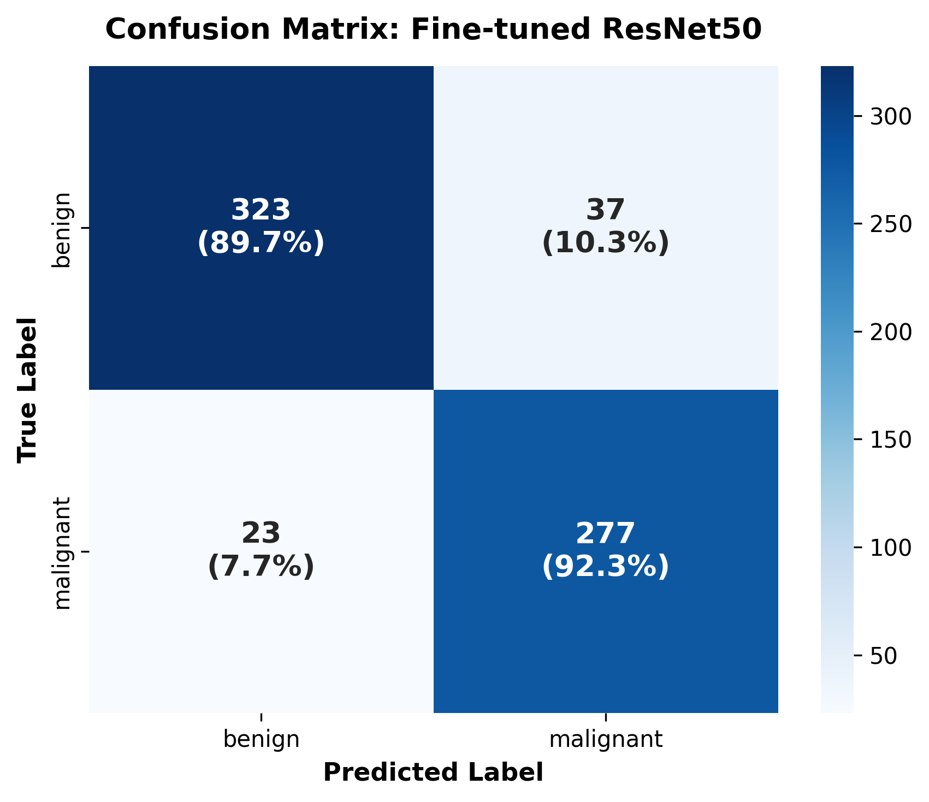
09 · RESULTS
Confusion Matrix — Fine-Tuned ResNet50 (Best Model)
92.33%
Sensitivity (Recall)
89.72%
Specificity
88.22%
Precision
96.59%
ROC-AUC
Fine-Tuned ResNet50 for Skin Cancer Detection
15 / 20

Slide 19
09 · RESULTS
Performance Across All Evaluated Models
16 / 20

Slide 20
09 · BENCHMARKING
Comparison with Published State-of-the-Art
Author & Ref. | Year | Model / Method | Acc. (%) | Sens. (%)
Farooq et al. | 2020 | InceptionV3 | 86.00 | 89.00
Ismail et al. | 2021 | ResNet | 75.31 | –
Kartal & Polat | 2022 | ResNet152 | 88.79 | 87.71
Hussein et al. | 2023 | SqueezeNet | 85.90 | 80.33
Bazgir et al. | 2024 | Inception Network | 85.94 | 86.89
Belabbaci et al. | 2025 | DarkNet53 + WPCA + RF | 88.01 | 87.69
Proposed | 2026 | Fine-tuned ResNet50 | 90.91 | 92.33
Reference Benchmark
DarkNet53 + WPCA + RF
88.01% Accuracy · 87.69% Sensitivity
Proposed
Fine-tuned ResNet50
90.91% Accuracy · 92.33% Sensitivity
+2.90 pp
Accuracy improvement over strongest published baseline
17 / 20

Slide 21
09 · BENCHMARKING
Gain Over the Reference Framework
Metric | Reference (%) | Proposed (%) | Gain (pp)
Accuracy | 88.01 | 90.91 | +2.90
Precision | 88.10 | 88.22 | +0.12
Sensitivity | 87.69 | 92.33 | +4.64
Specificity | 88.09 | 89.72 | +1.63
F1-score | 87.85 | 90.23 | +2.38
ROC-AUC is omitted from this comparison — the reference study does not report an AUC value for its final DarkNet53 + WPCA + RF configuration.
18 / 20

Slide 22
10 · CONCLUSION
Key Contributions & Takeaways
Compared four pretrained CNN models (ResNet50, DenseNet121, MobileNetV2, EfficientNet-B4) under the same 300×300 input setting.
Optimized ResNet50 with a two-layer dense head, staged fine-tuning, and validation-only threshold calibration.
Direct ablation of BCE vs. label-smoothed BCE vs. 5-view TTA — showing extra regularization is not automatically beneficial.
Full evaluation (accuracy, precision, sensitivity, specificity, F1, ROC-AUC, confusion matrices) plus qualitative Grad-CAM analysis.
FINAL RESULT
Fine-tuned ResNet50
90.91%
Accuracy
92.33%
Sensitivity
96.59%
ROC-AUC
+2.90 pp
Accuracy gain over the best published benchmark
19 / 20

Slide 23
Thank You
Belal Hossain • itsmebelalhossain@gmail.com
Nusrat Jahan • nusrat.tithy2003@gmail.com
Department of Computer Science, East West University, Dhaka, Bangladesh
20 / 20

