Slide 1

East West University | Dept. of CSE | CSE 347
StudyByte
Peer-to-Peer Micro-Tutoring Platform
Group 04 | Spring 2026
Belal Hossain · Esrat Jahan Samiya · Md. Majharul Islam · Md. Jakaria Masud
Supervisor: Dr. Hosney Jahan, Assistant Professor

Slide 2
Introduction
Project Overview
What is StudyByte?
A web-based Peer-to-Peer Micro-Tutoring platform for university students to offer and receive topic-based tutoring through a structured digital marketplace.
🎓 Tutor Side
📚 Learner Side
🔐 Platform Core
Submit grade report
List micro-topics & set price (tokens)
Conduct sessions & earn
Browse marketplace by topic
Book sessions using tokens
Rate & review tutors
Role-based dashboards
Escrow payment protection
Admin monitoring & disputes

Slide 3
Literature Review
Existing Platforms & Research Gap
Platform / Study | Strength | Gap Addressed by StudyByte
Chegg / Wyzant | On-demand tutoring | Not peer-driven; costly for students
Upwork (freelance) | Skill marketplace | No academic verification or escrow
MOOC (Coursera/edX) | Structured learning | No real-time peer interaction
P2P Learning Research | Proven peer learning benefits | No formal payment or trust mechanism
StudyByte | Verified peer tutors + escrow | Bridges gap for university context
Platform / Study
Strength
Gap Addressed by StudyByte
Chegg / Wyzant
On-demand tutoring
Not peer-driven; costly for students
Upwork (freelance)
Skill marketplace
No academic verification or escrow
MOOC (Coursera/edX)
Structured learning
No real-time peer interaction
P2P Learning Research
Proven peer learning benefits
No formal payment or trust mechanism
StudyByte
Verified peer tutors + escrow
Bridges gap for university context

Slide 4
Problem Statement
Challenges in Academic Peer Learning
❌ No Trusted Peer Platform
💸 Insecure Payments
Students lack a verified, structured space to offer or receive academic tutoring.
No reliable escrow mechanism causes mistrust—tutors may not deliver after payment.
🔍 Unverified Tutor Quality
📅 Scheduling Conflicts
Existing informal channels have no grade verification or rating systems.
Manual coordination via messaging apps is unstructured and error-prone.

Slide 5
Objectives
What StudyByte Sets Out to Achieve
01
02
03
Secure Academic Marketplace
Structured Booking & Scheduling
Token-Based Escrow Payment
A verified, trusted space for university peer tutoring
Prevent conflicts with availability-based session booking
Protect both parties—tokens held until session verified
04
05
06
Quality Assurance via Ratings
Admin Governance
Simple, Accessible Interface
Rating & review system maintains tutor accountability
Monitor, approve, and manage disputes platform-wide
Mobile-responsive UI for all university students

Slide 6
Proposed System / Methodology
Platform Architecture & Flow
1
2
3
4
5
6
Register
Marketplace
Book
Escrow
Session
Pay & Rate
University email + role
Browse / list topics
Select slot & confirm
Tokens held securely
Video + code verify
Release tokens + review
Tech Stack
HTML / CSS / JavaScript
PHP / Python (Backend)
MySQL (Database)
bKash (Withdrawal)
Token-based Wallet
Out of Scope: Built-in video conferencing · External banking gateway · Multi-institution deployment

Slide 7
Requirement Analysis
Functional Requirements
User Management
Marketplace & Booking
Payment & Wallet
Register via university email
Secure login / logout
3 roles: Learner, Tutor, Admin
Separate role-based dashboards
Tutors list micro-topics + set price
Filter by price, rating, urgency
Availability-based scheduling
No double booking of time slots
Token-based digital wallet
Tokens deducted on booking
Escrow holds until session ends
Release on meeting code validation
Session & Rating
Admin Control
Profile Management
Unique meeting code per session
Code submission verifies completion
Learner rates & reviews tutor
Auto-calculated average rating
Monitor users & transactions
Manage disputes
Approve token withdrawals
Suspend suspicious accounts
Update profile info
Tutors add expertise topics
Store student ID & department
Grade report verification

Slide 8
Requirement Analysis
Non-Functional Requirements
⚡ Performance
🔒 Security
🔄 Reliability
Page load < 2 seconds
500+ concurrent users
Wallet transactions < 3 sec
Role-based access control
Encrypted passwords
Only admin approves withdrawals
99% system uptime
Escrow prevents payment loss
Daily database backups
📱 Usability
🖥️ Operational
💰 Feasibility
Simple, user-friendly UI
Booking in ≤ 5 steps
Clear error messages
Modern browser support
Mobile responsive
Standard web server
Dev cost: BDT 40–50K
Infra: BDT 60–80K
Open-source tools (BDT 0)

Slide 9
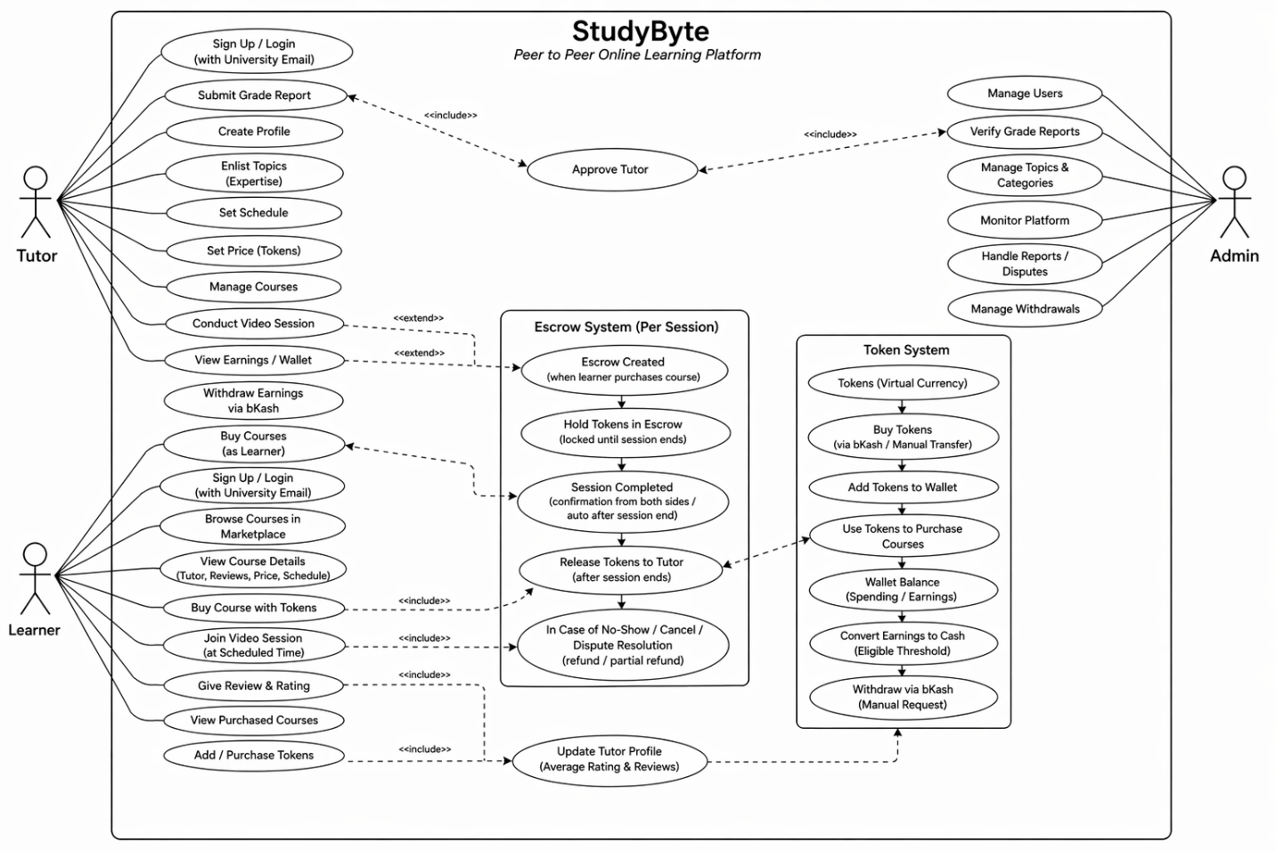
Diagrams — Use-Case Diagram

Slide 10
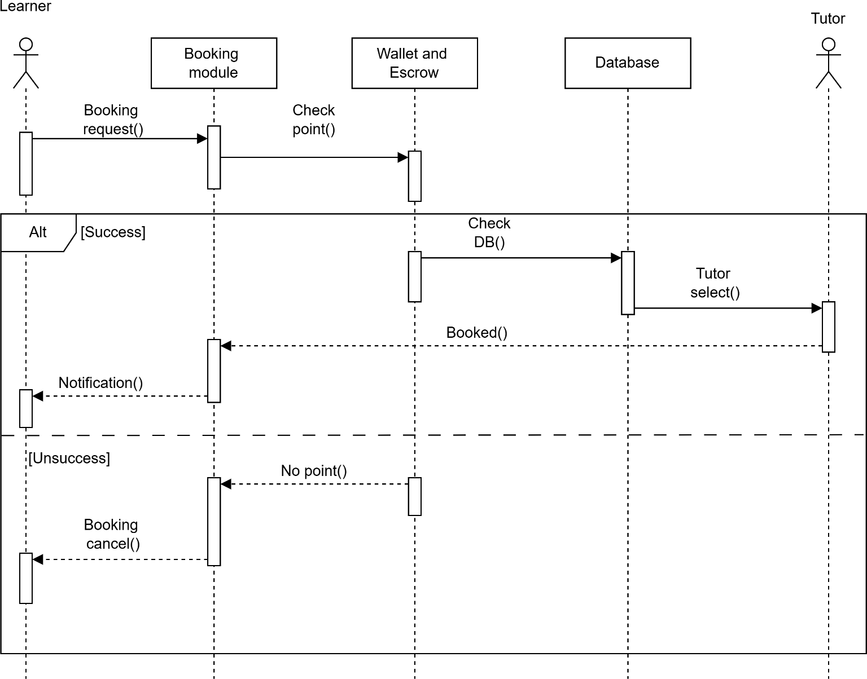
Diagrams — Sequence Diagram: Booking System

Slide 11
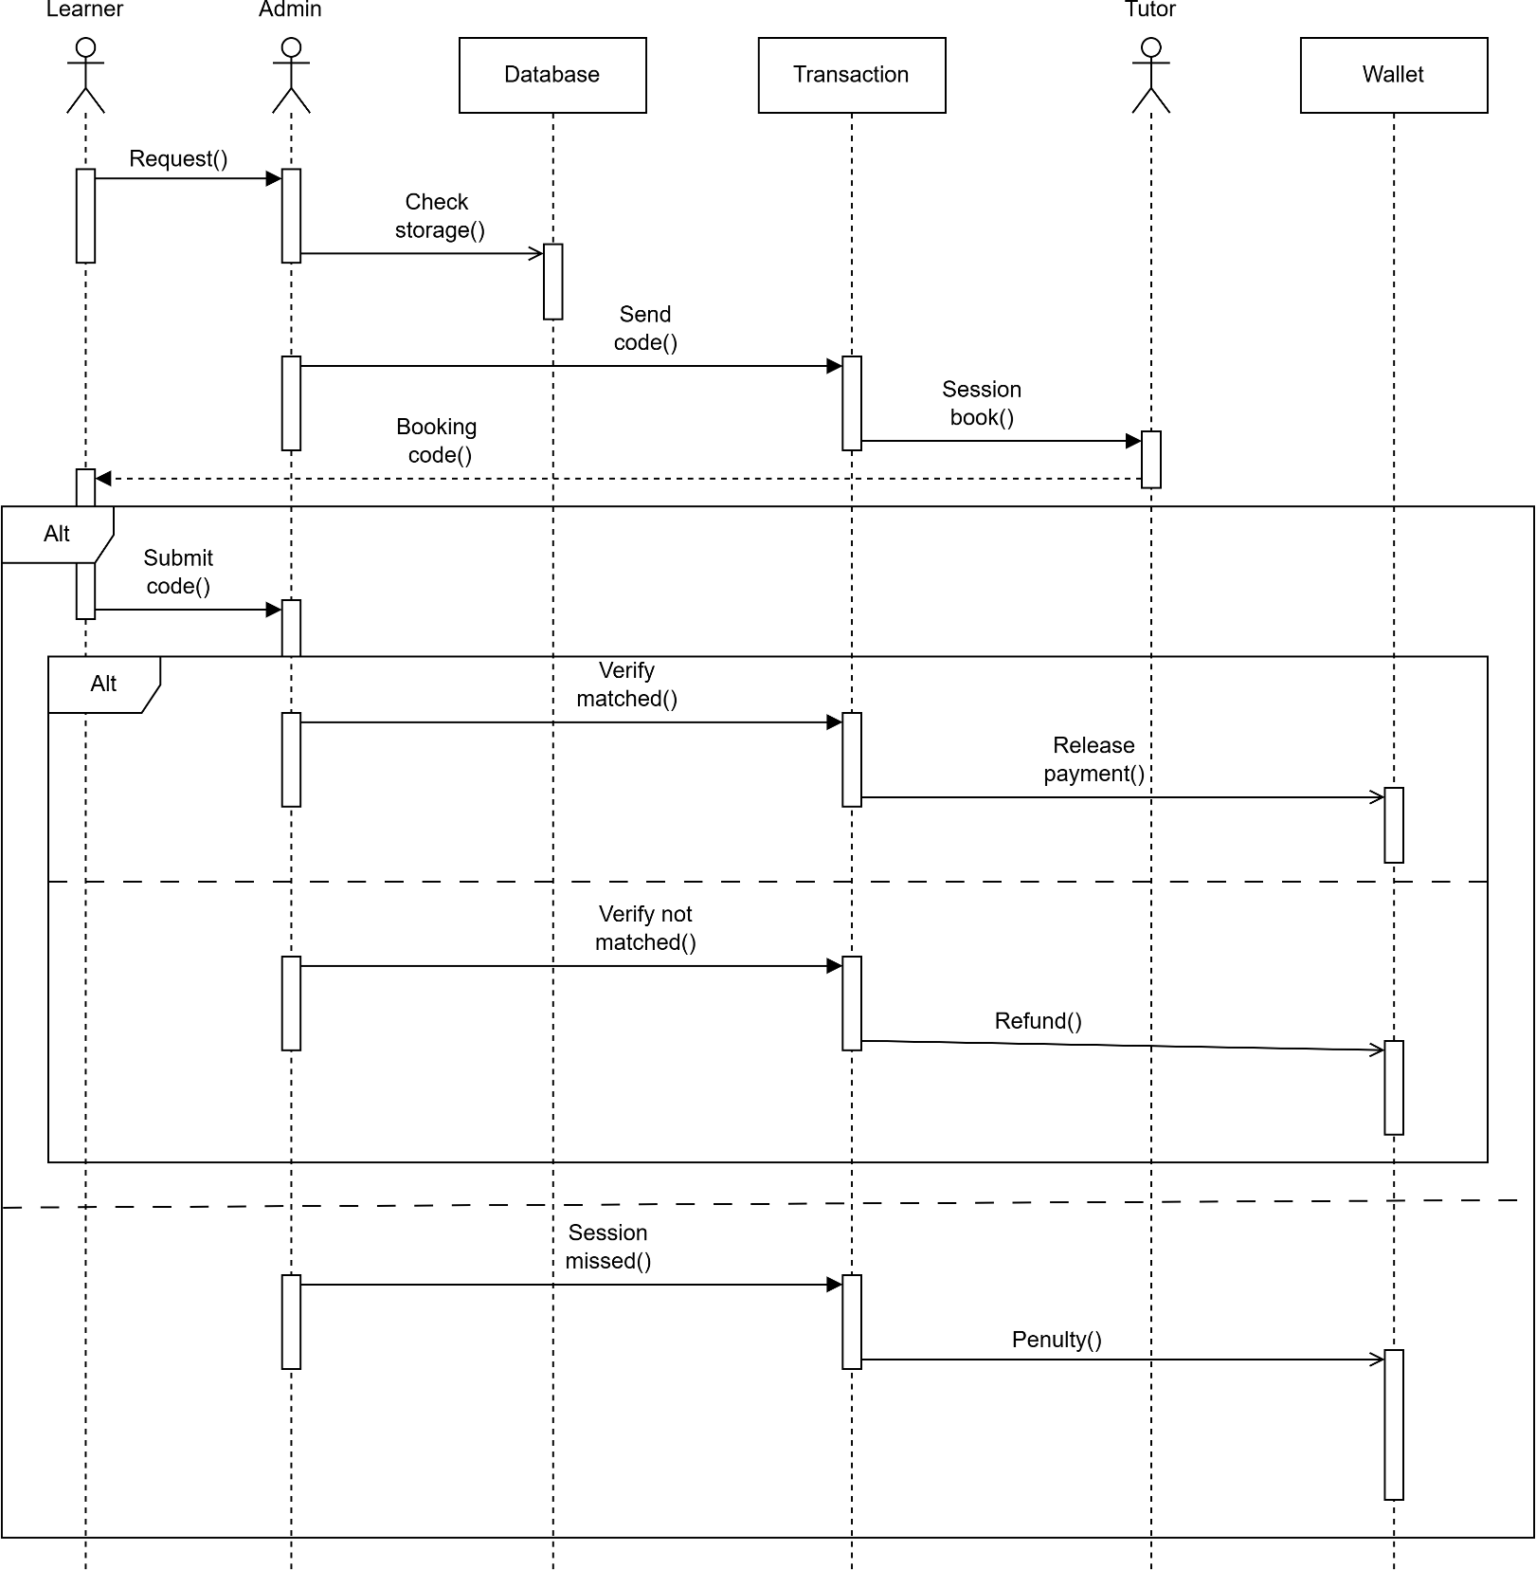
Diagrams — Sequence Diagram: Payment System

Slide 12
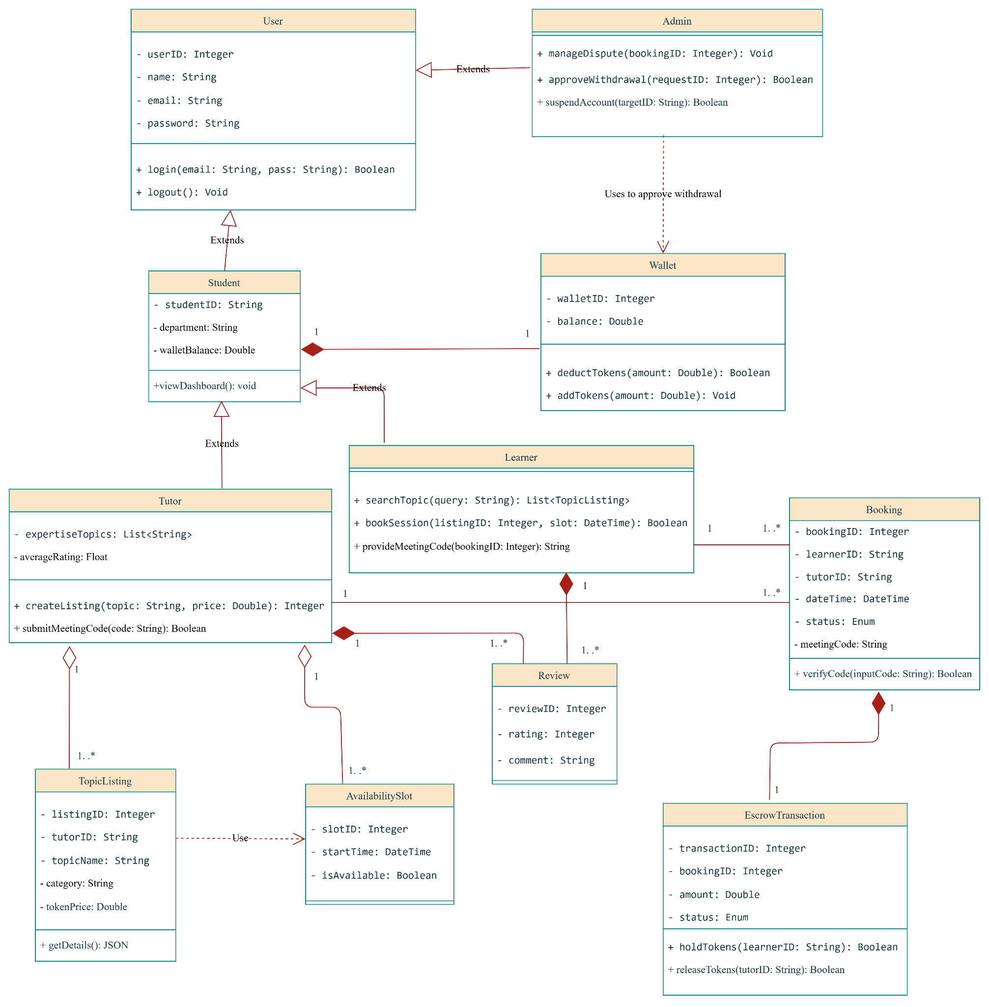
Diagrams — UML Class Diagram

Slide 13
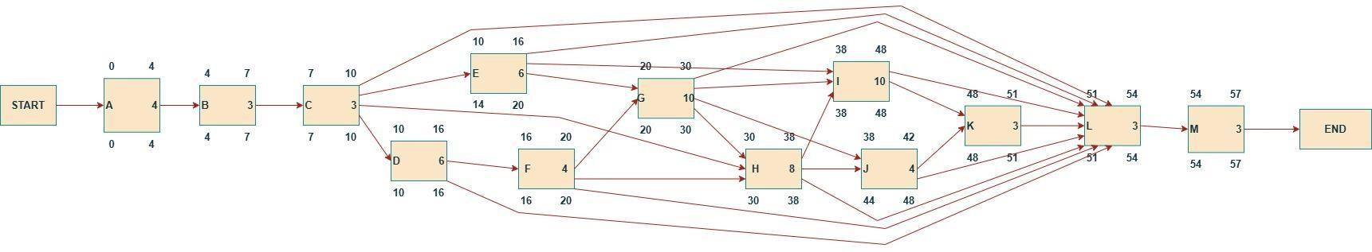
CPM — Network Diagram

Slide 14
CPM — Float Analysis & Summary
Activity
ES
EF
LS
LF
TF
FF
CP
A
0
4
0
4
0
0
✓
B
4
7
4
7
0
0
✓
C
7
10
7
10
0
0
✓
D
10
16
10
16
0
0
✓
E
10
16
14
20
4
4
—
F
16
20
16
20
0
0
✓
G
20
30
20
30
0
0
✓
H
30
38
30
38
0
0
✓
I
38
48
38
48
0
0
✓
J
38
42
44
48
6
6
—
K
48
51
48
51
0
0
✓
L
51
54
51
54
0
0
✓
M
54
57
54
57
0
0
✓
Project Duration
Critical Path
Critical Activities
Non-Critical
57 Days
A→B→C→D→F→G→H→I→K→L→M
11 / 13
E, J

Slide 15
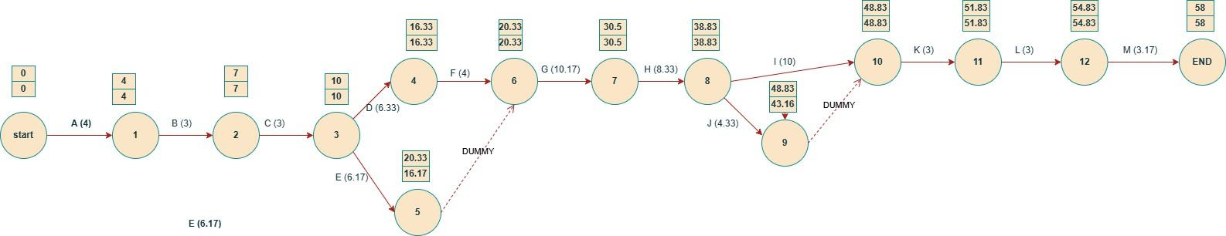
PERT — Network Diagram

Slide 16
PERT — Activity Table & Summary
O=Optimistic · M=Most Likely · P=Pessimistic · te=Expected Time
Activity
Dep
O
M
P
te
σ
A – Feasibility
—
2
4
6
4.00
0.67
B – Req. Gathering
A
1
3
5
3.00
0.67
C – Req. Analysis
B
1
3
5
3.00
0.67
D – System Design
C
4
6
10
6.33
1.00
E – Database Design
C
4
6
9
6.17
0.83
F – UI/UX
D
2
4
6
4.00
0.67
G – User Module
E,F
7
10
14
10.17
1.17
H – Booking Module
F,G,C
6
8
12
8.33
1.00
I – Wallet & Escrow
E,G,H
6
10
14
10.00
1.33
J – Rating Feature
G,H
2
4
8
4.33
1.00
K – Admin Control
I,J
2
3
4
3.00
0.33
L – Testing
All
1
3
5
3.00
0.67
M – Documentation
L
2
3
5
3.17
0.50
PERT Summary:
Critical Path: A→B→C→D→F→G→H→I→K→L→M
Expected Duration: 58 Days
Σ Variance (σ²) on CP: 8.20 days² | Std Deviation (σ): 2.86 days

Slide 17
Feasibility Study
All dimensions confirmed feasible
Technical
Economic
Operational
Schedule
Legal
✓ Feasible
✓ Feasible
✓ Feasible
✓ Feasible
✓ Feasible
HTML/CSS/JS + Python + SQLite
Standard web server sufficient
Moderate, manageable complexity
Dev: BDT 40–50K
Infra: BDT 60–80K
Open-source tools (BDT 0)
High student acceptance
Simple UI for ease of use
Ideal for university campus
11-week phased plan
Fits within one semester
CPM confirms 57-day delivery
No data protection violations
Tokens = internal virtual currency
Complies with university policies

Slide 18
Project Schedule
A
Feasibility Analysis
4d
B
Requirement Gathering
3d
C
Requirement Analysis
3d
D
System Design
6d
E
Database Design
6d
F
UI/UX
4d
G
User Module
10d
H
Booking Module
8d
I
Wallet & Escrow
10d
J
Rating Feature
4d
K
Admin Control
3d
L
Testing
3d
M
Documentation
3d
0
10
20
30
40
50
57
Critical Path
Non-Critical
Activity Timeline (57 Days – CPM Based)

Slide 19
Core System Flow
End-to-End Platform Logic
1
Authentication:
University email registration · Role selection (Tutor/Learner) · Admin approval for tutors
2
Marketplace:
Tutor lists topic · Sets price (tokens) + time slots · Marketplace becomes searchable
3
Booking & Escrow:
Learner selects tutor & slot · Tokens deducted & locked in escrow · Booking confirmed
4
Session Verification:
System generates unique meeting code · Tutor submits code · Code verified → escrow released
5
Rating & Withdrawal:
Learner rates tutor · Admin reviews withdrawals · Tutors cash out via bKash

Slide 20
Conclusion
StudyByte successfully addresses the peer tutoring gap in university environments.
Verified peer tutoring marketplace using university email authentication
Secure escrow payment protects both tutors and learners
Structured booking & scheduling eliminates manual coordination
Rating & review system ensures continuous quality improvement
Admin controls maintain platform trust and governance
Economically feasible within BDT 1.5–1.8 lakh · Delivers in 57 days
Thank You | Group 04 | CSE 347 | Spring 2026
Supervisor: Dr. Hosney Jahan | East West University, Dhaka

