Slide 1
Modeling the Relationship Between
Workload and Mental Health
in University Students
CSE303: Statistics for Data Science
Spring 2026
n = 205 Students
Term Project Report
📊 Data Collection & EDA
🔗 Correlation Analysis
📈 Linear Regression

Slide 2
SUBMITTED BY
SUBMITTED TO
Bushra Khan Zilik
2023-1-60-087
Ahmed Adnan
Lecturer, Department of CSE
Nusrat Jahan
2023-2-60-286
East West University
Mahadi Hasan
2021-3-60-270
Md. Sakib Husen
2022-1-60-274

Slide 3
Presentation Outline
01
Introduction & Motivation
05
Linear Regression Models
Why student mental health matters
3 OLS models built from scratch (NumPy)
02
Survey Design & Data Collection
06
Model Evaluation & Comparison
205 records — real + synthetic
R², RMSE, F-stat, p-value
03
Data Preprocessing
07
Discussion & Recommendations
Cleaning, encoding & imputation
Key insights and actionable suggestions
04
Exploratory Data Analysis
08
Conclusion & Future Work
Distributions, boxplots, correlations
Limitations and next steps

Slide 4
01 | Introduction & Motivation
The Problem
Research Goal
University students face mounting pressure from coursework, deadlines, part-time jobs, and extracurricular commitments — all impacting mental health.
Quantify the relationship between academic workload factors and mental health outcomes using statistical methods.
Key Outcomes
Why It Matters
Mental health effects include elevated stress, heightened anxiety, disrupted sleep, and reduced academic performance.
Findings can guide administrators, counsellors, and students to make evidence-based decisions to improve well-being.
Implemented 3 linear regression models | OLS from scratch using NumPy | n = 205

Slide 5
Project Objectives
Design and distribute a survey to collect real student data on workload and mental health indicators.
Build three OLS simple linear regression models entirely from scratch using NumPy.
1
4
Preprocess the combined dataset (205 records) — handling missing values, outliers, and encoding.
Interpret regression coefficients β₀ and β₁, assessing statistical significance (F-stat, p-value, R²).
2
5
Conduct descriptive statistics, Pearson correlations, and variance analysis on key variables.
Provide evidence-based recommendations for improving student well-being based on findings.
3
6

Slide 6
2 | Survey Design & Variables
Section 1: Demographics
Section 2: Workload Factors
Section 3: Mental Health
Year of Study (1st–4th)
Weekly study hours
Stress level (1–5 Likert)
Gender (Male/Female)
No. of courses enrolled
Anxiety score (1–5 Likert)
Age (numeric)
Extracurricular (Yes/No + hours)
Sleep hours (numeric)
CGPA (optional)
Part-time job (Yes/No + hours)
Sleep quality (1–10 scale)
📋 55 real responses collected via Google Forms + 150 synthetic records generated = 205 total

Slide 7
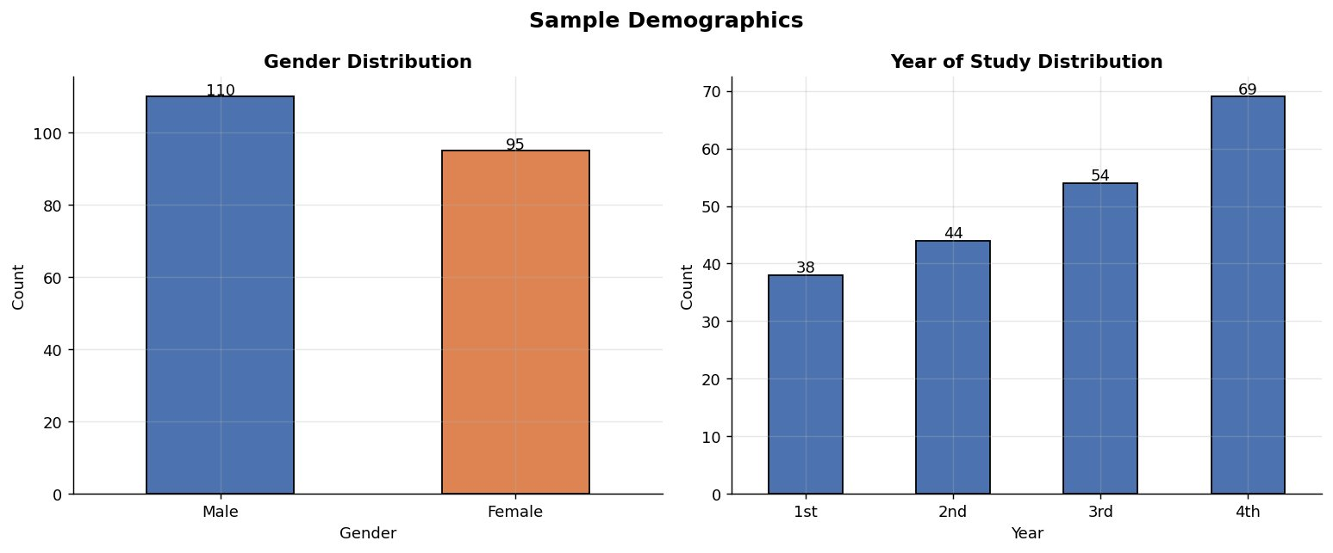
Sample Demographics
110
Male Students
95
Female Students
69
4th Year (largest)
The sample is slightly male-dominant (53.7% vs 46.3%). Year 4 students form the largest cohort,
suggesting senior students were more willing to participate in mental health surveys.

Slide 8
3 | Data Preprocessing Pipeline
1
Column Renaming
5
Categorical Encoding
Mapped verbose Google Form headers to short, consistent names.
Binary label-encoded: Gender, Extracurricular, Part-time (Yes=1, No=0).
2
Source Tagging
6
Missing Imputation
Added 'DataType' column (Real / Synthetic) for traceability.
Median-filled all NaN values per column across combined dataset.
3
Numeric Cleaning
7
Range Clipping
Parsed ranges (e.g., '7-8'→7.5), stripped units, averaged ranges.
Clipped Likert scales: Stress/Anxiety [1,5], Sleep quality [1,10].
4
Year Cleaning
8
Deduplication
Handled 'Graduated', typos ('4rth'), and out-of-range (e.g., 5th yr).
Removed exact duplicates (0 found) → Final: 205 rows × 15 columns.

Slide 9
Summary Statistics
Key descriptive stats for 10 variables (n = 205)
Variable | Mean | Median | Std Dev | Min | Max | Skewness
Weekly Study Hours | 17.98 | 17.00 | 11.31 | 0.00 | 39.0 | 0.247
Number of Courses | 4.23 | 4.00 | 1.20 | 0.00 | 8.0 | 0.449
Stress Level | 3.45 | 3.00 | 1.19 | 1.00 | 5.0 | −0.279
Anxiety Score | 3.42 | 3.00 | 0.96 | 1.00 | 5.0 | −0.020
Sleep Hours | 6.38 | 6.40 | 1.37 | 2.50 | 9.7 | −0.153
Sleep Quality | 6.02 | 6.00 | 1.92 | 1.00 | 10.0 | −0.139
Part-time Hours | 9.95 | 9.00 | 6.75 | 0.00 | 42.0 | 1.171
CGPA | 3.28 | 3.32 | 0.42 | 2.29 | 4.0 | −0.257
Age | 21.23 | 21.00 | 2.44 | 2.00 | 27.0 | −2.355
⚡ Stress mean 3.45/5 indicates moderate-to-high stress on average across students.

Slide 10
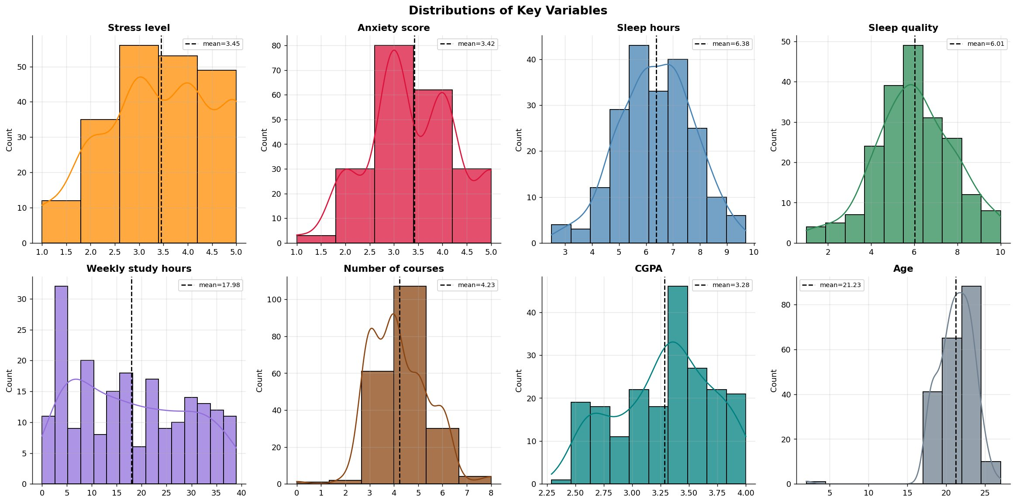
4 | EDA — Variable Distributions
Histograms with KDE curves for all key numeric variables
Stress & Anxiety: Near-symmetric (Likert 1–5). Sleep hours: Mean 6.38 hrs, slight negative skew. Study hours: Wide range 0–39 hrs, roughly uniform. Part-time hours: Right-skewed — most students work few hours.

Slide 11
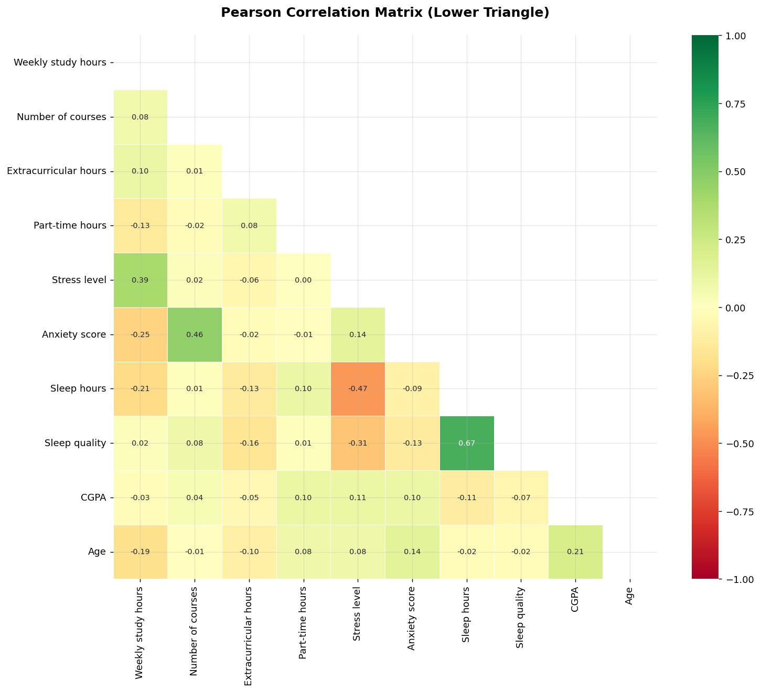
EDA — Pearson Correlation Matrix
Notable Correlations
r = +0.67
Sleep hrs ↔ Sleep quality
r = +0.46
Courses ↔ Anxiety
r = +0.39
Study hrs ↔ Stress
r = −0.47
Stress ↔ Sleep hrs
r = −0.25
Study hrs ↔ Anxiety
r = −0.21
Study hrs ↔ Sleep

Slide 12
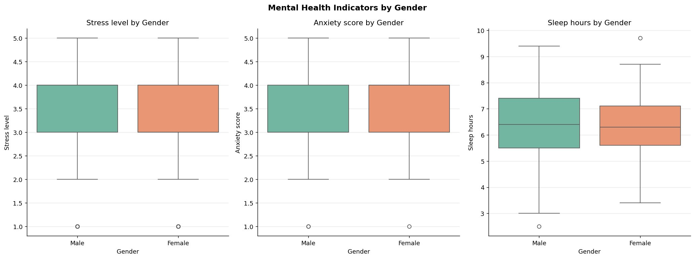
EDA — Mental Health Indicators by Gender
Comparing stress, anxiety, and sleep between male and female students
Stress: Males show slightly higher median stress (≈3.1 vs 3.0)
Anxiety: Females show marginally higher median anxiety — both groups similar spread
Sleep: Sleep hours nearly identical across genders; median ~6.3 hrs for both

Slide 13
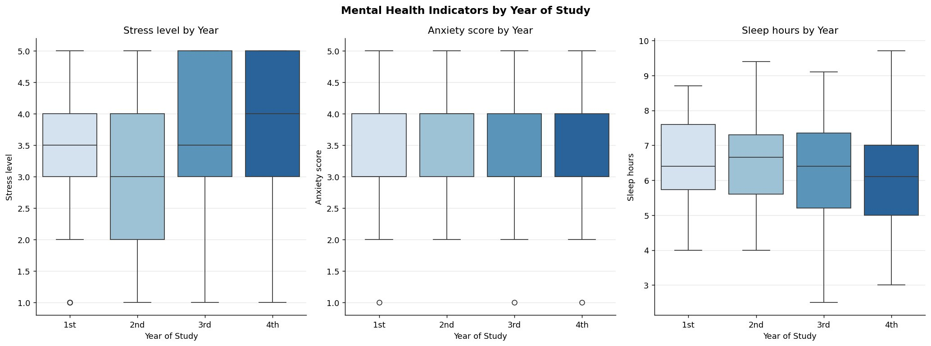
EDA — Mental Health Indicators by Year of Study
How stress, anxiety, and sleep evolve across 1st–4th year
📈 Stress peaks in 3rd–4th year (IQR shifts upward markedly)
😰 Anxiety remains similarly elevated from 1st to 4th year
😴 Sleep hours show a gradual declining trend through 4th year

Slide 14
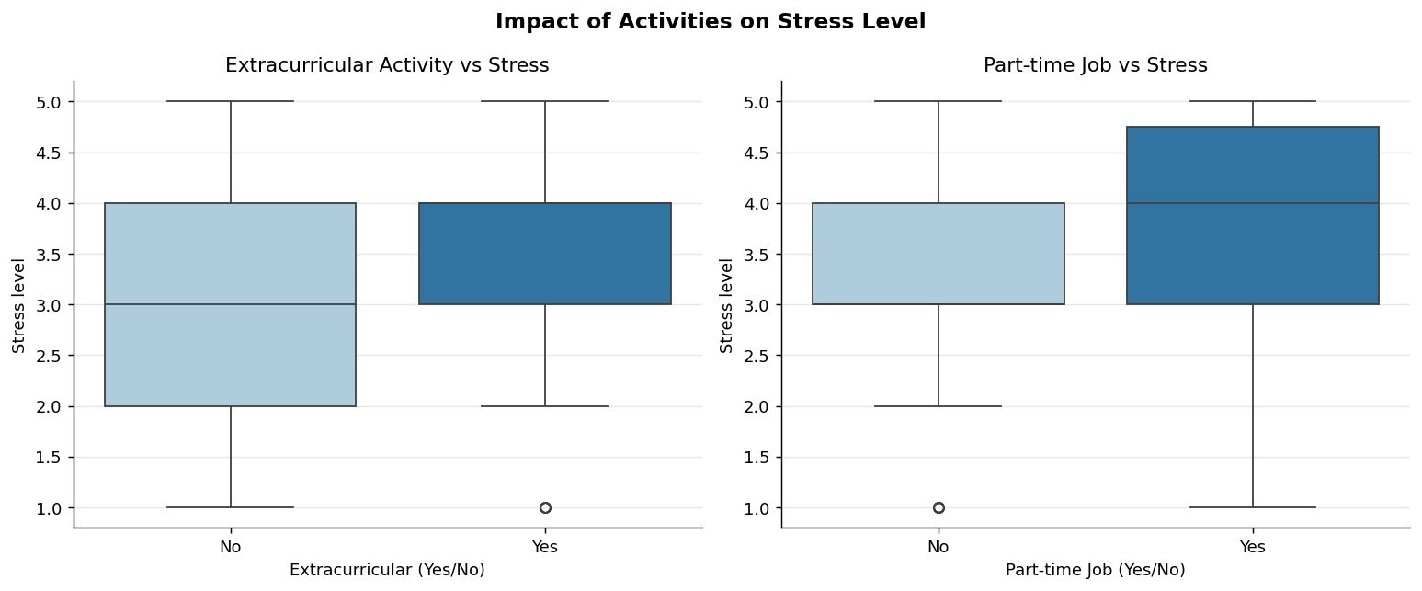
EDA — Activities vs Stress Level
Effect of extracurricular activities and part-time jobs on stress
🎭 Extracurricular: Students who participate show slightly lower median stress — structured social engagement may buffer academic stress.
💼 Part-time Job: Students with jobs show a higher median stress level — time pressure from work compounds academic load.

Slide 15
05 | OLS Linear Regression — Theory & Implementation
Model Form: ŷ = β₀ + β₁x
Slope β₁
β₁ = Σ[(xᵢ − x̄)(yᵢ − ȳ)] / Σ[(xᵢ − x̄)²]
Intercept β₀
β₀ = ȳ − β₁x̄
R² (Fit)
R² = 1 − SSR / SST
RMSE
RMSE = √[Σ(yᵢ − ŷᵢ)² / n]
⚠️ No sklearn or statsmodels used — all OLS computations implemented manually in NumPy, satisfying course constraints.

Slide 16
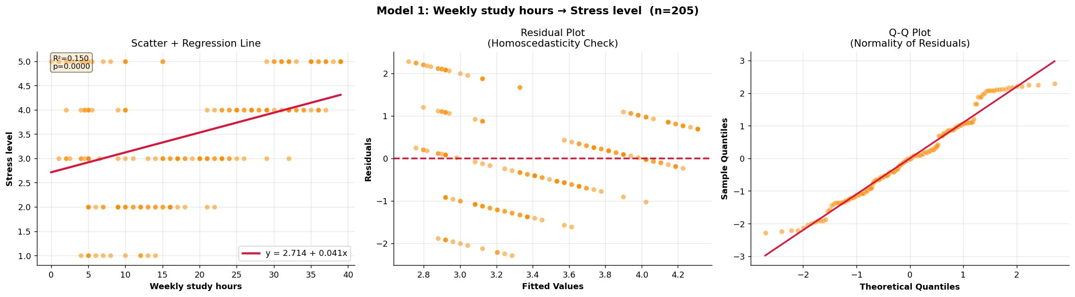
6 | Model 1: Weekly Study Hours → Stress Level
Every extra study hour raises stress by +0.041 points
ŷ = 2.714 + 0.041x
0.150
0.387
1.098
35.77
<0.0001
Significant: more studying → more stress (p < 0.0001)
R²
r
RMSE
F
p

Slide 17
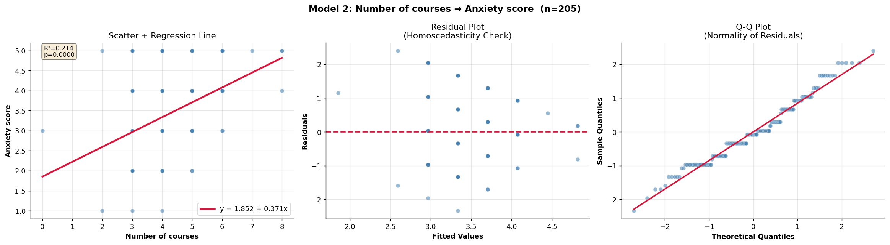
Model 2: Number of Courses → Anxiety Score
Each additional course raises anxiety by +0.371 points
ŷ = 1.852 + 0.371x
0.214
0.462
0.849
55.11
<0.0001
Strongest model — direct cognitive load from course count
R²
r
RMSE
F
p

Slide 18
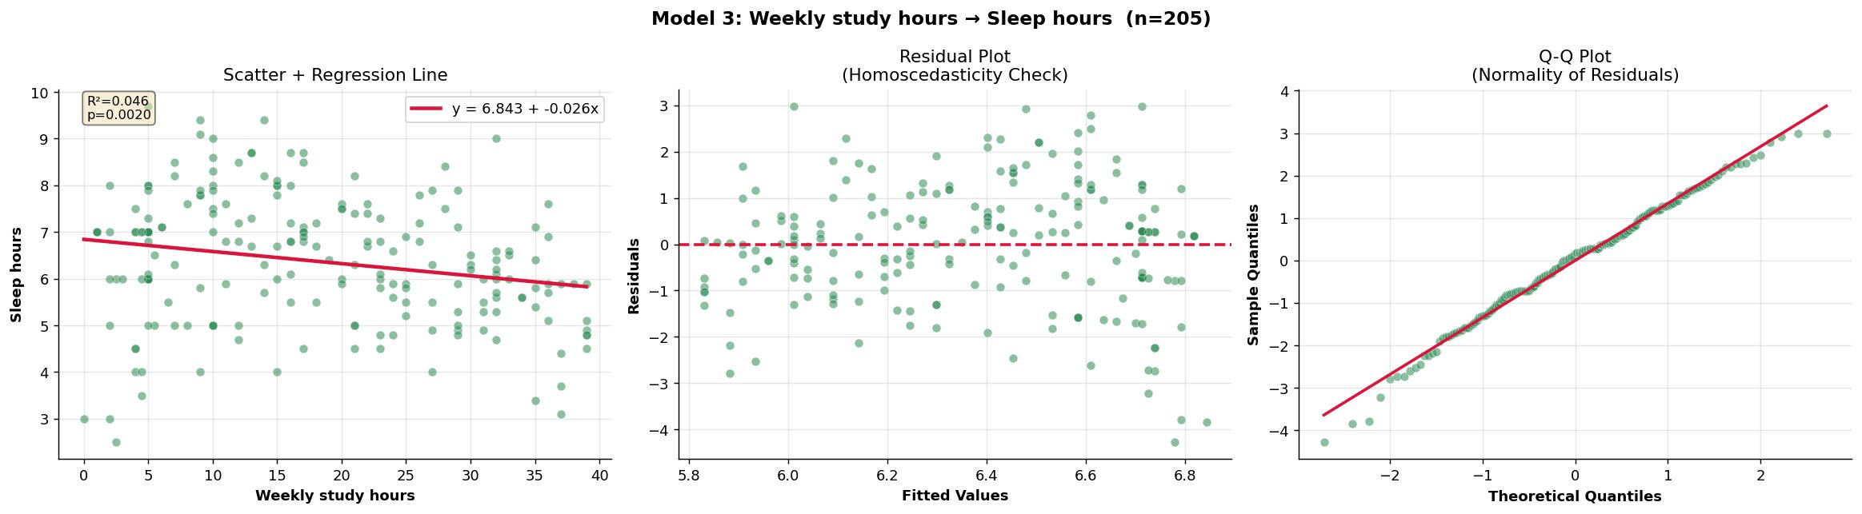
Model 3: Weekly Study Hours → Sleep Hours
More study time trades off with sleep (−0.026 hrs per study hour)
ŷ = 6.843 − 0.026x
0.046
−0.214
1.335
9.77
0.002
Weakest fit but still significant — sleep is governed by many factors
R²
r
RMSE
F
p

Slide 19
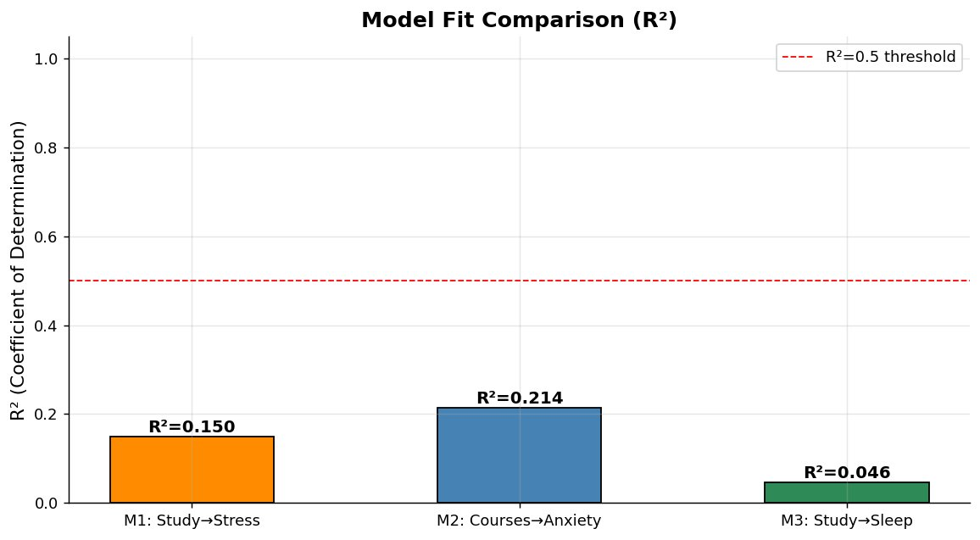
Model Evaluation & Comparison
Model | β₀ | β₁ | R² | r | RMSE | F | p
M1: Study→Stress | 2.714 | 0.041 | 0.150 | 0.387 | 1.098 | 35.77 | <0.0001
M2: Courses→Anxiety | 1.852 | 0.371 | 0.214 | 0.462 | 0.849 | 55.11 | <0.0001
M3: Study→Sleep | 6.843 | −0.026 | 0.046 | −0.214 | 1.335 | 9.77 | 0.002
M1 Significant ✓
Study hours meaningfully predict stress
M2 Best Fit ✓
Course count = strongest anxiety predictor
M3 Significant ✓
Weak R² but real trade-off confirmed
All three models are statistically significant (p < 0.05). Model 2 achieves best explanatory power (R²=0.214).

Slide 20
07 | Discussion
Why Model 2 performs best?
Stress–Sleep Feedback Loop
Course count imposes direct, measurable cognitive load — each course adds attendance, assignments, exams. This mechanistic clarity yields higher R² vs study hours, which are confounded by efficiency, motivation, and difficulty.
Stress↔Sleep correlation (r=−0.466) is the strongest inter-variable relationship. Stressed students sleep less; less sleep worsens stress — a vicious cycle simple linear regression cannot fully model but that is evidenced here.
Why Model 3 is weakest?
Real vs Synthetic Data
Sleep is governed by biology, social habits, screen time, and mental health — variables absent here. Despite the low R² (4.6%), the negative relationship is confirmed (p=0.002), indicating a real but complex trade-off.
55 real responses introduced realistic noise (e.g., '7-8 hrs', '42 part-time hrs') that validated our preprocessing pipeline. Future studies should collect 200+ purely real responses to eliminate any residual synthetic bias.

Slide 21
Evidence-Based Recommendations
🎓
Course Load Management
😴
Sleep Hygiene Campaigns
Cap enrollment at 4–5 courses per semester. Our data show anxiety rises +0.371 per additional course — this single policy change may meaningfully reduce student anxiety scores.
The strong sleep hours–sleep quality correlation (r=0.673) shows improving sleep duration directly improves quality. Universities should promote structured sleep hygiene workshops.
1
3
⏱️
Study Hours Monitoring
🏃
Extracurricular Encouragement
Flag students studying 30+ hours/week for proactive counselling. Stress = 2.714 + 0.041×(hrs) implies a student studying 35 hrs/week has an expected stress level of 4.1/5.
Participation in extracurricular activities is associated with slightly lower stress. Investment in student clubs, sports, and social events may serve as a cost-effective stress buffer.
2
4

Slide 22
Limitations & Future Work
Current Limitations
Future Work
Self-reported data is subject to recall bias and social desirability effects.
Multiple regression: model joint effects of workload variables simultaneously.
Only 55 real responses — 150 synthetic records reduce real-world validity.
Longitudinal design: track same cohort across semesters to establish causality.
Simple linear regression — only 1 predictor per model (no interaction effects).
Scale to 200+ purely real responses to eliminate synthetic data bias.
Cross-sectional design — no temporal causality can be established.
Include additional predictors: mental health history, social support, sleep disorders.
Convenience sampling — university may not be representative of all students.
Use ML models (Random Forest, Ridge Regression) for higher predictive accuracy.

Slide 23
08 | Conclusion
This project demonstrated the complete data science pipeline — survey design, data collection, preprocessing, EDA, correlation analysis, and regression modelling — applied to the domain of student mental health.
Finding 1
Weekly study hours significantly predict stress level (β₁=0.041, R²=0.150, p<0.0001) — more studying → more stress.
Finding 2
Number of courses is the strongest workload predictor, significantly predicting anxiety (β₁=0.371, R²=0.214, p<0.0001).
Finding 3
Study hours negatively predict sleep duration (β₁=−0.026, R²=0.046, p=0.002) — a real but complex trade-off confirmed.
All 3 models are statistically significant (p < 0.05) — OLS from scratch in NumPy — satisfying all course requirements.

Slide 24
Thank You
Questions & Discussion
Dataset:
205 students (55 real + 150 synthetic)
Method:
OLS Linear Regression — NumPy from scratch
Best Model:
M2: Courses → Anxiety (R² = 0.214)
Key Insight:
Course count & study hours significantly impact mental health
CSE303: Statistics for Data Science | Spring 2026 | Term Project

