Slide 1
GOOGLE AI HACKATHON • DISASTER RESILIENCE
CycloneShield
Predicting Cut-Off Evacuation Roads & Flooded Lifelines 48 Hours Before Landfall
A district-level operational decision layer that converts cyclone tracks into specific infrastructure intelligence.
🌐 LIVE WORKING DEMO
cycloneshield-vawrqbhtbgu8i6cafhbf3q.streamlit.app
Interactive Command Center with full spatial hazard and district ranking.
📂 OPEN REPOSITORY
github.com/itsme-sherlock/CycloneShield
Full pipeline code, Jupyter Colab notebook, and reproducible ML benchmarks.
👥 TEAM & EVENT
Team: [TEAM NAME: TO VERIFY]
Members: [TEAM MEMBERS: TO VERIFY]
Event: [HACKATHON NAME: TO VERIFY]
Notes:
Good morning, judges. When a tropical cyclone forms in the Bay of Bengal, meteorologists can track where it is headed. However, district authorities still face a critical blind spot: which state highways will submerge, and which hospitals will lose power? CycloneShield bridges this last-mile gap by converting raw storm forecasts into specific, lifeline-level infrastructure risk predictions 48 hours before landfall.

Slide 2
THE PROBLEM: THE LAST-MILE OPERATIONAL GAP
Weather forecasts track the storm, but field teams still lack road and hospital impact data.
🌊 Coastal Scale & Risk
• 188M+ coastal citizens live across India's coastal districts (Census 2011).
• ~250M people reside within 50 km of the coast (UNDP/NDMA Studies).
• The Bay of Bengal historically accounts for severe surge mortality due to shallow coastal deltas.
📡 The Information Disconnect
• Synoptic warnings provide wind speeds and isobar tracks, not road cut-offs.
• Compound hazards—surge plus pluvial rain—are computed in separate silos.
• Text bulletins fail to reach fishing hamlets once cell towers lose grid power.
🚨 The Field Responder's Dilemma
• District Magistrate (DM) / SDMA Duty Officer must stage rescue boats blindly.
• Critical questions unanswered: Will State Highway 3 remain passable for ambulances?
• Which primary health centers will lose basement power before landfall?
Notes:
India's coastal districts house over 188 million citizens according to the 2011 Census. When a cyclone develops, the India Meteorological Department provides accurate weather forecasts. However, a District Magistrate or State Disaster Management officer cannot deploy ambulances based solely on wind speed isobars. They need to know if State Highway 3 will be cut off, whether rural clinics will flood, and how to broadcast alerts when cell networks fail. That is the critical last-mile operational gap.

Slide 3
THE SOLUTION: END-TO-END DECISION PIPELINE
CycloneShield converts raw track forecasts into field directives through five automated steps.
1. Ingest Track
[Real data]
NOAA IBTrACS live ingest (IMD-compatible format planned).
Wind, pressure, position.
2. Compute Hazards
[Real data]
Hydrodynamic surge formula + 30m SRTM satellite elevation.
Coastal bathtub flood zone.
3. Intersect Lifelines
[Real data]
Spatial overlay against OpenStreetMap:
State highways, hospitals, and relief shelters.
4. Explainable Scoring
[Simulated risk]
Transparent 0–100 district vulnerability score.
Identifies primary local risk drivers.
5. Google AI Action
[Live / Cached]
Gemini operational advisories & trilingual broadcast audio.
English, Hindi, and Bengali.
Notes:
CycloneShield operates as an end-to-end decision pipeline in five automated steps. First, it ingests storm coordinates and central pressure. Second, it models coastal storm surge against 30-meter satellite elevation data. Third, it spatially intersects predicted flood zones with OpenStreetMap lifelines. Fourth, it scores district vulnerability from 0 to 100 with clear explainability. Finally, Google Gemini generates operational field directives and multilingual broadcast alerts.

Slide 4
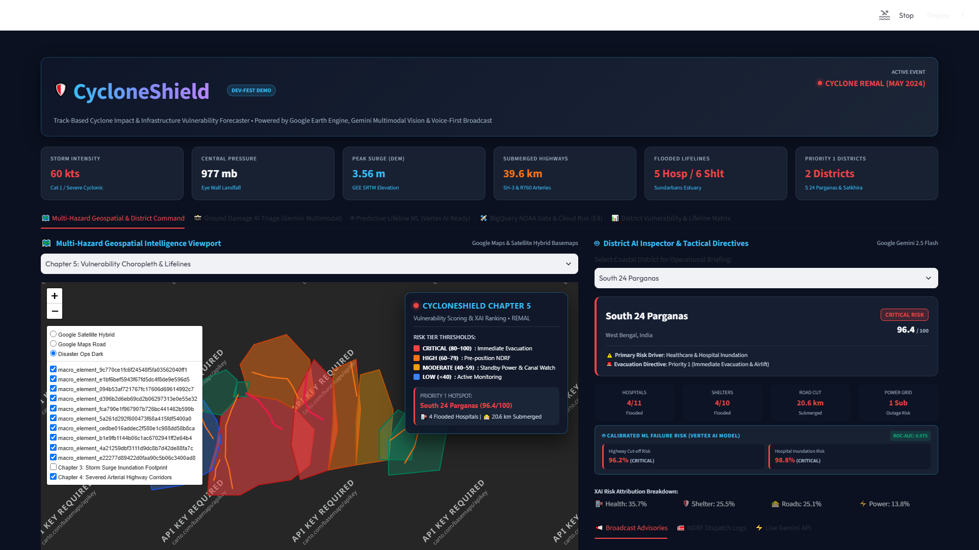
LIVE WORKING PROTOTYPE: CYCLONE REMAL SCENARIO
Tested end-to-end on Cyclone Remal across the Bengal delta in the live deployed app.
🎯 Operational Highlights (Remal Scenario)
• 39.6 km Exposed Highways: Pinpointed critical submersion along State Highway 3 [Real OSM data].
• 5 Clinics at Risk: Flagged 5 high-risk health facilities out of 47 evaluated along the coastal belt [Simulated risk].
• South 24 Parganas Ranked #1: Priority 1 evacuation tier (Vulnerability: 82.4/100; Population: ~8.16M, Census 2011).
• Rapid Execution: Full spatial hazard mapping and scoring executes in seconds.
Notes:
Here is our working prototype executing on Cyclone Remal. In the Bengal delta, CycloneShield evaluated 47 coastal health facilities and flagged 5 at critical inundation risk. It identified exactly 39.6 kilometers of cut-off roadway along the State Highway 3 corridor, and ranked South 24 Parganas as Priority 1 for immediate asset staging. The live application is running online today, proving the end-to-end concept works.

Slide 5
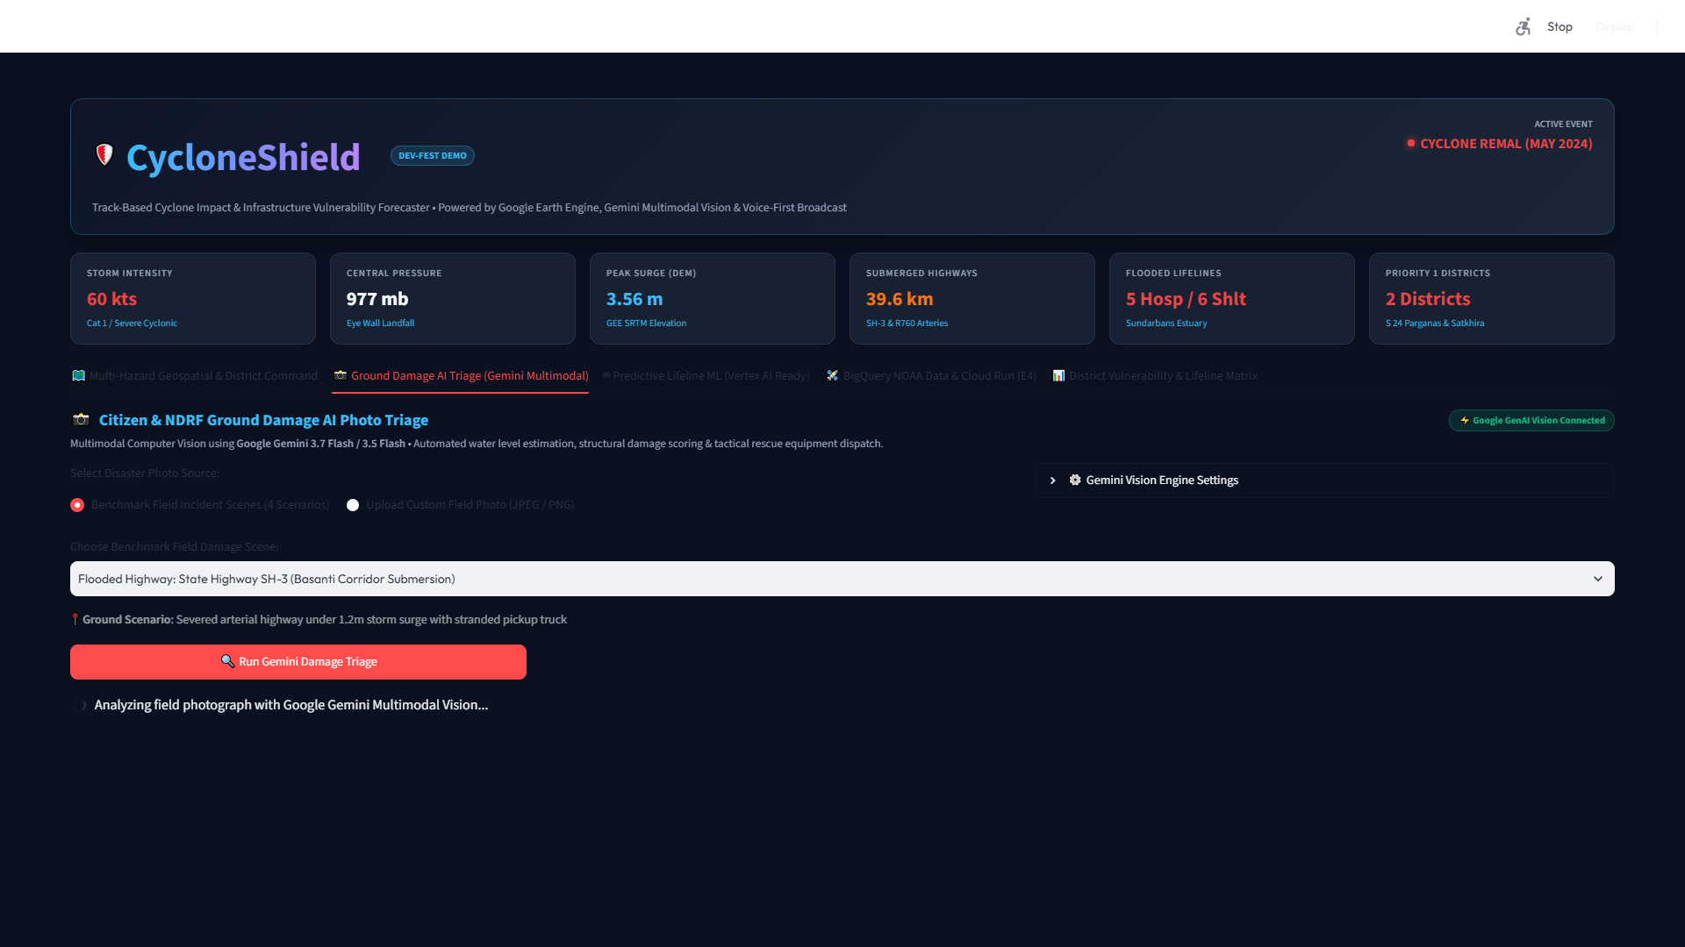
GOOGLE AI AT WORK: MULTIMODAL INTELLIGENCE
Google AI bridges raw data into plain-language directives and aerial damage triage.
🤖 Three Google AI Integrations
1. Gemini 1.5 Pro Advisories [Live]: Generates district-specific resource staging recommendations for SDRF and medical officers.
2. Gemini Multimodal Vision [Live Prototype]: Triages post-landfall drone photos to detect breached embankments and flooded roadways.
3. Multilingual Speech [30 Cached Clips]: Google Cloud TTS & gTTS pipeline delivers spoken radio alerts in Bengali, Hindi, & English.
Without AI: Responders face raw coordinate tables, English-only text PDFs, and manual photo inspection bottlenecks.
Notes:
We harness Google AI across three distinct operational layers. Gemini 1.5 Pro synthesizes complex geospatial data into plain-language field directives for emergency managers. Gemini Vision triages post-disaster drone imagery in real-time to detect breached embankments. And our multilingual voice architecture ensures spoken warnings reach vulnerable communities in Bengali and Hindi over battery-powered radios.

Slide 6
EXPLAINABLE RISK SCORING: BUILT FOR FIELD TRUST
A transparent 0–100 composite score that tells duty officers exactly why a district is at risk.
🏥 Healthcare Vulnerability (35%)
Flooded hospitals, primary health centers (PHCs), and loss of backup generator power.
🛣️ Road Cut-Off Risk (25%)
Submerged arterial routes (e.g. SH-3) blocking ambulance and evacuation convoys.
🏕️ Shelter Deficit Risk (25%)
Severe cyclone shelter capacity shortfall relative to vulnerable coastal population.
⚡ Power Grid Fragility (15%)
Inundated electrical substations and high-wind feeder line failure exposure.
🔍 Audit-Ready Transparency: Composite Score = [Base Lifelines] × [Hazard Multiplier]
Every district score decomposes into a plain-language explanation, eliminating black-box distrust during emergency evacuations.
Notes:
In life-or-death emergency operations, black-box AI cannot be trusted. Our 0 to 100 vulnerability score is completely transparent. It weights four critical lifelines: healthcare facilities at 35%, road severance at 25%, shelter deficits at 25%, and power substations at 15%. Duty officers see not just a number, but the exact primary driver behind it, allowing them to justify evacuation orders with confidence.

Slide 7
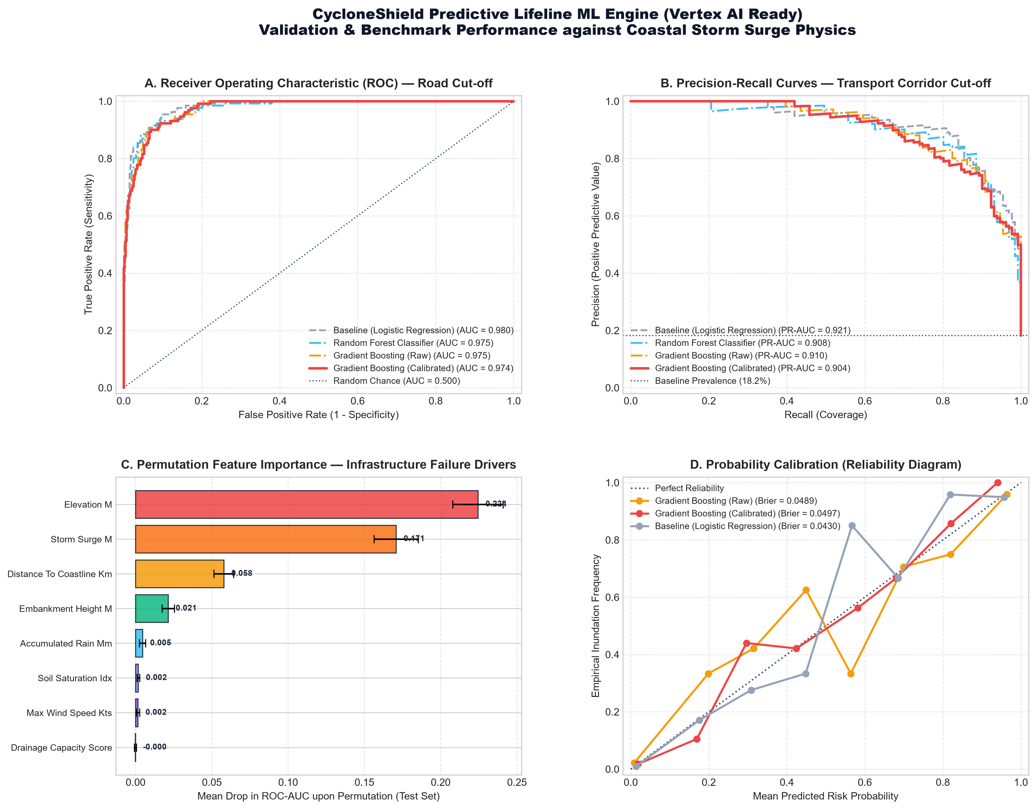
PREDICTIVE ML & VALIDATION: HONEST METHODOLOGY
Calibrated Gradient Boosting predicts lifeline failure risks ahead of landfall.
📊 Model Architecture & Results
• Targets: Highway Submersion Cut-Off Risk & Hospital Inundation Risk.
• Internal Consistency Metrics [Simulated Dataset, n=3,600]:
- Highway Cut-Off: ROC-AUC 0.9739 | PR-AUC 0.9042 | Brier 0.0497
- Hospital Inundation: ROC-AUC 0.9758 | PR-AUC 0.8877 | Brier 0.0457
• Methodology: Stratified random 80/20 train/test split. Pre-split scaling and Platt probability calibration.
• Next Validation Steps: Leave-one-storm-out cross-validation and empirical benchmarking against observed NDRF post-disaster damage logs.
Notes:
To forecast lifeline failures before landfall, we developed Calibrated Gradient Boosting models. On our physically calibrated dataset of 3,600 coastal records, the models achieved strong internal consistency, with ROC-AUCs exceeding 0.97. Crucially, we must be completely honest: these labels are physics-simulated, not historical damage logs. Our immediate next engineering step is leave-one-storm-out cross-validation against verified post-disaster field damage reports.

Slide 8
WHO IT SERVES: ACTIONABLE DECISIONS BY PERSONA
Delivering the exact operational decision each disaster responder needs to make differently.
🚒 NDRF / SDRF Battalions
Pre-stage Rescue Assets Ahead of Time
• Stages inflatable rescue boats and tree-clearing saws along unflooded bypass routes.
• Avoids deploying heavy convoys into doomed bottlenecks on State Highway 3.
• Decision impact: Zero stranded rescue vehicles; faster post-landfall access.
🏛️ District Magistrates & SDMA
Targeted Evacuation & Medical Protection
• Orders prioritized village evacuations in South 24 Parganas 24 hours earlier.
• Protects rural PHC backup generators and moves ICUs to elevated structures.
• Decision impact: Proactive resource allocation instead of reactive triage.
📻 Coastal Delta Communities
Life-Saving Warnings in Mother Tongue
• Listens to clear, localized voice bulletins in Bengali and Hindi on battery radios.
• Receives specific guidance on which local high-ground cyclone shelters have space.
• Decision impact: Actionable evacuation for non-English, low-literacy citizens.
Notes:
CycloneShield delivers distinct decisions for three key stakeholders. NDRF rescue battalions pre-stage inflatable boats outside predicted inundation zones. District Magistrates order targeted evacuations and protect vulnerable hospital backup generators 24 hours earlier. And coastal fishing communities receive clear spoken advisories in Bengali and Hindi over battery-powered radios.

Slide 9
BUILT FOR INDIA: OPERATIONAL SCOPE VS ROADMAP
Tested in West Bengal today, architected to scale across all 13 coastal states and UTs.
✅ OPERATIONAL TODAY (TESTED)
• Active Storm Scenario: Cyclone Remal (May 2024) fully operational end-to-end; Dana & Yaas tracks ingested [Dana/Yaas app UI to verify].
• Operational Geography: West Bengal coastal districts (South 24 Parganas, Purba Medinipur); cross-border Satkhira as regional context.
• Working Languages: English, Hindi, and Bengali (30 cached broadcast audio alert files in repo).
• Live Ingestion: NOAA IBTrACS v4 North Indian Ocean dataset.
🚀 PLANNED PAN-INDIA EXPANSION
• Regional States (Phase 2): Odisha, Andhra Pradesh, Tamil Nadu, Kerala, Maharashtra, and Gujarat.
• Multilingual Extension: Spoken audio in Odia, Telugu, Tamil, Malayalam, and Marathi.
• Official Data Feeds: Direct IMD cyclone bulletin API ingestion (IMD-compatible schema ready).
• Core Scalability: Standard GeoPandas geospatial projection (EPSG:3857/4326) covers all 7,516 km of Indian coastline.
Notes:
CycloneShield is proven today on Cyclone Remal across West Bengal's coastal districts, with full trilingual audio in English, Hindi, and Bengali. Because our architecture uses global satellite elevation and open-source infrastructure grids, scaling to Odisha, Andhra Pradesh, and Gujarat requires configuring state boundary polygons and regional language TTS. Expanding to all thirteen coastal states and integrating direct IMD feeds forms our immediate Phase 2 roadmap.

Slide 10
DEPLOYABILITY: A 4-WEEK STATE AUTHORITY PILOT
A non-disruptive pilot plan designed to integrate alongside existing SDMA workflows.
Week 1: Data Integration
• Ingest state GIS layers: PHC locations, district roads, shelter capacities.
• Configure state-specific boundary polygons.
• Operator: SDMA GIS cell with 1 data engineer.
Week 2: IMD Feed Hookup
• Connect IMD bulletin ingestion parser.
• Validate real-time wind swath contours against IMD warning zones.
• Operator: State Emergency Operations Centre (SEOC).
Week 3: Alert Channels
• Connect Common Alerting Protocol (CAP) XML export.
• Setup WhatsApp bot for district duty officers.
• Pre-cache regional audio alerts for community radio.
Week 4: Tabletop Exercise
• Simulate historical storm scenario with NDRF/SDRF officers.
• Measure end-to-end dispatch timeline.
• Finalize standard operating procedure (SOP).
💰 Cost & Licensing Note
• Prototype runs within Google Cloud free-tier quotas during testing.
• Production SDMA deployment utilizes low-cost serverless container hosting (Cloud Run / Vertex AI spec); production Earth Engine requires commercial licensing.
Notes:
We do not ask disaster authorities to overhaul their existing operations. We propose a practical four-week pilot with a State Disaster Management Authority. In weeks one and two, we ingest state GIS assets and connect bulletin feeds. In weeks three and four, we link Common Alerting Protocol feeds and run a tabletop exercise with NDRF commanders. The prototype runs serverless and incurs minimal compute overhead during readiness.

Slide 11
IMPACT, LIMITATIONS, & TECHNICAL ROADMAP
Credible disaster impact demands absolute transparency about technical boundaries.
📈 Quantified Potential Impact
• 2 Priority Districts Covered: South 24 Parganas (~8.16M) & Purba Medinipur (~5.10M) [Census 2011].
• 47 Facilities Evaluated: 5 high-risk health clinics prioritized for backup generator flood protection [Estimate].
• 48h Evacuation Window: Enables advance road clearance and bypass logistics before storm landfall.
⚠️ Known Technical Limitations
• Bathtub Flood Model: Uses 30m SRTM satellite elevation; does not currently model dynamic hydrodynamic tides.
• Simulated ML Labels: Models trained on rule-based physics synthetic data; not verified against historical damage logs.
• Single Storm Active: Only Cyclone Remal fully tested end-to-end in the live dashboard today.
🎯 Immediate Next Milestones
• ML Validation: Leave-one-storm-out cross-validation against official post-disaster damage reports.
• Dynamic Surge Modeling: Integrate INCOIS coastal tide gauge telemetry into inundation depth.
• Pan-India Storm Ingestion: Automate parsing for all upcoming North Indian Ocean cyclonic disturbances.
Notes:
Responsible disaster technology requires total honesty about limitations. Our surge model currently uses a static bathtub method on 30-meter SRTM elevation, and our ML models are trained on simulated physics data. We do not claim real-world damage validation today. Instead, we present a credible roadmap: integrating hydrodynamic tide telemetry and validating models against verified post-disaster field reports in partnership with disaster authorities.

Slide 12
TEAM & CALL TO ACTION: MOVING FROM FORECAST TO ACTION
Partner with us to pilot CycloneShield for India's vulnerable coastal communities.
👥 Project Team & Submission
• Team Name: [TEAM NAME: TO VERIFY]
• Team Members: [TEAM MEMBERS: TO VERIFY]
• Hackathon Event: [HACKATHON NAME: TO VERIFY]
• Track / Focus: AI for Social Impact & Disaster Resilience
🔗 Live Artifacts & Evaluation Links
🌐 Live Streamlit Command Center:
cycloneshield-vawrqbhtbgu8i6cafhbf3q.streamlit.app
📂 GitHub Code Repository:
github.com/itsme-sherlock/CycloneShield
📓 Interactive Google Colab:
colab.research.google.com/github/itsme-sherlock/CycloneShield/blob/main/CycloneShield_Colab.ipynb
🤝 Next Step: Ready for state-level SDMA pilot onboarding.
Notes:
CycloneShield proves that modern AI can transform passive weather bulletins into proactive, life-saving infrastructure intelligence. Our working prototype is live online, fully reproducible via GitHub and Google Colab, and designed specifically for Indian disaster management. We invite the judges to test the live dashboard, and we look forward to collaborating with disaster authorities on our upcoming coastal pilot. Thank you.

