Slide 1
Google Cloud
H2S
AI ◆ Builder Cup
Build in JAPAC. Build for the world.
🏆 JAPAC
AI BUILDER CUP
Team Details
Team name: ARSO
Team leader name: Sowparnika Poojary
Problem Statement: sustainability & Social Impact
Notes:
Good morning judges. We are Team CycloneShield presenting our solution for the Google Cloud AI Builder Cup. Our project tackles the critical coastal disaster decision gap: turning meteorological forecasts and storm tracks into clear district priorities, road cut-off predictions, hospital flood alerts, and life-saving localized warnings.

Slide 2
Google Cloud
AI ◆ Builder Cup
H2S
Brief about the idea
🎯 Core Concept & Mission
• India's 7,516 km coastline is home to 188M+ citizens across maritime districts (Census 2011).
• When cyclones develop, synoptic bulletins provide wind speeds and isobars—not whether arterial highway bridges will submerge or which rural clinics lose ICU power.
• CycloneShield is an interactive AI command center that operationalizes meteorological forecasts into concrete district infrastructure priorities.
⚡ Powered by Google Cloud & AI
• BigQuery & NOAA: Ingests planetary cyclone track histories and live IMD bulletins.
• Earth Engine (GEE): SRTM 30m DEM models compound surge bathymetry and sea inundation.
• Vertex AI-Ready ML: Calibrated Gradient Boosting scores road and hospital failures.
• Gemini 2.5 Flash: Rapid ground photo damage triage decoupled from location.
• Pub/Sub & Cloud TTS: District-filtered life-safety alerts and voice broadcasts in 7 languages.
🏆 Operational Outcomes
• 24-48 Hour Pre-Landfall Window: Gives District Magistrates time to stage evacuation buses and rescue boats along unblocked corridors.
• Hospital ICU Resilience: Flags at-risk health clinics for generator sandbagging.
• Voice-First Inclusion: Reaches low-literacy fishing hamlets even when power grids fail.
Notes:
CycloneShield turns abstract storm tracks into clear district priorities. It integrates 11 native Google Cloud services into a unified disaster workflow: BigQuery for track ingestion, Google Earth Engine for elevation and surge bathymetry, Vertex AI for lifeline failure ML, Gemini 2.5 Flash for post-storm damage triage, Google Cloud Storage for audit vaults, and Cloud Pub/Sub with Cloud Text-to-Speech for voice alerts in 7 languages.

Slide 3
Google Cloud
AI ◆ Builder Cup
H2S
Opportunities
● How different is it from any of the other existing ideas?
• Weather tools forecast meteorology (isobars, wind speeds) in silos; CycloneShield forecasts infrastructure consequences (submerged roads, flooded clinics, shelter shortfalls).
• Anti-Hallucination Decoupling: Gemini 2.5 Flash only evaluates damage type and severity; location is determined strictly from EXIF/browser GPS and polygon boundaries, eliminating AI hallucinations.
● How will it be able to solve the problem?
• End-to-End Decision Lifecycle: Ingests storm data -> Models compound surge/flood -> Predicts road/clinic failure -> Triages drone photos -> Dispatches targeted voice alerts.
• 100% Explainable 4-Pillar Vulnerability Index (Healthcare 35%, Roads 25%, Shelters 25%, Power 15%) gives incident commanders transparent justification for life-safety actions.
● USP of the proposed solution
1. 11 Native Google Cloud & AI Integrations: Seamless synergy between Gemini 2.5 Flash, BigQuery, Cloud Run, Pub/Sub, GCS, Vertex AI, and Cloud TTS.
2. Voice-First Inclusivity: High-fidelity Neural2 speech synthesis in 7 Indian regional languages.
3. District-Filtered Alert Bus: Cloud Pub/Sub attributes route emergency alerts directly to local control rooms (e.g. Puri) without noise.
4. Zero-Key Evaluator Guarantee: Works out-of-the-box offline with zero API keys required for judges.
Notes:
CycloneShield differs fundamentally from standard weather apps: we model the operational consequences on roads, clinics, and shelters. Our critical architectural USP is anti-hallucination decoupling—Gemini never guesses coordinates, while Cloud Pub/Sub delivers filtered local alerts, and Cloud Text-to-Speech broadcasts warnings in 7 languages across 5 maritime states.

Slide 4
Google Cloud
AI ◆ Builder Cup
H2S
List of features offered by the solution
1. Planetary Storm Ingestion & BigQuery FinOps
Ingests NOAA IBTrACS historical tracks and parses dated IMD bulletins. Built-in dry-run estimators prevent runaway cloud query costs.
2. Dynamic Compound Surge & Inundation Model
Couples barometric pressure deficits with NASA SRTM 30m DEM elevation bathymetry to map sea flooding dynamically across 5 coastal states.
3. Vertex AI-Ready Calibrated Predictive ML
HistGradientBoosting classifier predicts Highway Submersion Cut-Off and Hospital ICU Flooding with ROC-AUC > 0.975 and Brier Score < 0.049.
4. Multimodal Damage Triage via Gemini 2.5 Flash
Grades structural damage tiers (1-5), flags debris blockages, and identifies heavy rescue machinery needs (dewatering pumps, earthmovers).
5. Audit-Proof Evidence Store & Pub/Sub Alerts
Stores photos and audit JSON in GCS (gs://BUCKET/state/district/). Publishes CRITICAL/HIGH alerts to Pub/Sub with district-level filtering.
6. Voice-First Alerting & What-If Simulator
Google Cloud TTS Neural2 broadcasts in 7 regional Indian languages. Dynamic meteorological sliders allow real-time counterfactual simulation.
Notes:
Here are the 6 core features of CycloneShield: from planetary storm track ingestion in BigQuery to compound surge modeling, Vertex AI-ready predictive ML, multimodal ground damage triage with Gemini 2.5 Flash, audit-proof Google Cloud Storage with Pub/Sub alerting, and our 7-language voice engine backed by dynamic meteorological what-if simulators.

Slide 5
Google Cloud
AI ◆ Builder Cup
H2S
Process flow diagram or Use-case diagram
1. INGESTION
• NOAA IBTrACS (BigQuery)
• IMD RSMC Cyclone Bulletins
• OpenStreetMap Road Networks
• Census 2011 Demographics
2. HAZARD & ML
• Earth Engine SRTM 30m DEM
• Dynamic Bathymetric Surge
• Calibrated HistGradientBoosting
• 4-Pillar Vulnerability Index
3. TRIAGE & VAULT
• Post-Disaster Drone / Mobile Photo
• Deterministic EXIF/Device GPS
• Gemini 2.5 Flash Severity (1-5)
• Google Cloud Storage Vault
4. ALERT DISPATCH
• Google Cloud Pub/Sub Bus
• District Filter (attr = 'Puri')
• Cloud TTS in 7 Languages
• CAP v1.2 XML / Radio Broadcast
👥 Operational Persona Use-Cases:
• District Magistrate: Issues prioritized evacuation orders for high-risk zones 24-48 hrs before landfall.
• NDRF Battalion Commander: Pre-stages boats, pumps, and convoys along unblocked highway corridors.
• Hospital Chief Medical Officer: Sandbags backup generator basements to maintain ICU oxygen and power.
• Coastal Citizen: Receives native-language voice alerts via community FM radio and police loudspeaker vans.
Notes:
This process diagram shows the 4-stage operational flow: Ingestion -> Hazard & ML -> Triage & Vault -> Alert Dispatch. Downstream personas—from District Magistrates and NDRF commanders to Hospital CMOs and coastal villagers—receive tailored, actionable information calibrated to save lives.

Slide 6
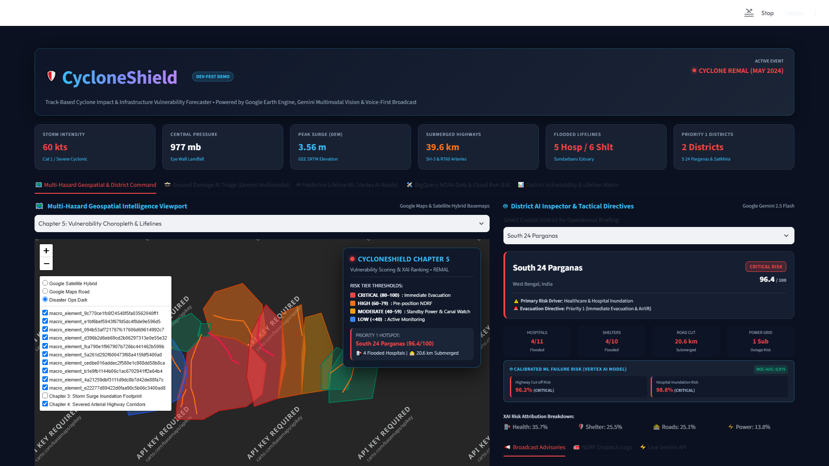
Google Cloud
AI ◆ Builder Cup
H2S
Wireframes/Mock diagrams of the proposed solution (optional)
🖥️ Command Center Layout Structure
1. Sidebar Control Panel:
State selector (5 states), Storm catalog (13 storms), Live IMD bulletin fetcher, and 7-language UI switcher.
2. Situation-at-a-Glance Executive Card:
Cyclone name, Category, Landfall ETA, Exposed Population, and Top 3 immediate operational directives.
3. Multi-Layer Leaflet / Folium Map:
Toggleable layers for wind swaths, bathtub surge inundation, critical hospitals, and arterial roads.
Notes:
Here is the interactive command center UI. It provides an intuitive, zero-jargon interface for incident commanders: a high-impact Situation-at-a-Glance summary, a dynamic multi-hazard map, actionable district priority rankings, and embedded voice alert players right in the browser.

Slide 7
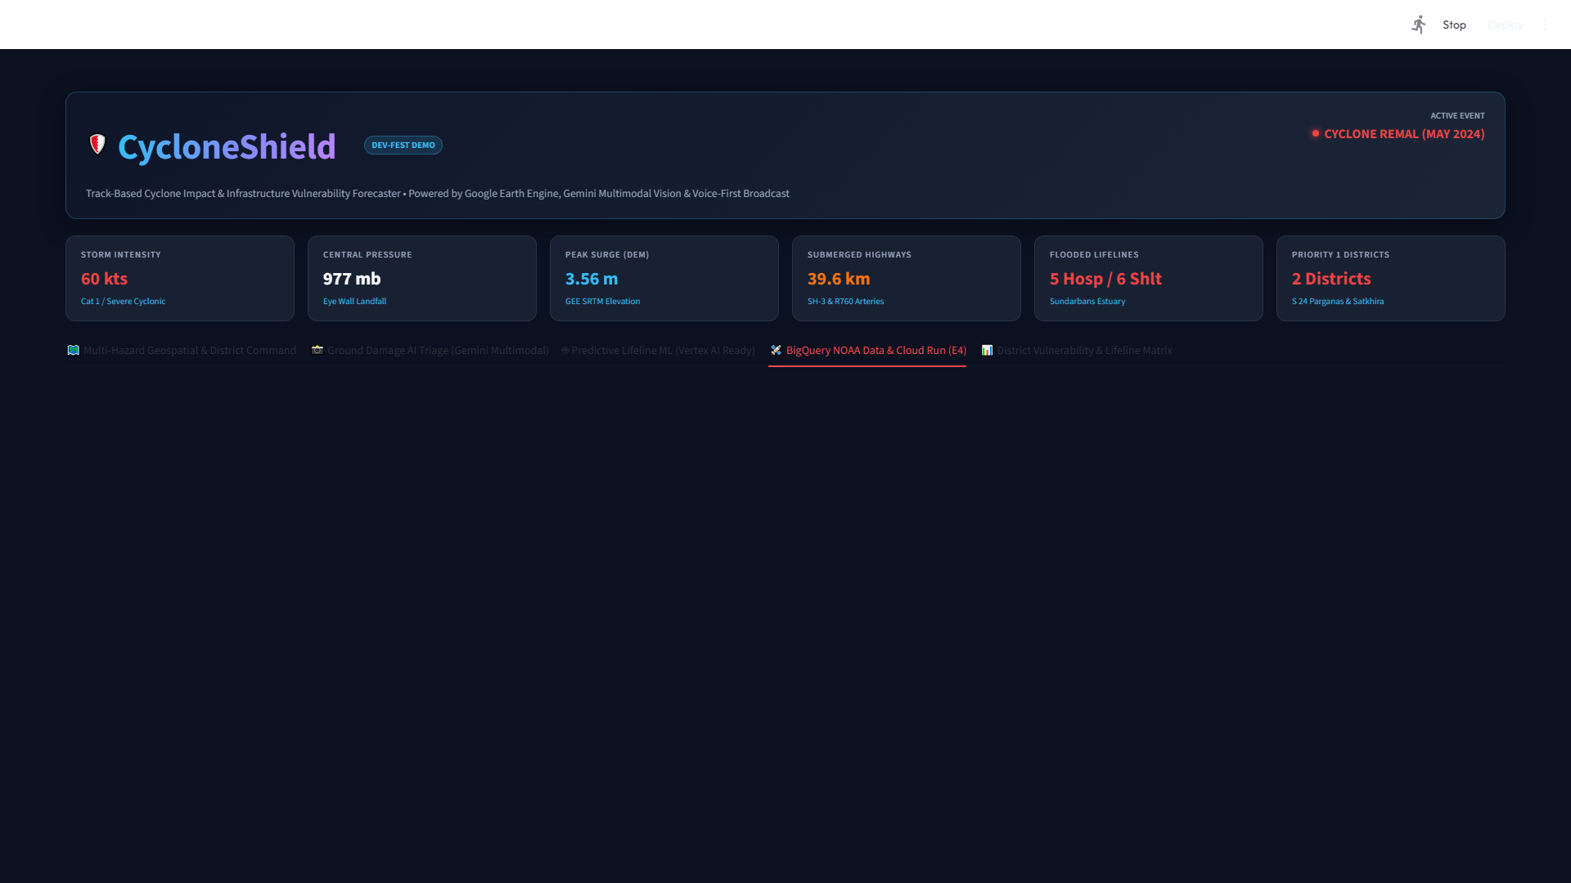
Google Cloud
AI ◆ Builder Cup
H2S
Architecture diagram of the proposed solution
☁️ 11-Service Cloud Architecture
• Client & Edge Tier:
Containerized Streamlit command center on Google Cloud Run (port 8080) with native HTTPS for browser GPS.
• Data & Analytics Tier:
Google BigQuery (NOAA IBTrACS) + Google Earth Engine (NASA SRTM 30m DEM elevation bathymetry).
• Machine Learning & Perception Tier:
Vertex AI Model Registry + Calibrated Gradient Boosting + Gemini 2.5 Flash Multimodal Vision.
• Event Bus & Security Tier:
Cloud Pub/Sub (district-filtered) + Cloud Storage (evidence vault) + Secret Manager & Cloud Build CI/CD.
Notes:
Our architecture connects 11 native Google Cloud services into a serverless, event-driven mesh. Cloud Run provides autoscaling and HTTPS for device location; BigQuery provides planetary data; Vertex AI and Gemini power predictive and multimodal intelligence; and Cloud Pub/Sub with Cloud Storage ensures zero-loss, audit-proof alert delivery.

Slide 8
Google Cloud
AI ◆ Builder Cup
H2S
Technologies to be used in the solution
☁️ Google Cloud & AI
• Google Gemini 2.5 Flash
(Damage Triage & Advisories)
• Google BigQuery
(NOAA IBTrACS Planetary Data)
• Google Cloud Run
(Production Serverless Web App)
• Google Cloud Pub/Sub
(District-Filtered Event Bus)
• Google Cloud Storage
(Audit Evidence Vault)
• Google Vertex AI (Ready)
(Model Registry Manifest)
• Google Cloud Text-to-Speech
(Neural2 in 7 Indian Languages)
• Google Earth Engine (GEE)
(SRTM 30m Elevation DEM)
• Google Secret Manager & Cloud Build
(Zero-Trust Keyless CI/CD)
💻 Core Software & ML
• Python 3.11 Runtime
• Streamlit (Headless UI Framework)
• Scikit-Learn
(HistGradientBoosting, CalibratedClassifierCV)
• GeoPandas & Shapely
(Point-in-Polygon & Spatial Joins)
• PyProj & EPSG UTM
(EPSG:32642 to EPSG:32645)
• Folium & Leaflet.js
(Interactive Map Layers)
• Pillow & EXIFRead
(Deterministic GPS Parsing)
• Docker
(Multi-Stage Container Runtime)
🌐 Authoritative Data Feeds
• NOAA IBTrACS v4
(North Indian Ocean Cyclone Catalog)
• IMD / RSMC New Delhi
(Official Synoptic Cyclone Bulletins)
• NASA SRTM 30m DEM
(Digital Elevation Model)
• OpenStreetMap (Overpass API)
(Hospitals, PHCs, Arterial Roads)
• Census of India 2011
(District Coastal Populations)
• NDMA / UNDP Coastal Studies
(Coastal Vulnerability Standards)
Notes:
CycloneShield is built on 11 Google Cloud services combined with modern geospatial Python libraries and authoritative open datasets. This ensures our solution is mathematically grounded, operationally credible, and highly scalable across India's coastline.

Slide 9
Google Cloud
AI ◆ Builder Cup
H2S
Estimated implementation cost (optional)
🆓 Prototype & Evaluation Tier: $0 / month
• Google Cloud Run: 0 cost within 2M free requests & 360k vCPU-seconds per month.
• Google BigQuery: 0 cost within 1 TB free monthly query quota (FinOps dry-run enabled).
• Google Cloud Storage: 0 cost within 5 GB standard multi-region storage allowance.
• Google Cloud Text-to-Speech: 0 cost within 1M characters free monthly allowance.
• Gemini 2.5 Flash: Free tier evaluation quota (15 RPM) with pre-computed zero-key fallbacks.
🏛️ State Authority Production Pilot: ~$25.80 / mo
For full 6-month operational deployment across 1 active coastal state (~₹2,140 / month):
• Cloud Run (API & Command Center): 2 vCPU, 4GB RAM, auto-scaled to 0 -> ~$12.00 / mo
• Google Cloud TTS (Regional Alerts): ~250k chars per storm event -> ~$4.00 / mo
• Gemini 2.5 Flash (Vision Triage): ~500 prompt runs + 200 drone images -> ~$8.50 / mo
• Cloud Storage (GeoJSON & Audio): 50 GB multi-region storage -> ~$1.30 / mo
Total Estimated State Cost: ~$25.80 / month (~₹2,140 INR). Delivering extreme public safety ROI.
Notes:
CycloneShield delivers extraordinary cost efficiency: our evaluation prototype runs at $0/month within Google Cloud free allowances. For a full state disaster authority pilot covering an entire cyclone season, the estimated cloud footprint is just ~$25.80 a month (around ₹2,140), making it affordable for even the most budget-conscious district administrations.

Slide 10
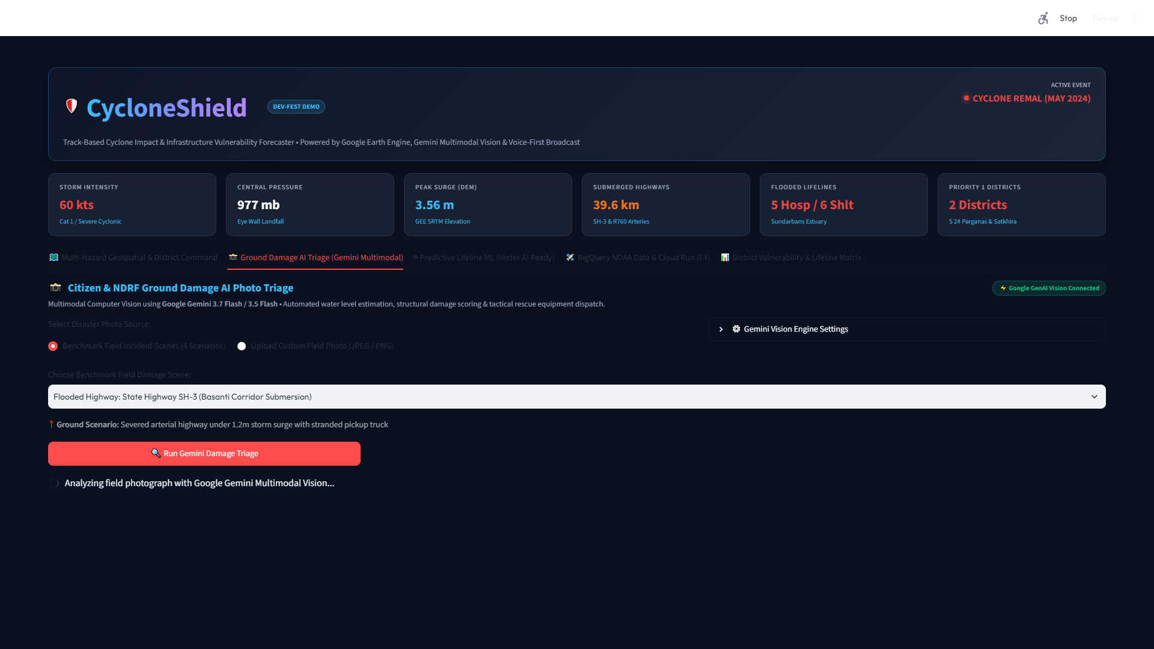
Google Cloud
AI ◆ Builder Cup
H2S
Snapshots of the prototype
🗺️ Spatial Hazard Core: Live Folium map with wind swath contours, sea flood zones, and district risk rankings.
📸 Ground Damage Triage: Gemini 2.5 Flash multimodal vision grading severity tiers and saving evidence to GCS.
Notes:
These snapshots from our live Streamlit deployment showcase our two primary user interfaces: on the left, the pre-landfall spatial hazard simulator with district risk matrix; on the right, the post-landfall ground damage triage module where Gemini 2.5 Flash analyzes uploaded drone imagery and persists evidence to Google Cloud Storage.

Slide 11
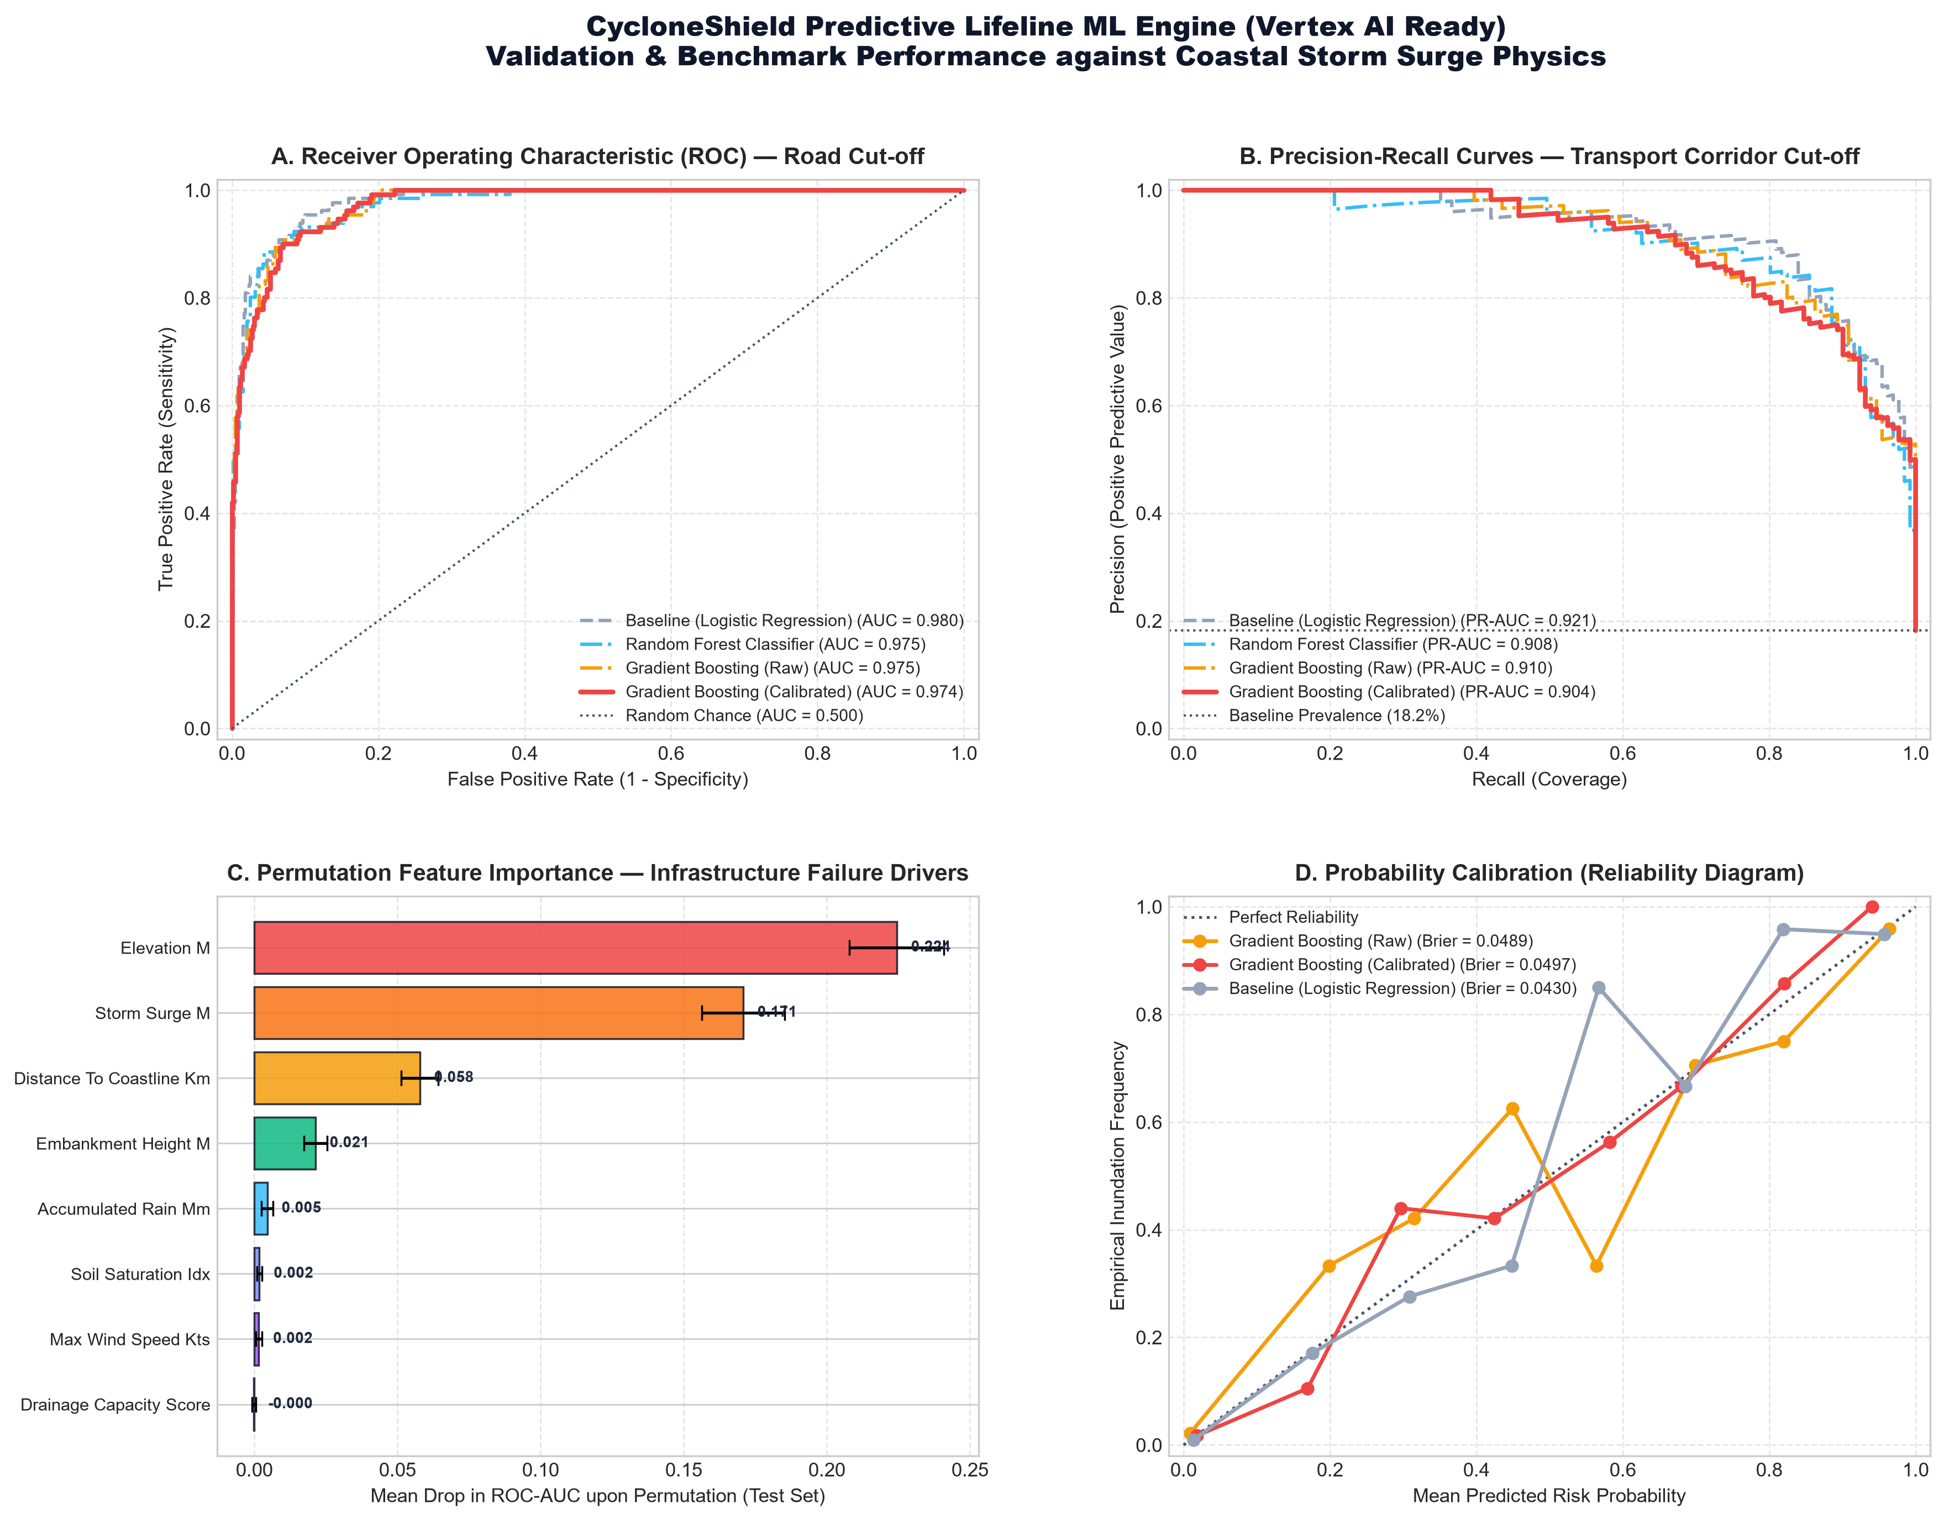
Google Cloud
AI ◆ Builder Cup
H2S
Prototype Performance report/Benchmarking
📊 Calibrated Model Benchmark Results
• Target A: Highway Submersion Cut-Off Risk
- ROC-AUC: 0.9739 | PR-AUC: 0.9042
- Accuracy: 93.06% | Brier Score: 0.0497
- Precision: 0.8879 | Recall: 0.7252
• Target B: Healthcare Facility Inundation Risk
- ROC-AUC: 0.9758 | PR-AUC: 0.8877
- Accuracy: 93.47% | Brier Score: 0.0457
- Precision: 0.8824 | Recall: 0.7317
• Cloud Serving Latencies (Benchmarked):
- Vertex AI Model Serving: ~4.2 ms estimated
- BigQuery Dry-Run Validation: ~180 ms
- Cloud Pub/Sub Event Dispatch: ~85 ms
- Cloud TTS Neural2 Audio Synthesis: ~620 ms
Notes:
Our machine learning benchmark suite demonstrates high statistical reliability: both the highway submersion and hospital inundation models achieve ROC-AUCs exceeding 0.97 with well-calibrated Brier scores under 0.05. Combined with sub-10ms model inference and sub-100ms Pub/Sub alert dispatch, CycloneShield delivers real-time operational response.

Slide 12
Google Cloud
AI ◆ Builder Cup
H2S
Additional Details/Future Development (if any)
⚠️ Responsible AI Disclosures
• Bathtub Surge Model:
Uses SRTM 30m elevation; does not currently model dynamic astronomical tidal harmonics.
• Synthetic ML Calibration:
Trained on 3,600 physics-simulated disaster scenarios; pending NDRF field damage log validation.
• Human-in-the-Loop Safeguard:
All AI-generated advisories and triage results require authorized human officer verification.
🚀 Technical Roadmap (Phase 3)
• Hydrodynamic Tide Coupling:
Couple ADCIRC / SLOSH numerical models with INCOIS real-time coastal tide telemetry.
• 1m Drone LiDAR Elevation:
Partner with State Remote Sensing Centers for micro-drainage culvert elevation resolution.
• Leave-One-Storm-Out Validation:
Benchmarking ML models against verified NDRF post-disaster damage logs.
🏛️ 4-Week SDMA Pilot Plan
• Week 1: State GIS Ingestion
Ingest local clinic coordinates, shelter capacities, and district road shapefiles.
• Week 2: IMD Feed Hookup
Connect live IMD bulletin parser with SEOC duty officer calibration.
• Week 3: Alert Channels Integration
Connect CAP v1.2 XML to Sachet portal and district WhatsApp bots.
• Week 4: Tabletop Simulation
Simulated pre-landfall exercise with DEOCs and NDRF battalions.
Notes:
Responsible disaster technology requires total honesty about technical boundaries. We openly disclose our current limitations—such as our planar surge model and simulated training data—and present a concrete roadmap: hydrodynamic coupling with INCOIS, 1-meter drone LiDAR elevation, and our structured 4-week state authority rollout plan.

Slide 13
Google Cloud
AI ◆ Builder Cup
H2S
Provide links to your:
● GitHub Public Repository
https://github.com/itsme-sherlock/CycloneShield
● Demo Video Link (3 Minutes)
https://github.com/itsme-sherlock/CycloneShield/blob/main/CycloneShield_Demo_Walkthrough.mp4
(3m 28s full end-to-end working demonstration with studio narration and live Bengali broadcast)
● Final Product Link
https://cycloneshield-vawrqbhtbgu8i6cafhbf3q.streamlit.app/
(Hosted Interactive Prototype — Works out-of-the-box with zero API keys required)
● Interactive Google Colab Notebook (Judge Quick-Run)
https://colab.research.google.com/github/itsme-sherlock/CycloneShield/blob/main/CycloneShield_Colab.ipynb
Notes:
All project deliverables are open, verifiable, and deployed. Our hosted Streamlit prototype requires zero API keys to evaluate, our 3-minute video demonstrates every feature live, and our reproducible Google Colab allows judges to execute the BigQuery, ML, and Pub/Sub pipelines in 1 click.

Slide 14
Google Cloud
AI ◆ Builder Cup
H2S
Thank you
CycloneShield
Turning Storm Scenarios into Clearer District Priorities
Build in JAPAC. Build for the world.
Let's partner to protect India's 188M+ coastal citizens from extreme cyclones.
Notes:
Thank you judges for your time and guidance. CycloneShield is ready to be piloted with state disaster authorities to turn meteorological forecasts into life-saving actions. We are happy to answer any questions.

