Slide 1
Tour Package Management System
By:
Ankit Adhikari
Biswas Banstola
Dipesh Adhikari
Subash Dahal
Guided By :Er. Rajendra Bahadur Thapa

Slide 2
Background:
Nepal is renowned for its scenic beauty and vibrant culture, attracting numerous travelers.
Planning and travelling tours can be complex due to multiple reasons. Eg : not a good packages , insufficient information about the destination , provided packages etc
We aim to solve it with an online platform for easy travel planning and booking.

Slide 3
Why us ?
Most of the Available online platform lacks security .
Available platforms do not provides better information about available packages than our system.
Customer can simply provide us Email without logging in to our system so we can contact with them easily. (Customer support)

Slide 4
Objectives:
Provide detailed information on travel destinations and adventure activities.
Enable users to choose and customize their desired packages.

Slide 5
Features:
Easy to use interface .
Detailed descriptions of adventure activities.
Admin has full control to accept and reject the bookings done by the customer.
Users can add notes while booking the packages .
Users can choose the dates for the packages they like .

Slide 6
Features(more features):
Separate login portals for the admin and the Customer,
Multiple admins can use our system .
Admin can be added .(have separate account for each admins)

Slide 7
Development Tools Used:
Tools Name | Purpose
Vs code | To edit codes
Xampp | Used as localhost
Microsoft Office Package | For document creation
Dia | To make ER-diagrams, use case diagrams, Sequence diagrams.

Slide 8
Programming Languages Used:
Programming languages | Description
HTML | Webpage programming
CSS | Webpage styling
JavaScript | Front-end and Client side Programming
PHP | Backend and server side programming
MySQL | Database handling.

Slide 9
Use Case diagram:

Slide 10
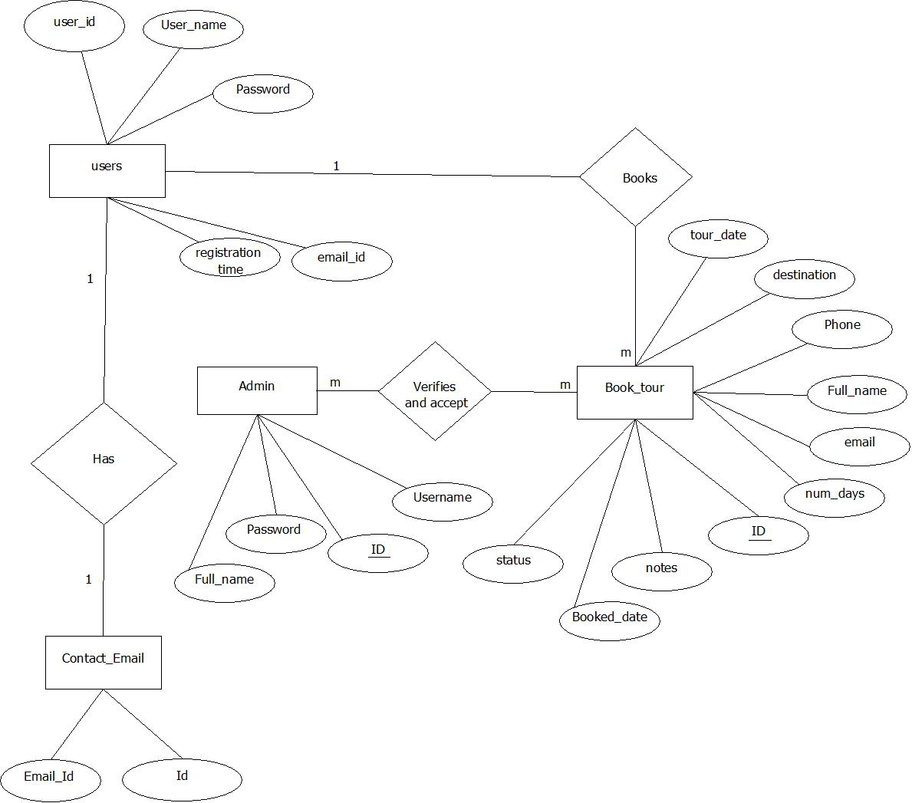
ER- Diagram:

Slide 11
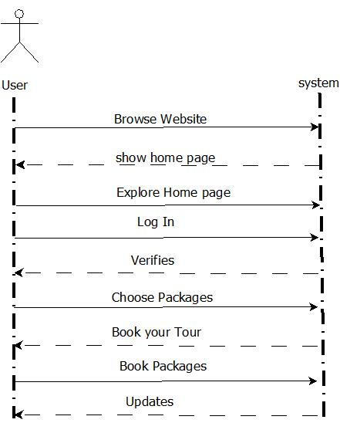
SSD for User:

Slide 12
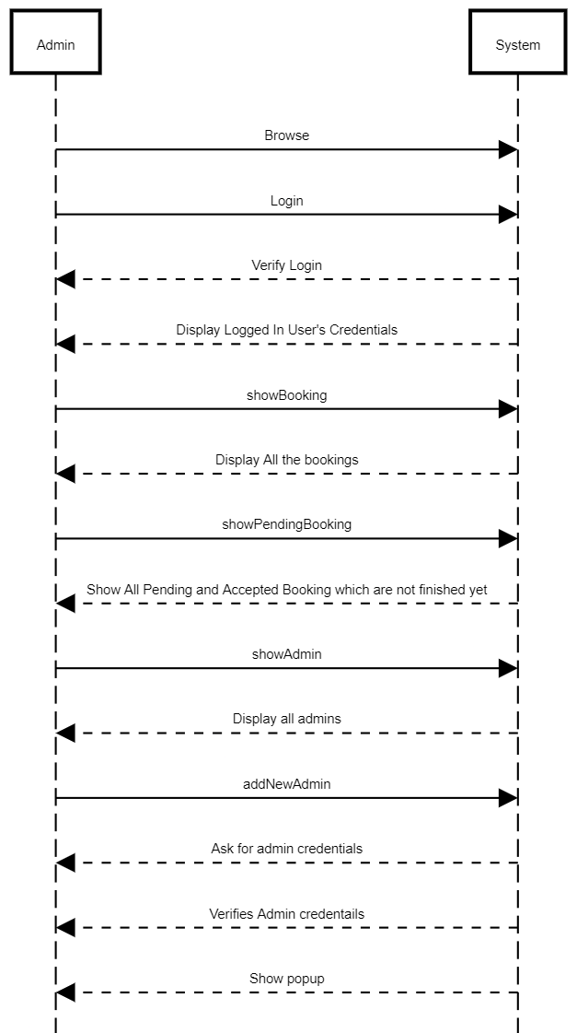
SSD for Admin:

Slide 13
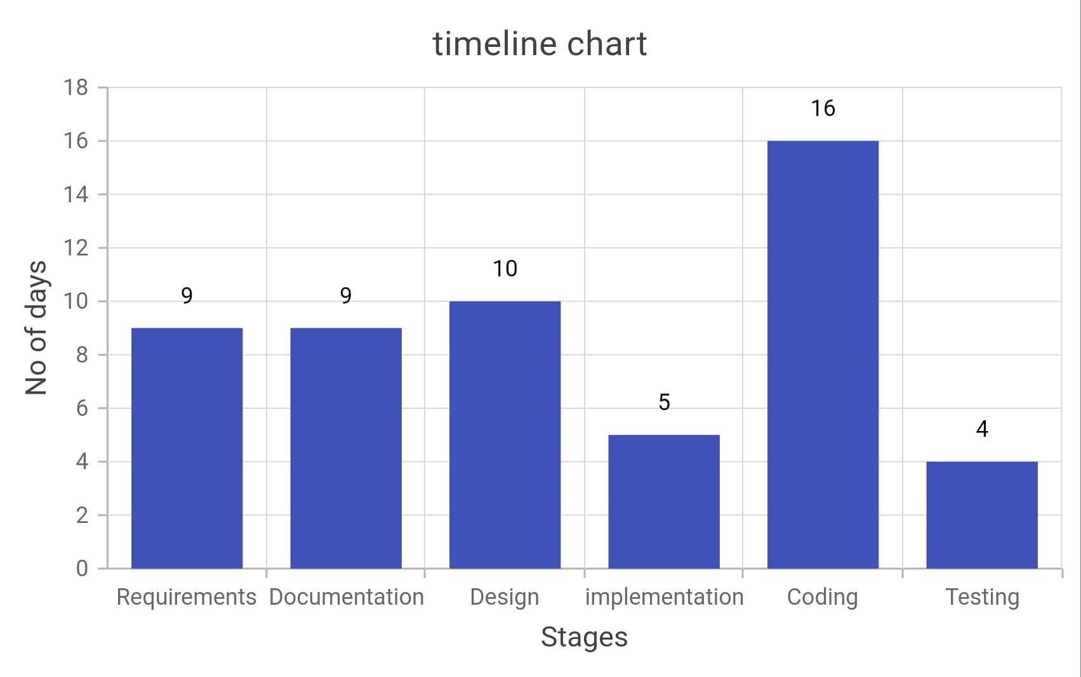
Project Schedule:
Requirement Analysis: 9 days
Documentation: 9 days
Design: 10 days
Implementation: 5 days
Coding: 16 days
Testing: 4 days

Slide 14
Conclusion:
Easy and seamless booking process .And Improved User Experience.
Secure system.
Customer support.

Slide 15
Thank You

