Slide 1
Unlocking Business Value with Data: Ghana Pay Transaction Insights
A professional case for boosting revenue and efficiency through data analytics – Q1 Analysis & Strategic Recommendation
Date: August 3, 2025
Made with Genspark

Slide 2



About GhanaPay
GhanaPay is a comprehensive mobile money platform provided by universal banks, rural banks, and savings and loans companies across Ghana, designed to promote financial inclusion and drive digital payment adoption.
Our Mission
To empower all Ghanaians with secure, accessible, and affordable digital financial services, regardless of whether they have a traditional bank account.
Key Offerings:
Mobile Money Transfer
Merchant Payment
Bill payments
Loan Disbursement and Loan Repayment
Airtime Purchase

Slide 3
Business Problems
Reliability: 8% failed transactions (8 of 100), risking customer trust.
Engagement gaps: 20 unique customers, but activity is concentrated—some transact often, others rarely.
Product imbalance: Bill Payment (21%) and Loan Repayment (20%) dominate, others underused.
Regional disparities: Most transactions in Cape Coast (20), Ho (18), Kumasi (14); other locations see less activity.

Slide 4
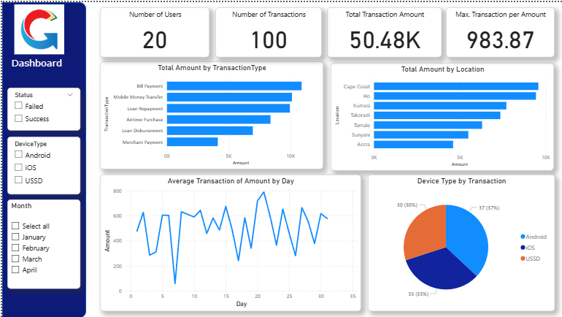

Slide 5
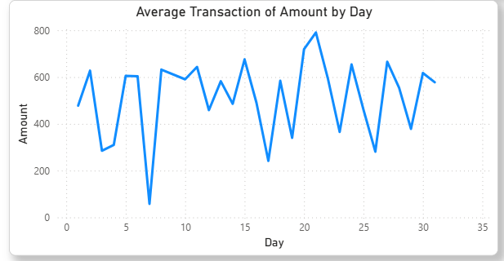
Average Transaction Amount by Day
March 2025 had the highest transaction volume (38 transactions, over ₵18,200), signaling successful campaigns or seasonal effects.
April’s sharp drop (just 2 transactions) highlights the need to investigate and maintain momentum.
Tracking monthly trends helps us optimize marketing and spot sudden drops before they harm growth

Slide 6
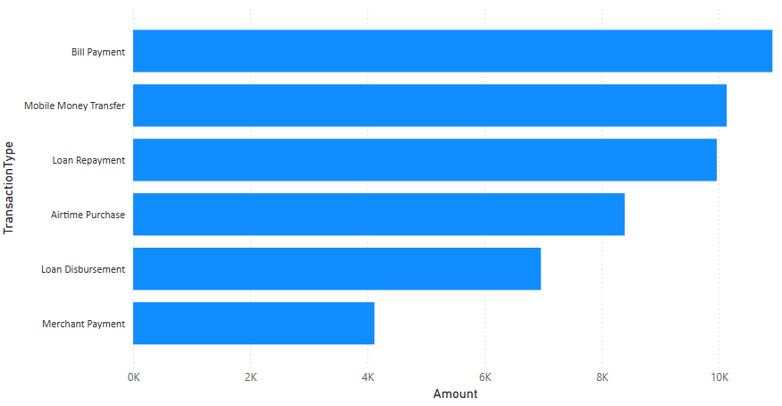
Service Breakdown
The chart shows that Bill Payments and Mobile Money Transfers generate the highest transaction amounts, suggesting that the business should focus on optimizing and promoting these services as they drive the most value

Slide 7
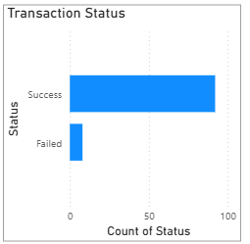
Transaction Success vs Failure Rate
92% success rate is strong, but 8% failures (8 of 100) impact customer experience.
Failures are not randomly distributed they spike on certain devices and in some towns.
Why this matters: Fixing hotspots can rescue revenue and prevent user churn.

Slide 8
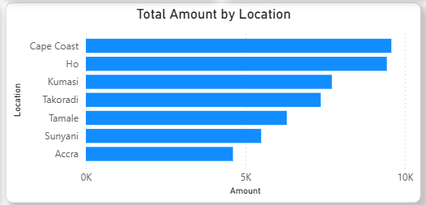
Regional Transaction Distribution
Cape Coast, Ho, and Kumasi account for most transactions.
Market share in Sunyani, Accra, and others is low ,these areas offer growth opportunities.
Why this matters: Targeting new regions can diversify risk and expand GhanaPay's user base.

Slide 9
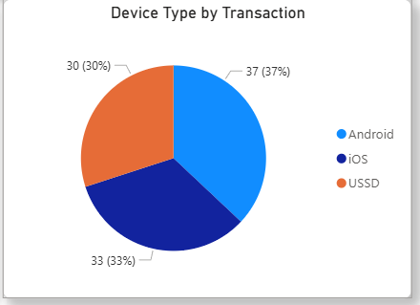
Device Usage Distribution
Android (37%) and iOS (33%) dominate, but 30% of users rely on USSD.
Why this matters: Technical support and new features must work smoothly across all platforms especially where failure rates are high.

Slide 10
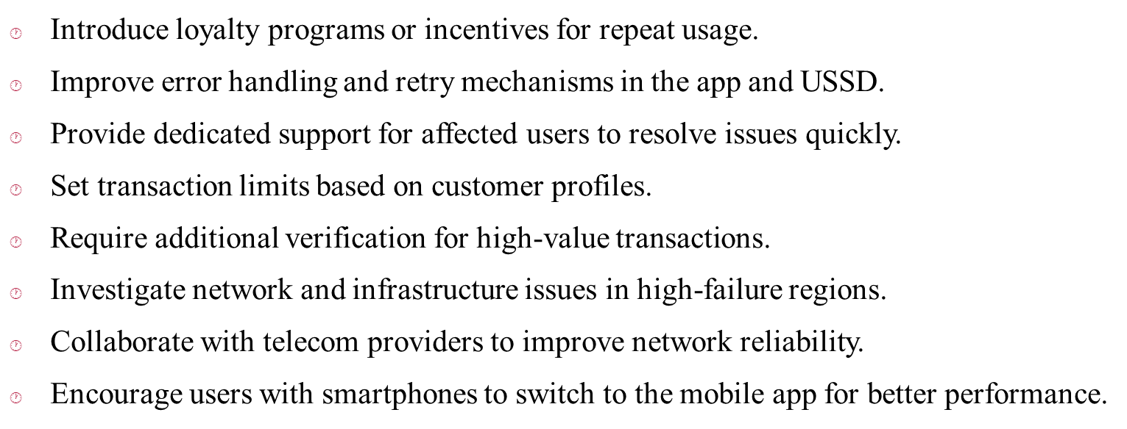
Recommendations

Slide 11




Closifig & Next Steps
Hiring a data analyst is a strategic investment to power GhanaPay's next phase of growth. Our analysis shows that with the right analytical capabilities, GhanaPay can:
Let's Unlock Your Data's Full Value
Unlock hidden revenue opportunities worth 10-15% of current value
Reduce customer churn by targeting at-risk segments Optimize agent networks for maximum efficiency
Gain competitive edge in Ghana's rapidly evolving fintech space
Data-driven organizations outperform peers by 23x in customer acquisition, 6x in customer retention, and 19x in profitability.
Proceed with Hiring
Recommended Next Steps:
Q&A Section
Approve budget for data analyst position (GHS 5k-10k/month)
Begin recruitment process within next 2 weeks
Prepare data infrastructure for analytics capabilities
We welcome your questions about implementation timelines, candidate qualifications, or specific data initiatives you'd
like to prioritize.

