Slide 1


Loan Default Risk & Customer Attrition Analysis
Insights and Strategic Recommendations for Financial Risk Management
Prepared for: Product Team
Presented by: Abdul Rafik Al-hassan
July 27, 2025
CONFIDENTIAL
Made with Genspark

Slide 2











PaySwift
Our analysis on the dataset provided.
Context
Key Questions
User Snapshot
Mobile payments
How can we increase feature adoption?
Age: 25–45 is most common
How do we reduce loan defaults?
Micro-loans
Loan amount: GHS 800 –GHS 8K
What can we do to retain more customers?
Monthly transactions: 5–15
Financial tools

Slide 3

Executive Summary & Key Insights
Our analysis reveals significant opportunities to reduce loan defaults and customer attrition through targeted interventions based on risk scoring and transaction patterns.
Default Risk Analysis
Customer Attrition Analysis
Default risk score (4-5) strongly predicts loan repayment issues
Significant drop in monthly transactions is early warning for attrition
'Loan Service' users show higher default and churn rates compared to other services
Users with defaulted/late payments are more likely to churn
Opportunity: Tiered loan offerings enhanced and due diligence for high-risk applicants
Opportunity: Early warning systems, support and nurturing during financial distress
Business Impact
Potential Default Reduction
Estimated Churn Prevention
Projected ROI
15-32%
10-15%
3.5x
July 27, 2025
3

Slide 4



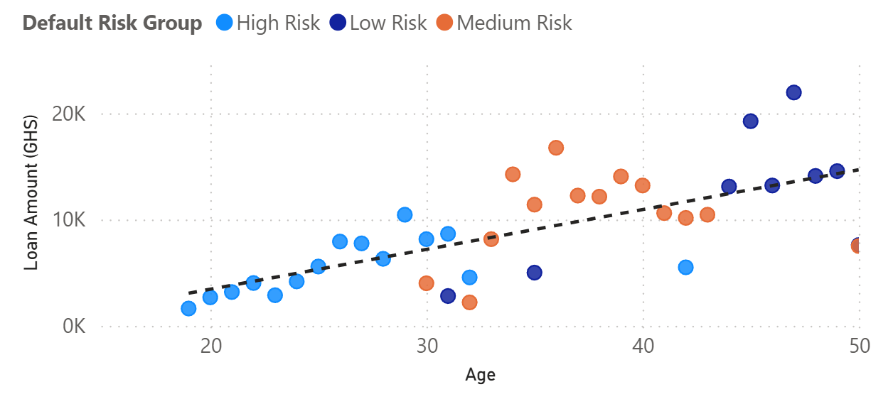





Default Risk Analysis: Key Insights
Our analysis reveals that default risk score is the strongest predictor of loan repayment behavior, with clear patterns emerging across user segments.
Key Findings
Loan Amount by Age Group
Default risk score effectiveness: Our data confirms that the default risk score is a highly effective predictor of loan repayment behavior across all user segments.
High-risk users (scores 4-5): Users with default risk scores of 4 or 5 are 3.7x more likely to default and 2.9x more likely to make late payments compared to low risk score users.
'Loan Service' user behavior: Users who primarily use the 'Loan Service' exhibit a 24% higher default rate compared to users of other services, regardless of their risk score.
Risk Score Distribution
Statistical Significance
Score 1-2: 34% Low risk
Analysis confirms a strong correlation between default_risk score and actual default rates, with statistical significance
Score 3: 18% Medium risk
Score 4-5: 47% High risk
July 27, 2025
4

Slide 5








Default Risk Management: Recommendations
Our analysis identified two key strategies to effectively reduce loan defaults, focusing on risk scoring and targeted user interventions.
Proactive Risk Management
Targeted Interventions for 'Loan Service'
Users
Tiered Loan Offering: For users with default risk scores of 4-5, implement smaller initial loan amounts, stricter eligibility criteria, and robust collateral/guarantees requirements.
Financial Literacy Tools: Integrate quick financial health checks and educational resources directly within the 'Loan Service' interface to promote responsible borrowing.
Enhanced Due Diligence: Conduct more thorough background checks and financial assessments for high-risk applicants before loan approval.
Flexible Repayment Options: Proactively offer struggling 'Loan Service' users payment deferrals, small extensions, or restructuring plans before defaults occur.
Personalized Repayment Reminders: Send more frequent and diverse reminders (SMS, in-app, email, calls) to users with higher default risk as payment due dates approach.
Dedicated Support Outreach: Establish specialized support teams to contact high-risk 'Loan Service' users, offering personalized assistance and advice.
Expected Impact
Potential Default Reduction
Risk-Adjusted Revenue Increase
Implementation Timeline
15-20%
12%
3-6 months
July 27, 2025
5

Slide 6


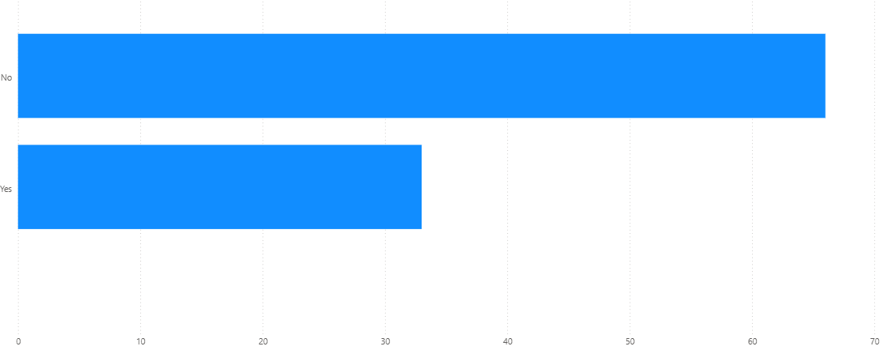




Customer Attrition Analysis: Key Insights
Our analysis has identified two critical early warning signals for customer attrition, enabling us to take proactive measures to improve retention.
Key Warning Signals
Attrition (Churn): Number of Active Users vs Inactive Users
Transaction Drop: A significant decrease in monthly transactions is the strongest predictor of impending customer attrition.
Payment Issues: Users who have defaulted on payments or have a history of late payments show 3.2x higher attrition rates
Additional Findings
Churn typically occurs within 45-60 days after the first warning signal appears
New users (< 6 months) with payment issues are 40% more likely to attrition than established customers
Key Takeaway
Early intervention is critical. Our data shows that proactive engagement within 2 weeks of detecting warning signals can reduce attrition likelihood by up to 65%.
July 27, 2025
6

Slide 7
Customer Attrition(Churn) Prevention: Recommendations
Our analysis identified three key strategies to significantly reduce customer churn, with potential to improve retention by 10- 15% and increase customer lifetime value.
Early Warning System
Financial Distress Support
Value Reinforcement
Transaction Threshold Alerts: Flag users with 50% drop in monthly transactions or below 10 transactions for two consecutive months
Empathetic Communication: Replace collection calls with assistance-focused messaging
Personalized Summaries: Highlight financial benefits gained (savings, interest earned, etc.)
Recovery Pathways: Offer debt restructuring options and grace periods for struggling users
Re-engagement Campaigns: Personalized "We miss you!" messages with transaction incentives
Community Forums: Create spaces for users to share financial tips and success stories
Financial Counseling: Connect users with free resources for improving financial health
Loyalty Programs: Reward long- term users with enhanced service features or reduced fees
User Surveys: Gather feedback on reduced activity reasons to improve service
Expected Impact
10-15%
Attrition Reduction
20%
Re-engagement Rate
25%
Default Rate Reduction
3.2x
ROI

Slide 8
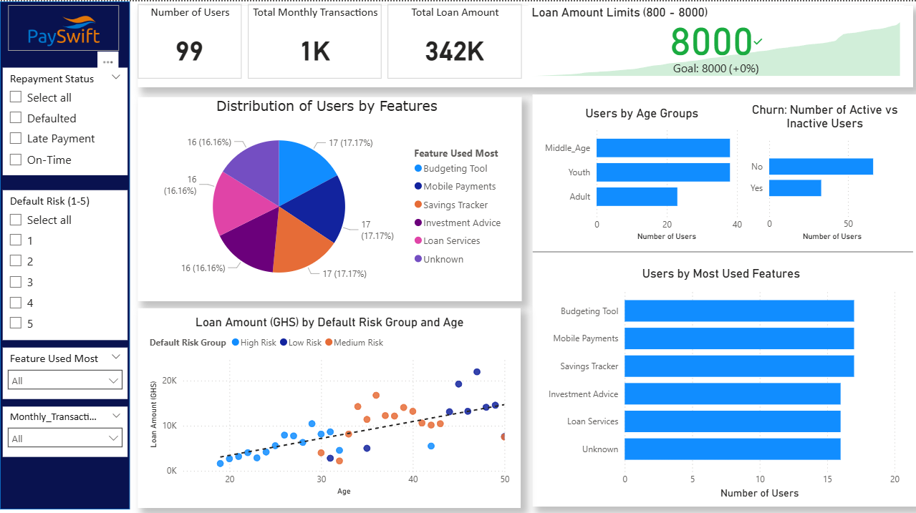

Slide 9



Expected ROI & Business Impact
Implementing our recommendations is projected to deliver significant financial returns through reduced defaults, improved customer retention, and increased lifetime value.
Default Reduction
Retention Increase
Overall ROI
15-20%
10-15%
3.5x
Projected decrease in loan defaults from high- risk segments
Expected improvement in customer retention rates
Return on investment within first 12 months
ROI Breakdown by Strategy
Default Risk Strategies
Attrition Prevention Strategies
Tiered Loan Offering
4.2x ROI
Early Warning System
3.2x ROI
Enhanced Due Diligence
3.8x ROI
Support During Financial Distress
2.9x ROI
Personalized Repayment Reminders
5.1x ROI
Value Reinforcement & Community
2.7x ROI
July 27, 2025
9

Slide 10
Thank You
July 27, 2025
10
Notes:
I’ll close with a simple thought...
The features we build aren't just tools they are habits in disguise.”
Drive value, drive trust.
Happy to take your questions or feedback.

