Slide 1

Task -1
Himanshu Chauhan
(23041376)
UNEMPLOYMENT
Department of Computer Applications
Graphic Era Hill University Bhimtal Campus

Slide 2



Slide 3
What is unemployment ?
The term unemployment refers to a situation where a person actively searches for employment but is unable to find work.
Unemployment is considered to be a key measure of the health of the economy.

Slide 4
How Unemployment Works :
Unemployment is a key economic indicator because it signals the ability (or inability) of workers to obtain gainful work and contribute to the productive output of the economy.
More unemployed workers mean less total economic production.

Slide 5
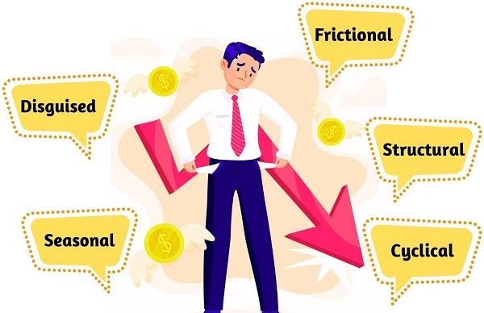
Types of Unemployment:-
The main types of unemployment are :-

Slide 6
Frictional Unemployment :
It is the duration when people are in search mode, i.e. looking out for jobs. Moreover, it is a time lag between the last job and the aspiring job.
It is alternatively known as Temporary Unemployment.
This is because people will get employed as soon as they get a good job opportunity.

