Slide 1


Practical File
DIGITAL PRODUCTIVITY AND MODERN WORKSPACES
(PBC 102)
BCA First Semester
Session 2023-2026
Submitted to:
Mr.Janmejay pant
Assistant Professor
School of Computing
Graphic Era Hill University
Bhimtal Campus
Submitted by:
Himanshu Chauhan
BCA
Section : A
Roll no:-2371145

Slide 2
College Roll No:_________ Examination Roll no:_______
THIS IS TO CERTIFY THAT MR. HIMANSHU CHAUHAN HAS SATISFACTORILY COMPLETED ALL THE EXPERIMENTS IN THE LABORATORY OF THIS COLLEGE. THE COURSE OF THE EXPERIMENTS / TERM WORK
_____________ IN PARTIAL FULLFILLMENT OF THE REQUIREMENT IN ________SEMESTER OF BCA
DEGREEE COURSE PRESCRIBED BY THE GRAPHIC ERA HILL UNIVERSITY BHIMTAL DURING THE YEAR 2023-2026.
CONCERNED FACULTY HEAD OF DEPARTMENT
NAME OF EXAMINER:
SIGNATURE OF EXAMINER:

Slide 3
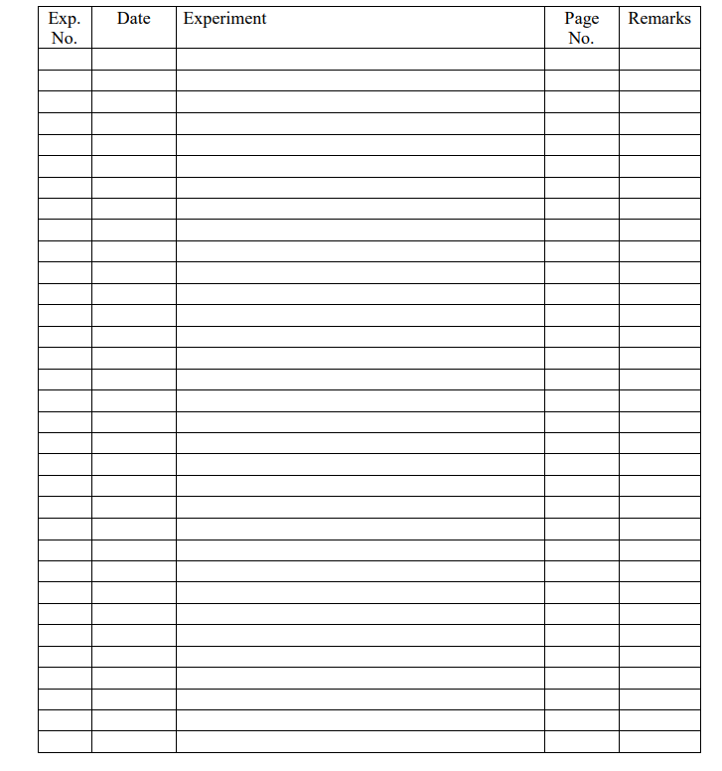
INDEX

Slide 4

MS WORD exercises

Slide 5
Question 1.
Create and Design Admission/Enquiry Forms etc.
To create this kind of form, you need to use shapes, text boxes, colors, formatting options, tables, and horizontal lines in MS Word. This is a very good exercise to practice because it will give you an idea of how to use such options practically on various official documents that we use in our daily official life.
Example is shown on the next slide.
Reference Link:
to create a forms in ms word

Slide 6
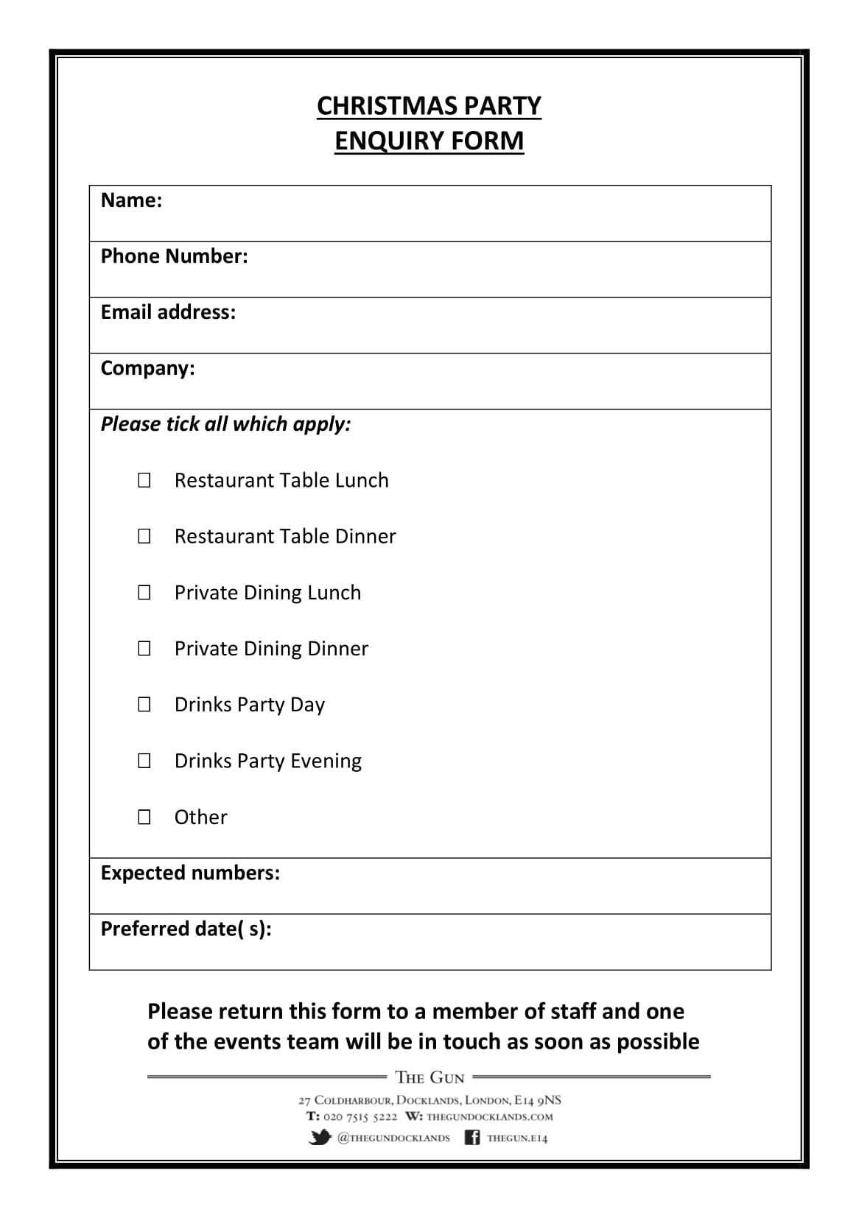

Slide 7

Question 2.
Create Business Cards using different Shapes, text, and colors in ms word.
Reference link:
Click here to see how to create a business card using different shapes ,text,and colors in ms word
Example:

Slide 8
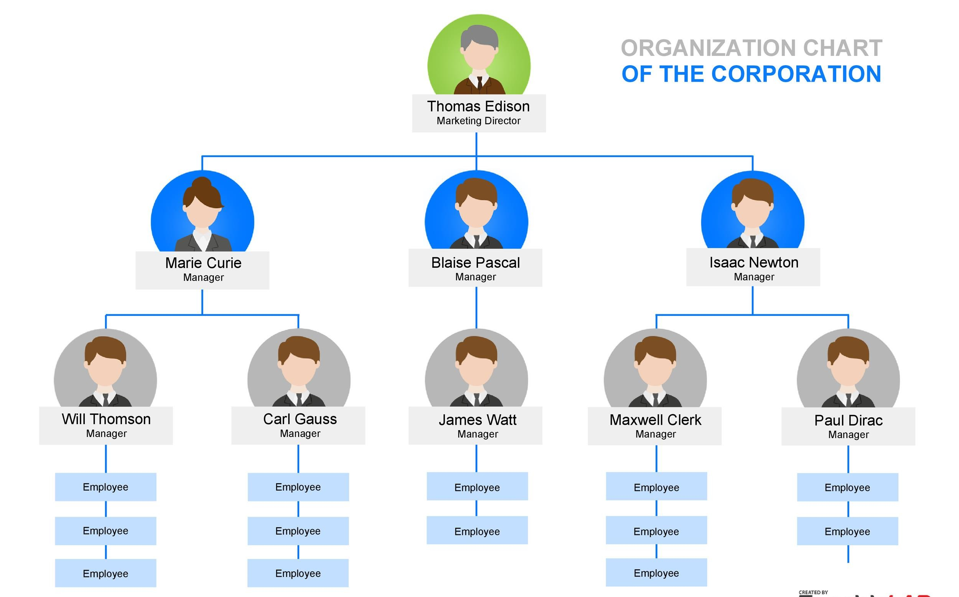
Question 3.
Use smart art and create organizational charts and showcase relations:
Smart Art is one of the favorite options in Microsoft Word. Smart art is used to draw diagrams that are used to showcase the content visually that will be easy to understand and manage. As you see below the smart art image Hierarchy Diagram is used to create an organizational chart or structure of the Telecom company.
Reference link :
How to create Organisational Charts in Ms word

Slide 9
Question 4.
Make book content page or index page ?
This is another idea in which you need to create an index or content page of the book. In this process, you will learn about the first-line indent, hanging indent, and the perfect use of the ruler bar in Microsoft Word.
And also about a page number, and a hyperlink (if it is an eBook).
EXAMPLE IS ALSO GIVEN ON THE NEXT SLIDE.
Reference link:
Click here to see how you can create a book content page or index page in ms word

Slide 10
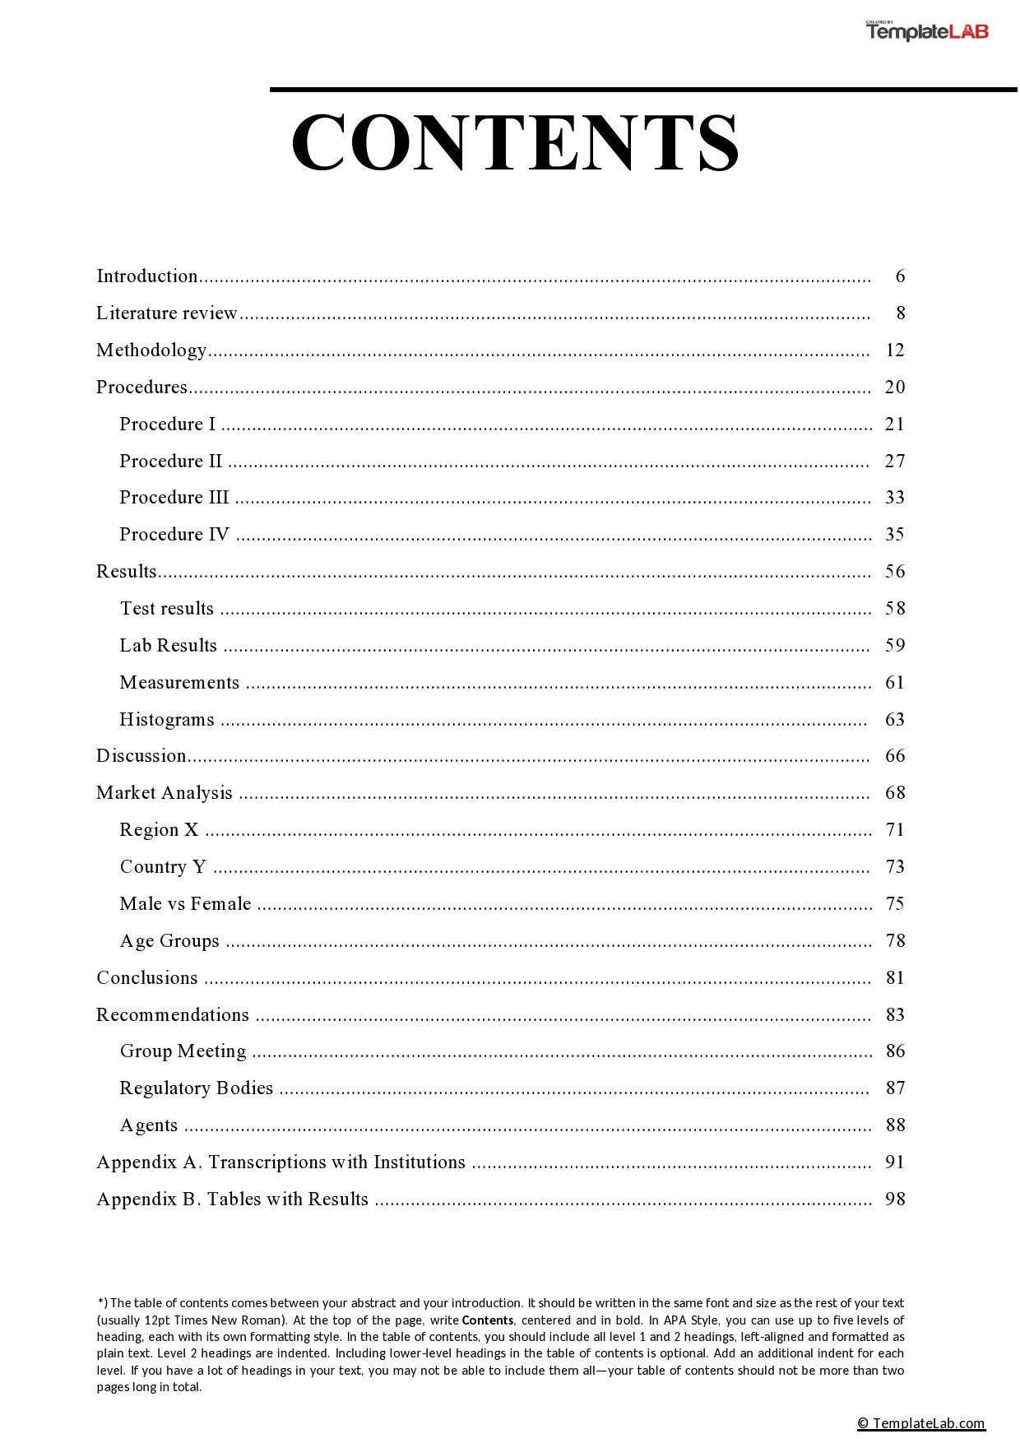

Slide 11
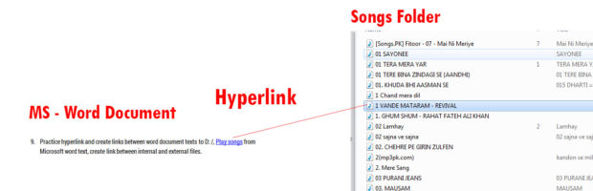
Quesition 5.
Practice hyperlinking and creating links between Word document texts to D: /, Play songs from Microsoft Word text, and create links between internal and external files?
This is the most important option in Microsoft Word. Most of the processes on the internet contain links. The hyperlink is the starting point in which you learn how things are connected with each other.
Reference link to create a Hyperlink in ms word..
Example:

Slide 12

Question 6.
Design a Happy Birthday Message by using Word Art and print it.
You can use the Word Art option for this. You can create the best wishes message in MS Word. After that, you can print. And give it to the person. It’s about creating small things at home. This is also a good way to make kids interested in learning the computer.

Slide 13
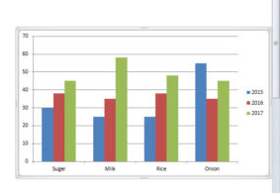
Question 7.
Create a chart and show the product price comparison between years:
The chart option is very important in Microsoft Word and Excel. However, the use of the chart option and any other option in MS Word depends on the demand for a certain content type.
For example, you’re writing a book or making notes about something in which you have to write and explain the price comparison between 3-4 years. Then you can use the chart for visualizations to analyze the data.
Reference link:
Charts in MS word

Slide 14

Question 8.
Take a double-column book or newspaper and design or create a similar paragraph style in the Word document.
find the newspaper similarly as you see below and create or type the text as you’re seeing in the newspaper. And if you’re having a problem, ask your teachers. So, when your teachers teach you how to do that thing or this thing, it will be great for your knowledge.
Reference links:
Link 1
Link 2

Slide 15
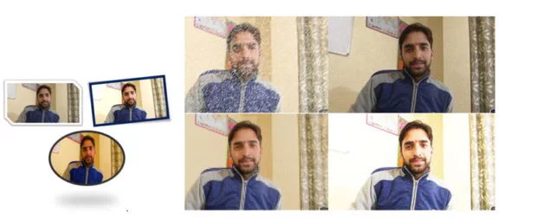
Question 10:
Insert Images and Practice on Format Menu and Image Options.
You can use image options and style to decorate, retouch, and adjustment of colors and brightness in MS Word. As you can see, I have created various styles and image effects. These are easy to create.

