Slide 1
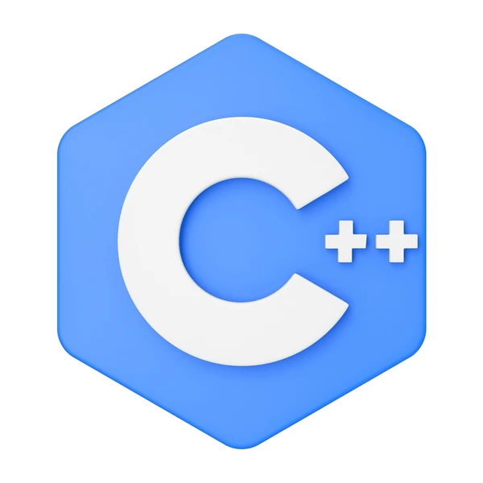
Introduction To C++
Created By : -Khushbu Rawat
Course :- BCA
Section :- “A”

Slide 2
C++ for C Programmers,Part A
Week 1
Week 2
Week 3
Week 4
Week 5
Module 1
Module 2
Module 3
Module 4
Module 5
Module 6
Module 7
Module 8
Module 9
Module 10

Slide 3
Week 1

Slide 4
History Of C++
C ++ was designed at AT&T Bell Labs by Bjarne Stroustrup in the early 80’s.
Based on the ‘C’ programming language.
He Chose “c” because it is general - purpose ,fast and portable.
C++ language standardised in 1998.
Bjarne Stroustrup is known as the founder of C++ language.

Slide 5
C V/S C++
C++
C
C was developed by Dennis Ritchie in 1972 at AT&T Bell Labs.
C is a structural programming language.
C does not supports object orientation features.
C is a subset of C++.
File extension in .c
C++ was developed by Bjarne Stroustrup in 1979.
C++ is both structural and object oriented programming language.
C++ supports object orientation features.
C++ is a superset of C.
File extension is .cpp

Slide 6
Why C++ is Better
C ++ is an advanced language that supports various programming methods like functional ,procedural , and object – oriented programming. It is a fast language; its compile – time and execution time is faster than other programming languages.

Slide 7
Advantages of C++
Portability
Multi – Paradigm
Object – Oriented
Compatibility
Memory Management
Large Community support

Slide 8
Disadvantages Of C++
Use of Pointers.
Absence of Garbage Collector.
Security Issues.

Slide 9
Basic Syntax of C++
Header file for taking input & printing output
Preprocessor directive used to include files
#include<iostream>
using namespace std;
int main()
{
cout<<“Hello World”;
return 0;
}
Mandatory for any program
Used to display output
Ends of a statement
Exit status of a function

Slide 10
Input Output function in C++
cin – For taking input.
cout – For printing output.

Slide 11
Swap program from 2 different versions….

Slide 12
From C Version
#include<stdio.h>
int main(){
int a,b,c;
printf(“Enter Two numbers:”);
scanf(“%d%d”,&a,&b);
c=a;
a=b;
b=c;
printf(“after swapping:%d%d”,a,b);
return 0;
}

Slide 13
From C++ version
#include<iostream>
using namespace std;
int main(){
int a,b,c;
cout<<“enter two numbers”;
cin>>a>>b;
c=a;
a=b;
b=c;
cout<<“after swapping”endl;
cout<<“a=“<<a<<“,b=“<<b<<endl;
return 0;
}

Slide 14
Week 2

Slide 15
Introduction To Loops in C++….
For loop
While loop
Do – while loop

Slide 16
For loop
for( initialisation ; condition ;updation){
//body
}

Slide 17
While Loop
While(condition is true){
//body
//updation
}

Slide 18
Do – While Loop
do{
//body
}while(condition);

Slide 19
Operators
Operators are symbol that tell the compiler to perform some specefic operations on operands.

Slide 20
Types Of Operators
Airthmetic Operators
Relational Operators
Logical Operators
Bitwise Operators
Assignment Operators

Slide 21
Airthmetic Operators (+ , - , * ,/ , %)
Binary Operator
Unary Operator
Relational Operators (==,!=,>,<,<=,>=,==)
Defines a relation between two operands.
Returns a boolean value.
Logical Operators (&&,||,!=)
Used to connect multiple conditions/ expression together or to reverse logical value.

Slide 22
Bitwise Operators (&,|,^,<<,>>)
Operate on bits and perform bit - by - bit operations.
Assignment Operators (=,+=,-=,*=,/=)

Slide 23
Week 3

Slide 24
Functions in C++
In simple words , Function is a piece of code that performs a specific task.
A function is a block of code which only runs when it is called. You can pass data, known as parameters , into a function . Functions are used to perform certain actions , and they are important for reusing code : define the code once and use, it many times.

Slide 25
Syntax of a Function
return type function Name(parameter 1,Parameter 2,…..){
// function body
}

Slide 26
Types Of Function
User Defined
Library
Pre – Defined
Declaration inside header files
For ex –
getch(),clrscr() etc.
Created by User
Reduced complexity of program

Slide 27
Pointers In C++
Pointers are variables that store the address of other variable.

Slide 28
Syntax Of a Pointer
Data type *var_name;
Int *ptr; //ptr can point to an address which holds int data

Slide 29
Advantages Of Pointer
Pointer reduces the code and improves the performance.
We can return multiple values from function using pointer.
It makes you able to access any memory location in the computer’s memory.

Slide 30
Symbols used in pointer
Symbol
Name
Description
&
(ampersand sign)
*
(asterisk
Sign)
Address operator
Indirection Operator
Address of a variable
Access the value of an address.

Slide 31
Week 4

Slide 32
What Is
An Array

Slide 33
Introduction To Array in C++
In C++,an array is a data structure that ia used to store multiple values of similar data types in a contiguous memory location.

Slide 34
A Properties of Arrays in C++
Indexing of an array starts from 0. It means the first element is stored at the 0th index,the second at 1st,and so on.
Elements of an array can be accessed using their indices.
Once an array is declared its size remains constant throughout the program.
An array can have multiple dimensions.

Slide 35
Array Declaration in C++
data_type array_name [Size_of_array]
For example :-
int arr[5];

Slide 36
Types Of Array
One Dimensional Array (1d Array)
Multi Dimensional Array ( 2d Array)
2.1 2d Array
2.2 3d Array

Slide 37
1. One Dimensional Array
The One – dimensional Arrays, also known as 1-D arrays in C++ are those Arrays that have only one dimension.
Syntax Of 1D Array
Data_type array_name [size]

Slide 38
2. Two Dimensional Array
A Two – Dimensional array or 2D array in C ++ is an array that vhas exactly two dimensions.They can be visualized in the form of rows and columns organized in a two dimensional plane.
. Syntax of 2D Array
Data_Type array_name[size1] [size 2];

Slide 39
Size of an Array in C++
We can calculate the size of an array using sizeof() operator.
Data_type size = sizeof(Array _Name) / sizeof(Array _ Name [index]);

Slide 40
Cout<<“Thank You”;

