Slide 1


Practical File
DIGITAL PRODUCTIVITY AND MODERN WORKSPACES
(PBC 102)
BCA First Semester
Session 2023-2026
Submitted to:
Mr.Janmejay pant
Assistant Professor
School of Computing
Graphic Era Hill University
Bhimtal Campus
Submitted by:
Himanshu Chauhan
BCA
Section : A
Roll no:-2371145

Slide 2
College Roll No:_________ Examination Roll no:_______
THIS IS TO CERTIFY THAT MR. HIMANSHU CHAUHAN HAS SATISFACTORILY COMPLETED ALL THE EXPERIMENTS IN THE LABORATORY OF THIS COLLEGE. THE COURSE OF THE EXPERIMENTS / TERM WORK
_____________ IN PARTIAL FULLFILLMENT OF THE REQUIREMENT IN ________SEMESTER OF BCA
DEGREEE COURSE PRESCRIBED BY THE GRAPHIC ERA HILL UNIVERSITY BHIMTAL DURING THE YEAR 2023-2026.
CONCERNED FACULTY HEAD OF DEPARTMENT
NAME OF EXAMINER:
SIGNATURE OF EXAMINER:

Slide 3
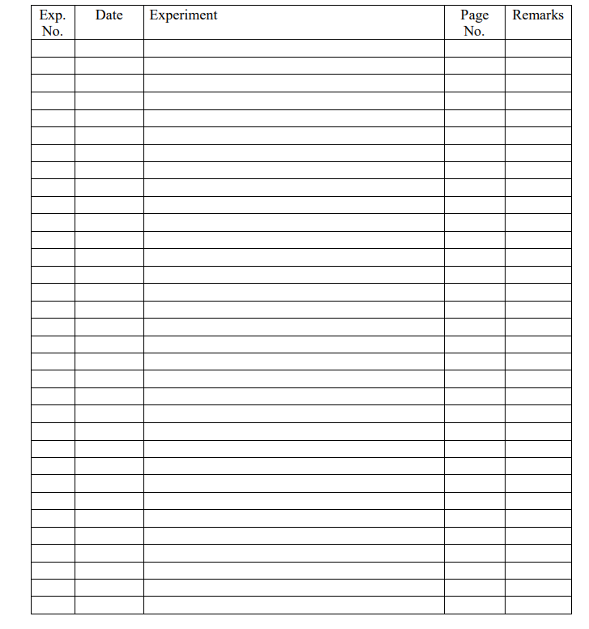
INDEX

