Slide 1

MS WORD exercises

Slide 2
Question 1.
Create and Design Admission/Enquiry Forms etc.
To create this kind of form, you need to use shapes, text boxes, colors, formatting options, tables, and horizontal lines in MS Word. This is a very good exercise to practice because it will give you an idea of how to use such options practically on various official documents that we use in our daily official life.
Example is shown on the next slide.
Reference Link:
to create a forms in ms word

Slide 3
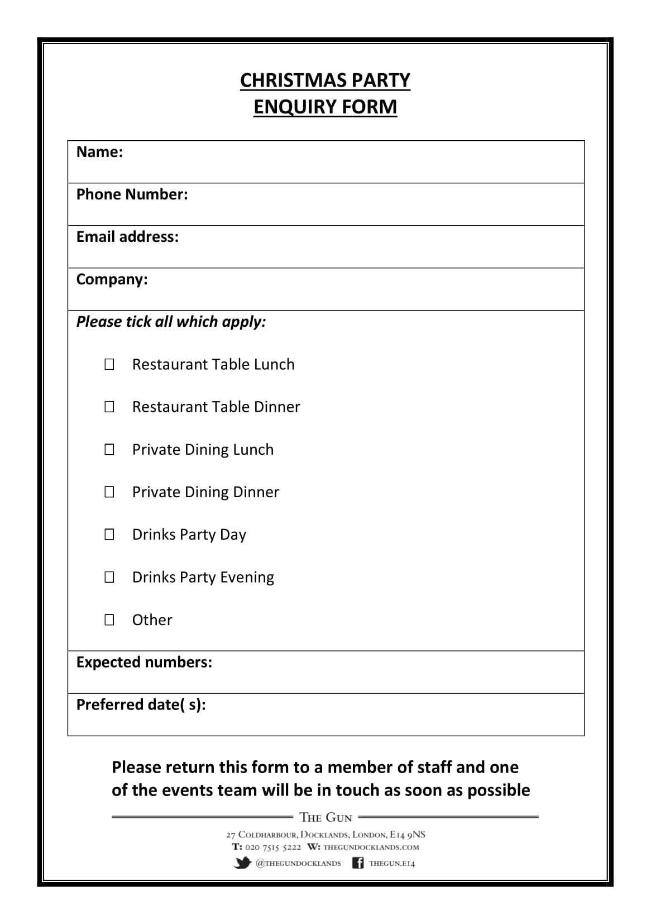

Slide 4

Question 2.
Create Business Cards using different Shapes, text, and colors in ms word.
Reference link:
Click here to see how to create a business card using different shapes ,text,and colors in ms word
Example:

Slide 5
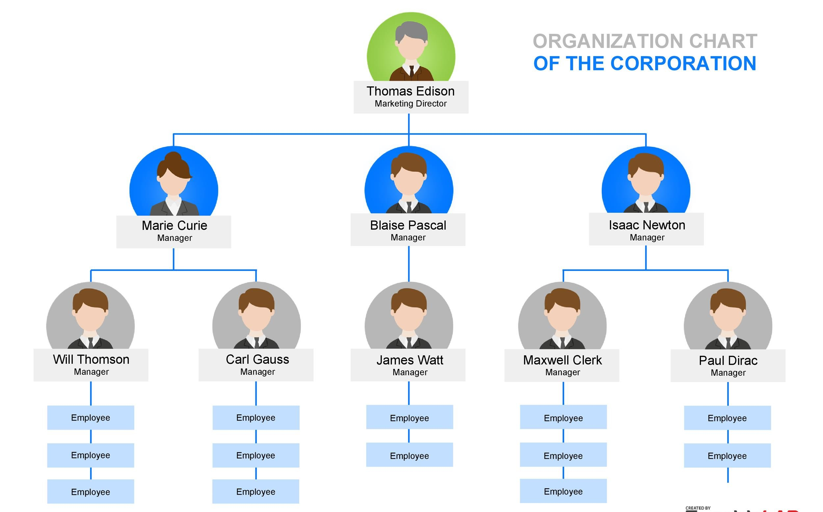
Question 3.
Use smart art and create organizational charts and showcase relations:
Smart Art is one of the favorite options in Microsoft Word. Smart art is used to draw diagrams that are used to showcase the content visually that will be easy to understand and manage. As you see below the smart art image Hierarchy Diagram is used to create an organizational chart or structure of the Telecom company.
Reference link :
How to create Organisational Charts in Ms word

Slide 6
Question 4.
Make book content page or index page ?
This is another idea in which you need to create an index or content page of the book. In this process, you will learn about the first-line indent, hanging indent, and the perfect use of the ruler bar in Microsoft Word.
And also about a page number, and a hyperlink (if it is an eBook).
EXAMPLE IS ALSO GIVEN ON THE NEXT SLIDE.
Reference link:
Click here to see how you can create a book content page or index page in ms word

Slide 7
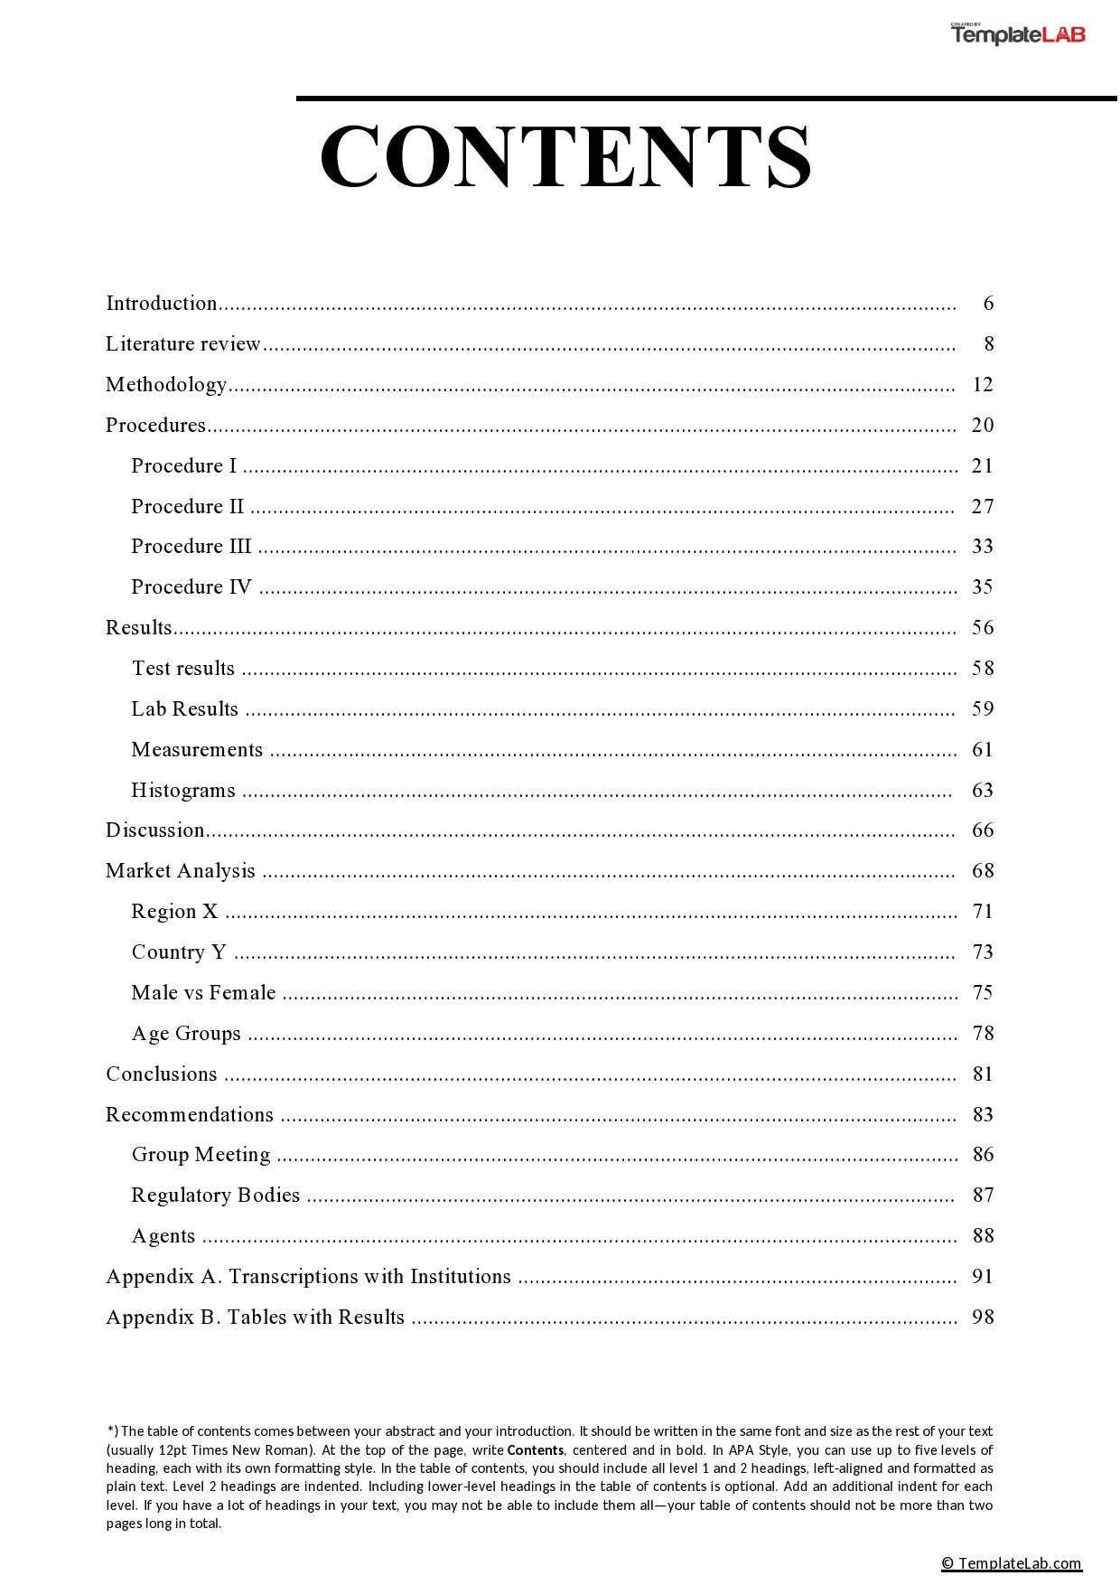

Slide 8
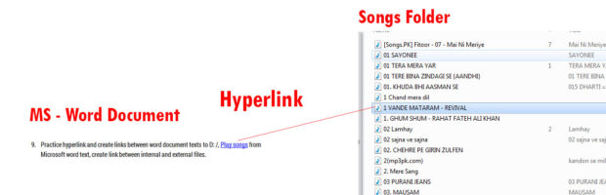
Quesition 5.
Practice hyperlinking and creating links between Word document texts to D: /, Play songs from Microsoft Word text, and create links between internal and external files?
This is the most important option in Microsoft Word. Most of the processes on the internet contain links. The hyperlink is the starting point in which you learn how things are connected with each other.
Reference link to create a Hyperlink in ms word..
Example:

Slide 9

Question 6.
Add a macro to your ms word file.Also add a watermark named “GEHU” in your document .
Reference link:
For macro:
link 1
For watermark:
link 1

Slide 10
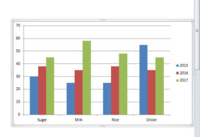
Question 7.
Create a chart and show the product price comparison between years:
The chart option is very important in Microsoft Word and Excel. However, the use of the chart option and any other option in MS Word depends on the demand for a certain content type.
For example, you’re writing a book or making notes about something in which you have to write and explain the price comparison between 3-4 years. Then you can use the chart for visualizations to analyze the data.
Reference link:
Charts in MS word

Slide 11

Question 8.
Take a double-column book or newspaper and design or create a similar paragraph style in the Word document.
find the newspaper similarly as you see below and create or type the text as you’re seeing in the newspaper. And if you’re having a problem, ask your teachers. So, when your teachers teach you how to do that thing or this thing, it will be great for your knowledge.
Reference links:
Link 1
Link 2

Slide 12

Question 10:
Insert Images and Practice on Format Menu and Image Options.
You can use image options and style to decorate, retouch, and adjustment of colors and brightness in MS Word. As you can see, I have created various styles and image effects. These are easy to create.

Slide 13
Exercise - Mail Merge (Letters)
1. Open your word processing application and type the following letter on a new blank page.
Gehu,bhimtal
Uttarakhand
Dear Participant
As you may be aware we have been running a variety of courses at the college
ranging from 1 week to 12 weeks. We are now happy to inform you that we are
introducing a number of 2-day courses, which will be held both at weekends and
mid-week to suit the varying needs of potential students.
Please find enclosed an application form and a program schedule. We look forward
to your participation.
Yours truly,
M C lohani
Course Director

Slide 14
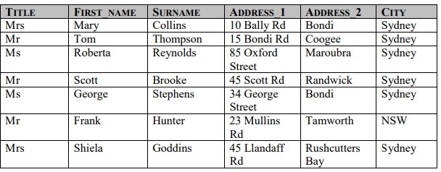
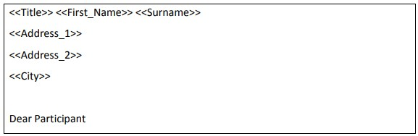
2. Save the letter as Course Letter.
3. Open a new blank document and create the table below.
4. Save the file as Course_Participant_Data.
5. Close the document.
6. Using the current document Course Letter as a form letter and the
Course_Participants_Data as the data source merge the two documents and
insert the merged fields Title, First_Name, Surname, Address and City fields
above Dear Participant in the letter, as shown below.
7. Save the mail merge document as Course2014.doc.
8. Save and close all open documents.

