Slide 1

MS EXCEL
EXERCISES

Slide 2
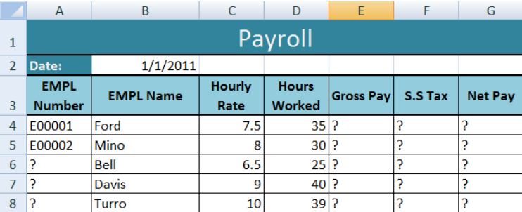
Exercise 1
Objectives:
Introduction to MS Excel files, Workbooks, Worksheets, Columns and Rows.
Formatting Worksheets.
AutoFill, Numeric formats, previewing worksheets.
Questions:
1. Open a new workbook and save the file with the name “Payroll”.
2. Enter the labels and values in the exact cells locations as desired.
3. Use AutoFill to put the Employee Numbers into cells A6:A8.
4. Set the columns width and rows height appropriately.
5. Set labels alignment appropriately.
6. Use warp text and merge cells as desired.
7. Apply borders, gridlines and shading to the table as desired.
8. Format cell B2 to Short Date format.
9. Format cells E4:G8 to include dollar sign with two decimal places. 10. Calculate the Gross Pay for employee; enter a formula in cell E4 to multiply Hourly Rate by Hours Worked.
11. Calculate the Social Security Tax (S.S Tax), which is 6% of the Gross Pay; enter a formula in cell F4 to multiply Gross Pay by 6%.
12. Calculate the Net Pay; enter a formula in cell G4 to subtract Social Security Tax from Gross Pay.
13. Set the work sheet vertically and horizontally on the page.
14. Save your work.

Slide 3
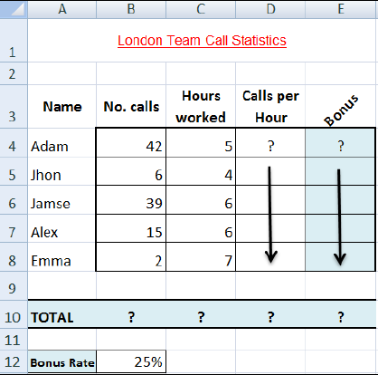
Exercise 2
Objectives:
Using Formulas.
Header and Footers.

Slide 4
Questions:
Open a new workbook and save the file with the name “Call Statistics”.
Delete Sheet 2 & 3, and rename Sheet 1 to (Call Statistics).
Enter the labels and values in the exact cells locations as desired.
Set the row height of rows 1 & 3 to size 30; and rows 4 until 10 to size 20.
Set labels alignment appropriately.
Use Warp Text, Orientation and merge cells as desired.
Apply border, gridlines and shading to the table as desired.
Format column E to include euro (€) sign with two decimal places.
Format cell B12 to include % sign with 0 Decimal places.
Calculate the Calls per Hour, enter a formula in cell D4 to divide numbers of calls by Hours worked. Using AutoFill, copy the formula to the remaining cells.
Calculate the Bonus. Enter a formula in cell E4 to multiply ‘Calls per Hours’ by the fixed Bonus Rate in cell B12. Using AutoFill, copy the formula to the remaining cells.
Calculate the ‘TOTAL’.
Set the worksheet vertically and horizontally on the page.
Create a header that includes your name in the left section, and your ID number in the right section. Create the footer that includes the current Date in the center.

Slide 5
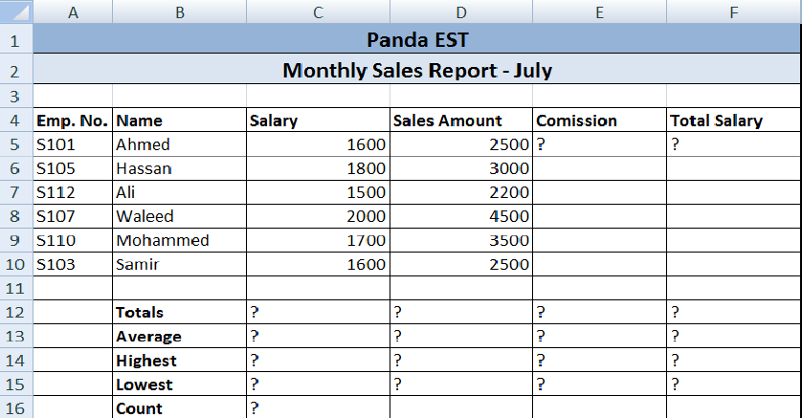
Exercise 3
Objectives:
Number, Commas and Decimal numeric formats.
Working with Formulas (Maximum, Minimum, Average, Count and Sum).
Percentage Numeric Formats.

Slide 6
Questions:
Create the worksheet shown above.
Set the column widths as follows: Column A: 8, Column B: 14, Columns C & D: 15, Columns E & F: 14.
Enter the formula to find COMMISSION for the first employee. The commission rate is 2% of sales, COMMISSION = SALES * 2% Copy the formula to the remaining employees.
Enter the formula to find TOTAL SALARY for the first employee where:
TOTAL SALARY = SALARY + COMMISSION
Copy the formula to the remaining employees.
Enter formula to find TOTALS, AVERAGE, HIGHEST, LOWEST, and COUNT values.
Copy the formula to each column.
6. Format numeric data to include commas and two decimal places.
7. Align all column title labels horizontally and vertically at the center.
8. Create a Header that includes your name in the left section, page number in the
center section, and your ID number in the right section.
9. Create footer with DATE in the left section and TIME in the right section.
10. Save the file with name Exercise 3

Slide 7
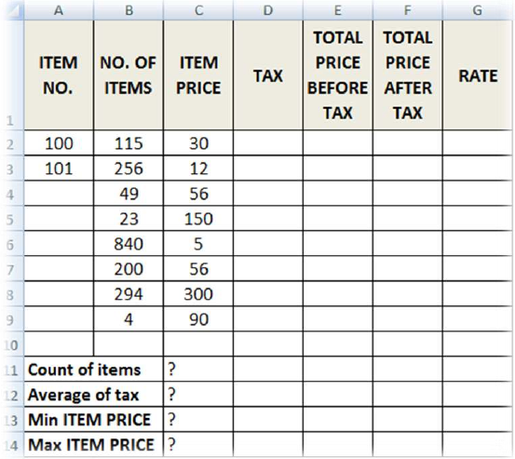
Exercise 4
Objectives:
Working with the IF Statement.

Slide 8
Questions:
For the above table find the following:
1. TAX (If ITEM PRICE is less than 100, TAX is 50, otherwise it should be 100).
2. TOTAL PRICE BEFORE TAX =NO. OF ITEMS * ITEM PRICE.
3. TOTAL PRICE AFTER TAX = TOTAL PRICE BEFORE TAX + TAX.
4. RATE (If TOTAL PRICE AFTER TAX > 3500 then the rate is “HIGH”, otherwise it is
REASONABLE.
5. Find Count of Items, Average of Taxes, Min Item PRICE and Max Item PRICE.
6. Save file as Exercise 4.

Slide 9
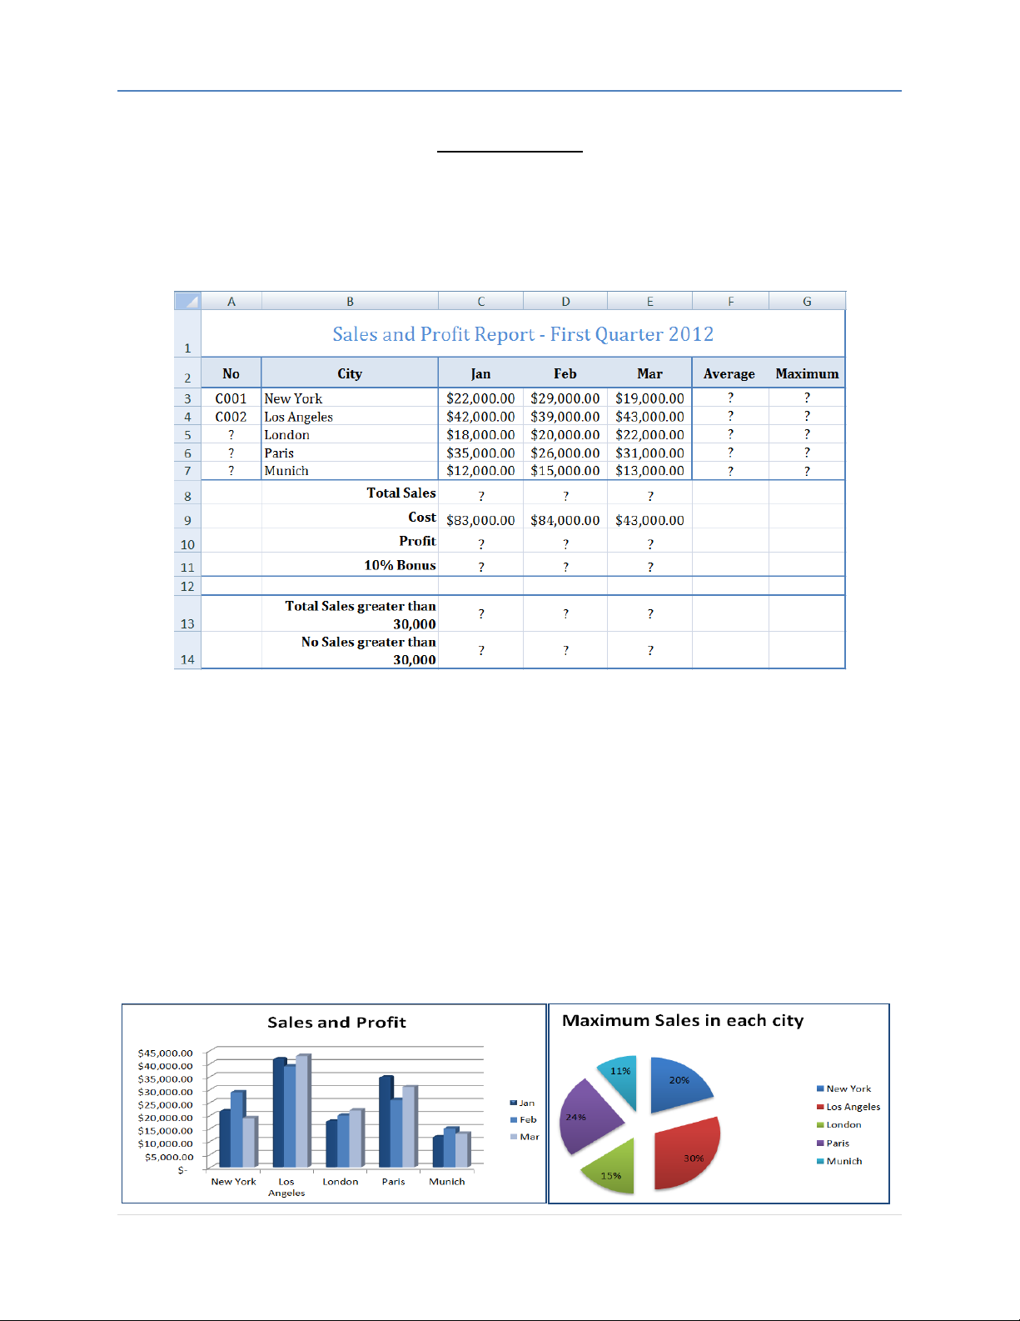
Exercise 5
Objectives:
Working with Sum IF and Count IF statements.
Inserting Charts.

Slide 10
Questions:
1. Create the worksheet shown above.
2. Set the Text alignment, Columns width and high appropriately.
3. Use AutoFill to put the Series Numbers into cells A5:A7.
4. Format cells C3:G7, C8:E11, C13:E13 to include dollar sign with two decimal places.
5. Find the Average Sales and Maximum Sales for each City.
6. Find the Total Sales for each Month.
7. Calculate the Profit for each month , where profit = Total Sales – Cost
8. Calculate the 10% Bonus, which is 10% of the Profit.
9. Find the Total Sales for each Month; only for sales greater than 30,000.
10. Find the No of Sales for each Month; only for sales greater than 30,000.
11. Create the following Charts:

Slide 11
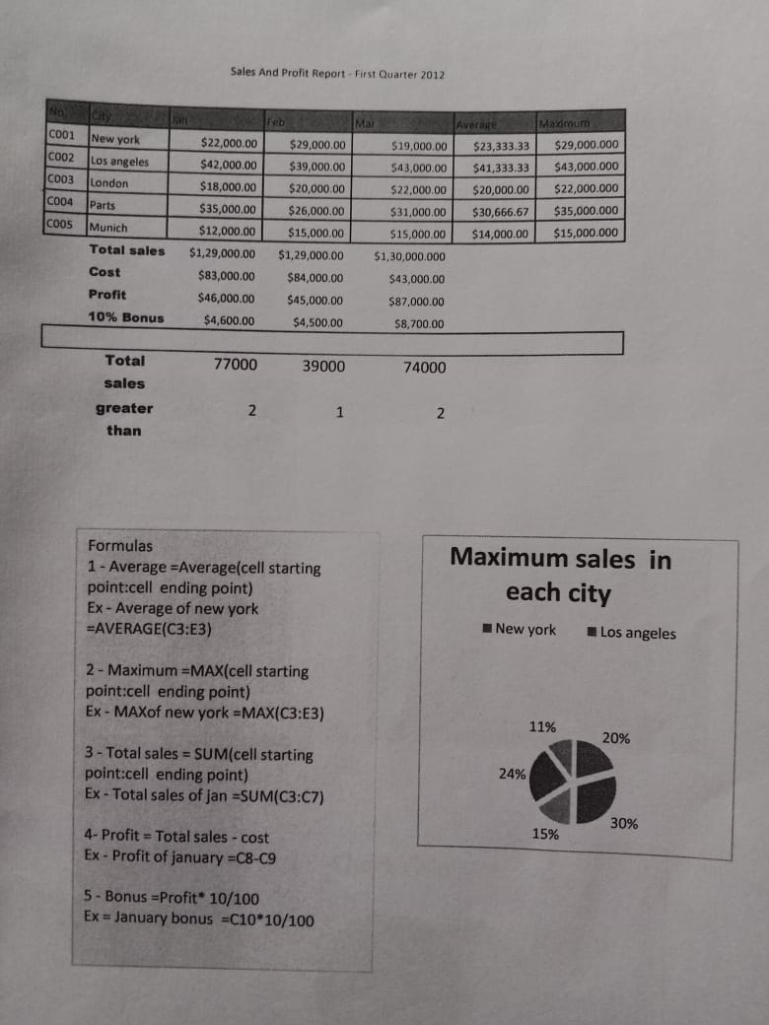
Example of a
MS Excel solution

Slide 12

Ms Powerpoint

Slide 13
Question:
Create a powerpoint presentation of any one topic using different slide layouts,Inserting text ,Word art,Formatting text,bullets and Numbering ,Auto Shapes ,Lines and arrows ,Hyperlinks.
Inserting –Images,Clip art,Audio,Video,Objects etc
Introduction to computers and Basic computer Organisation
Roles of input /output devices in a computer system
Computer storage and Software
Operating System
Programming Languages

Slide 14

Dos
Exercises

Slide 15
Admin
Geu
Gehu
Bca
Btech
Bca
Btech
sem
sub
sem
sub
sem
sub
sem
sub
1.txt
1.txt
1.txt
1.txt
2.txt
2.txt
2.txt
2.txt
3.txt
3.txt
3.txt
3.txt

Slide 16
Questions:
1. Create the tree structure of the folders using Dos commands
2. On Admin/ geu/ bca/sub create three new files named fit.txt,fcp.txt,math.txt
3. Move 1.txt from Admin/ geu/bca/sem to Admin/ gehu/btech/sub
4. Move 1.txt from Admin/gehu/bca/sem to Admin/ geu/bca/sem
5.Copy 2.txt from Admin/gehu/btech/sem to Admin/ gehu/ btech/sub folder
6.Delete all the files from Admin/gehu/btech/sem
7.Hide all the files from Admin/geu/btech/sem
8.Rename folder Admin With your name
9.Print current date in command prompt
10.Add text “I am a BCA student” to the file 2.txt
Of Admin/gehu/bca/sem

Slide 17
Thank
You

