Slide 1
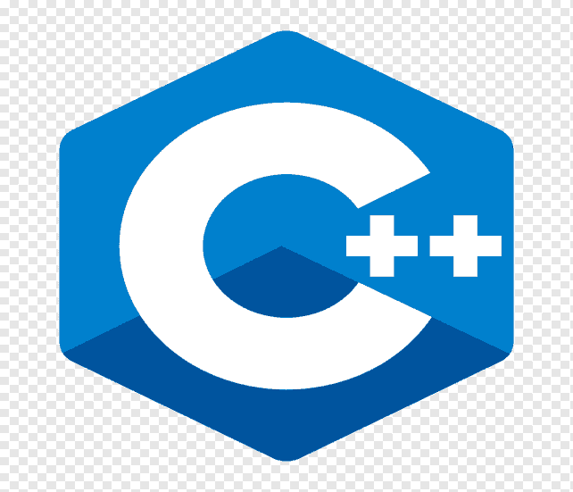
Introduction
to C++
Created By
Khushbu Rawat
Course - BCA
Section - ‘A’

Slide 2
History of C++
The name C++ was created by Rick Mascitti and was first used in December of 1983.
Stroustrup worked on “C” in 1979 .
Wanted to develop a language to enhance software development.
He chose “C” because it is general –purpose , fast and portable.
He later enhanced “C” and it became C++.

Slide 3
Uses of C++ Language
C++ is used by programmers to develop computer software .
It is used to create general system software.
Used to build drivers for various computer devices.
Software for servers and software for Specific applications.
Used in the creation of video games.

Slide 4
Advantages of C++
C++ language is efficient having less compiled time.
It is much suitable for large projects.
The properties of inheritance make simple the program by complexity. Do not required to write again.
C ++ programming is implemented on real life scenario.
C++ language is efficient having less compiled time.
C++ programming is easy to maintain and modify existing code as new objects with small difference to existing ones.

Slide 5
Disadvantages of C++
Complex in very large high level program.
C++ can’t support garbage collection.
C++ is not secure because it have pointer , friend function ,and global variable.
When C++ used for web applications complex and difficult to debug.

Slide 6
Basic Syntax Of C++ Programming Language
#include<iostream>
using namespace std;
//main() is where program execution begins.
int main(){
cout<<“Hello world”; //prints Hello world
return 0;
}

Slide 7
cout<<“THANKYOU”;

