Slide 1
Travel Optimizer:A Comparitive Study to find the Optimal Path

Slide 2


Slide 3
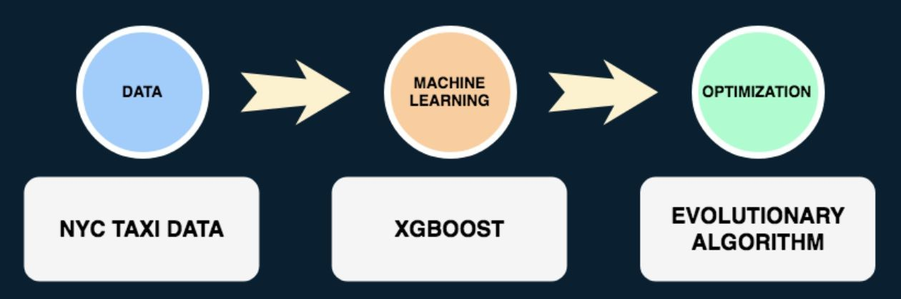

Slide 4
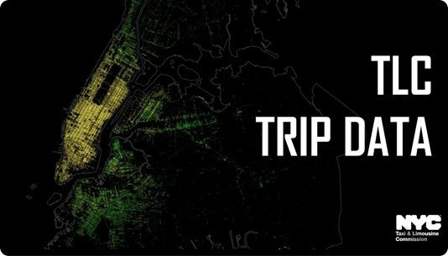
NYC Taxi and Limousine Commission Trip Record
1.5 Million Trips
Year 2016
11 Attributes:
Id
Vendor_id
Pickup_datetime
Dropoff_datetime
Passenger_count
Pickup_longitude
Pickup_latitude
Dropoff_longitude
Dropoff_latitude
Store_and_fwd_flag
Trip_duration

Slide 5
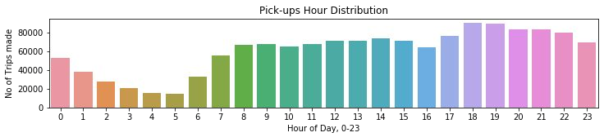
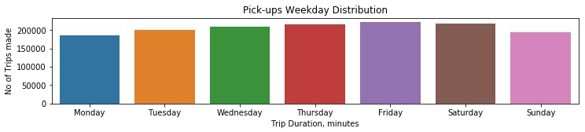
Pick-Up Times

Slide 6
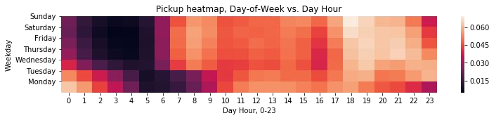
Pick-Up Times

Slide 7
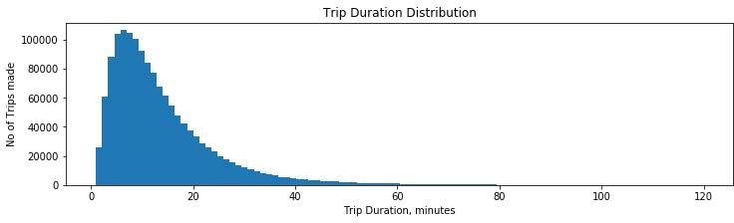
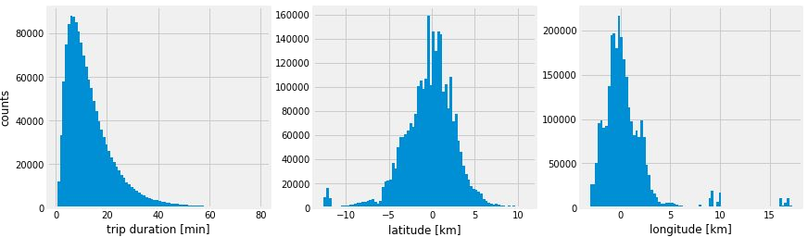
Trip Duration

Slide 8
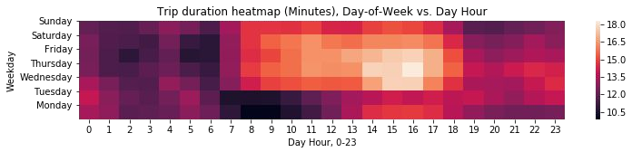
Trip Duration

Slide 9
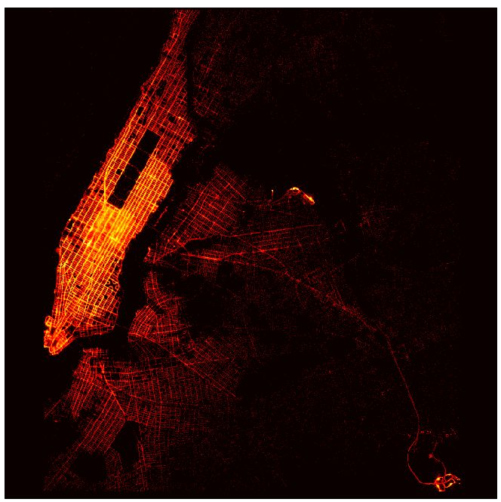
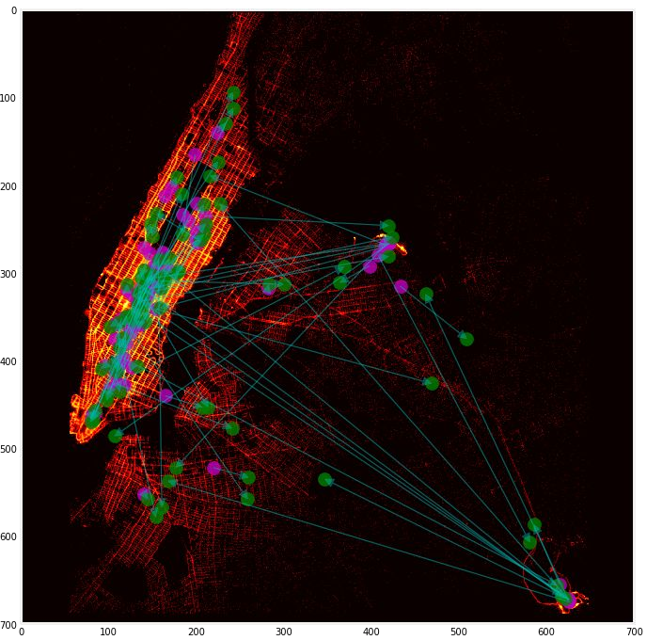
Pickup and Dropoff Locations

Slide 10
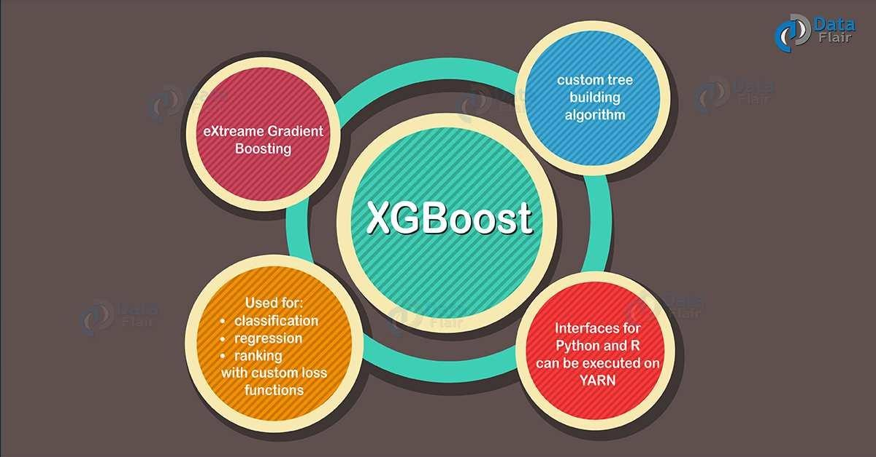
Machine Learning
Features: passenger_count, pickup_longitude, pickup_latitude, dropoff_longitude, dropoff_latitude, store_and_fwd_flag
Target: trip_duration
XGBoost’s Hyperparameters:
Learning_rate = 0.05
Max_depth = 14
Subsample = 0.9
Silent = 1
Feval = rmsle

Slide 11
Proposed Solutions
Ant Colony & Genetic Evolution Optimization

Slide 12
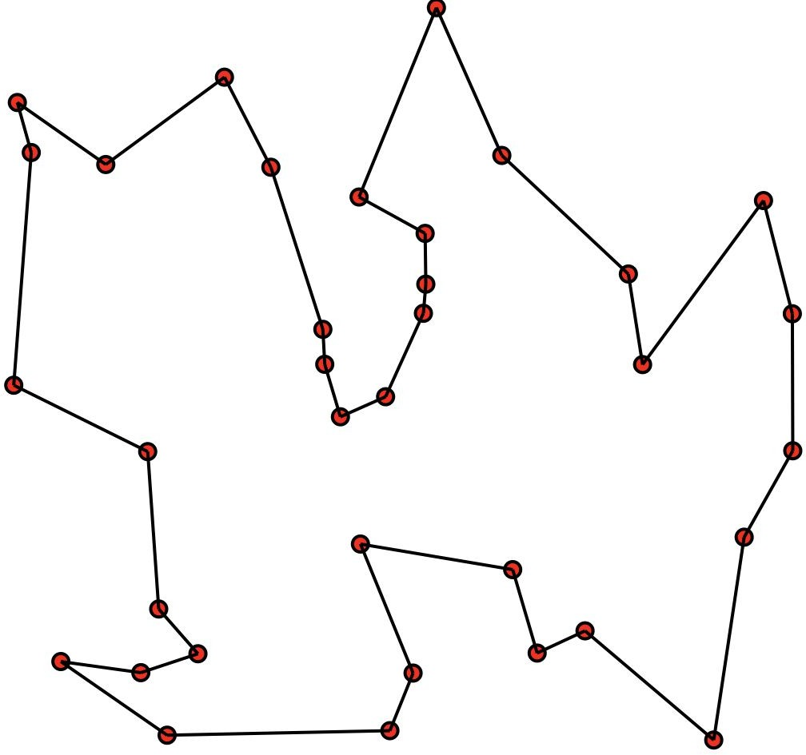
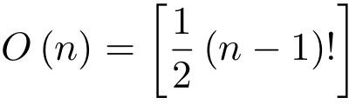
Traveling Salesman Problem (TSP)

Slide 13
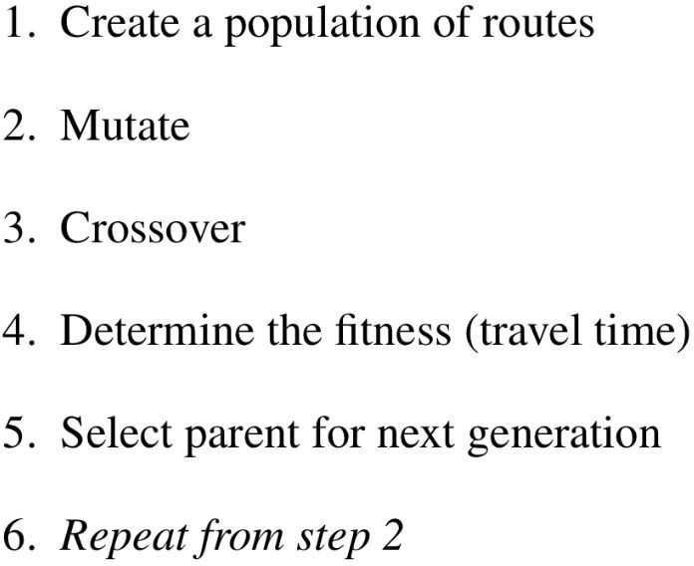

Genetic Evolution Optimization

Slide 14
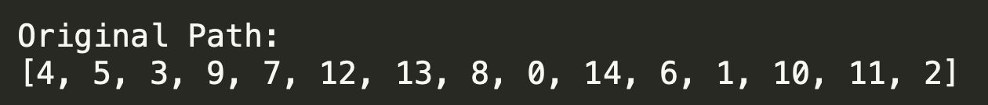
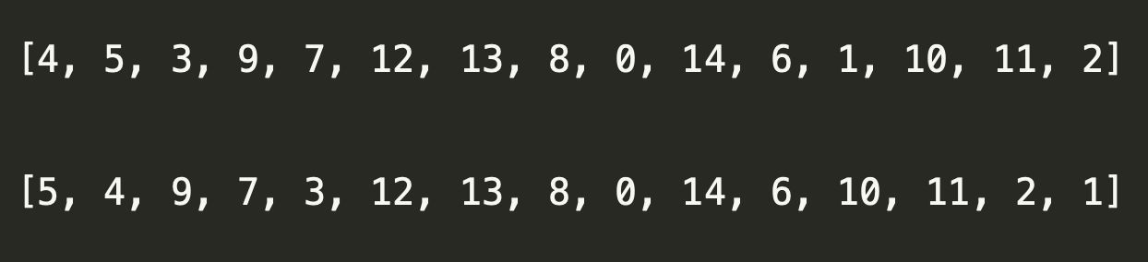
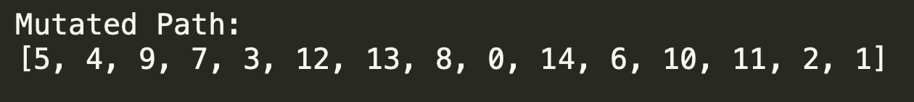
Mutation

Slide 15
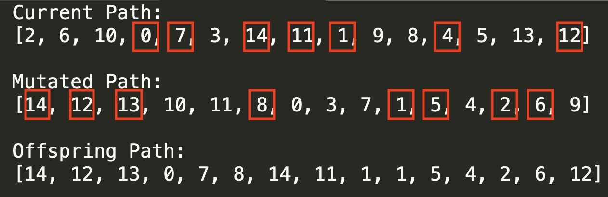
Crossover

Slide 16
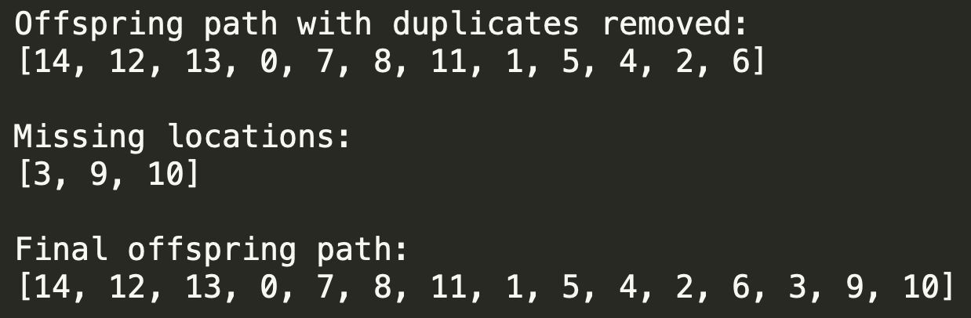
Crossover

Slide 17
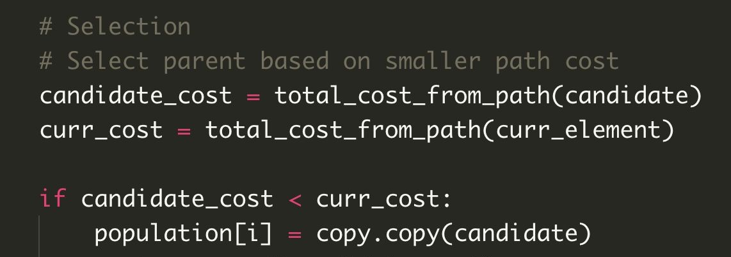
Evaluate Fitness

Slide 18
Experimental Results

Slide 19
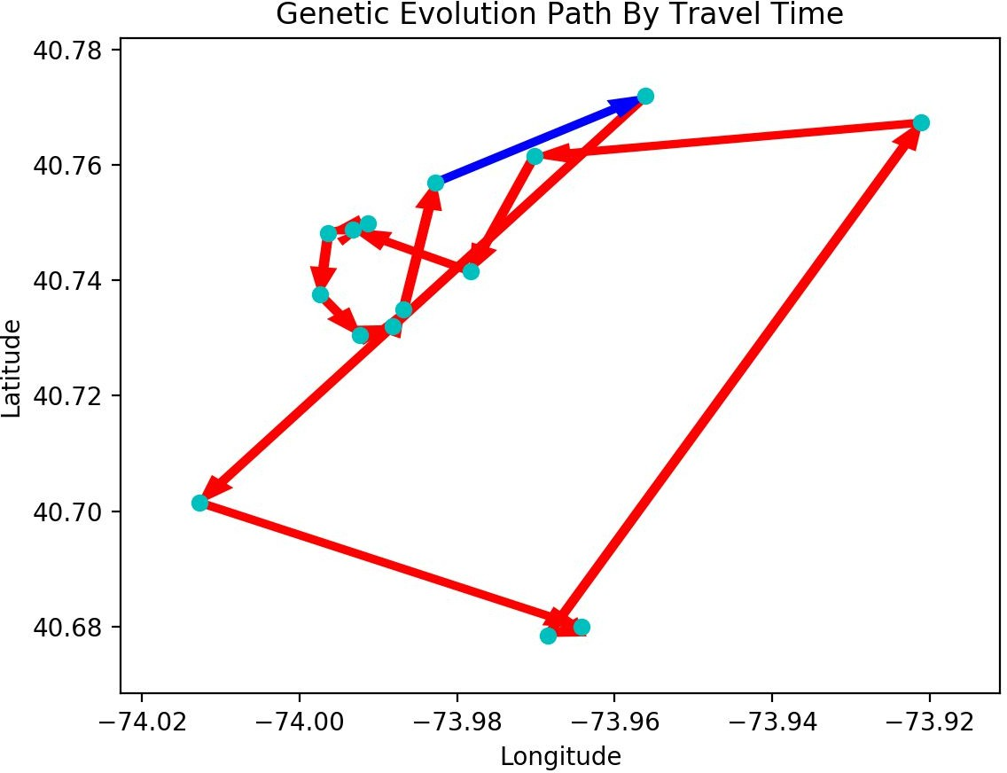
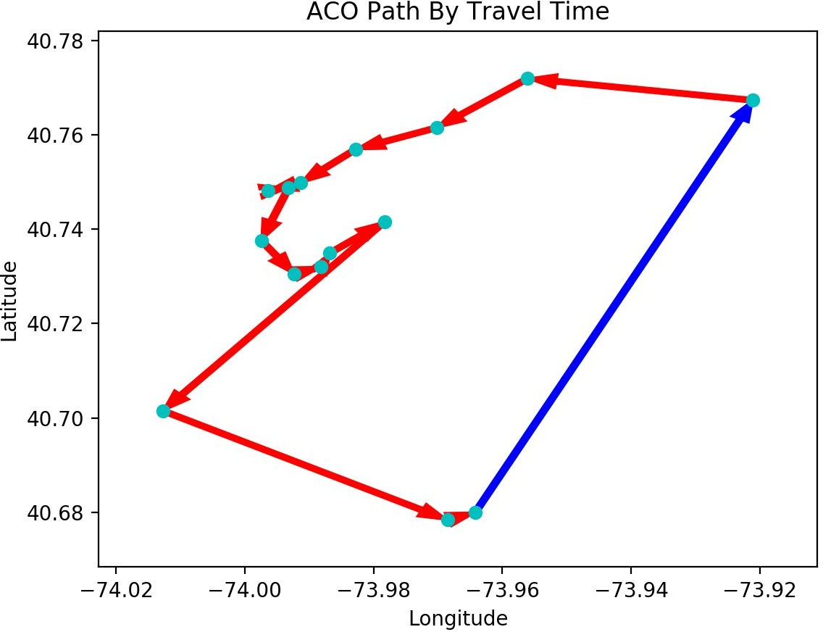
Generated Optimal Paths

Slide 20
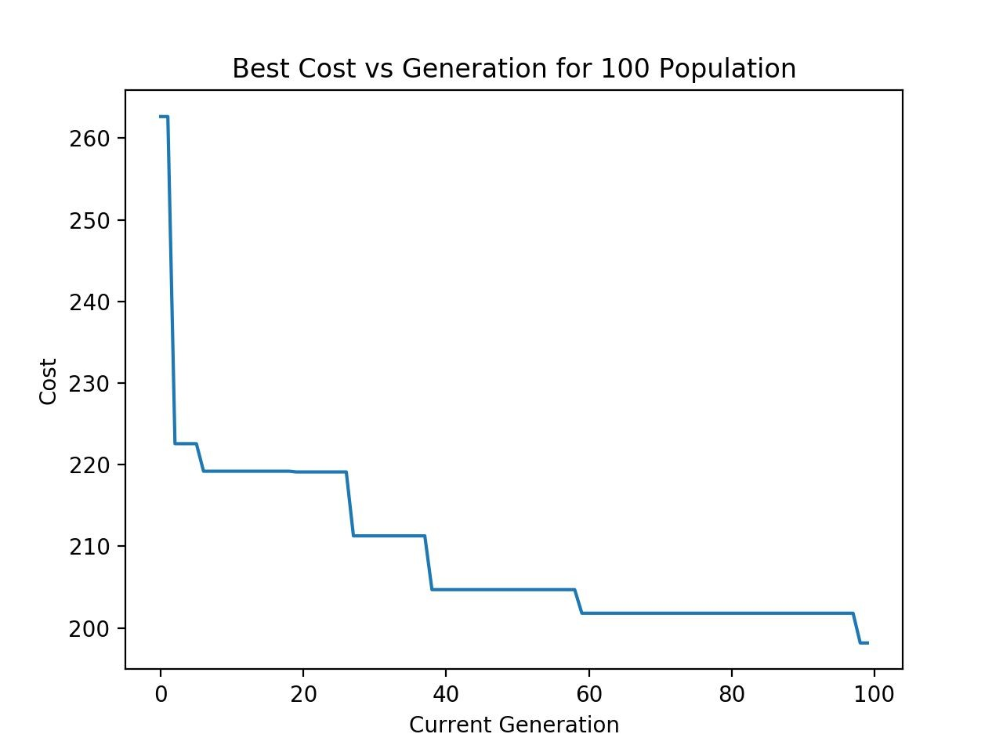
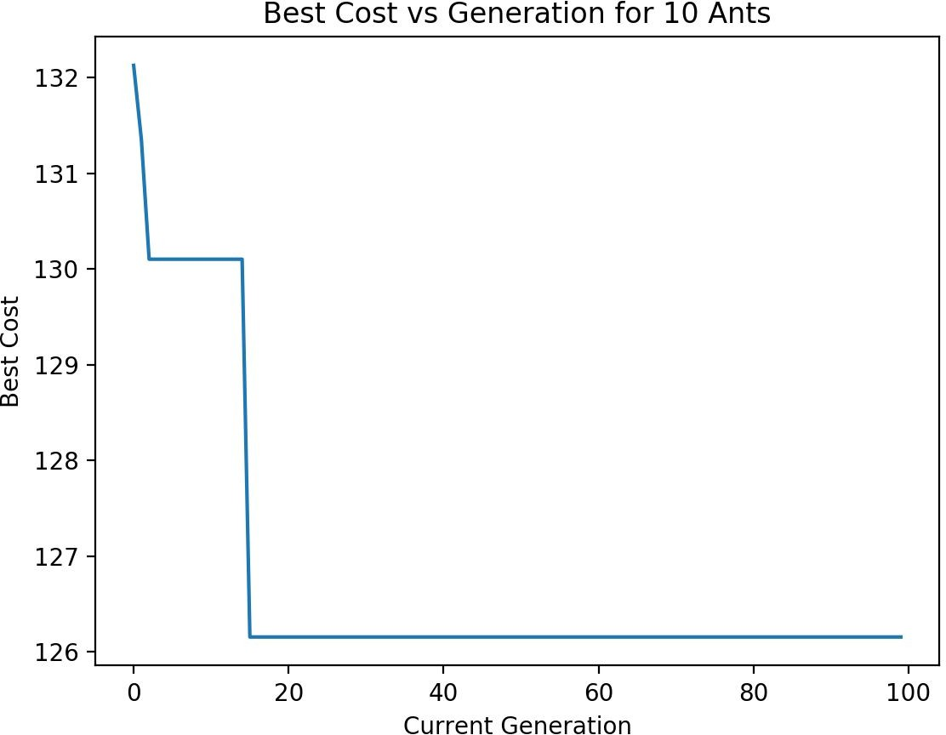
Optimal Cost Per Generation

Slide 21
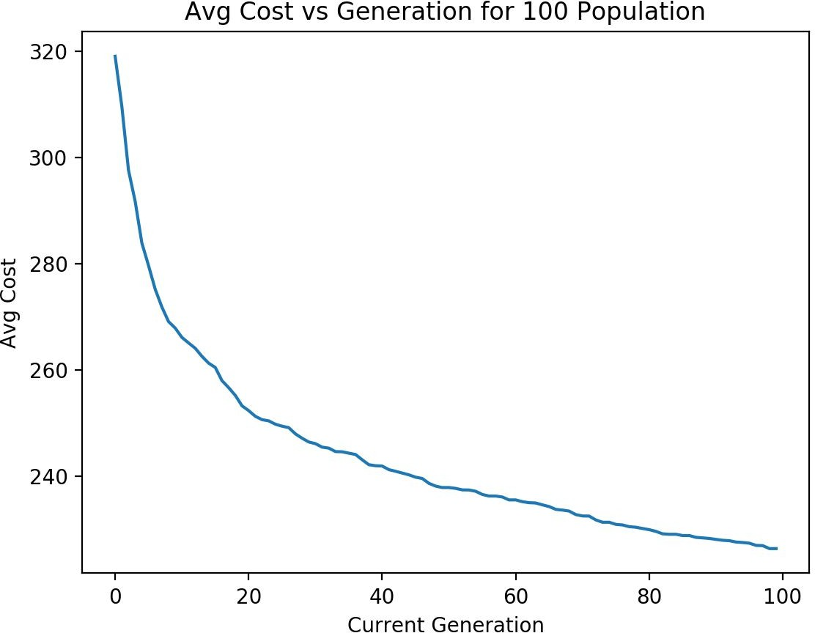
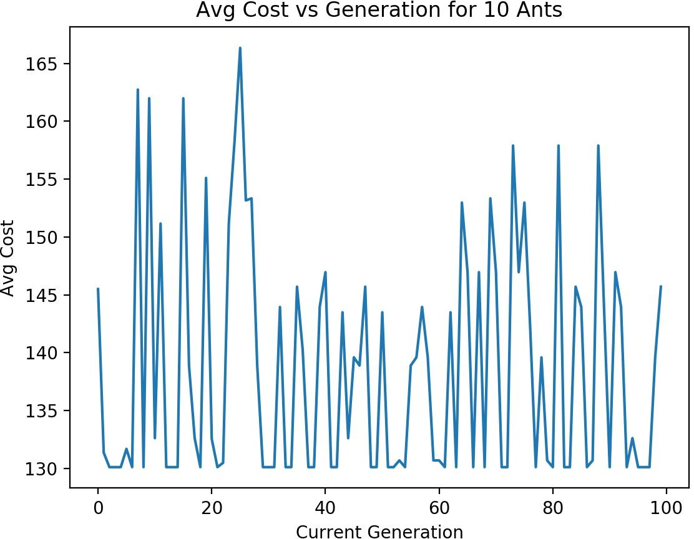
Average Cost Per Generation

Slide 22
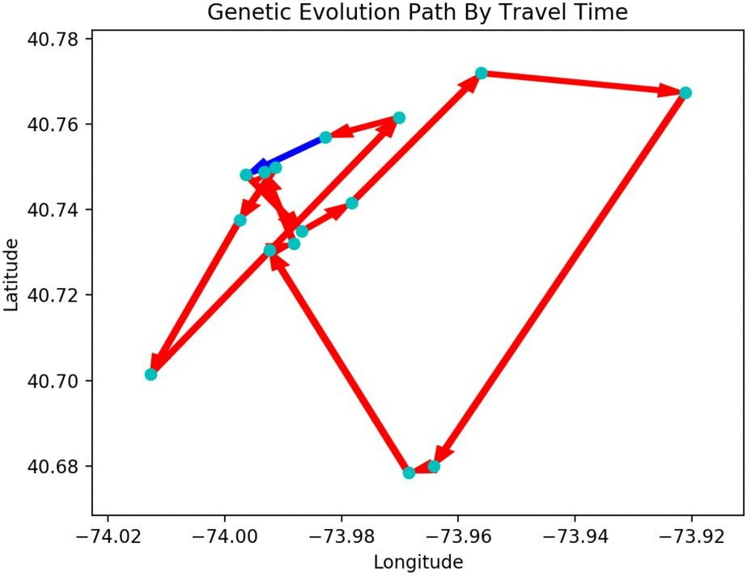
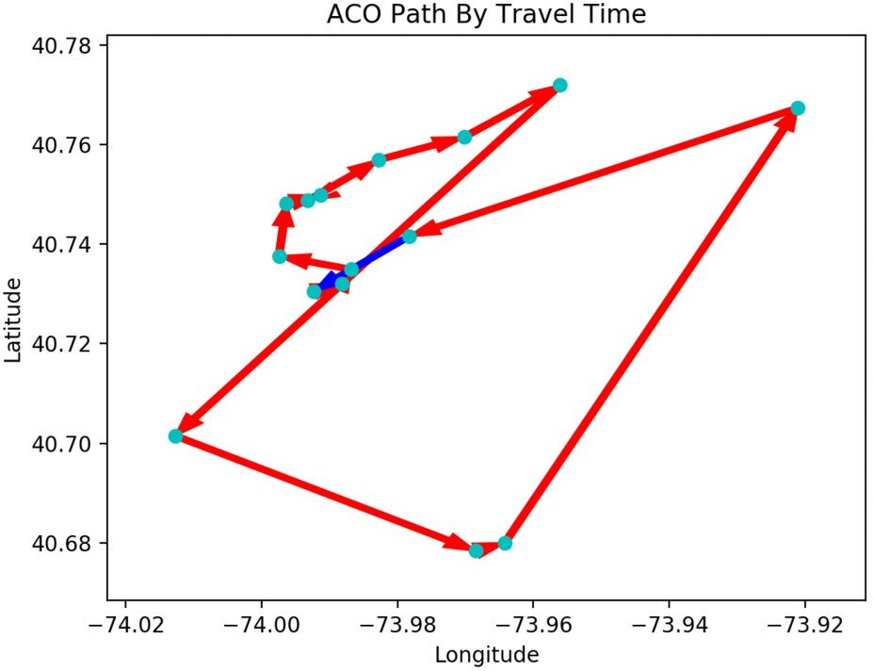
Generated Paths

