Slide 1
MedGuardian
AI-Assisted Early Disease Detection System
B.Sc. Computer Science — Final Year Project
[Your Full Name] | [Guide Name] | [College Name] | [2024 – 2025]

Slide 2
Agenda
Introduction & Problem Statement
Objectives & Scope
System Architecture
Key Modules
Technology Stack
Risk Score Formulae
Datasets & Sample Reports
Demo & Results
Deployment (Git & Streamlit Cloud)
Limitations & Future Work
Conclusion

Slide 3
1. Introduction
Chronic conditions (diabetes, hypertension, cholesterol) need early risk detection
Lab reports are PDFs — text-based or scanned
Manual data entry is tedious and error-prone
MedGuardian automates extraction and risk computation

Slide 4
2. Problem Statement
Extract biomarker values from PDF lab reports
Support both text-based and scanned PDFs (OCR)
Compute standardised risk scores for diabetes, BP, cholesterol
Track trends over time
Data stored in SQLite on deployment server (no third-party analytics)

Slide 5
3. Objectives
Build a Streamlit web app for early disease detection
Parse PDFs with pdfplumber + Tesseract OCR fallback
Use regex to extract glucose, HbA1c, BMI, BP, cholesterol
Apply clinical formulae (ADA, JNC 8, ACC/AHA)
Provide gauges and trend charts (Plotly)

Slide 6
4. System Architecture
┌─────────────────┐ ┌──────────────────┐ ┌─────────────┐ │ Streamlit UI │────▶│ Services / │────▶│ SQLite │ │ (5 pages) │ │ Models │ │ Database │ └─────────────────┘ └──────────────────┘ └─────────────┘ │ │ │ PDF Upload │ Risk Scores ▼ ▼ ┌─────────────────┐ ┌──────────────────┐ │ PDF Parser + │ │ Diabetes / BP / │ │ OCR │ │ Cholesterol │ └─────────────────┘ └──────────────────┘

Slide 7
5. Key Modules
Module | Function
Auth | Session-based login, SHA-256 password hash
Patient Profile | CRUD for patients
Upload Report | PDF → text → biomarkers → health record
Risk Dashboard | Compute & display risk scores
History | Trend charts for biomarkers & risk

Slide 8
6. Risk Score Formulae
Diabetes (0–100%): - 0.4×glucose_dev + 0.4×hba1c_dev + 0.1×BMI_mod + 0.1×family_history - Ranges: 0–20% Low, 21–50% Moderate, 51–100% High
Blood Pressure: JNC 8 / ACC-AHA 2017
Cholesterol: ACC/AHA 2018 (<200, 200–239, ≥240 mg/dL)

Slide 9
7. Technology Stack
Python 3.10+, Streamlit
SQLite (on deployment server)
pdfplumber, PyMuPDF, pytesseract, Pillow
Plotly, pandas, numpy

Slide 10
8. Datasets & Sample Reports
sample_patients.csv — 15 demo patients (aligned with report metadata)
sample_health_records.csv — 15 health records (one per patient)
15 PDF lab reports from 5 laboratories (Care Diagnostics, Apollo, Thyro Lab, Metropolitan, Sunrise)
Age groups: 24–70 yrs (young adult to senior)
Risk profiles: 5 low, 5 moderate, 5 high
Load sample data from Home page when DB empty; Reset & reload when needed

Slide 11
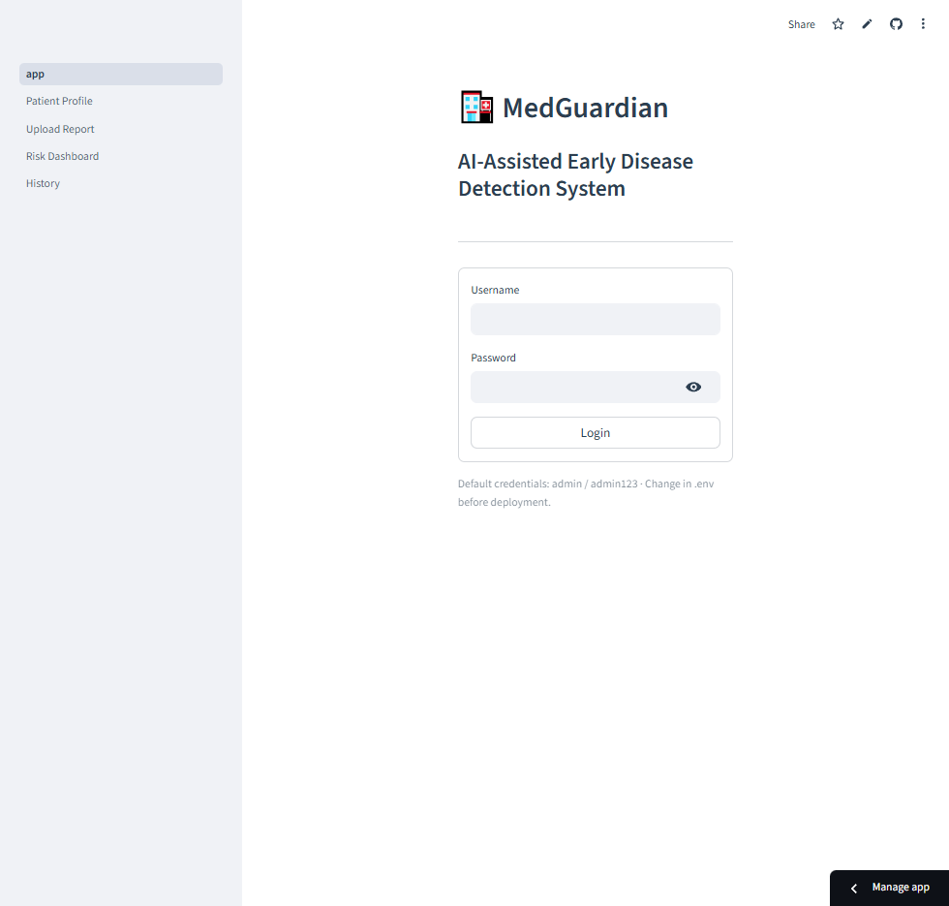
9. Demo & Results
Patient profile creation and CRUD
PDF upload → text extraction (pdfplumber / OCR)
Biomarker parsing and user verification; Save Health Record → status: pending → processed
Risk dashboard with gauge charts
History: risk trends, biomarker trends, uploaded reports (status: processed / pending / failed)
Sample data loader (15 patients, 15 records) for empty DB
Login

Slide 12
10. Deployment (Git & Streamlit Cloud)
Git upload: git init → git add . → git commit → git remote add origin → git push -u origin main
Streamlit Cloud: Push to GitHub → share.streamlit.io → Create app → Select repo, main file path (MedGuardian_Project/app.py) → Add secrets (ADMIN_PASSWORD_HASH) → Deploy. App runs at https://<name>.streamlit.app

Slide 13
11. Limitations
Tesseract must be installed separately; not available on Streamlit Cloud
Single admin user; no multi-tenancy
Regex may not cover all lab report formats
No EHR/LIS integration
Ephemeral DB on Streamlit Cloud; load sample data after each cold start

Slide 14
12. Future Work
More biomarkers (triglycerides, LDL, HDL, creatinine)
Multi-user roles (admin, clinician, patient)
Export reports to PDF
Integration with lab information systems
Mobile responsiveness

Slide 15
13. Conclusion
MedGuardian delivers an AI-assisted early disease detection system that: - Parses PDF lab reports (text + OCR) - Extracts biomarkers automatically - Detects early disease risk (diabetes, hypertension, cholesterol) - Stores data in SQLite on deployment server - Provides gauge charts and trend visualisation - Supports 15 sample reports from 5 laboratories
Thank You

Slide 16
Q & A
Contact: [Your Full Name] Roll No: [Your Roll No] Guide: [Guide Name]

