Slide 1

Introduction to Spring Framework

Slide 2

Content
What is Spring Framework?
Key features of Spring Framework
Dependency Injection and Inversion of Control
Aspect Oriented Programming
Spring Modules
Advantages of using Spring Framework

Slide 3
Spring Framework history(1)
the first version was written by Rod Johnson
Expert One-on-One J2EE Design and Development
first released in June 2003
milestone releases in 2004 and 2005
awards
Jolt productivity award
JAX Innovation award

Slide 4
Spring Framework history(2)
Spring 5.0(released September 28, 2017)
Spring 4.0 (released December 2013)
Spring 3.0 (released Dec 2009)
Java 1.5+
REST support, SpEL, more annotations, JavaConfig
Spring 2.5 (released Nov 2007)
Java 1.4+
XML namespaces, annotations
Spring 2.0 (released Oct 2006)
Java 1.3+
AspectJ support, JPA

Slide 5
Goals
make J2EE easier to use
make the common tasks easier
promote good programming practice
you can focus on the domain problems

Slide 6
What is Spring Framework today?
an open source application framework
a lightweight solution for enterprise applications
non-invasive (POJO based)
is modular
extendible for other frameworks
de facto standard of Java Enterprise Application

Slide 7
What is Spring Framework?
Spring is the most popular application development framework for
enterprise Java.
Open source Java platform since 2003.
Spring supports all major application servers and JEE standards.
Spring handles the infrastructure so you can focus on your application.

Slide 8
The Spring projects
Spring MVC
Spring Social
Spring WebFlow
Spring Batch
Spring Security
Spring Framework
Spring Data
Spring Integration
Spring
Web Services
And
…

Slide 9
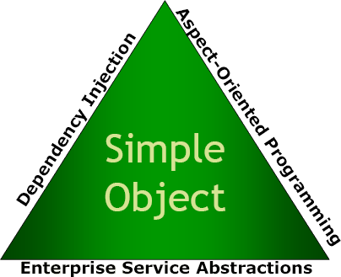
The Spring triangle

Slide 10
Dependency Injection
Introduction to Concept
The technology that actually defines Spring (Heart of Spring).
Dependency Injection helps us to keep our classes as indepedent as possible.
Increase reuse by applying low coupling
Easy testing
More understandable

Slide 11
Dependency Injection
Introduction to Concept
An injection is the passing of a dependency (a service) to a dependent object (a client).
Passing the service to the client, rather than allowing a client to build or find the service, is the fundamental requirement of the pattern.
“Dependency injection is a pattern where the container passes objects by name to
other objects, via either constructors, properties, or factory methods.”

Slide 12
Dependency Injection
Relationship Between DI and Inversion of Control
In software engineering, inversion of control (IoC) describes a design in which custom- written portions of a computer program receive the flow of control from a generic, reusable library.
The Inversion of Control (IoC) is a general concept, and it can be expressed in many different ways and dependency Injection is merely one concrete example of Inversion of Control.

Slide 13
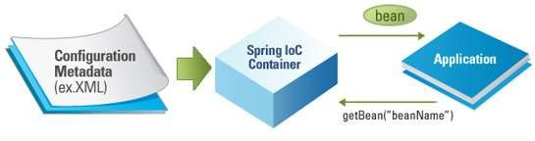
Dependency Injection
IoC Container
The Spring container (IoC Container) is at the core of the Spring Framework.
The container will create the objects, wire them together, configure them, and manage their complete lifecycle from creation till destruction.

Slide 14
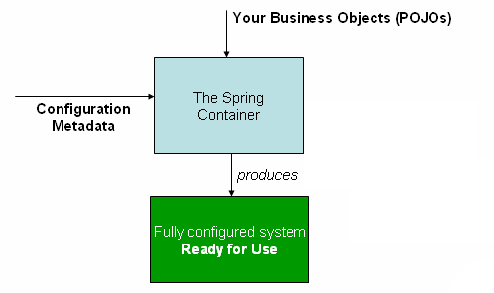
Dependency Injection
IoC Container
The container gets its instructions on what objects to instantiate, configure, and assemble by reading configuration metadata provided.
The configuration metadata can be represented either by;
XML,
Java annotations,
Java code.

Slide 15
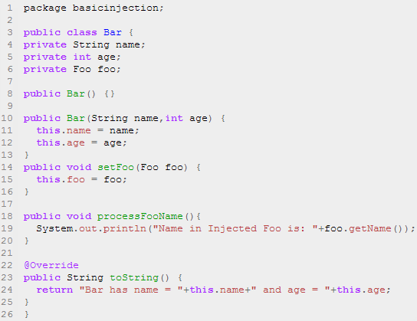
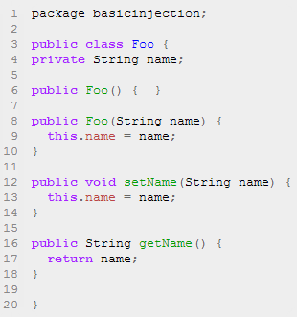
Dependency Injection
Code Example
To instantiate the above classes, one way is to do the usual new operator like new Foo() or new Bar() OR we can use the Spring dependency injection to instantiate these classes and set the properties accordingly.

Slide 16
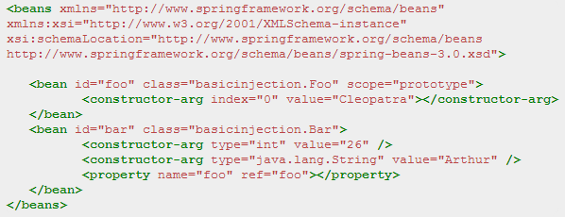
Dependency Injection
Code Example
Foo f = new Foo("Cleopatra");
Bar b = new Bar("Arthur",26);
b.setFoo(f);

Slide 17
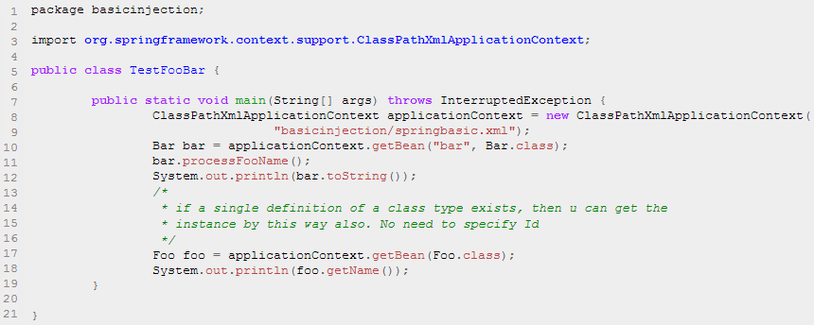
Dependency Injection
Code Example
Spring's ClassPathXmlApplicationContext is the commonly used object that hold the information of all the beans that it instantiates.

Slide 18
Constructor-based DI
is accomplished by the container invoking a constructor with a number of arguments, each representing a dependency
calling a static factory method with specific arguments to construct the bean is nearly equivalent

Slide 19
Constructor argument resolution
argument resolution
<bean id="b1" class="org.examples.ClientServiceBean">
<constructor-arg ref="b2"/>
<constructor-arg ref="b3"/>
</bean>
argument type matching
<bean id="b2" class="ClientService" factory-method="getInstance">
<constructor-arg type="int" value="7500000"/>
<constructor-arg type="java.lang.String" value="42"/>
</bean>
argument index
<bean id="b3" factory-bean="factory" factory-method="getInstance"/>
<constructor-arg index="0" value="75"/>
<constructor-arg index="1" value="42"/>
</bean>

Slide 20
Setter-based DI
is accomplished by the container calling setter methods on your beans after invoking a no- argument constructor or no-argument static factory method to instantiate bean

Slide 21
Constructor vs setter
constructor
mandatory dependencies
immutability
setter
optional dependencies and default values
obvious names
auto inheritance

Slide 22
Spring static factory-method
Spring framework, if you want to create a bean by invoking a static factory-method,
whose purpose is to encapsulate the object-creation process in a
static method then you could use factory-method attribute.
<bean id="manager" class="com.bean.factory.EmployeeFactory"
factory-method="createEmployeeOfType">
<constructor-arg value="manager" />
</bean>
<bean id="director" class="com.bean.factory.EmployeeFactory"
factory-method="createEmployeeOfType">
<constructor-arg value="director" />
</bean>

Slide 23
Bean Scopes
Singleton (default scope)
Instantiated on context startup
Only one instance exists during application lifetime
Prototype
Instantiated on demand
There may be as many instances as was requested
Web-aware Scopes
Request
Session
Global session
Custom Scopes

Slide 24
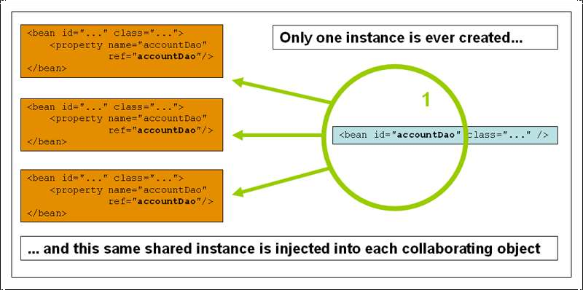
Dependency Injection
Bean Scopes
Scope | Description
Singleton | (Default) Scopes a single bean definition to a single object instance per Spring IoC container.
Prototype | Scopes a single bean definition to any number of object instances.
The Singleton scope

Slide 25
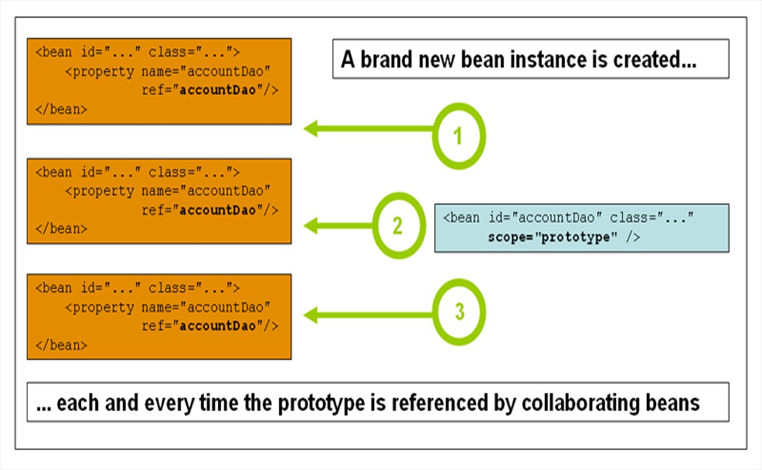
The prototype scope

Slide 26
Spring - Java Based Configuration
Java-based configuration option enables you to write most of your Spring configuration without XML but with the help of few Java-based annotations.
@Configuration & @Bean Annotations
Annotating a class with the @Configuration indicates that the class can be used by the Spring IoC container as a source of bean definitions.
The @Bean annotation tells Spring that a method annotated with @Bean will return an object that should be registered as a bean in the Spring application context.
public static void main(String[] args) {
ApplicationContext ctx = new AnnotationConfigApplicationContext(HelloConfig.class);
HelloWorld helloWorld = ctx.getBean(HelloWorld.class);
helloWorld.setMessage("Hello Spring!");
helloWorld.getMessage();
}
public class HelloWorld {
private String message;
getter/setter
}
}
@Configuration
public class HelloConfig {
@Bean
public HelloWorld helloWorld(){
return new HelloWorld();
}
}

Slide 27
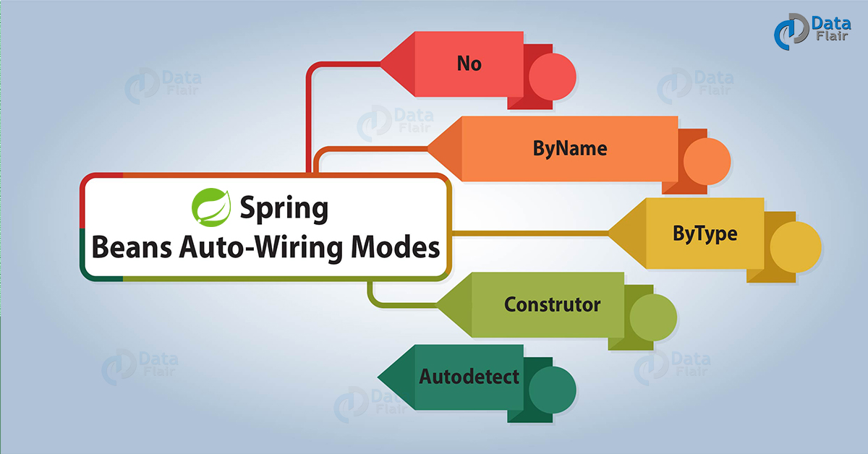
Spring Bean Auto wiring
Spring framework, declaring bean dependencies in configuration files is a good practice to follow, so the Spring container is able to autowire relationships between collaborating beans. This means that it is possible to automatically let Spring resolve collaborators (other beans) for your beans by inspecting the contents of the Application Context. This is called spring bean autowiring.
The default autowire mode in XML configuration is no.
The default autowire mode in java configuration is byType.
<bean id=“XXX" class=“XXXXX" autowire="byName">
<property name="fullName" value=“John"/>
</bean>
<bean id=“XXXX" class=“XXXX" >
<property name="name" value="Human Resource" />
</bean>

Slide 28
@Autowired annotation
Apart from the autowiring modes provided in bean configuration file, autowiring can be specified in bean classes also using @Autowired annotation. To use @Autowired annotation in bean classes, you must first enable the annotation in spring application using below configuration.
<context:annotation-config /> Enable annotation config
2. @Autowired on property setters
When @Autowired is used on setters, it is also equivalent to autowiring by ‘byType‘ in configuration file.
@Autowired
public void setDepartmentBean(DepartmentBean departmentBean) {
this.departmentBean = departmentBean;
}
Using @Autowired annotation
Now, when annotation configuration has been enables, you are free to autowire bean dependencies using @Autowired, the way you like. This is done by three ways:
1. @Autowired on properties
When @Autowired is used on properties, it is equivalent to autowiring by ‘byType‘ in configuration file.
@Autowired
private DepartmentBean departmentBean;
3. @Autowired on constructors
When @Autowired is used on bean’s constructor, it is also equivalent to autowiring by ‘constructor‘ in configuration file.
@Autowired
public EmployeeBean(DepartmentBean departmentBean)
{
this.departmentBean = departmentBean;
}

Slide 29
@Qualifier for conflict resolution
we are using autowiring in ‘byType‘ mode and dependencies are looked for property class types. If no such type is found, an error is thrown. But, what if there are two or more beans for same class type.
In this case spring will not be able to choose correct bean to inject into property, and you will need to help the container using qualifiers.
To resolve a specific bean using qualifier, we need to use @Qualifier annotation along with @Autowired annotation and pass the bean name in annotation parameter.
@Autowired
@Qualifier("finance")
private DepartmentBean departmentBean;
<context:annotation-config />
<bean id="employee" class="com. autowire.constructor.EmployeeBean" autowire="constructor">
<property name="fullName" value="Lokesh Gupta"/>
</bean>
<!--First bean of type DepartmentBean-->
<bean id="humanResource" class="com.autowire.constructor.DepartmentBean" >
<property name="name" value="Human Resource" />
</bean>
<!--Second bean of type DepartmentBean-->
<bean id="finance" class="com.autowire.constructor.DepartmentBean" >
<property name="name" value="Finance" />
</bean>

Slide 30
Error safe autowiring with ‘required=false’
Even if you have used utmost care in autowiring bean dependencies, still you may find strange lookup failures. So, solve this issue, you will need to make autowiring optional so that if no dependency is found, application should not throw any exception and autowiring should simply be ignored.
This can be done in two ways:
1. If you want to make specific bean autowiring non-mandatory for a specific bean property, use required=”false” attribute in @Autowired annotation.
@Autowired (required=false)
@Qualifier ("finance")
private DepartmentBean departmentBean;
2. If you want to apply optional autowiring at global level i.e. for all properties in all beans; use below configuration setting.
<bean class="org.springframework.beans.factory.annotation.AutowiredAnnotationBeanPostProcessor">
<property name="requiredParameterValue" value="false" />
</bean>

Slide 31
Bean Life Cycle
Setting Properties
Creation
Initialization
Destroying
Finalization
Notes:
Let’s take a look at how classes are living inside the IoC-container. First, we have to declare that some class is a bean, and Spring provides us with at least 4 different ways to do it. Speaking of the last stable version of Spring framework, we can declare a bean using XML-file configuration, Java annotations, Java class configuration or in a Groovy script as well. In this presentation we will omit the latter configuration approach.
From now on we will refer to IoC-container as application context – a place where all the beans are created, and from which they are taken to be used within the application.

Slide 32
Bean Life Cycle
Setting Properties
Creation
Initialization
Destroying
Finalization
Notes:
After properties are set you may need to do some initialization on the created object. For example, load some data from the injected datasource. Usually initialization is made apart from the constructor in a special “init-method.” This can be done on the “initialization” or “post-construct” phases of bean life cycle.

Slide 33
Bean Life Cycle: Initialization
XML Configuration
<bean id=“myBean” class=“com.netcracker.example.MyBean”
init-method=“initialize”>
Annotation-driven Configuration
public class MyBean {
@PostConstruct
public void initialize() {
...
}
}
Notes:
When you use XML configuration, the initialization method name should be declared within <bean> tag as the value for ”init-method” attribute. Initialization method must be parameter-less, otherwise it will not be called. In case an exception is thrown while executing init-method, application context will be closed and destroyed.
In case of annotation-driven configuration, you just have to use annotation initialization method with @PostConstruct annotation.

Slide 34
Bean Life Cycle: Initialization
Java Configuration
@Configuration
public class AppConfig {
@Bean(initMethodName = "initialize")
public MyBean myBean() {
MyBean myBean = new MyBean();
//myBean.initialize();
return myBean;
}
}
Notes:
Java configuration offers two ways of calling the initialization method. You can either call the method right inside the method declaring the bean – it’s the only case when you are able to pass arguments to the init-method – or you can designate the name of init-method within @Bean annotation.

Slide 35
Bean Life Cycle: Initialization
Initializing bean
public class MyBean implements InitializingBean {
…
public void afterPropertiesSet() {
…
}
…
}
Notes:
Another way to call bean post-initialization is to implement interface InitializingBean and put initialization logic inside afterPropertiesSet() method.

Slide 36
Bean Life Cycle: Initialization
@PostConstruct
afterPropertiesSet
init-method
Notes:
It is important to know that if a bean contains several initialization implementations, they will be called in displayed order: first of all a @PostConstruct-annotated method will be called, then afterPropertiesSet() and the last one will be init-method declared in XML.

Slide 37
Default initialization and destroy methods
default-init-method and default-destroy-method
If you have too many beans having initialization and/or destroy methods with the same name, you don't need to declare init-method and destroy-method on each individual bean.
the framework provides the flexibility to configure such situation using default-init-method and default-destroy-method attributes on the <beans> element .
<beans xmlns = "http://www.springframework.org/schema/beans"
xmlns:xsi = "http://www.w3.org/2001/XMLSchema-instance"
xsi:schemaLocation = "http://www.springframework.org/schema/beans
http://www.springframework.org/schema/beans/spring-beans-3.0.xsd"
default-init-method = "init"
default-destroy-method = "destroy">
<bean id = "..." class = "...">
<!-- collaborators and configuration for this bean go here -->
</bean>
</beans>

Slide 38
Bean Life Cycle
Setting Properties
Creation
Initialization
Destroying
Finalization

Slide 39
Bean Life Cycle: Finalization
XML Configuration
<bean id=“myBean” class=“com.netcracker.example.MyBean”
destroy-method=“destroy”/>
Annotation-driven configuration
public class MyBean {
@PreDestroy
public void destroy() {
...
}
}

Slide 40
Bean Life Cycle: Finalization
Java Configuration
@Configuration
public class AppConfig {
@Bean(destroyMethodName = “destroy")
public MyBean myBean() {
return new MyBean();
}
}

Slide 41
Bean Life Cycle: Finalization
Disposable bean
public class MyBean implements DisposableBean {
…
public void destroy() {
…
}
…
}

Slide 42
Bean Life Cycle
Setting Properties
Creation
Initialization
Destroying
Finalization

Slide 43
Bean Life Cycle: Destroying
Beans are destroyed once the container is shut down and JVM is terminated.
Before shutting down the container, the beans’ finalizing methods are called.

Slide 44
Spring - Bean Post Processors
The BeanPostProcessor interface defines callback methods that you can implement to provide your own instantiation logic, dependency-resolution logic, etc. You can also implement some custom logic after the Spring container finishes instantiating, configuring, and initializing a bean by plugging in one or more BeanPostProcessor implementations.
You can configure multiple BeanPostProcessor interfaces and you can control the order in which these BeanPostProcessor interfaces execute by setting the order property provided the BeanPostProcessor implements the Ordered interface.
The BeanPostProcessors operate on bean (or object) instances, which means that the Spring IoC container instantiates a bean instance and then BeanPostProcessor interfaces do their work.
An ApplicationContext automatically detects any beans that are defined with the implementation of the BeanPostProcessor interface and registers these beans as postprocessors, to be then called appropriately by the container upon bean creation.

Slide 45
Spring - Bean Post Processors
<bean id = "helloWorld" class = "com.bean.HelloWorld"
init-method = "init" destroy-method = "destroy">
<property name = "message" value = "Hello World!"/>
</bean>
<bean class = "com.bean.InitHelloWorld" />
public class InitHelloWorld implements BeanPostProcessor {
public Object postProcessBeforeInitialization(Object bean, String beanName)
throws BeansException {
System.out.println("BeforeInitialization : " + beanName);
return bean; // you can return any other object as well
}
public Object postProcessAfterInitialization(Object bean, String beanName)
throws BeansException {
System.out.println("AfterInitialization : " + beanName);
return bean; // you can return any other object as well
}
}
Beans.xml
AbstractApplicationContext context =
new ClassPathXmlApplicationContext("Beans.xml");
HelloWorld obj = (HelloWorld) context.getBean("helloWorld");
obj.getMessage();
context.registerShutdownHook();
BeanPostProcessorClass
Main.java

Slide 46
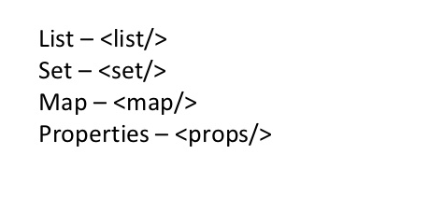
Spring - Injecting Collection
<property name = "addressProp">
<props>
<prop key = "one">INDIA</prop>
<prop key = "one">INDIA</prop>
<prop key = "two">Pakistan</prop>
<prop key = "three">USA</prop>
<prop key = "four">USA</prop>
</props>
</property>

Slide 47
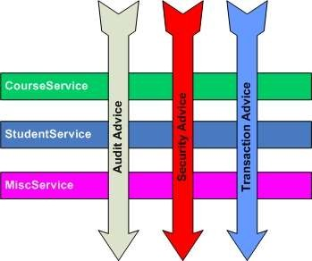
Aspect Oriented Programming (AOP)
Introduction to Concept
AOP entails breaking down program logic into distinct parts called concerns.
The functions that span multiple points of an application are called cross-cutting concerns and these cross-cutting concerns are conceptually separate from the application's business logic.
AOP is like triggers in programming languages such as Perl, .NET, Java and others.
Examples of cross-cutting concerns:
Logging
Security
Transaction
Caching

Slide 48


Aspect Oriented Programming (AOP)
Spring AOP
Spring AOP module provides interceptors to intercept an application, for example, when a method is executed, you can add extra functionality before or after the method execution.
Spring AOP's approach to AOP differs from that of most other AOP frameworks. The aim is to provide a close integration between AOP implementation and Spring IoC, not to provide the most complete AOP implementation.
Spring Framework's AOP functionality is normally used in conjunction with the Spring IoC container. Aspects are configured using normal bean definition syntax.

Slide 49
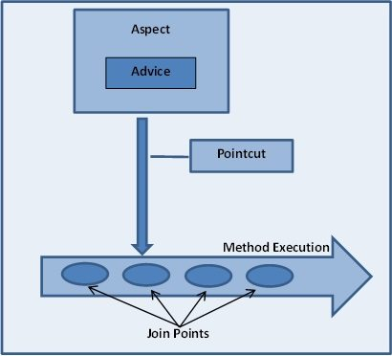
Advice, Joinpoint and Pointcut
An important term in AOP is advice. It is the action taken by an aspect at a particular join-point.
Joinpoint is a point of execution of the program, such as the execution of a method or the handling of an exception. In Spring AOP, a joinpoint always represents a method execution.
Pointcut is a predicate or expression that matches join points.
Advice is associated with a pointcut expression and runs at any join point matched by the pointcut.
Spring uses the AspectJ pointcut expression language by default.

Slide 50
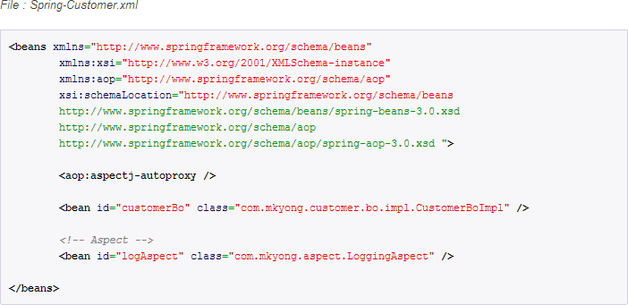
Aspect Oriented Programming (AOP)
Code Example

Slide 51
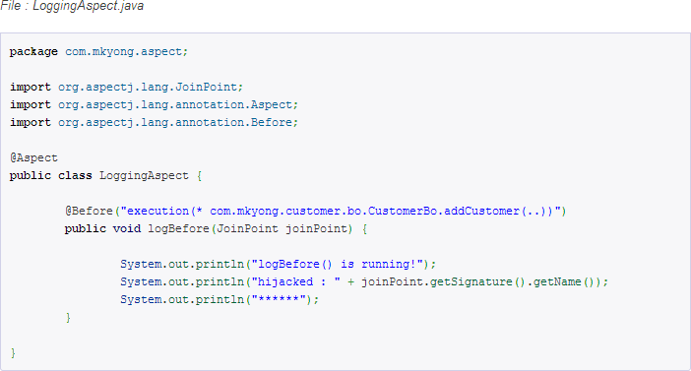
Aspect Oriented Programming (AOP)
Code Example
@Before – Run before the method execution
@After – Run after the method returned a result
@AfterReturning – Run after the method returned a result, intercept the returned result as well.
@Around – Run around the method execution, combine all three advices above.
@AfterThrowing – Run after the method throws an exception
Pointcut (AspectJ Pointcut Expression Language)
Join Point
Advice

Slide 52
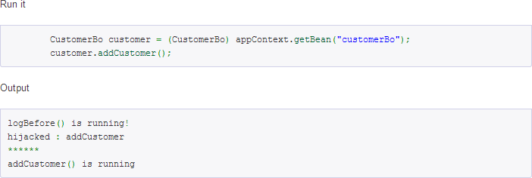
Aspect Oriented Programming (AOP)
Code Example

Slide 53
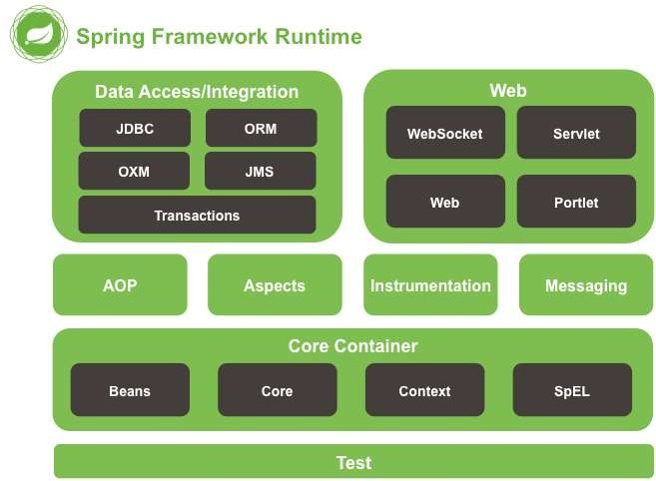
Spring Modules
The Spring Framework consists of features organized into about 20 modules.
These modules are grouped into Core Container, Data Access/Integration, Web, AOP (Aspect Oriented Programming), Instrumentation, and Test.
Overview of the Spring Framework

Slide 54
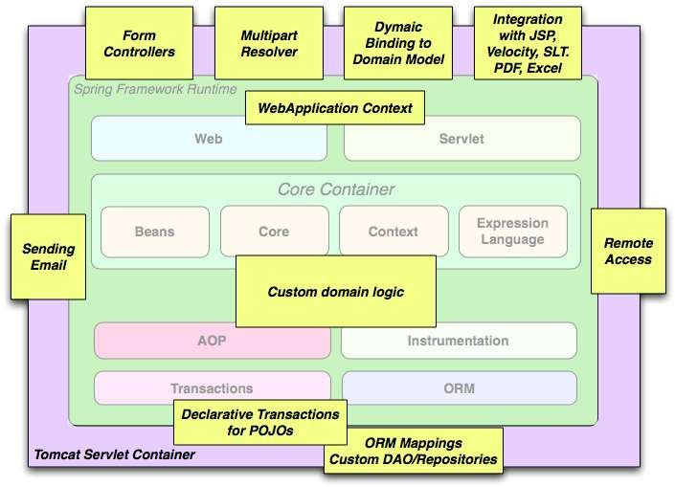
Spring Modules
The building blocks described previously make Spring a logical choice in many scenarios, from applets to full- fledged enterprise applications that use Spring's transaction management functionality and web framework integration.
Typical full-fledged Spring web application

Slide 55
Spring Modules
Spring Projects
Spring XD
Spring Data
Spring Integration
Spring Batch
Spring Security
Spring Cloud
Spring AMQP
Spring Grails
Spring Mobile
Spring Social
Spring for Android
Spring Web Flow
Spring LDAP
Spring Groovy
Spring Hateoas
Spring Security OAuth

Slide 56

Advantages of Using Spring Framework
Open source
Lightweight and fast
Moduler structure
Low coupling thanks to Dependency Injection
Resuable software
AOP support
Stable and lots of resources
Projects that make our life easier like Spring Security

Slide 57
Introduction to Spring Framework - Part 2

Slide 58
Content
Spring MVC
Spring RESTful Services
Spring Security
Spring Test

Slide 59
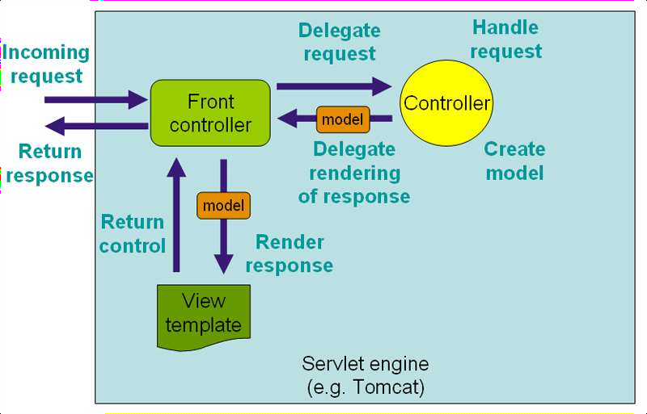
Spring MVC
The Spring web MVC framework provides model-view-controller architecture and ready components that can be used to develop flexible and loosely coupled web applications.
The MVC pattern results in separating the different aspects of the application (input logic, business logic, and UI logic), while providing a loose coupling between these elements.

Slide 60
Spring MVC
MVC Bean Scopes
Scope | Description
Request | Scopes a single bean definition to the lifecycle of a single HTTP request; that is, each HTTP request has its own instance of a bean created off the back of a single bean definition. Only valid in the context of a web- aware Spring ApplicationContext.
Session | Scopes a single bean definition to the lifecycle of an HTTP Session. Only valid in the context of a web- aware Spring ApplicationContext.
Global Session | Scopes a single bean definition to the lifecycle of a global HTTP Session. Typically only valid when used in a portlet context. Only valid in the context of a web-aware SpringApplicationContext.
Application | Scopes a single bean definition to the lifecycle of a ServletContext. Only valid in the context of a web- aware Spring ApplicationContext.

Slide 61
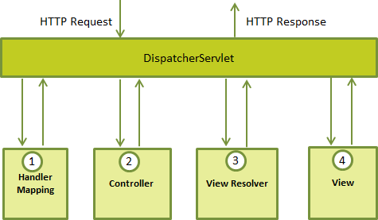
Spring MVC
The DispatcherServlet
The Spring Web model-view-controller (MVC) framework is designed around a DispatcherServlet that handles all the HTTP requests and responses.

Slide 62
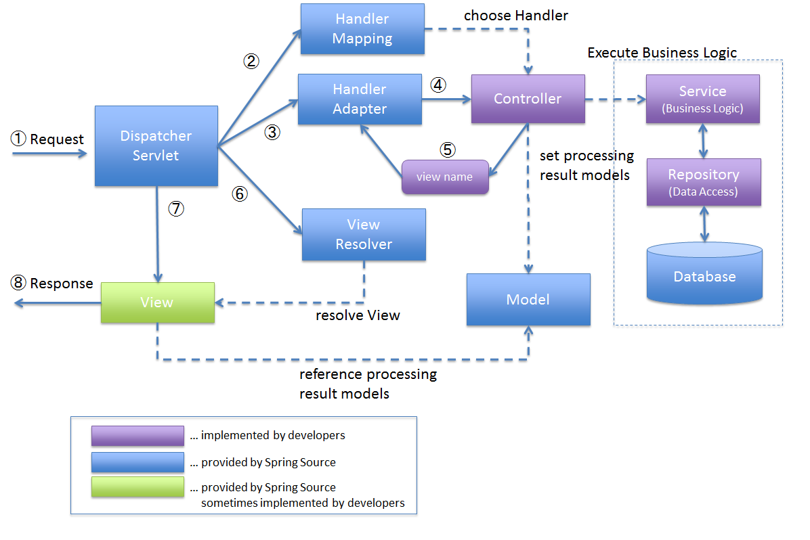
Spring LifeCycle

Slide 63
Spring MVC
Web.xml
You need to map requests that you want the DispatcherServlet to handle, by using a URL mapping in the web.xml file.
<servlet>
<servlet-name>HelloWeb</servlet-name>
<servlet-class>
org.springframework.web.servlet.DispatcherServlet
</servlet-class>
<load-on-startup>1</load-on-startup>
</servlet>
<servlet-mapping>
<servlet-name>HelloWeb</servlet-name>
<url-pattern>/</url-pattern>
</servlet-mapping>

Slide 64
Spring MVC
Servlet.xml
Now, let us check the required configuration for example-servlet.xml file, placed in your web application's WebContent/WEB-INF directory:
<context:component-scan base-package = "com.puru" />
<bean class ="org.springframework.web.servlet.view.InternalResourceViewResolver">
<property name = "prefix" value = "/WEB-INF/jsp/" />
<property name = "suffix" value = ".jsp" />
</bean>

Slide 65
Spring MVC
Controller & View
HomeController.java:
Home.jsp
@Controller
public class HomeController {
<html>
<head>
<title>Here is home page</title>
</head>
<body>
<h2>${message}</h2>
</body>
</html>
@RequestMapping(value = { "/", "/home" }, method = RequestMethod.GET)
public String showHomePage(ModelMap model) {
model.addAttribute("message", "Hello Spring MVC Framework!");
return "home";
}
}

Slide 66
Spring – Forms Handling
HTML form, you use spring:form tag and bind the controller object via @modelAttribute.
<%@ taglib prefix="spring" uri="http://www.springframework.org/tags"%>
<%@ taglib prefix="form" uri="http://www.springframework.org/tags/form"%>
<form:form method="post" modelAttribute="userForm" action="${userActionUrl}">
<form:input path="name" type="text" /> <!-- bind to user.name-->
<form:errors path="name" />
</form:form>
When the HTML form is “POST”, you get the value via @ModelAttribute.
@RequestMapping(value = "/users", method = RequestMethod.POST)
public String saveOrUpdateUser(@ModelAttribute("userForm") User user,
BindingResult result, Model model) {
//...
}

Slide 67
Spring – Stereotype annotations
@Component, @Repository, @Service and @Controller annotations in place and automatic component scanning enabled, Spring will automatically import the beans into the container and inject to dependencies. These annotations are called Stereotype annotations as well.
@Component annotation
The @Component annotation marks a java class as a bean so the component-scanning mechanism of spring can pick it up and pull it into the application context. To use this annotation, apply it over class.
@Repository annotation
To provides additional benefits specifically for DAOs i.e. @Repository annotation. The @Repository annotation is a specialization of the @Component annotation with similar use and functionality. In addition to importing the DAOs into the DI container, it also makes the unchecked exceptions (thrown from DAO methods) eligible for translation into Spring DataAccessException.
@Service annotation
The @Service annotation is also a specialization of the component annotation. It doesn’t currently provide any additional behaviour over the @Component annotation, but it’s a good idea to use @Service over @Component in service-layer classes because it specifies intent better.

Slide 68
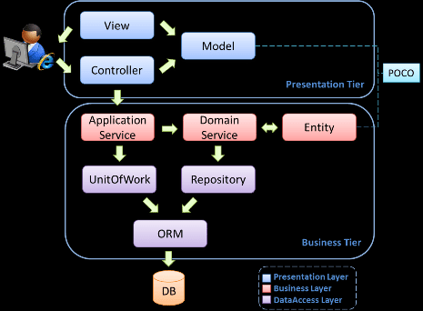
Spring MVC
Some developers consider the service layer and DAO layers classes as part of model component in MVC. I have a different opinion on this. I do not consider service and DAO layers classes the part of MVC framework. Usually a web application is 3-tier architecture i.e. data-service-presentation. MVC is actually part of presentation layer.

Slide 69
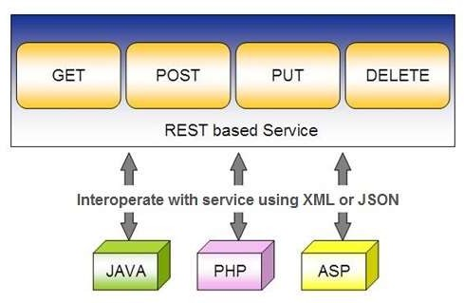
Spring RESTful Services
REST does not require the client to know anything about the structure of the API. Rather, the server needs to provide whatever information the client needs to interact with the service.

Slide 70
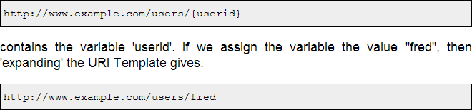
Spring RESTful Services
Spring's annotation-based MVC framework serves as the basis for creating RESTful Web Services.
RESTful services use URIs to name resources. To facilitate accessing the information contained in a URI, its structure follows conventions so that it can easily be described in a parameterized form.

Slide 71
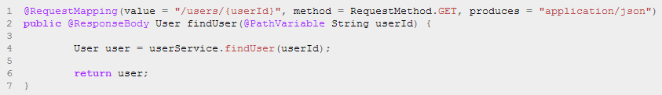
Spring RESTful Services
Spring uses the @RequestMapping method annotation to define the URI Template for the request. The @PathVariable annotation is used to extract the value of the template variables and assign their value to a method variable.
When a request comes in for /users/serhat, the value ‘serhat' is bound to the method
parameter String userId.

Slide 72

Spring RESTful Services
A RESTful architecture may expose multiple representations of a resource. There are two strategies for a client to inform the server of the representation it is interested in receiving.
The first strategy is to use a distinct URI for each resource. This is typically done by using a different file extension in the URI.
For example the URI http://www.example.com/users/serhat.pdf requests a PDF representation of the user serhat while http://www.example.com/users/serhat.xml requests an XML representation.
The second strategy is for the client to use the same URI to locate the resource but set the Accept HTTP request header to list the media types that it understands.
For example, a HTTP request for http://www.example.com/users/serhat with an Accept header set to application/pdf requests a PDF representation of the user serhat
while http://www.example.com/users/serhat with an Accept header set to text/xml requests an XML
representation. This strategy is known as content negotiation.

Slide 73
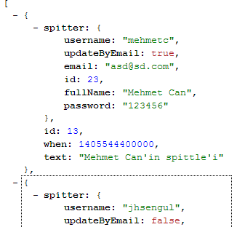

Spring RESTful Services
Do not forget to implement serializable in your entity

Slide 74
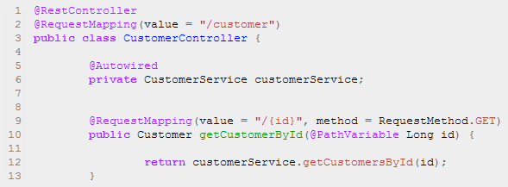
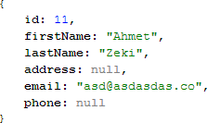
Spring RESTful Services
This code uses Spring 4’s new @RestController annotation, which marks the class as a controller where every method returns a domain object instead of a view. It’s shorthand for @Controller and @ResponseBody rolled together.
The Greeting object must be converted to JSON. Thanks to Spring’s HTTP message converter support, you don’t need to do this conversion manually.

Slide 75
References
http://docs.spring.io/spring/docs/current/spring-framework-reference/html/
http://projects.spring.io/spring-security/
http://www.mkyong.com/tutorials/spring-mvc-tutorials/
http://www.mkyong.com/tutorials/spring-security-tutorials/
http://www.tutorialspoint.com/spring/
http://www.mkyong.com/tutorials/spring-tutorials/
http://www.slideshare.net/rstoya05/testing-web-apps-with-spring-framework-32
http://www.petrikainulainen.net/programming/spring-framework/integration- testing-of-spring-mvc-applications-security/

Slide 76
Thank you for listening...

