Slide 1

Scholarship Hub
Cabatuan, Allen Jay B.

Slide 2
Introduction
The Scholarship Hub is a system platform designed to simplify the process of applying for scholarships and managing applications. It provides an easy-to-use interface for applicants to submit their information, while allowing Scholarship Providers / Committee to manage scholarships and review applications. Basically, it involved a Three (3) user Admin, Scholarship Providers, and Applicant. It ensures a smooth, secure, and efficient experience for both Applicants and Scholarship Providers, making the entire scholarship process faster and more efficient.

Slide 3

Main Features

Slide 4
Main Features
Create
This operation allows users to create new records in the system, such as adding new scholarship details, creating new applicant accounts, or submitting scholarship applications.
Read
This operation involves retrieving and displaying data from the database to view records, such as viewing scholarship details or the list of applicants.
Update
This operation allows admins or scholarship providers to modify existing records, such as updating an user status or modifying a scholarship's details.
Delete
This operation allows users or admins to remove existing records from the system, such as deleting a user or removing a scholarship.

Slide 5
Three (3) Users
Administrator
Applicant
Scholarship Providers / Committee
Benefactors:
Students needing financial aid
Applicants with high GPA or achievements
Low-income families
Deserving scholars based on set criteria

Slide 6

ERD DESIGN

Slide 7
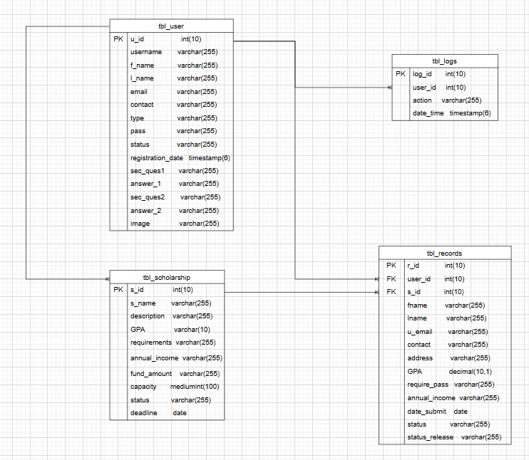

Slide 8

FLOWCHART

Slide 9
THANK YOU !

