Slide 1
Segmentation of Shops
by Median Household Income in Metro Vancouver

Slide 2
Background
Objective: Find segmentation of shops and effect of income levels
Location: Metro Vancouver
Reasons for this location:
Highly diverse urban area
Wide range of income level
Large collection of shops

Slide 3
Data Source
2016 Census Profile from Statistics Canada
Geolocation Services API
Foursquare API

Slide 4
Methodology
Python – Jupyter Notebook
Pandas
Requests
Sklearn
Etc.

Slide 5
Data Process Pipeline
Read CSV and import Metro Vancouver FSAs
Query the Geolocation Service and get coordinates
Join the income and FSA coordinates datasets
Read CSV and import median household income from 2016 Canada Census
Normalize the income and prepare for KMeans Clustering
Run the sklearn's KMeans algorirhtm
Visualize the results in Folium

Slide 6
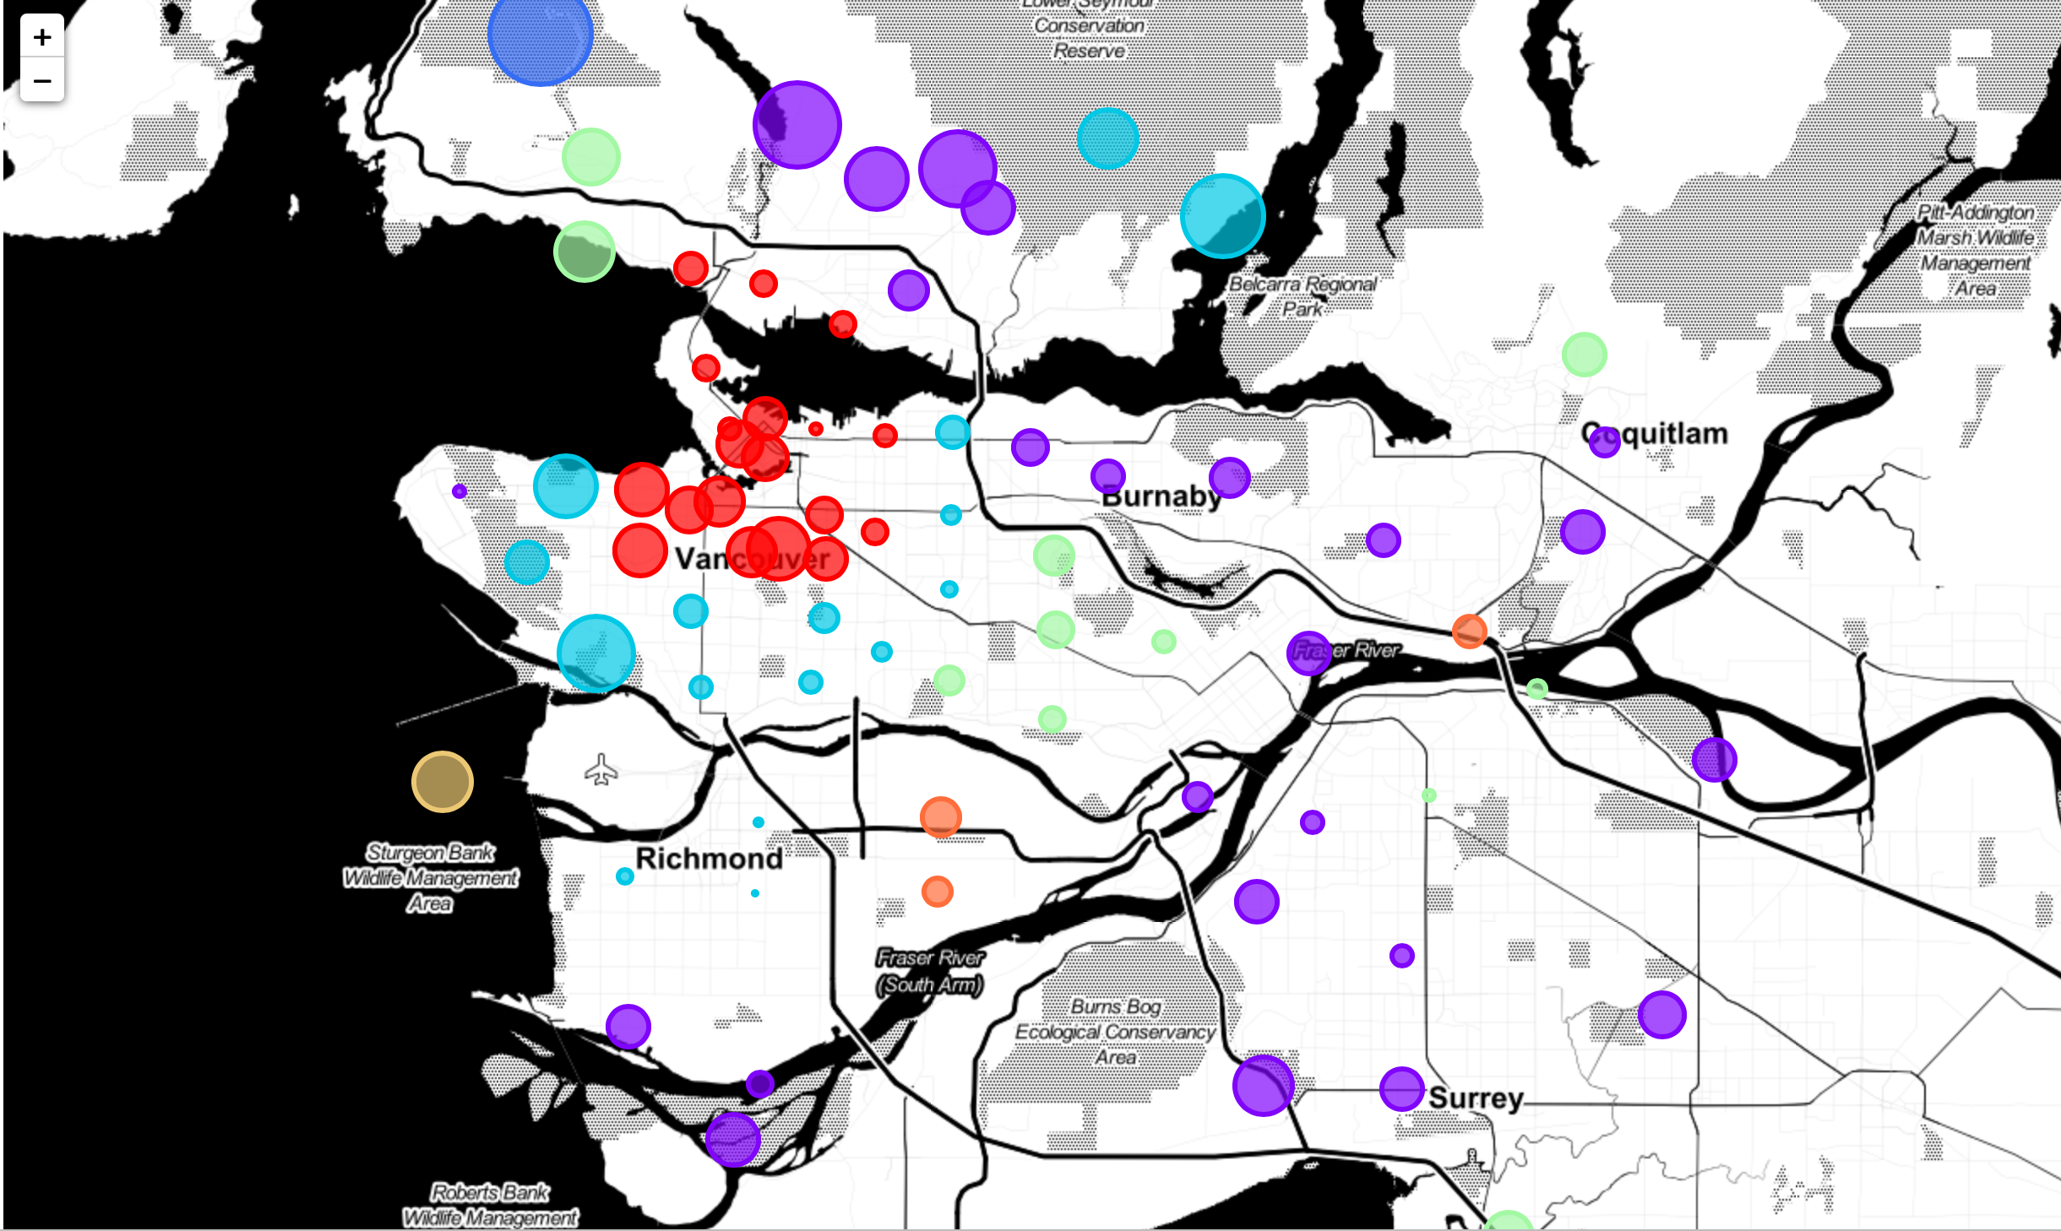
Results
Color: Clusters based on common restaurants
Size: Median Household Income

Slide 7
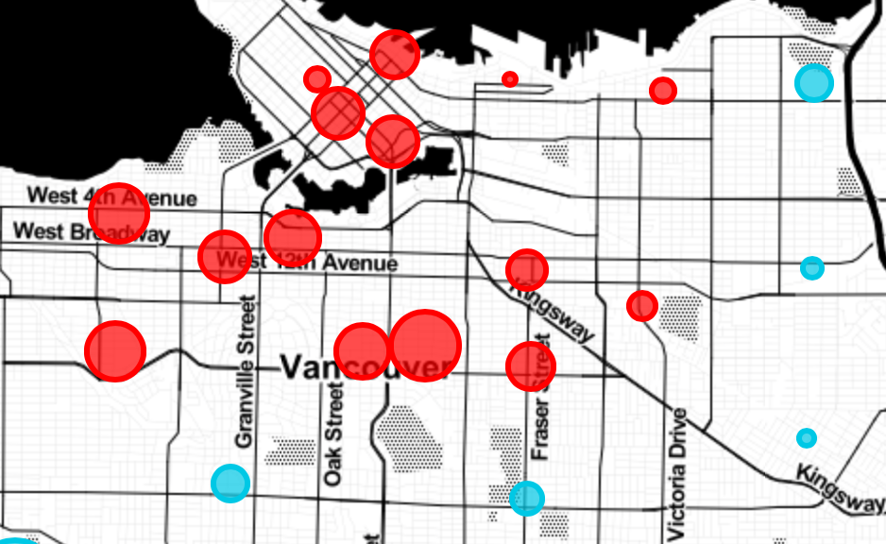
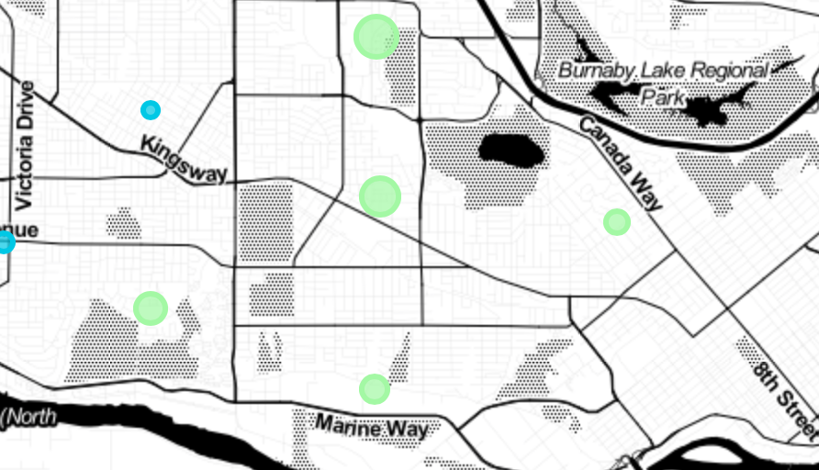
Example
Red Cluster:
Most Common Shops:
Grocery Store
Apparel
Pharmacy
Liquor Store
Income: $95407
Green Cluster:
Most Common Shops:
Big Box Store
Supermarket
Discount Store
Income: $91936

Slide 8
Discussion
Higher income -> More expensive shops
More factors may affect the shop categories, such as:
Culture
Race
Household size
Etc.

Slide 9
Thank you
Bingbing Zhang

