Slide 1

Submitted : Bhargavi P
Lakshmi

Slide 2
DEFINATION OF MOTIVATION
The act or process of stimulating to action,providind an
Incentive or motive, especially for an act.
Motive is the urge ,need,want or desire that includes a person to work.
Motivation is a kind of internal energy which drives a person to do something in order to achieve something.
“To motivate is to induce people to act in a desired manner.”

Slide 3


EXTRINSIC AND INTRINSIC MOTIVATION
Extrinsic Motivation - Extrinsic motivation is when we are motivated to perform a behavior or engage in ana activity because we want to earn a reward or avoid punishment. You will engage in behavior not because you find it satisfying, but because you expect to get something in return or avoid something unpleasant.
Intrinsic Motivation – intrinsic motivation is when you engage in a behavior because you find it rewarding . You are performance an activity for its own sake rather than from the desire for some external reward. The behavior itself is its own reward.

Slide 4

WORK MOTIVATION

Slide 5
Theories
Theories of motivation
Maslow’s Need Hierarchy Theory
Hertzberg’s two factors theory

Slide 6
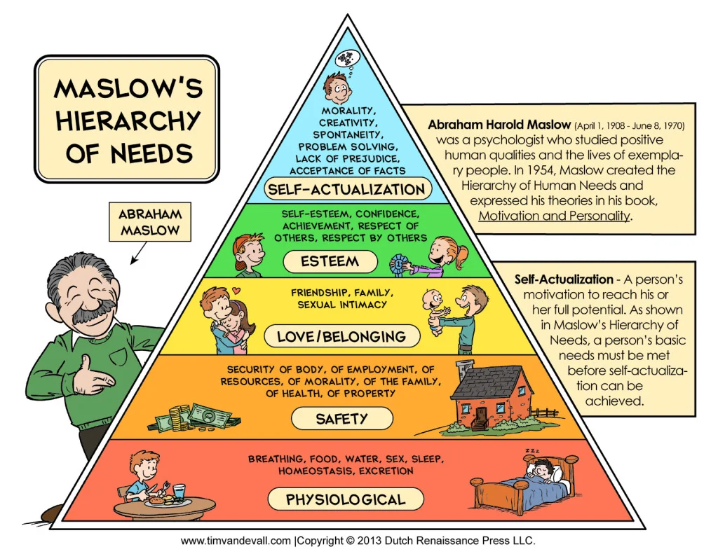

Slide 7
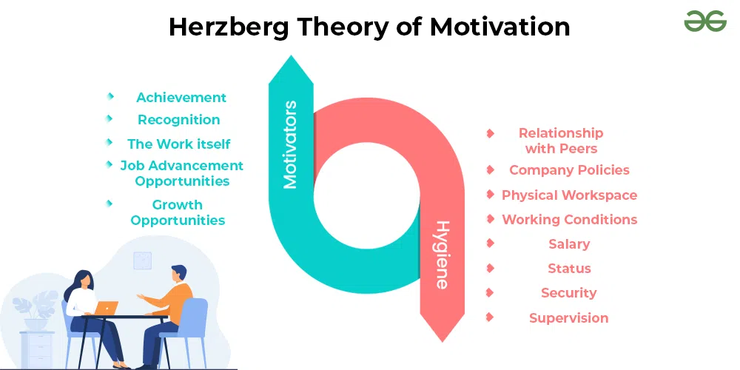

Slide 8
Case Study on Employee Motivation in XYZ Company
Introduction: Motivating employees is crucial for enhancing performance, job satisfaction, and overall organizational success. This case study focuses on XYZ Company, a technology firm with approximately 300 employees, and how it effectively fosters motivation among its workforce.
Background: XYZ Company operates in a highly competitive industry with rapidly changing market demands. To maintain a competitive edge, it recognizes the significance of motivated employees who are committed to achieving individual and organizational goals.
Challenges: Before implementing its motivation strategies, XYZ Company faced several challenges, including low employee morale, lack of engagement, and a decline in productivity. High turnover rates were a major concern, leading to disruptions in workflow and increased recruitment and training costs.

Slide 9
Theories
Motivation Strategies:
Establishing a Clear Vision and Goal Alignment
Providing Opportunities for Skill Development
Offering Performance-Based Incentives
Encouraging Employee Engagement and Collaboration
Results and Outcomes:
Increased Employee Satisfaction
Enhanced Productivity
Reduced Turnover
Improved Innovation and Creativity
Conclusion: Motivating employees is a continuous process that requires a strategic approach. XYZ Company's case study demonstrates the positive impact of implementing effective motivation strategies. By aligning organizational goals with employees' aspirations, providing growth opportunities, and promoting a positive work environment, XYZ Company has successfully cultivated a motivated workforce, resulting in increased productivity, reduced turnover, and improved overall performance.

Slide 10

This Photo by Unknown Author is licensed under CC BY-SA

