Slide 1
Team Name: Cognitive Crew
SL NO. | MEMBERS | NAME | ACADEMIC YEAR
01. | Team Lead | Matheswaran S | IV
02. | Member 02 | Nithish kumar G | IV
03. | Member 03 | Swathi B | IV
Velammal College of Engineering and Technology

Slide 2

Zintellect AI: Intelligent Healthcare Prior Authorization Automation Platform
Track: Human – AI Collaboration
Problem Statement:
In insurance-based healthcare systems, patients face critical administrative barriers before accessing specialist treatments, medications and procedures. Prior authorization is heavily dependent on manual paperwork, scanned document processing, repetitive data entry and complex policy verification between doctors and insurers. Existing systems cannot process handwritten or scanned medical documents and lack dynamic policy matching capability, causing treatment delays, exhausted clinical staff and inequitable patient access. Zintellect AI eliminates this friction between a clinical decision to treat and the patient's actual receipt of treatment through a scalable, auditable and rights-protective Hybrid AI automation platform.
Problem Scope:
Automate prior authorization workflows in insurance-based healthcare using Hybrid AI
Process scanned, handwritten and digital medical documents using Multimodal OCR
Extract clinical entities such as symptoms, diagnoses, procedures and CPT codes via NER
Dynamically retrieve insurance policy clauses using RAG based semantic search
Validate treatment requests against insurance policies using AI rule engine
Accelerate approval and rejection decisions using weighted risk scoring
Ensure auditable decisions through Explainable AI reasoning traces
Enable AI assisted decision support while retaining provider oversight
Minimize administrative burden and reduce authorization turnaround time
Improve patient access to timely healthcare services through faster approvals

Slide 3
Zintellect AI: Intelligent Healthcare Prior Authorization Automation Platform
Proposed Solution:
We propose Zintellect AI, an AI powered Prior Authorization Automation Platform built on a Hybrid Multimodal Hierarchical RAG Expert System (HMH-RAGES) that streamlines healthcare authorization workflows between doctors, patients and insurance providers.
The system enables healthcare providers to submit authorization requests digitally by uploading patient information, clinical notes, lab reports and scanned documents. The HMH-RAGES pipeline automatically processes multimodal documents, extracts clinical entities via Medical NER and dynamically retrieves relevant insurance policy clauses using RAG based semantic search.
By integrating Multimodal OCR, Hierarchical RAG, Rule Based Expert System and Explainable AI, the platform delivers faster, transparent and auditable authorization outcomes while maintaining accuracy, compliance and provider oversight.
Innovation:
1) Hybrid Multimodal Hierarchical RAG Expert System (HMH-RAGES)
2) Multimodal OCR Engine for Scanned and Handwritten Document Processing
3) Hierarchical RAG Based Dynamic Insurance Policy Retrieval
4) Medical NER for Clinical Entity and CPT Code Extraction
5) Weighted Risk Scoring with Automated Prior Authorization Decisions
6) Explainable AI with Full Decision Reasoning Trace
7) Human in the Loop Provider Validation Workflow
8) Secure Multi Role Healthcare Ecosystem with Cloud Native Architecture

Slide 4

Technology Stack
Frontend
React.js — Single Page Application for healthcare workflow management
Tailwind CSS — Responsive and modern user interface design
Axios — API communication between frontend and backend services
Lucide React Icons — Modern healthcare dashboard iconography
React Router DOM — Navigation and role based page routing
Backend & APIs
Python FastAPI — High performance REST API framework
Uvicorn — ASGI server for FastAPI deployment
RESTful APIs — Secure communication between system modules
Pydantic — Request validation and data serialization
Databases
SQLite – Lightweight relational database
Deployment & Infrastructure
Docker Containerization
Cloudflare Tunnel (Public Access)
Cross-Platform Deployment Support
Artificial Intelligence Layer
HMH-RAGES — Hybrid Multimodal Hierarchical RAG Expert System
PaddleOCR-VL / LayoutLMv3 — Multimodal OCR for scanned and handwritten documents
BGE-Large / E5-Large — Vector embedding generation
FAISS / ChromaDB — Vector database for policy storage and retrieval
Medical NER — Symptoms, diagnoses, procedures and CPT code extraction
Ollama Qwen 2.5 (1.5B) — Large Language Model for clinical reasoning
Weighted Risk Scoring Engine — AI confidence score generation
Explainable AI (XAI) — Transparent decision reasoning trace
Security & Authentication
JWT (JSON Web Token) Authentication
Password Hashing using Bcrypt
Role-Based Access Control (Doctor / Provider / Patient)
Development Tools
Swagger UI (API Testing) and npm / Vite Build System

Slide 5
Zintellect AI: Intelligent Healthcare Prior Authorization Automation Platform
Implementation Plan:
Patient Registration Patient registers with personal and insurance information
Insurance Verification System validates insurance membership and eligibility
Secure Data Fetch Authorization Request Creation Doctor submits treatment/procedure authorization request
Clinical Document Upload Medical reports, prescriptions, and supporting evidence uploaded
AI Clinical Analysis Qwen HMH-RAGES pipeline processes documents via Multimodal OCR, Hierarchical RAG retrieval and Medical NER extraction
Policy Rule Matching RAG based semantic search dynamically retrieves relevant insurance policy clauses and validates via rule engine
Authorization Decision Engine Weighted risk scoring generates approval, rejection or manual review with confidence score
Provider Validation Insurance provider reviews and confirms final authorization decision
Request Storage & Tracking Requests and decisions stored in SQLite database
Authorization Outcome Final status displayed in dashboard and request history

Slide 6
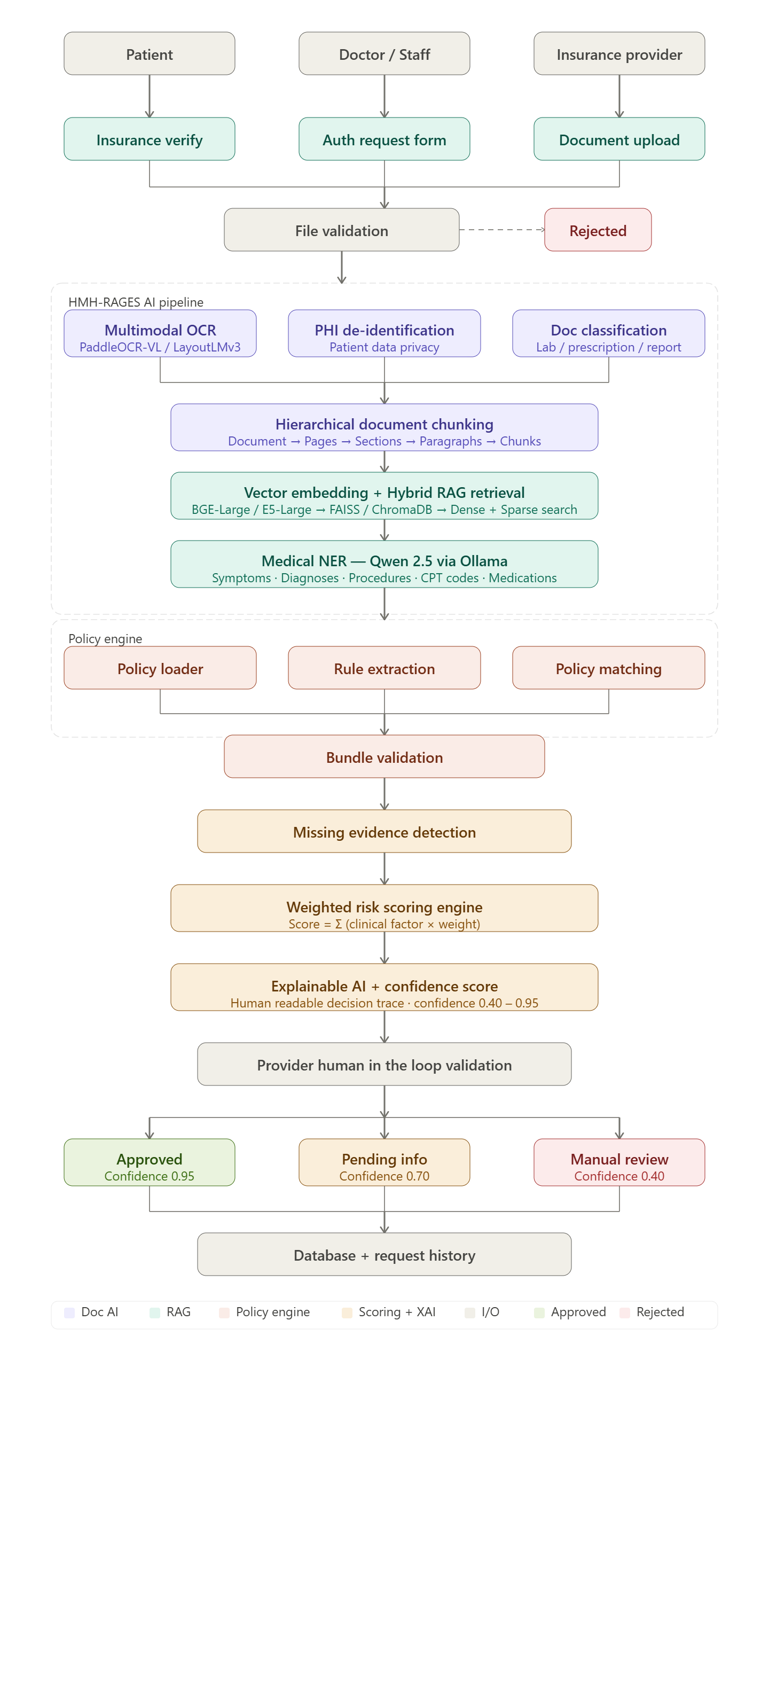
Zintellect AI: Intelligent Healthcare Prior Authorization Automation Platform
System Flow:

Slide 7

Zintellect AI: Intelligent Healthcare Prior Authorization Automation Platform
Benefits
Reduces prior authorization processing time from days to minutes
Automates clinical document review and insurance policy validation
Minimizes administrative workload for healthcare providers
Improves authorization accuracy through AI-powered decision support
Enhances collaboration between doctors, patients, and insurance providers
Efficiency & Automation
Eliminates manual paperwork and repetitive authorization tasks
Performs real-time insurance eligibility verification
HMH-RAGES pipeline — Multimodal OCR, Hierarchical RAG and Medical NER for clinical analysis
RAG based dynamic policy retrieval with weighted risk scoring and XAI recommendation generation
Centralized request tracking and authorization history management
Scalability
Cloud-native architecture supports multiple healthcare organizations
Handles large volumes of authorization requests efficiently
Modular microservices architecture enables easy feature expansion
Supports integration with multiple insurance providers and healthcare systems
Ready for deployment on Docker, Cloudflare, and cloud platforms
Healthcare Impact
Accelerates patient access to critical treatments and procedures
Reduces treatment delays caused by authorization bottlenecks
Improves patient satisfaction through faster approval workflows
Enables transparent and auditable authorization decisions
Supports digital transformation in healthcare administration

Slide 8
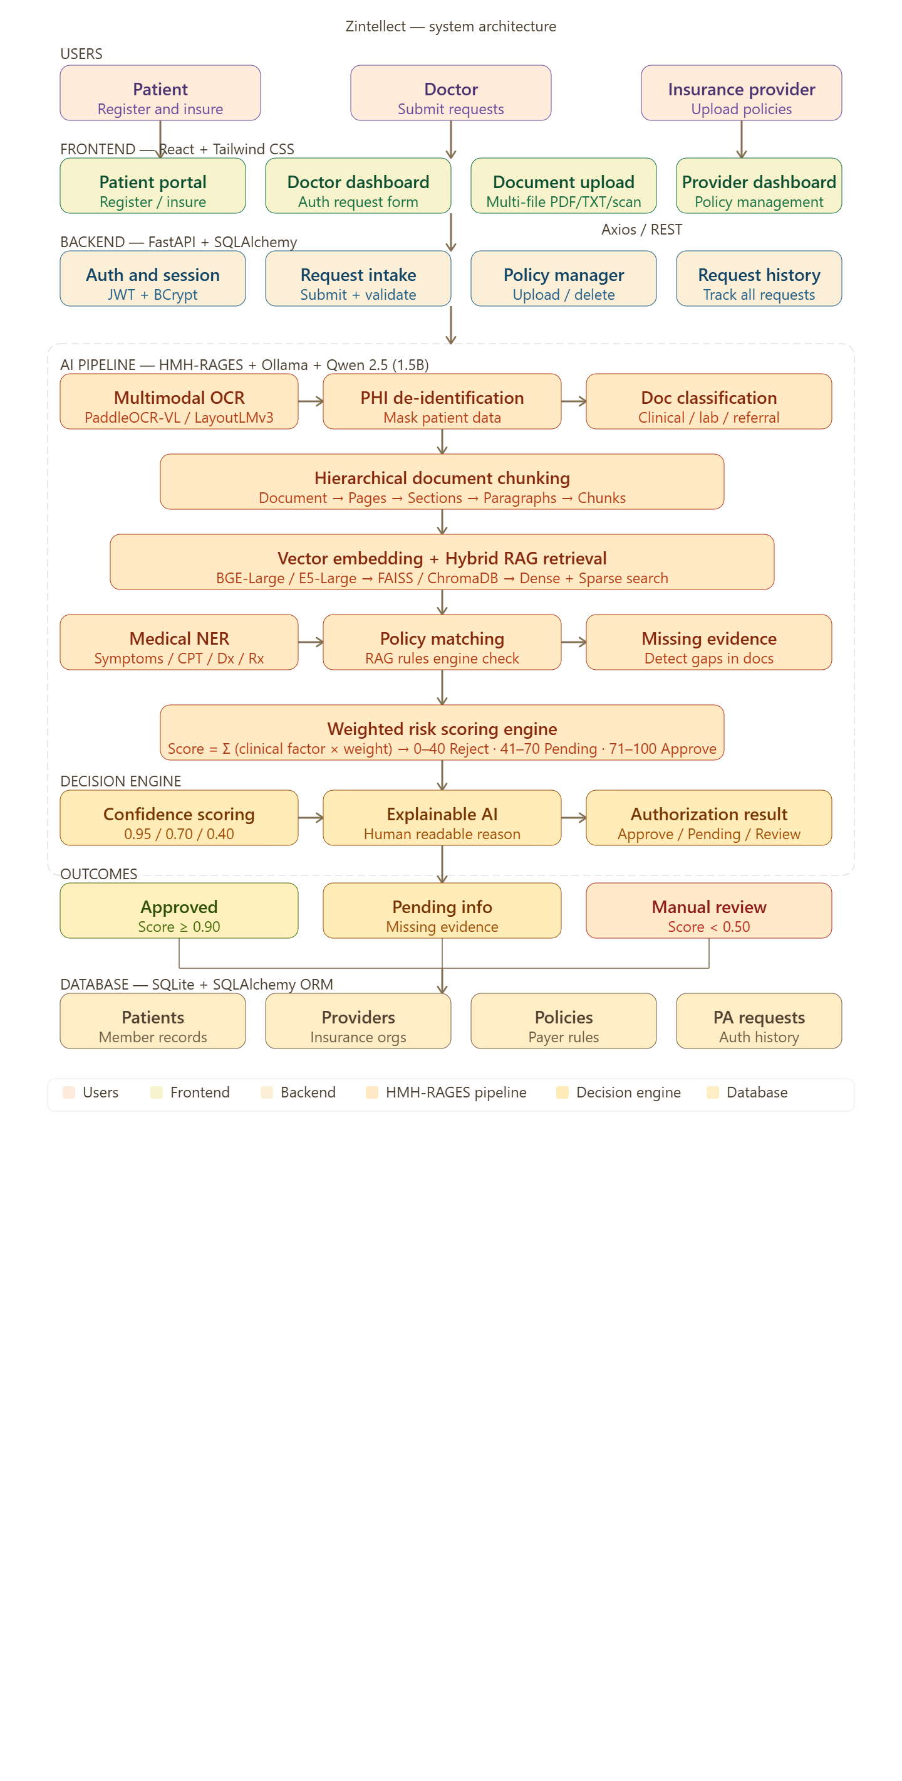
Zintellect AI: Intelligent Healthcare Prior Authorization Automation Platform
Architectural Diagram:
Future Enhancements:
AI Enhancements
✔ Upgrade to Qwen 2.5 7B / 14B for complex clinical reasoning
✔ Multi-LLM Support (Qwen, Llama, GPT)
✔ Full HMH-RAGES production deployment with persistent vector DB
✔ Clinical Risk Assessment Engine
User Experience
✔ Mobile Application Support
✔ SMS Notifications
✔ Real-Time Authorization Alerts
✔ Voice-Based Clinical Documentation
Enterprise Scalability
✔ Cloud Deployment (AWS / Azure)
✔ Kubernetes Orchestration
✔ Multi-Hospital Support
✔ Analytics & Reporting Dashboard

Slide 9
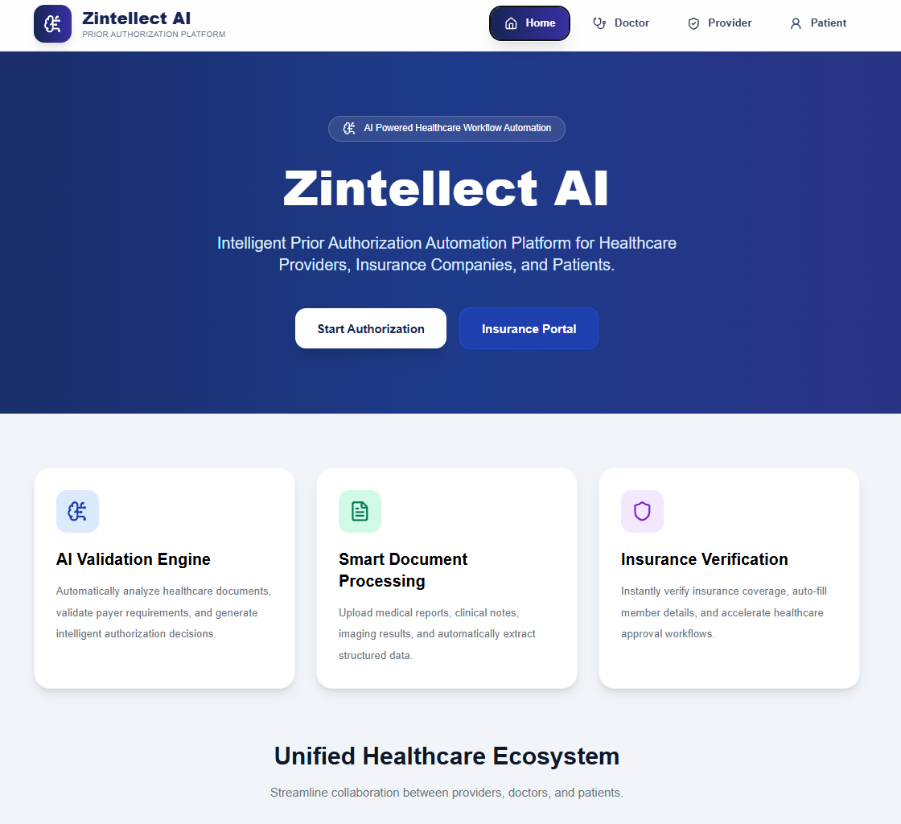
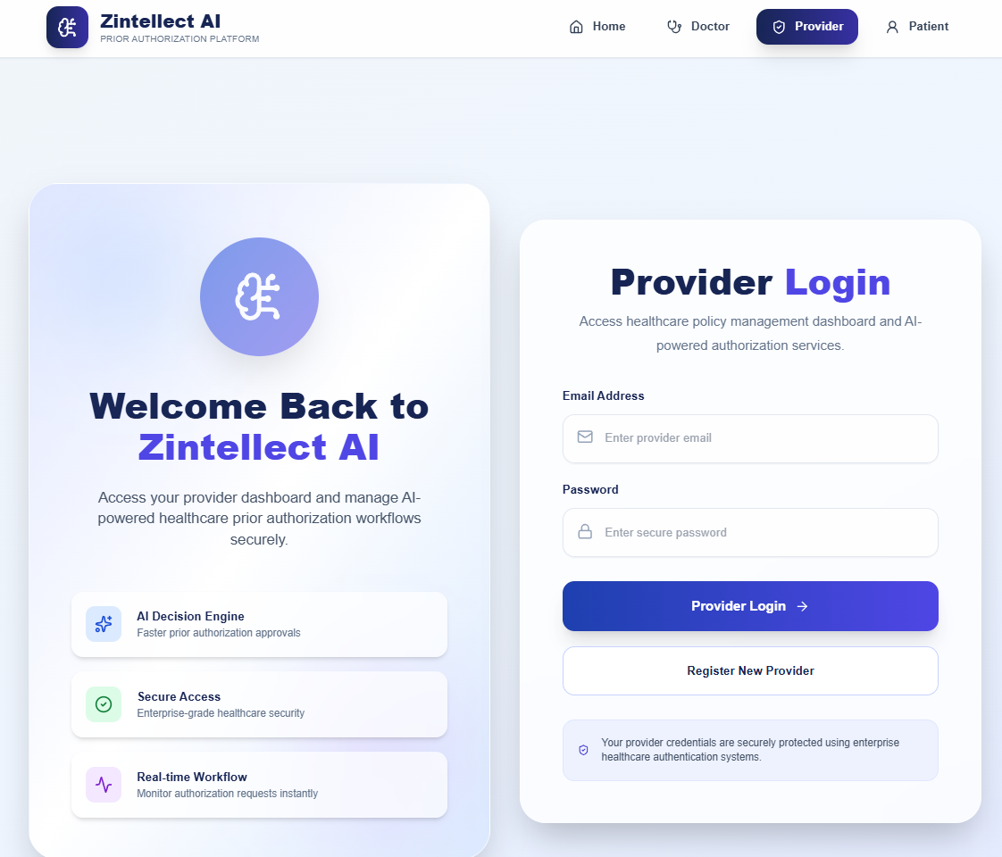
Zintellect AI – System Demonstration
UI Interfaces:
Live Demo Video: https://drive.google.com/file/d/1WEqnDNSu0PBs_ENfD7Vvpty2qYha-Q2U/view?usp=sharing

