Slide 1
Deskewing
Data Science Assignment

Slide 2
Slides
Problem Statement & Objective
Assumptions taken
Dataset Gathering & Analysis
Preprocessing
Modelling & Evaluation
Conclusion

Slide 3
Problem Statement & Objective
Deskewing is an essential pre-processing step in document analysis and OCR (Optical Character Recognition) tasks, helping to ensure that text within the documents is horizontally aligned.
To create a machine learning based model that can automatically detect and correct the skewness in document images.

Slide 4
Assumptions taken
All the skewness angle is between -5 to +5 degrees.
Input image is always of the size (566,400).
The scans are documents containing text written in Latin with the header 'Surety' at different line justifications.

Slide 5
Dataset Gathering & Analysis
https://www.kaggle.com/datasets/sthabile/noisy-and-rotated-scanned-documents/data
Data set contains 500 train set images and 100 test images (without label). Each image is of dimension (566,400).

Slide 6
Preprocessing
Denoising: To minimize the unwanted (noisy part) from the image.
denoise_tv_chambolle()
Transformation of image to have better feature related to angle and edge detection.
Fast Fourier Transform()

Slide 7
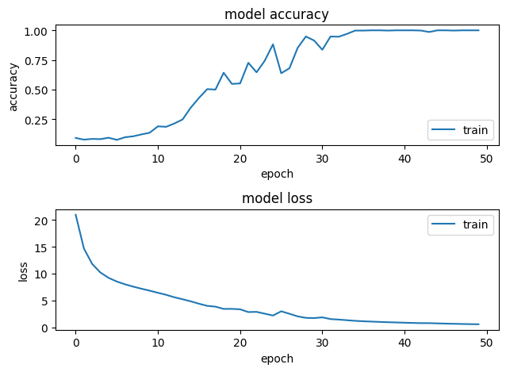
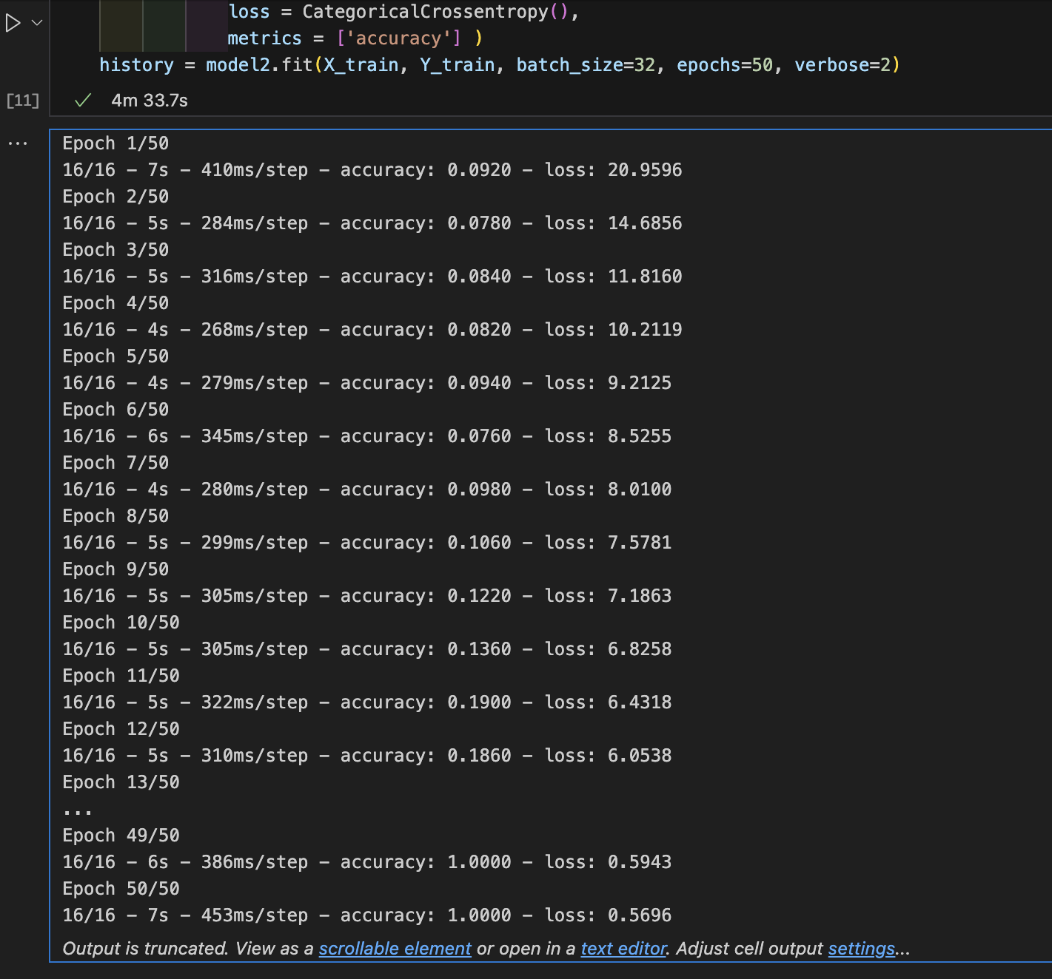
Modelling & Evaluation

Slide 8
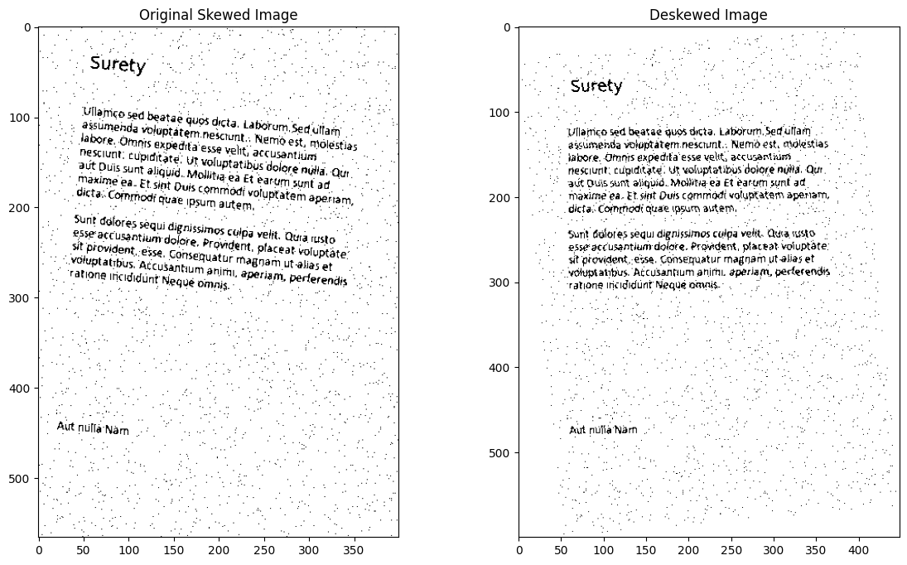
Conclusion
Model Evaluation metrics:
loss: 0.5696311593055725

