Slide 1
Project Name__Collaborative Recommendation
Mentor Name_Miss. Manisha Khadase
Leader Name_ Shivram Marwadi
Participants _Vaishnavi Thorat
Shreya Belakar
Prathmesh Kadam
Sangram Nangare

Slide 2
Collaborative Recommendation

Slide 3
What Are Recommendation Systems in Machine Learning?
Recommender systems are the systems that are designed to recommend things to the user based on many different factors. These systems predict the most likely product that the users are most likely to purchase and are of interest to. Companies like Netflix, Amazon, etc. use recommender systems to help their users to identify the correct product or movies for them.
The recommender system deals with a large volume of information present by filtering the most important information based on the data provided by a user and other factors that take care of the user’s preference and interest. It finds out the match between user and item and imputes the similarities between users and items for recommendation.
Both the users and the services provided have benefited from these kinds of systems. The quality and decision-making process has also improved through these kinds of systems

Slide 4
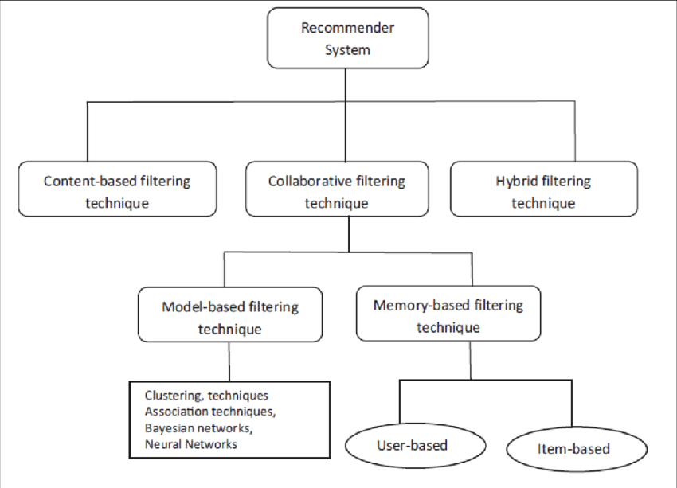

Slide 5
what is content based recomondation system
We are encounter many serch engine in daily life like amazon,google,netflix,hotstar etc. They have diffrent type of catagory and content, so they will suggest you diffrent kind of data to.But how ?
here comes ML in scean ,see ML has various method to calculate datasets, and content based is one of them . in content based data system , contain csv file which has all type of data like catagory,maker,brand etc. so model will calculate all things and then project point in multi dimensnion. we cant imagine because there will lots of dimensions due to multipl features. so by using similarity between points we can identify which point is similar to which one.after identifysuccesfully we just need user reqirement.
like in this programm if user enter any movie he likes then it will print most similar movies so user will defenetly watch ,and their business will grow.for other technical defination or explanation i already attach comments so read it before you remove.

Slide 6
What is collaborative recommendation system ?
Recommender systems that recommend items through consumer collaborations and are the most widely used and proven method of providing recommendations. There are two types: user-to-user collaborative filtering based on user-to-user similarity and item-to-item collaborative filtering based on item-to-item similarity.

Slide 7
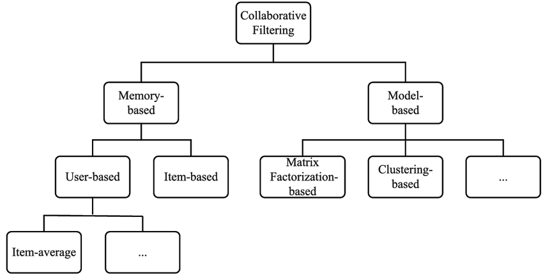

Slide 8
There are two classes of Collaborative Filtering:
User-based, which measures the similarity between target users and other users.
Item-based, which measures the similarity between the items that target users rate or interact with and other items

Slide 9
User-Based Collaborative Filtering
User-Based Collaborative Filtering is a technique used to predict the items that a user might like on the basis of ratings given to that item by the other users who have similar taste with that of the target user.
Many websites use collaborative filtering for building their recommendation system.

Slide 10
Item based collaborative recommendation
Item-item collaborative filtering is a type of recommendation system that is based on the similarity between items calculated using the rating users have given to items. It helps solve issues that user-based collaborative filters suffer from such as when the system has many items with fewer items rated.

Slide 11
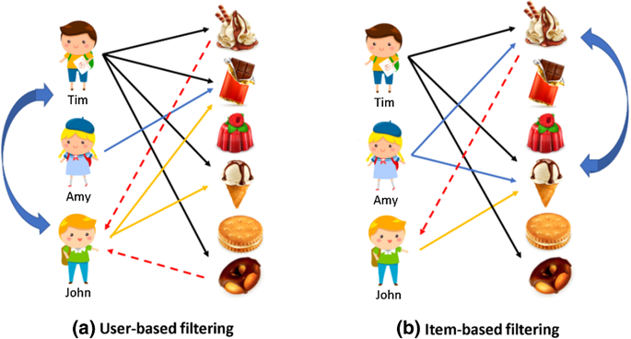

Slide 12
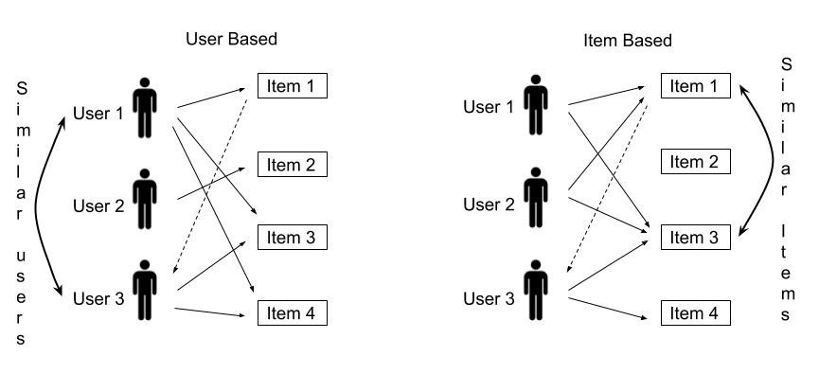

Slide 13
What is meant by collaborative filtering in recommender system ?
Collaborative filtering needs a set of items that are based on the user's historical choices. Other purchaser's reactions are taken into consideration while suggesting a specific product to the primary user. It keeps track of the behavior of all users before recommending which item is mostly liked by users.

Slide 14
The Dataset
To experiment with recommendation algorithms, you’ll need data that contains a set of items and a set of users who have reacted to some of the items. The reaction can be explicit (rating on a scale of 1 to 5, likes or dislikes) or implicit (viewing an item, adding it to a wish list, the time spent on an article). While working with such data, you’ll mostly see it in the form of a matrix consisting of the reactions given by a set of users to some items from a set of items. Each row would contain the ratings given by a user, and each column would contain the ratings received by an item. A matrix with five users and five items could look like this
There are a lot of datasets that have been collected and made available to the public for research and benchmarking. Here’s a list of high-quality data sources that you can choose from.

Slide 15
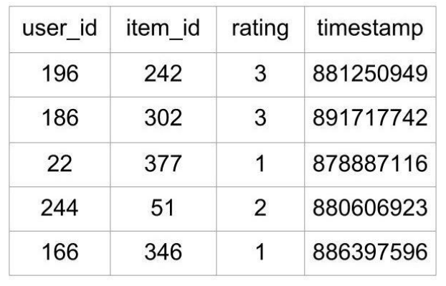
Example of Dataset
First 5 Rows of MovieLens 100k Data As shown above, the file tells what rating a user gave to a particular movie. This file contains 100,000 such ratings, which will be used to predict the ratings of the movies not seen by the users.
This is a sample dataset of a movie ratings given by different users

Slide 16
Examples Of Collaborative Filtering
Amazon is known for its use of collaborative filtering, matching products to users based on past purchases. For example, the system can identify all of the products a customer and users with similar behaviors have purchased and/or positively rated.
Most websites like Amazon, YouTube, and Netflix use collaborative filtering as a part of their sophisticated recommendation systems. You can use this technique to build recommenders that give suggestions to a user on the basis of the likes and dislikes of similar users.

