Slide 1

VENIT,
VIDIT, VICIT!

Slide 2
Currently, there are over 10,000 Facebook pages operating businesses in Bangladesh, among which only “100” pages are affiliated with e-CAB. To become e-CAB member, having a trade license is mandatory. However, none of those businesses have any such document.
REALITY

Slide 3
“ Anyone using a Facebook page is somewhat involved in a BUSINESS. There is no law for doing business through Facebook in Bangladesh. I think there should be some sort of code for digital law, since it is important to bring such businesses under a valid framework.
Mustafa Jabbar
REALITY

Slide 4
“I earn Tk 15,000 to Tk 25,000 a month on a regular basis, which sometimes jumps to
Tk 40,000 during occasions.
Mahbuba Hossain
Owner of Pach4on
SUCCESS
STORY

Slide 5
“My dress price start from Tk 700 to Tk 10,000 and per month average sell Tk 6,00,000++
Nusrat Akhter Lopa
Owner of HUR Nusrat
SUCCESS
STORY

Slide 6
30 million active FB user in Bangladesh and majority lives in Dhaka.
72% of them are male and 28% are female.
Users are aged between 18-32.
More likely to be pursuing undergraduate degree or working blue collar jobs.
86% Facebook users use Facebook only from mobile phone
OPPORTUNITY

Slide 7
10,000+ FB pages operating businesses.
Mostly click and order stores.
Payments via Online or cash on delivery.
Businesses majorly belong to cosmetics, boutiques, fashion houses, photography and event management services, electronics, music, books, watches and foods etc.
OPPORTUNITY

Slide 8
Average Monthly Transaction
10,000 store x Tk. 50,000 =
Tk. 50,00,00,000
Average Yearly Transaction
Tk. 600cr.
* The size of Bangladesh’s e-commerce market is estimated to be around Tk 900 crore ($110-115 million)

Slide 9
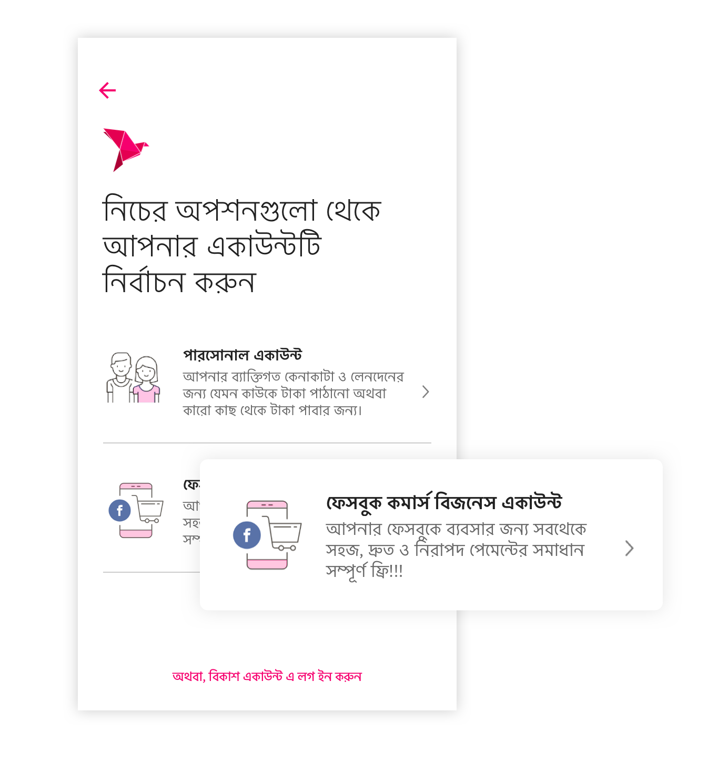
INTRODUCING
SOMETHING
NEW
F-Commerce Business Account. Opportunity to meet 30 million active internet user in Bangladesh in a different way.

Slide 10
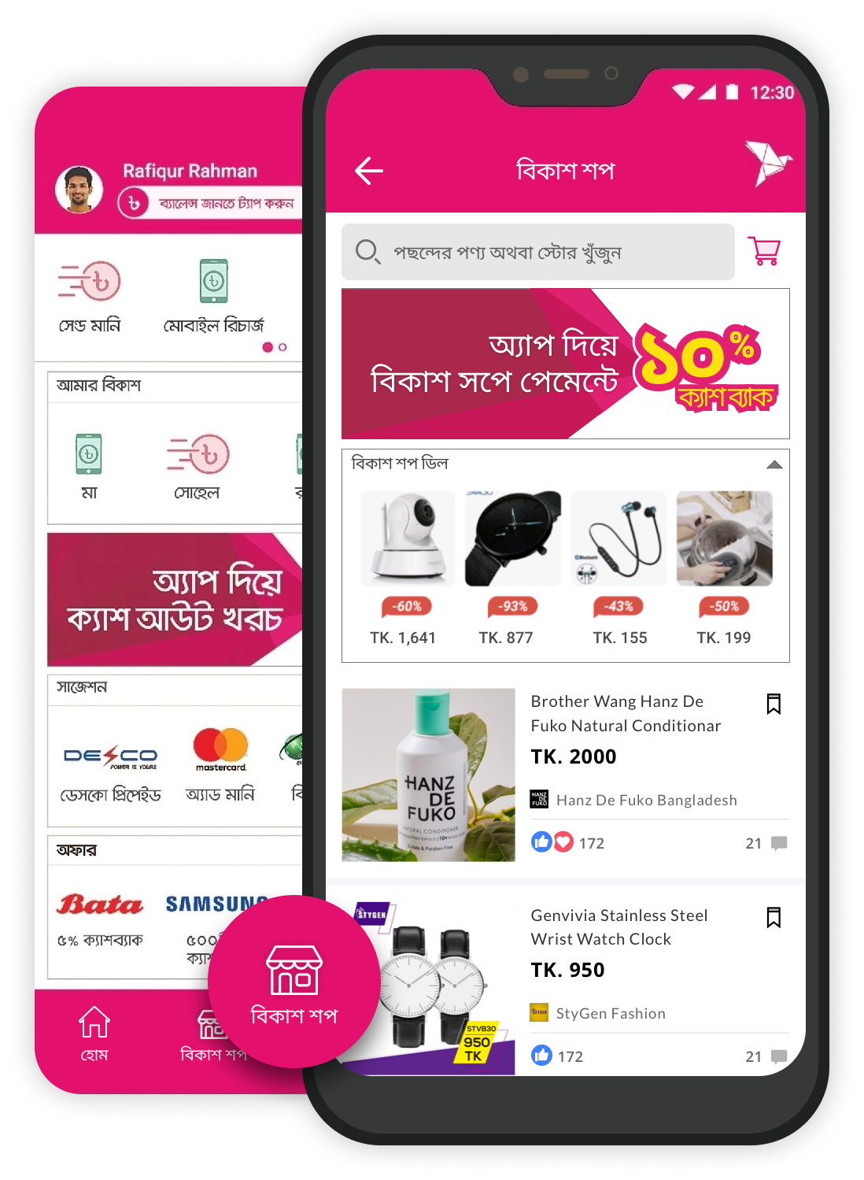
SIMPLE SHOPPING
bKashSHOP
A new possibilities to build the largest e-commerce platform via f-commerce business user. Maximum variety of product, maximum sell, maximum number of transaction.

Slide 11
A instant payment solution including platform benefit with endless opportunities.
VALUE
PROPOSITION

Slide 12
- F-Commerce Business Account is also treated as merchant account.
- A/C holder must have a FB Business Page and has to provide basic info of that page (page title, page link, page profile pic), page admin’s basic info, SOF info and valid ID copy.
- F-Commerce Business Account user has to pay commision on sells.
SIMPLE
GAME PLAN

Slide 13
- Onboard minimum 1000+ popular, most successful FB business page for F-com Business Account on first month
- Introduce F-com Business a/c user to bKashShop platform & motivate them to upload & sell their product on their
- Notify regular bKash user that their fav FB stores are now in bKash platform.
GO-TO-MARKET
STRATEGY

Slide 14
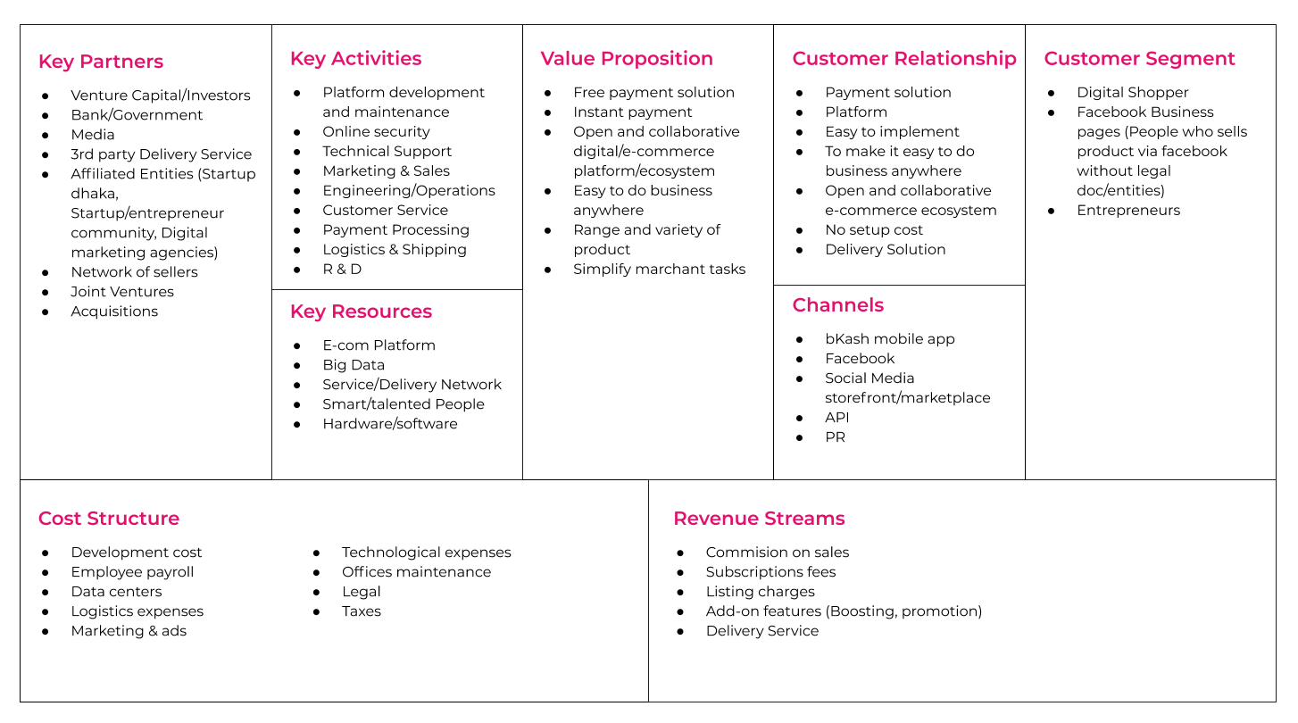
BUSINESS MODEL
CANVAS

Slide 15
FINANCIAL
PROJECTIONS
Onboard minimum 1k F-com store in bKash Store under 10tk sales commission
Develop and test
F-com Business a/c
Launch F-com a/c and
bKashShop
1k store, 10k Sell per day
& generate min Tk30,00,000 as sales commision per month
5k+ store, 100k Sell per day
& generate min Tk3,00,00,000 as sales commision per month
jul-20
start aug-20
mid aug-20
end aug-20
end oct-20
10k+ store, 2500k Sell, min Tk7,50,00,000 as sales commision per month, Boosting Tk1,50,00,000 and delivery Tk5,70,00,000
8k+ store, 200k Sell, min Tk6,00,00,000 as sales commision per month, add listing charge 5tk per item, introduce product boosting service
6k+ store, 150k Sell, min Tk4,50,00,000 as sales commision mo/, introduce delivery service
jun -21
feb-21
dec-20

Slide 16
Year - 2020
SOR: Sales Commision
Tk. 11,8cr(min)
Year - till june 2021
SOR: Sales Commision, Delivery Service Commision, Listing & Boosting charge
Tk. 43,7cr.(min)
*SOR - Source of Revenue

Slide 17
Form Follows Function.
Whatever we want to build something for somebody, it's demand, necessity, requirements should come from the people who will use it. Unless it's very hard to satisfy that person.
It's always scary to break the norms, but it's always exciting and interesting to redefining the stereotype. What I am proposing, this is crazy or might be fantasy, but it seems something new, something rules breaking innovative and most importantly people are now in need this kind of solution.
Who knows, it might be the - Venit, vidit, vicit!
BOTTOM LINE

Slide 18
Mahedi Salim
a product people
Mobile: 01676524172
E-mail: mahedisalim@gmail.com
Thank You

