Slide 1
Digital Portfolio
STUDENT NAME: VIGNESH K
REGISTER NO AND NMID: 7AD1CD6BCBF2620AFA9467DB4BD5FFAC
DEPARTMENT: BSC AIML
COLLEGE: COLLEGE/ UNIVERSITY: Akshaya College of arts and Science/ bharathiar university - coimbatore

Slide 2
PROJECT TITLE
Digital Dynamic Portfolio

Slide 3


AGENDA
Problem Statement
Project Overview
End Users
Tools and Technologies
Portfolio design and Layout
Features and Functionality
Results and Screenshots
Conclusion
Github Link
3/21/2024 Annual Review

Slide 4

PROBLEM STATEMENT
In today's digital age, students and professionals need a centralized platform to showcase their skills and projects. Traditional resumes are static and limiting. A self-developed digital portfolio solves this by providing a dynamic and comprehensive showcase of one's abilities and creativity.

Slide 5

PROJECT OVERVIEW
This project involved developing a fully responsive, single-page portfolio website from scratch using HTML, CSS, and JavaScript. The objective was to create a professional online presence that highlights my educational background, technical skills, academic projects, and interests in AI/ML, serving as an interactive resume and central hub for my academic career.

Slide 6

WHO ARE THE END USERS?
Recruiters & Companies: To assess technical skills and project experience for internships and entry-level positions.
University Professors & Peers: For academic collaboration, project reviews, and networking.
Hackathon & Project Collaborators: To understand my skill set for potential team formations.
Myself: A living document of my learning progress and achievements in AI/ML.

Slide 7

TOOLS AND TECHNIQUES
Frontend: HTML5, CSS3, JavaScript (ES6+)
Styling: Custom CSS with Flexbox & Grid for layout
Icons & UI: Font Awesome Icons
Design Principles: Mobile-First Responsive Design
Version Control: Git & GitHub
Code Editor: VS Code

Slide 8
POTFOLIO DESIGN AND LAYOUT
Navigation Bar: Fixed header with links to all sections.
Hero: Personal introduction with call-to-action buttons.
About: Personal bio and key skill tags.
Education: Timeline of academic qualifications.
Projects: Grid layout showcasing 3 projects with tech stacks.
Skills: Visual skill bars categorized by Programming, AI/ML, and Web Tech.
Interests: Card-based layout for AI/ML passions.
Contact: Contact information and functional form.
Footer: Social media links and copyright.
8

Slide 9
FEATURES AND FUNCTIONALITY
Fully Responsive: Adapts seamlessly to desktop, tablet, and mobile devices.
Interactive UI: Smooth scrolling navigation, hover effects on buttons and cards.
Dynamic Skills Section: Visual progress bars to quantify proficiency levels
Functional Contact Form: Client-side validation for user inputs.
Mobile-Friendly Navigation: Hamburger menu for smaller screens.

Slide 10
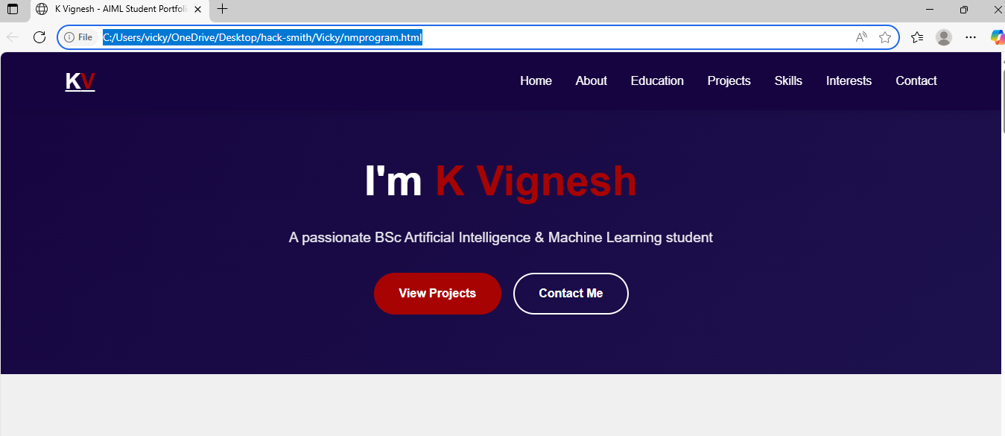
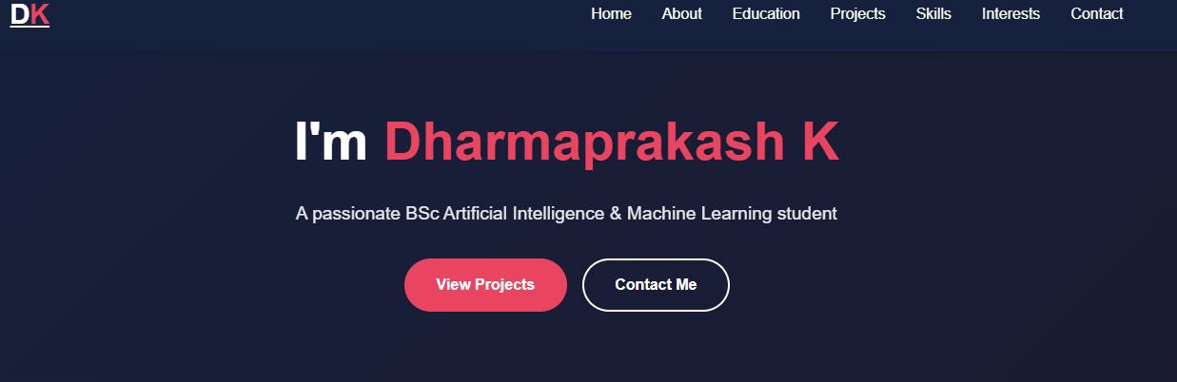

RESULTS AND SCREENSHOTS
3/21/2024 Annual Review
10

Slide 11
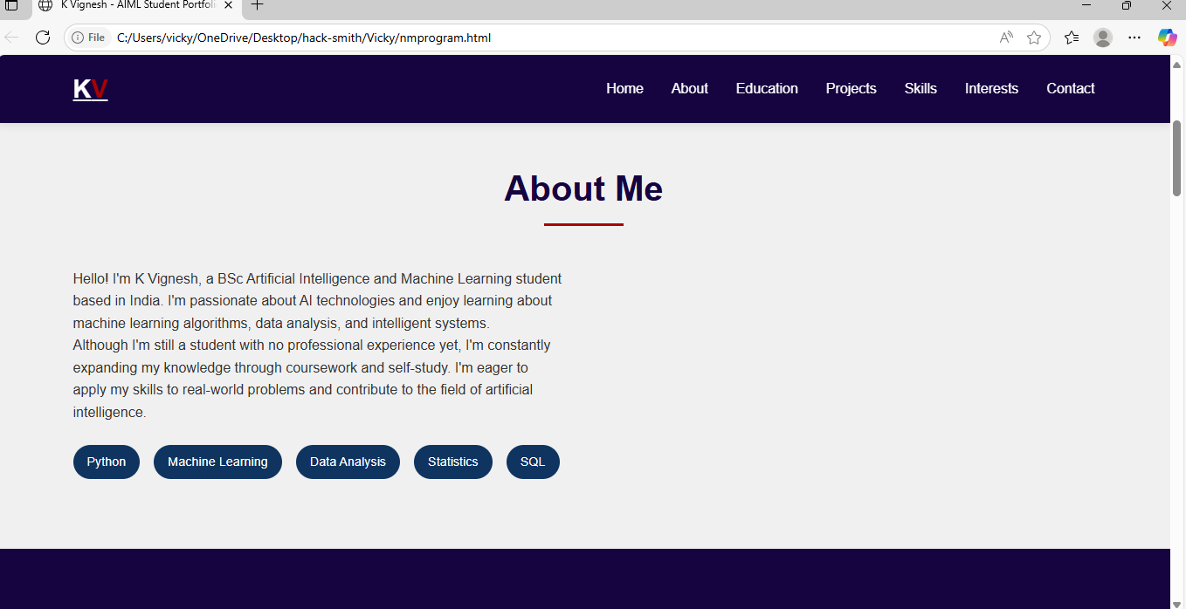
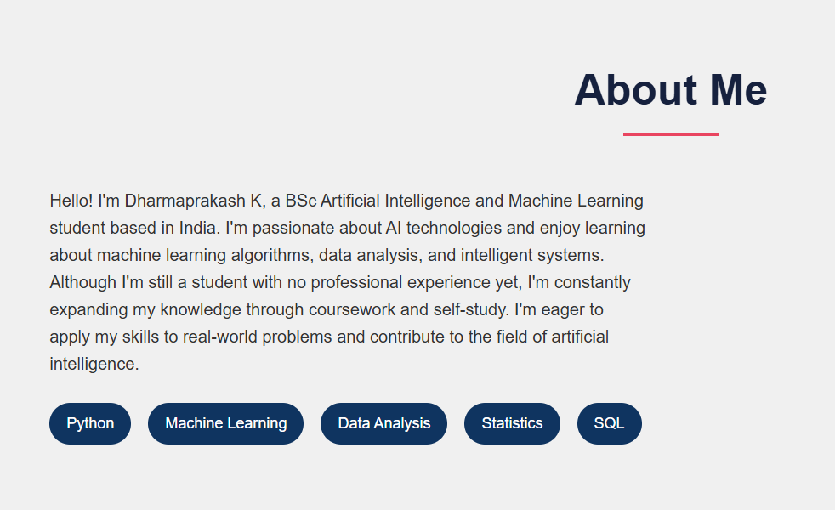
3/21/2024 Annual Review
11

Slide 12
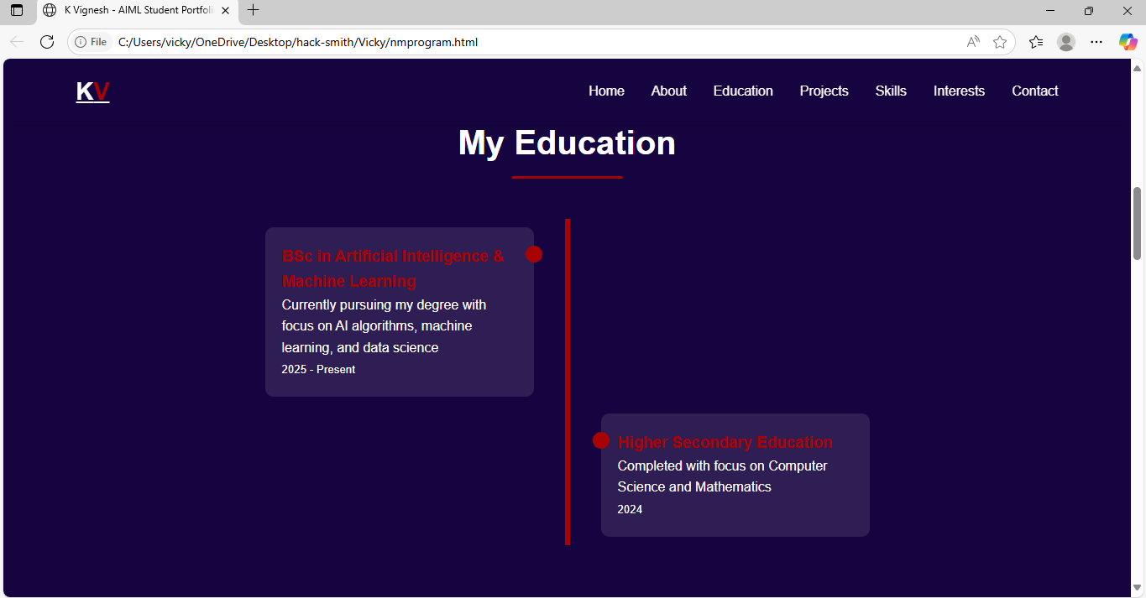
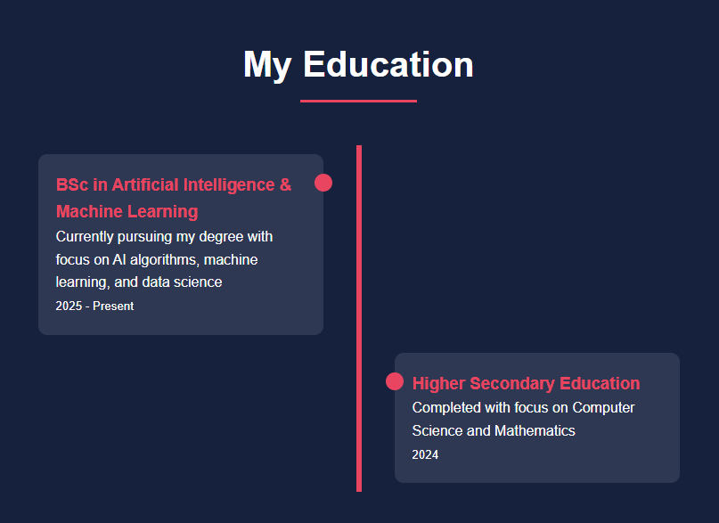

Slide 13
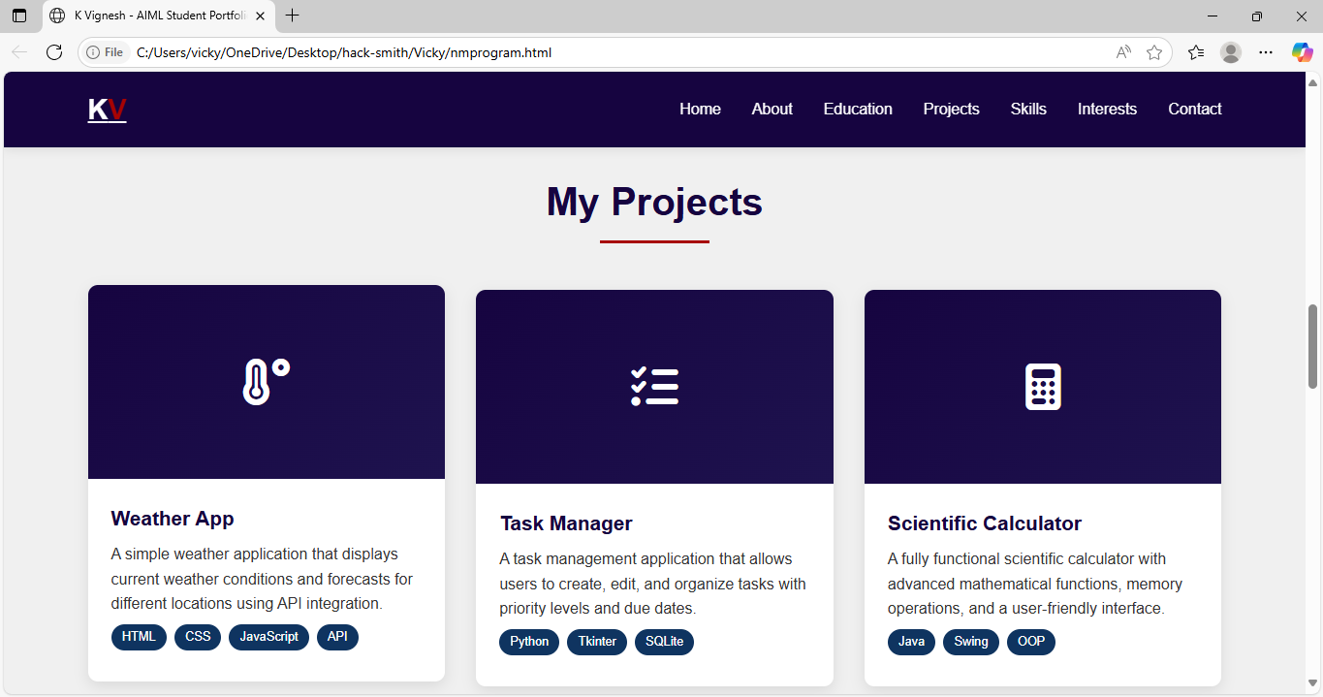
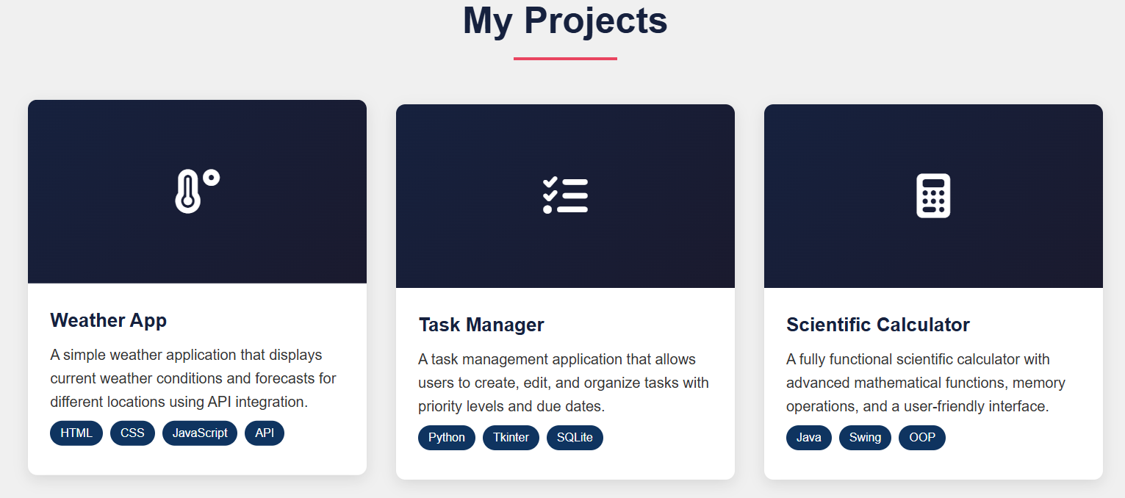

Slide 14
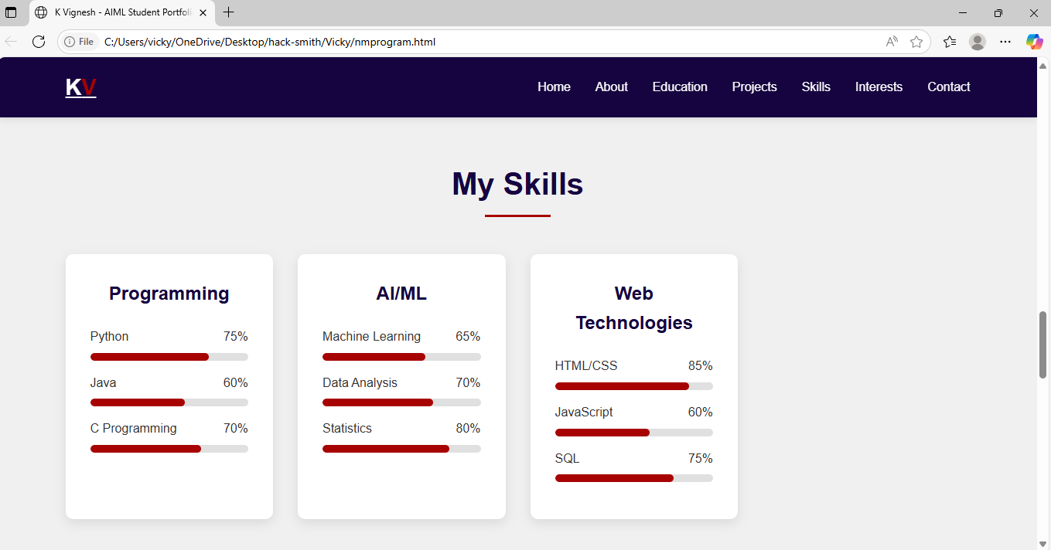
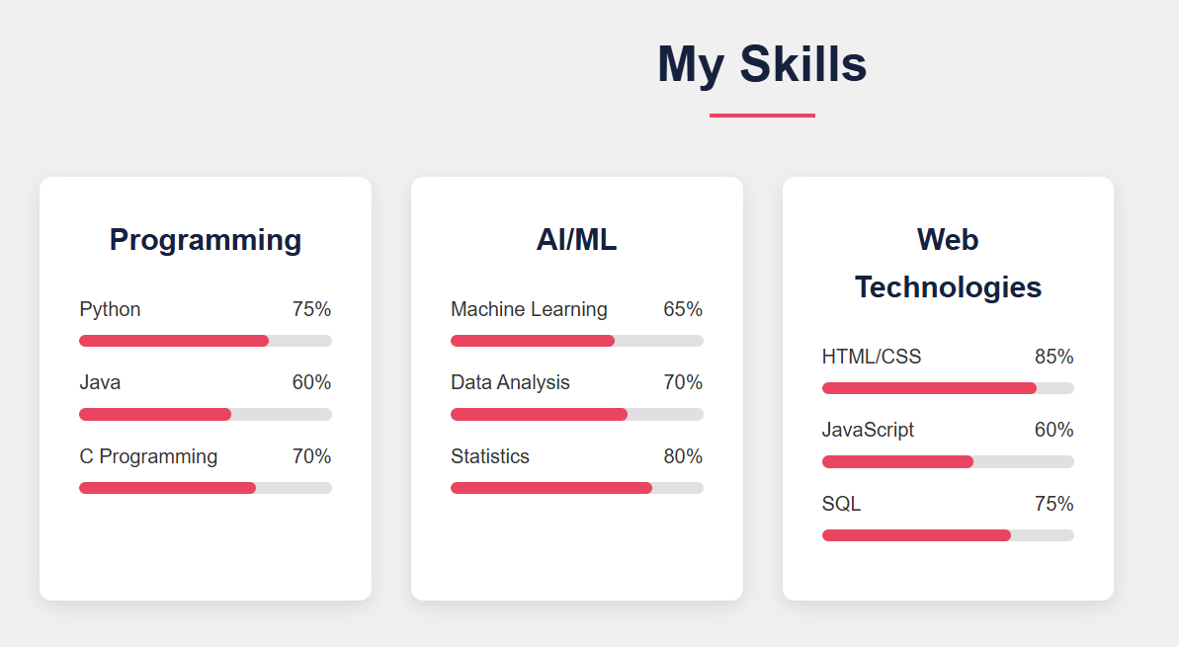

Slide 15
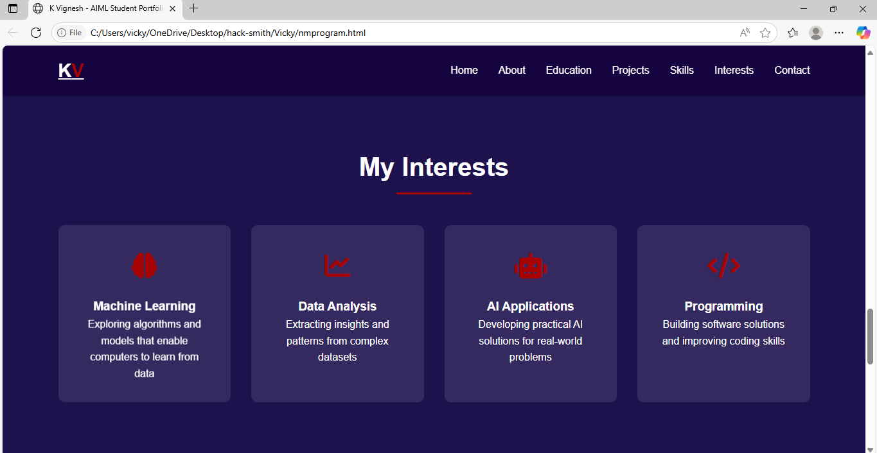
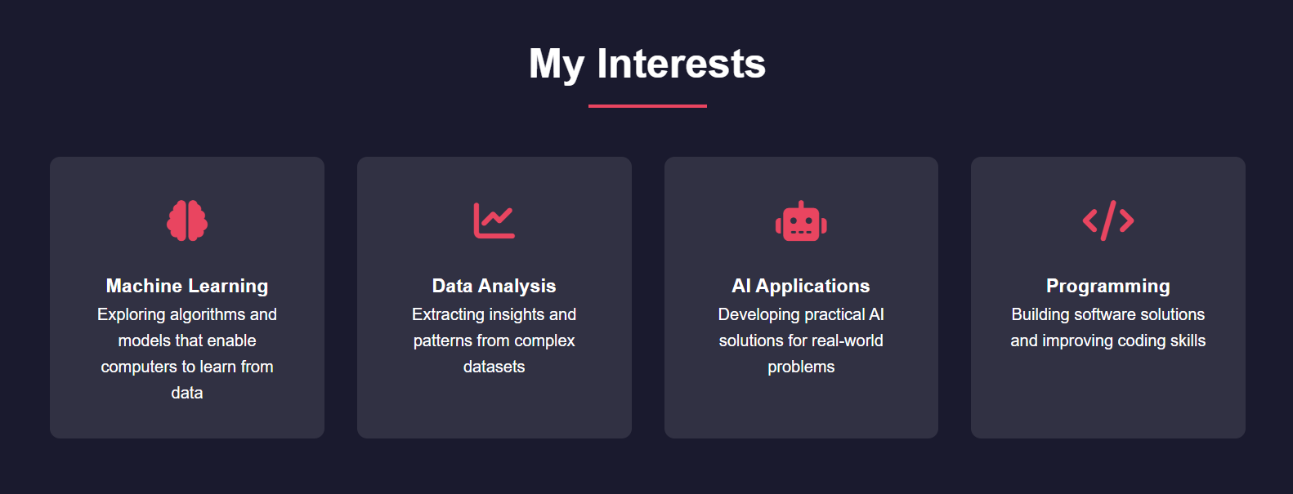

Slide 16
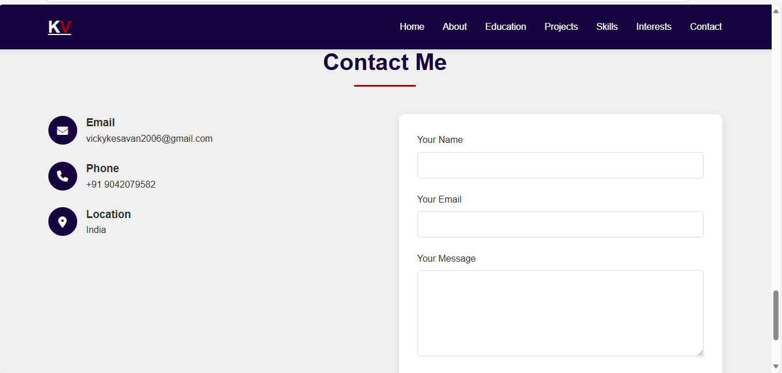
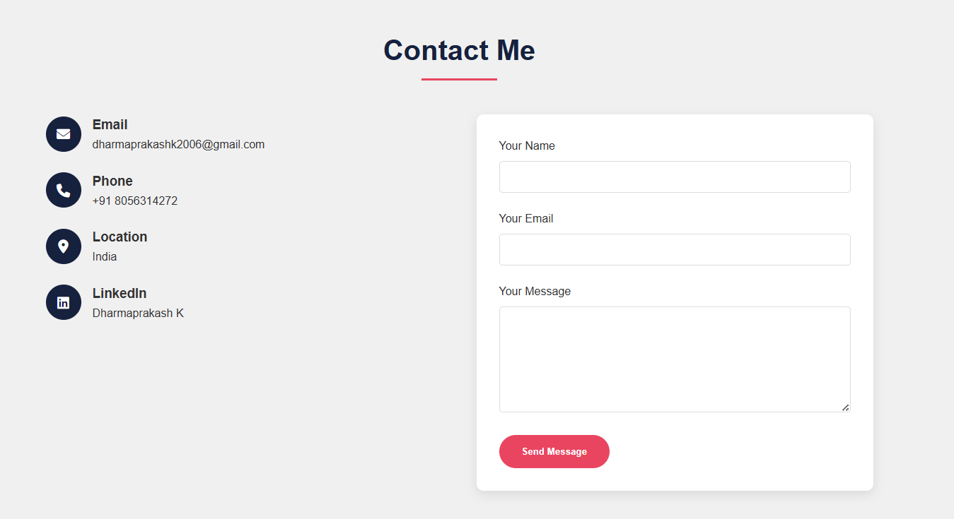

Slide 17
CONCLUSION
This portfolio project was an excellent practical application of front-end development skills. It successfully demonstrates my ability to design, code, and deploy a modern, responsive website. More than just a project, it acts as the primary showcase for my AI/ML journey, highlighting my technical skills, projects, and passion for the field. It is a foundational asset that I will continually update throughout my academic and professional career.
17

