Slide 1

Data Analysis & Insights
Key Findings and Visualizations
Mir Abdul Malique
Date: 2024

Slide 2
Introduction
Airbnb, headquartered in San Francisco, California, operates a popular online marketplace specializing in short-term accommodations and experiences. Established in 2008 by founders Brian Chesky, Nathan Blecharczyk, and Joe Gebbia, the name Airbnb is derived from its original moniker, AirBedandBreakfast.com
The primary objective is to analyze Airbnb data to reveal insights into user experiences and satisfaction levels with the numerous listed stays, all accomplished using Power BI.
Total Host Listing: 7M
Total Reviews: 5.37M by 4.45 M reviewers.

Slide 3
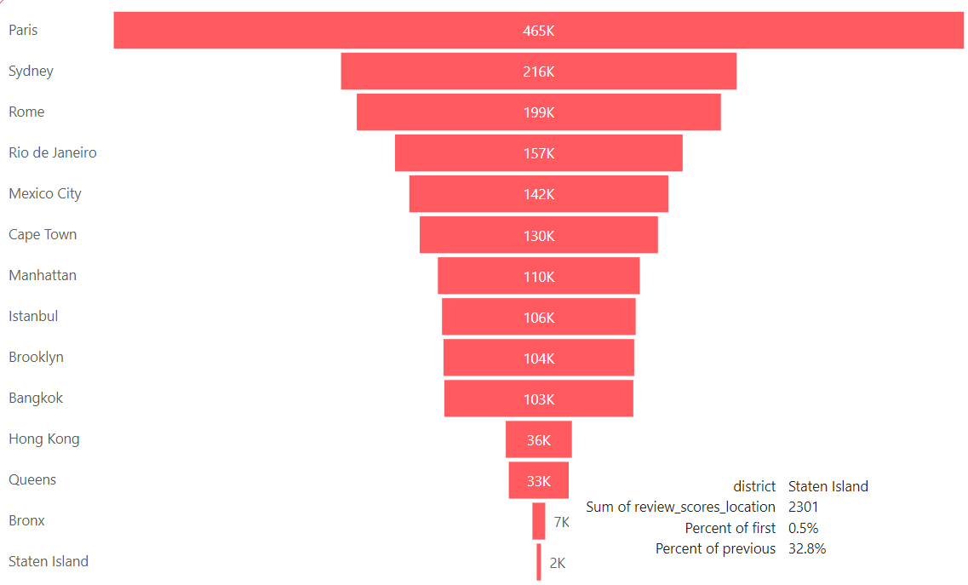
Assessing District Location Scores
Objective: Identify districts with the least favorable location scores.
From the visual it can be inferred that people are more visiting paris whereas the least favourable location is Staten Island with location score 2301 i.e 2k
Potential reasons for lower scores (e.g., accessibility, safety, amenities).

Slide 4
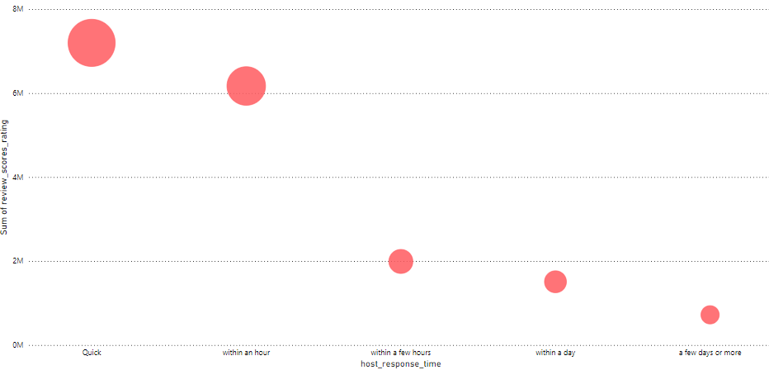
Examining Host Response Time Impact
Objective: Explore the relationship between host response times and overall ratings.
Correlation between fast response times and higher ratings shows that the quicker the response , quicker will be the services . If we drill down to more granular level in terms of city Paris , New York etc stands higher
Impact of delayed responses on guest satisfaction.

Slide 5
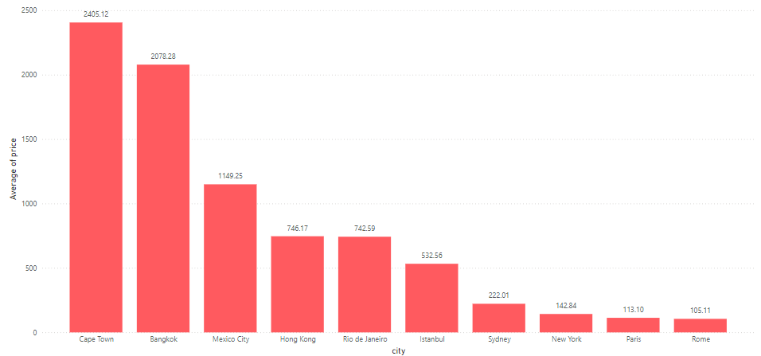
Visualizing Airbnb Listing Prices
Objective: Analyze listing prices across different cities.
Cities with the highest average rice is Cape Town whereas lowest average prices is Rome.
Affordability may be the reason Paris/Rome is the most visited places.
With all the amenities included(e.g., luxury properties, seasonal variations).

Slide 6
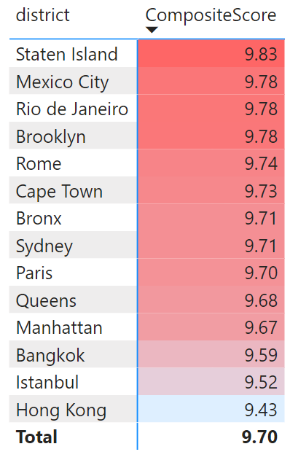
Analyzing Composite Scores
Objective: Create a composite score integrating check-in experience and host communication.
Methodology for composite score calculation.
AvgCheckInExperience = AVERAGE(Listings[review_scores_checkin])
AvgHostCommunication = AVERAGE(Listings[review_scores_communication])
CompositeScore = ([AvgCheckInExperience]+[AvgHostCommunication])/2
From the Heat map we can see that combining both check-in experience & Host communication the composite scores.
Guest experience is strong in Staten island whereas poor in Hong Kong
Hong Kong needs improvement in terms of check-in & host Communication.

Slide 7
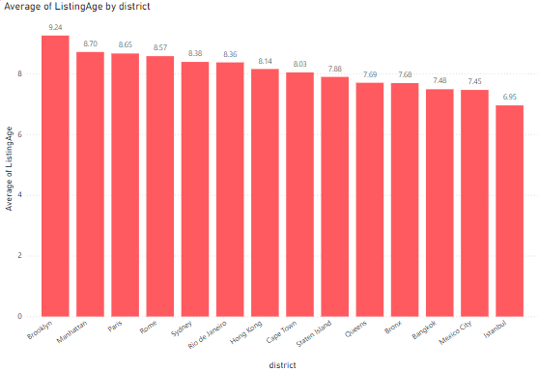
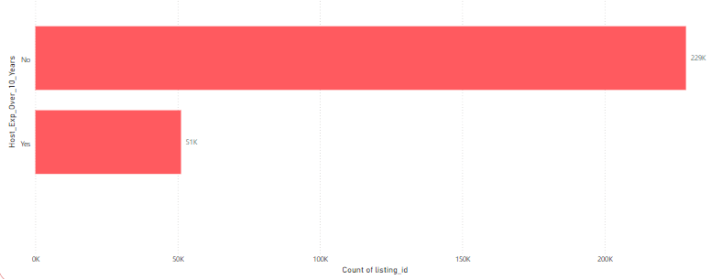
Calculating Listing Age and Host Tenure
Objective: Determine the age of listings and identify experienced hosts.
ListingAge = DATEDIFF([host_since], TODAY(), YEAR)
Host_Exp_Over_10_Years = IF([ListingAge] > 10, "Yes", "No")
Listing Age by District
No.of Host over 10 years of experience

Slide 8
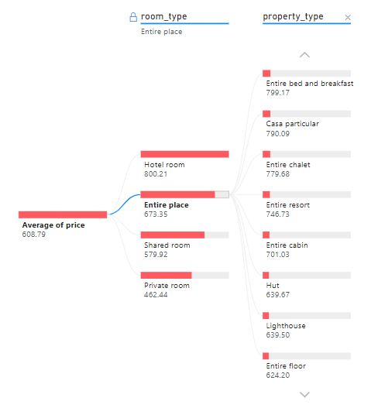
Property Type Price Analysis
Objective: Property type with the highest average price (focus on entire places).
From the tree map we can infer that :
private room is less in cost whereas Hotel room is quite expensive.

Slide 9
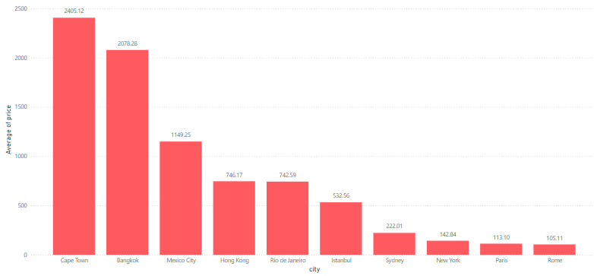
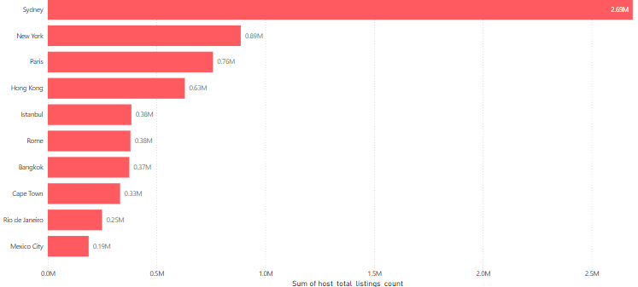
Crafting a Comprehensive City Insights Report
Objective: Provide a detailed report on city-specific insights.
Cape Town has more price i.e expensive
Sydney has more no. of listing

Slide 10
Conclusion & Recommendations
The district with the lowest average location score could indicate an area where improvements or additional amenities are needed to enhance guest satisfaction.
If there's a strong correlation, it indicates that quicker host response times might lead to better guest ratings, emphasizing the importance of prompt communication.
This will help identify which cities have higher or lower average prices, providing insights into market dynamics and pricing strategies
Composite score will pinpoint areas where the guest experience is strong or needs improvement, focusing on the check-in process and host communication.
Understanding the longevity of listings and experienced hosts can reveal trends about the sustainability and reliability of certain listings.
Property price analysis will show which property types command higher prices, which can inform decisions about property investments or pricing strategies.
The report will provide a comprehensive overview of market dynamics, particularly in how visitor patterns changed during 2020, which could be due to external factors like the pandemic.

Slide 11
Q&A
Open the floor for any questions.

