Slide 1




































































































VOIS Innovation Marathon 2.0

Slide 2


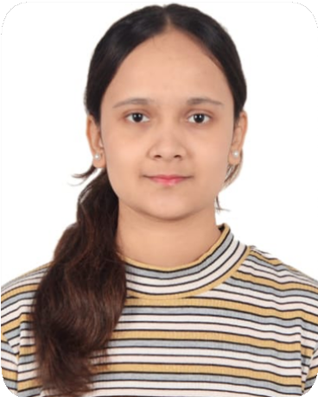

Project Title :
PestGuard AI – Smart Pest Early Warning System
Team Lead, Mitali Kishor Jadhav, CSE
Team No : 03
Yash Govind Rathi, CSE
Soumya Sachin Patharwalkar, CSE
Deccan Education Society Pune University

Slide 3
Problem Statement
AI-Based Crop Pest Detection System
The Challenge: Farmers face significant crop losses due to inefficiencies in pest identification and monitoring, mainly caused by:
Delayed pest detection
Manual identification limitations
Limited expert access
Crop yield and financial loss
Without a fast, accurate, and easily accessible pest detection solution, farmers struggle to take timely preventive action, resulting in avoidable crop damage and lower productivity.

Slide 4

Why This Project Matters & Who It Serves
Early pest detection is essential to prevent major crop damage and reduce yield loss.
Farmers often lack quick access to agricultural experts for accurate pest identification.
Delayed or incorrect identification leads to improper pesticide usage.
Excessive or wrong pesticide use harms crops, soil health, and the environment.
Farmers and other users need a fast and reliable
AI-based pest detection system.

Slide 5
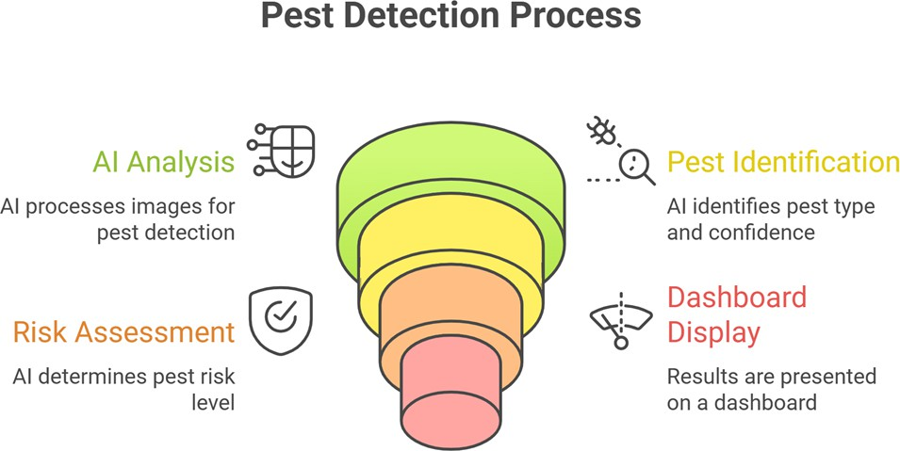
The Solution Proposed
AI-Powered Pest Detection Web Application
Upload / capture crop image
AI model detects pest & risk level
Instant results on dashboard 5. Actionable insights for farmers
and users .

Slide 6
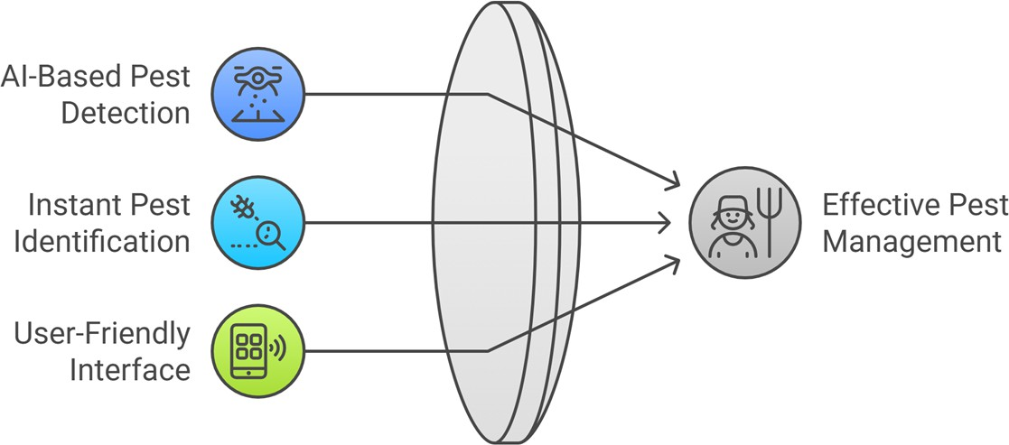
AI-Driven Pest Management: Value at a Glance
Smart. Fast. Farmer-Friendly.
Detects crop pests in real time using AI
Delivers instant, reliable pest insights
Designed for farmers and non-technical users

Slide 7
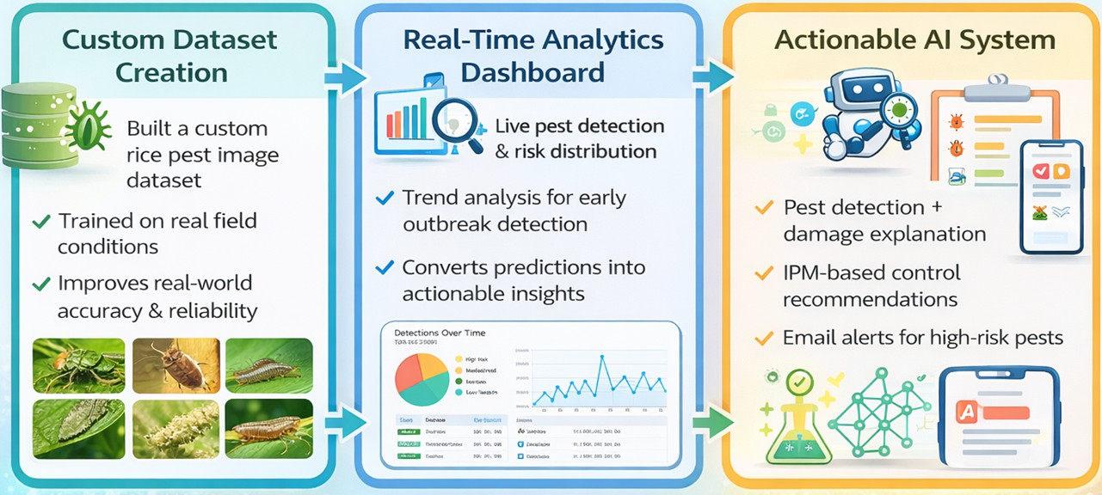
THE WOW IN YOUR SOLUTION

Slide 8
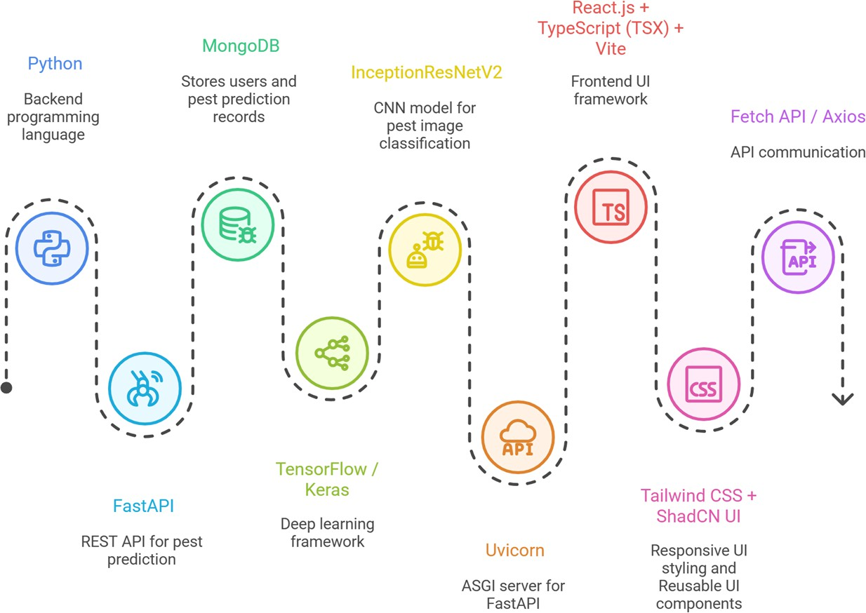
Technical flow diagram -

Slide 9
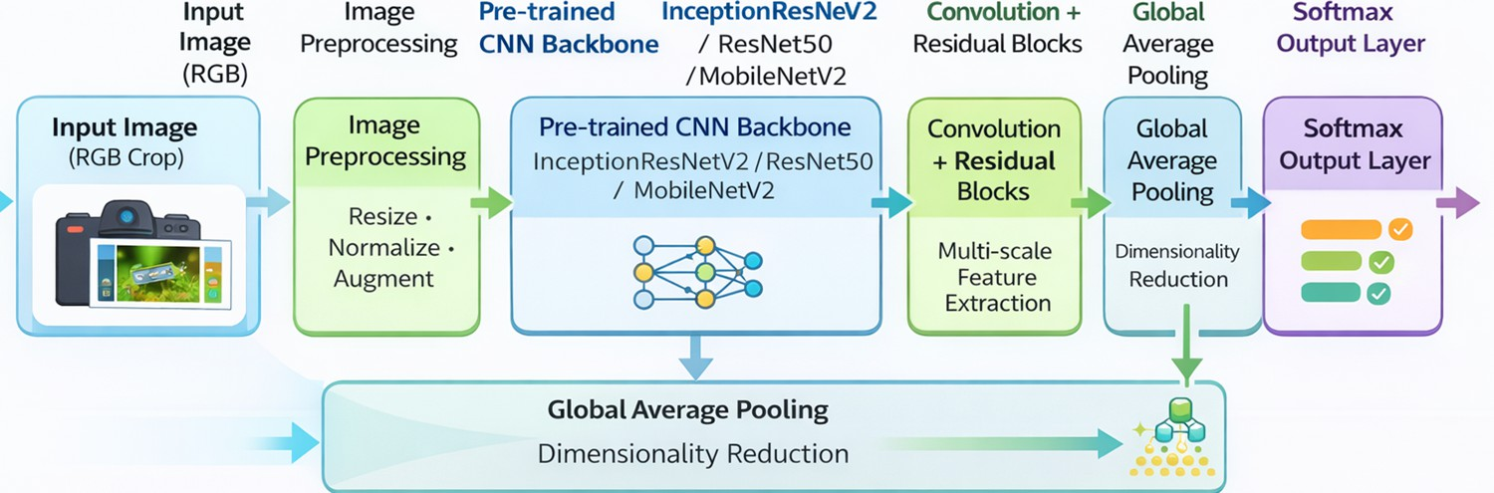
Neural Network Architecture
Model | Precision (%) | Recall (%) | Confidence (%) | Key Advantage
InceptionResNetV2 | 98.5 | 98.1 | 99.0 | Highest accuracy, multi-scale + residual learning
ResNet50 | 96.9 | 96.4 | 97.2 | Strong baseline, stable training
MobileNetV2 | 94.2 | 93.8 | 95.0 | Lightweight, fast inference

Slide 10
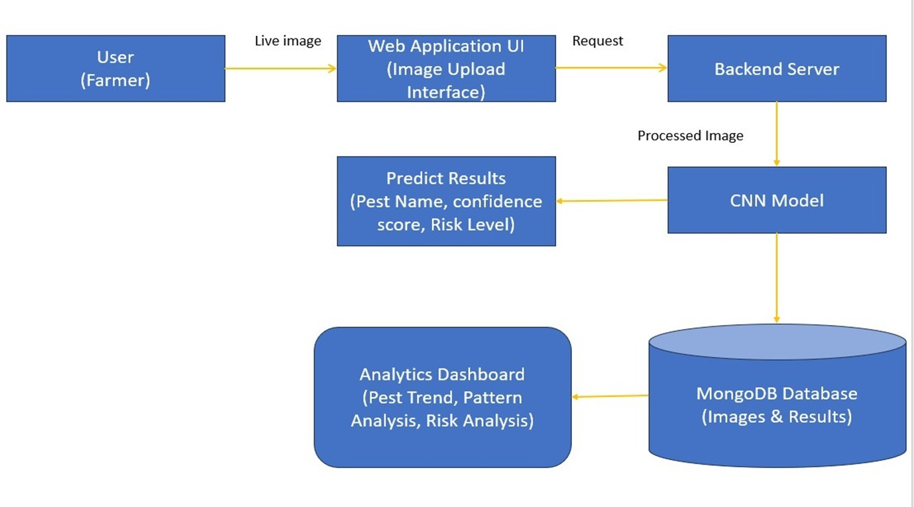
Workflow diagram

Slide 11
Novelty and Uniqueness
1
2
3
4
5 pest classes: Rice
Bug, Green Leafhopper, Planthopper, Rice Stem Borer, Rice Leaf Roller
275 original images,
expanded to 5,054 using data augmentation & transfer learning
Real-Time Risk
Categorization Engine- Dynamic High / Medium / Low risk scoring
High Alert: Triggered when a high-risk pest is detected, with email service

Slide 12
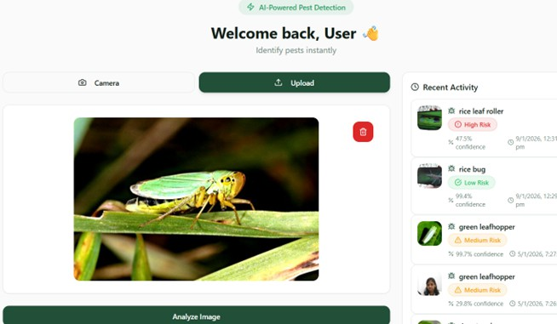
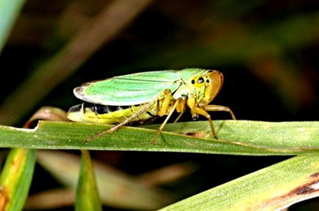
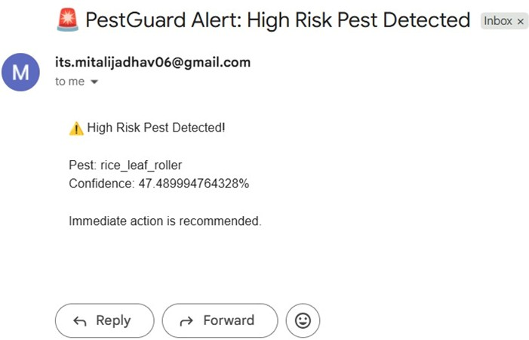
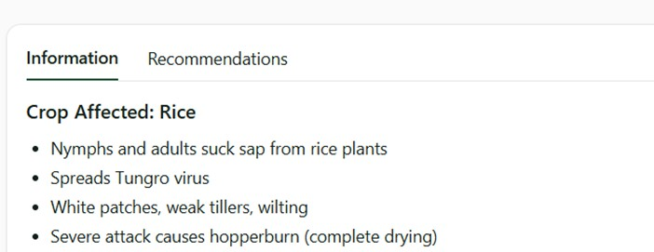
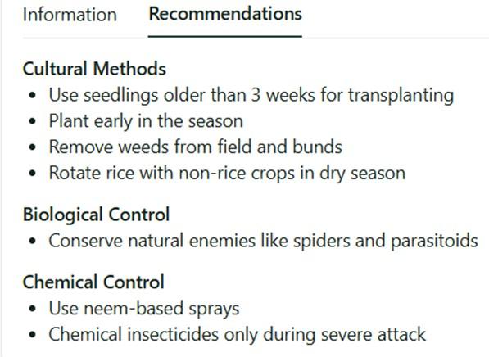
Screen shots of your project -
Predict Page -
High Alert: Triggered when a high-risk pest is detected
Pest:
Green Leafhopper

Slide 13
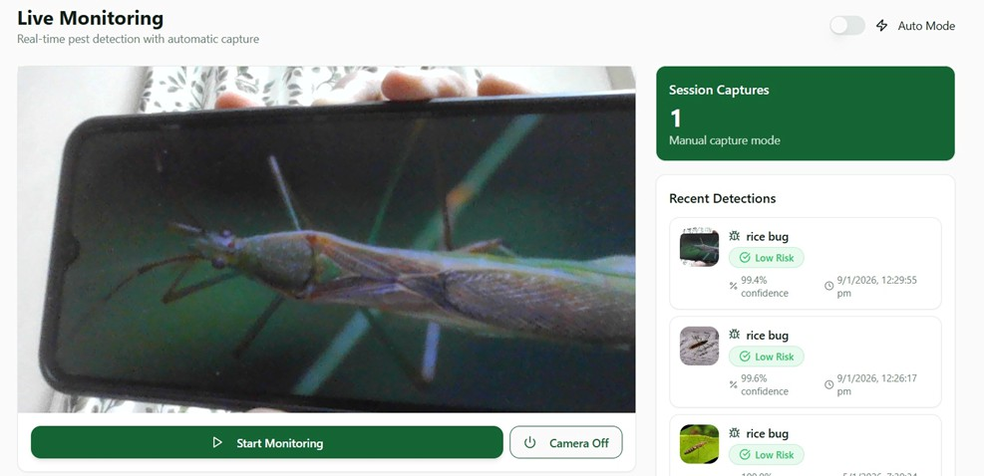
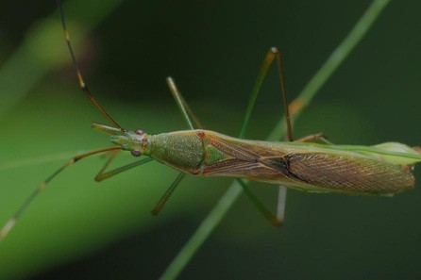
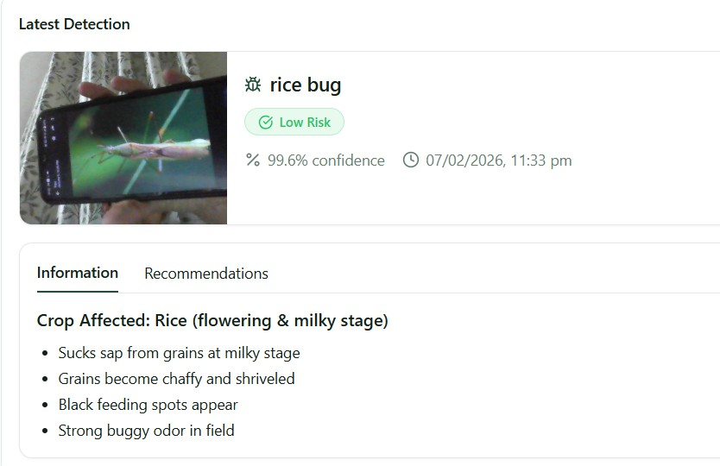
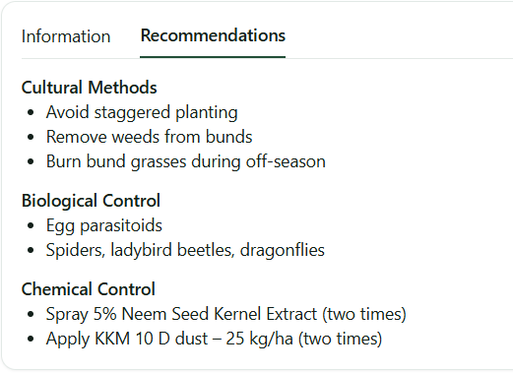
Screen shots of your project -
Live Monitoring Page -
Live Monitoring:
Continuous pest detection using OpenCV
Pest: Rice Bug

Slide 14
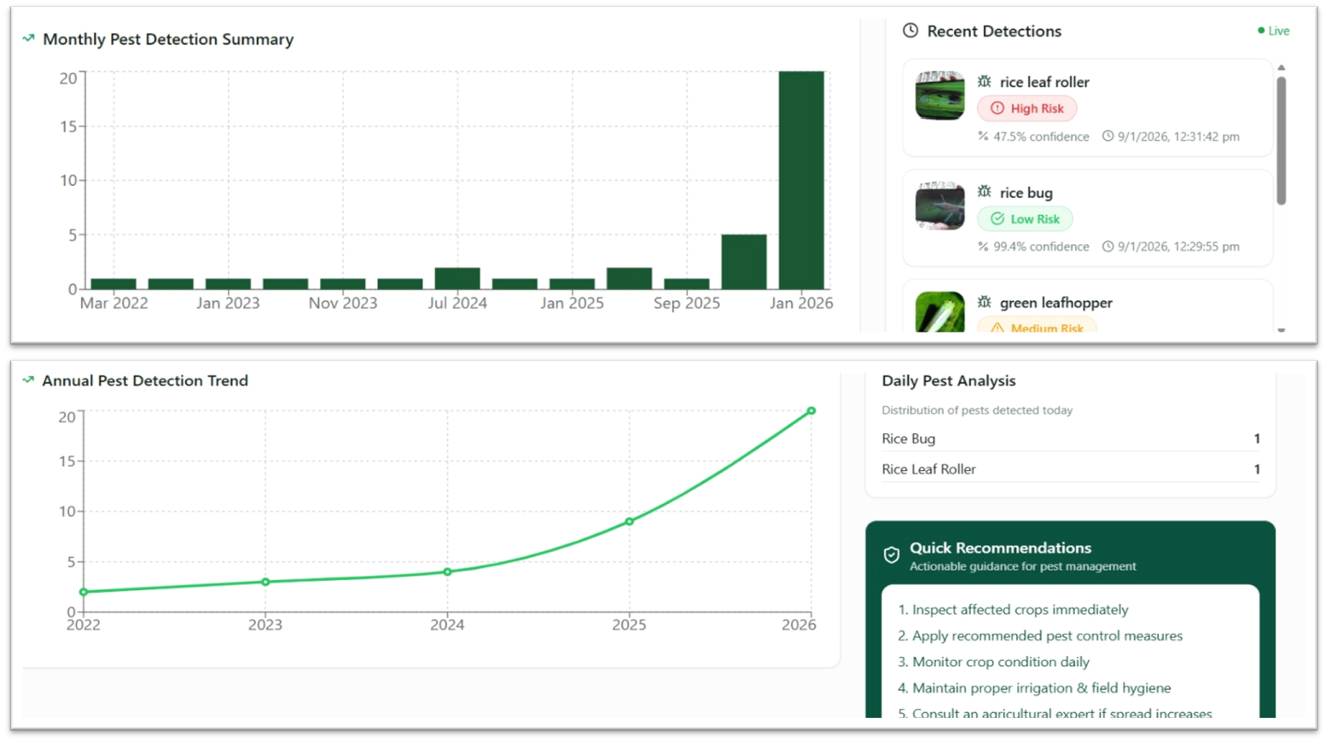
Screen shots of your project -
Analytic Dashboard Page - (Monthly Summary + Recent Detections + Detection Trends + Daily Analysis)

Slide 15
Impact & Future Scope
Impact
Early pest detection reduces crop damage & yield loss
Data-driven alerts enable timely farmer action
Promotes IPM-based recommendations, reducing pesticide use
Improves crop health, productivity & farmer income
Scalable solution for small & marginal farmers
Future Scope
Support for multiple crops & regional pests
Weather-based pest prediction and preventive alerts
Continuous AI model improvement Mobile app (Android/iOS) with camera-based detection

Slide 16
Git Hub Link
GitHub Repo Link-
itsmitalijadhav06-beep/pest-detection

Slide 17
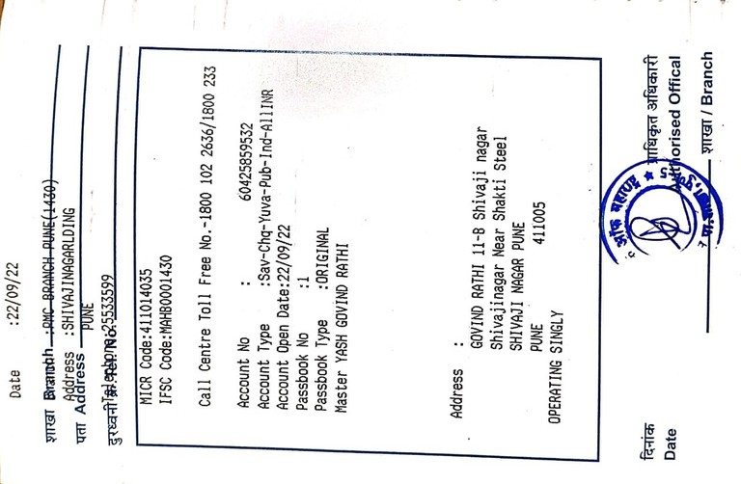
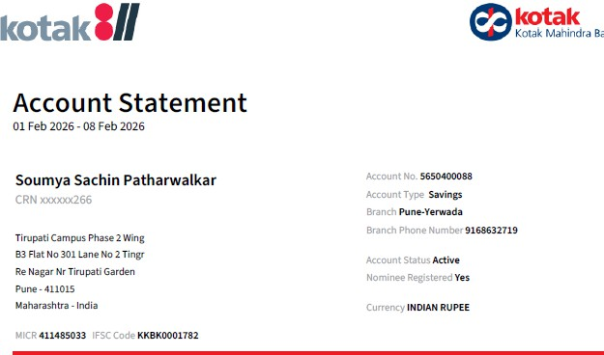
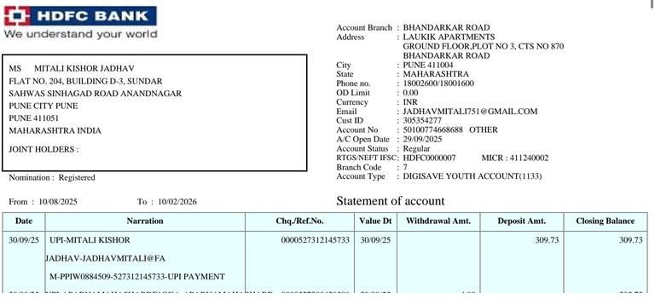
Bank Details
Full Name (as per bank records): | Bank Name | Branch Name | Account Number | Account Type (Savings / Current) | IFSC Code
YASH GOVIND RATHI
Soumya Sachin Patharwalkar
Mitali Jadhav
BANK OF
MAHARASHTRA
Kotak Mahindra Bank HDFC Bank
PMC BRANCH PUNE
(1430)
Pune- Yerwada
BHANDARKAR ROAD, PUNE
60425859532
5650400088
50100774668688
SAVINGS
SAVINGS SAVINGS
MAHB0001430
KKBK0001782 HDFC0000007
YASH GOVIND
Soumya Sachin Patharwalkar
Mitali Jadhav

Slide 18
Thank You

