Slide 1

“Built For Apple Intelligence”
Apple Store Reviews Statistical Analysis
Presented By:- SHARAD MITTAL

Slide 2
Blog
Products
About us
contact
Login
Measure Central Tendency of App Ratings
Analyze Purchase Behavior Spread
Assess Engagement Variability
Examine Rating Distribution Shape
Project: Apple Store Reviews
Explore Relationships
Compare App Performance
“Built For Apple Intelligence”
Demonstrate the Central Limit Theorem (CLT)

Slide 3
Problem Statement
Mobile applications on the Apple App Store rely heavily on user reviews and ratings to understand customer satisfaction, identify improvement areas, and drive product decisions. However, raw review data often contains variability, noise, and subjective biases, making it essential to apply statistical methods to extract meaningful insights.
In this analysis, we aim to evaluate user sentiment and engagement patterns across popular mobile applications by performing both descriptive and inferential statistical analysis on an Apple App Store reviews dataset.
Use Statistics Analysis to analyze Apple store Reviews for better decisions.

Slide 4
Rating Analysis
Mean: 2.869 The mean is slightly below 3, suggesting that extreme low ratings (like 1) are pulling the average down Median: 3 The median indicates that half of the ratings are below and half are above this value, making it a better representation of central tendency in this case
Mode: 1 The mode being the most frequent rating indicates a significant number of users rated the app poorly
Conclusion: The median best represents the central tendency of the ratings, as it is not skewed by extreme values and reflects the "middle" user experience better than the mean
MEDIAN IS BEST

Slide 5
Variance and Standard Deviation
Variance:- 822.8547
Variance indicates the average squared deviation from the mean, reflecting the degree to which likes vary from the average.
Standard Deviation:- 28.6854
The standard deviation (28.6854) represents the spread in the same units as the original data, highlighting significant variability in user engagement with reviews.
Conclusion: A high standard deviation suggests diverse reactions among users, indicating that while some reviews received few likes, others received many.

Slide 6
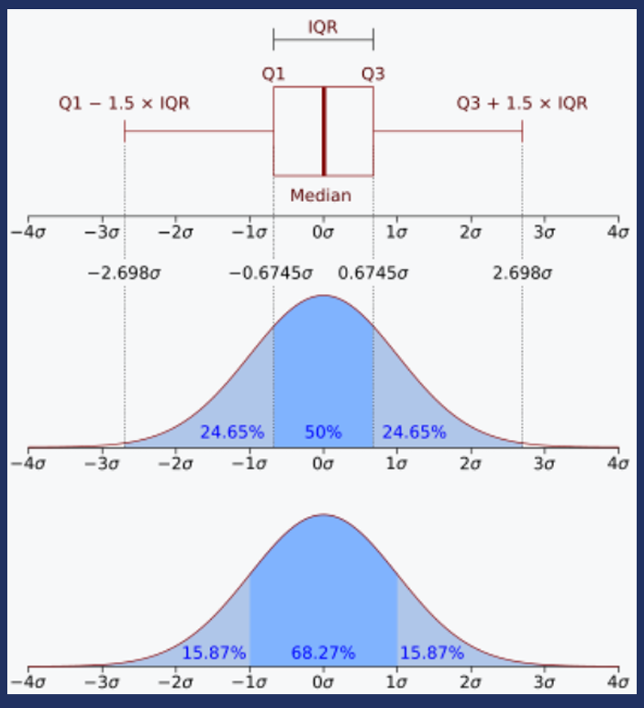
Spread of Purchase Amount
Range: 19.97
The range of 19.97 provides a comprehensive view of the variability in purchase amounts, showing the difference between the highest and lowest values.
IQR: 10.1925
The IQR (10.1925), which measures the range of the middle 50% of the data, helps focus on typical purchase amounts without being influenced by outliers.
Conclusion: The range offers an overview of data variability, while the IQR gives insight into the spread of typical purchase amounts, aiding in identifying anomalies.

Slide 7
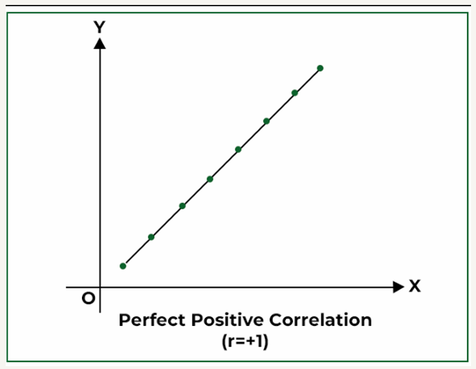
Correlation between Likes and Rating
Correlation Coefficient 0.8425
Analysis A correlation coefficient of 0.8425 indicates a strong positive correlation between likes and ratings, suggesting that higher likes tend to accompany higher ratings.
Conclusion This strong correlation implies that user satisfaction and engagement (likes) are closely related

Slide 8
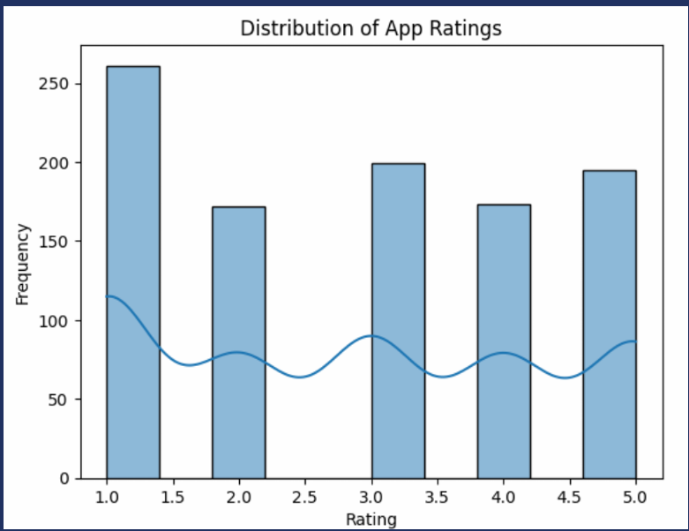
Distribution of App Ratings
Skewness (assumed based on visual analysis)
Analysis If the distribution is positively skewed, this indicates that a majority of users rated the app lower, with a few high ratings pulling the average up. Conversely, a negatively skewed distribution would suggest most users rated the app higher.
Conclusion A positively skewed distribution may suggest overall dissatisfaction, while a negatively skewed distribution would imply user satisfaction.

Slide 9
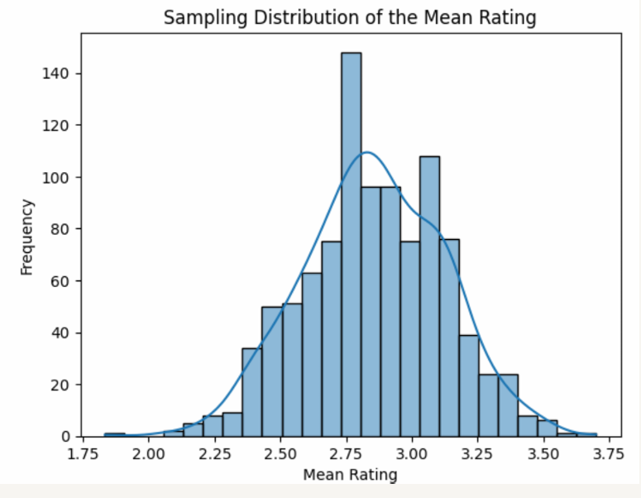
Sampling Distribution and Central Limit Theorem
Sampling Distribution: The histogram of sample means demonstrates an approximately normal distribution.
Analysis: The Central Limit Theorem (CLT) states that the sampling distribution of the sample mean will be normally distributed if the sample size is sufficiently large (n ≥ 30).
In this case, the histogram shows a clear normal shape, validating the application of the CLT

Slide 10
Hypothesis Test for Instagram vs. WhatsApp Ratings:-
Hypothesis Testing Framework: Null Hypothesis (H₀)
The average rating for Instagram is equal to or less than the average rating for WhatsApp. H₀: μInstagram <= μ Whatsap
Alternative Hypothesis (H₁): The average rating for Instagram is greater than the average rating for WhatsApp. H₁: μInstagram > μ Whatsapp
T-statistic: -0.7967
P-value: 0.7868
Interpretation: A high p-value indicates we fail to reject the null hypothesis.
Conclusion: There is no significant difference between average ratings for Instagram and WhatsApp, suggesting user perceptions are similar.

Slide 11
Conclusion: Analysis of Apple Store Reviews:-
1. The median rating of 3 suggests mixed user satisfaction, with many low ratings (mode of 1).
2. The range and IQR of purchase amounts show moderate variability in spending behavior.
3. Significant variance in likes highlights diverse user engagement with app reviews.
4. A strong positive correlation (0.8425) between likes and ratings suggests that higher-rated reviews attract more likes.
5. Hypothesis testing found no significant difference between Instagram and WhatsApp ratings.
6. The Central Limit Theorem supported reliable inferences, helping guide improvements in app features and user satisfaction.

Slide 12

Thank You!
We Respect your valuable time with APPLE INC .
If you have any questions, please reach us

