Slide 1



Slide 2

ITC Hotels Revenue Optimization
Executive Summary
Reports are crucial in documenting and analyzing a company’s progress across different domains such as financial performance, customer engagement, and operational efficiency. For ITC Hotels, this report provides insights into financial performance, customer booking behavior, occupancy trends, and room category performance to optimize revenue generation, minimize cancellations, and enhance customer satisfaction. This report is backed by real-time data visualized in an interactive Power BI dashboard, designed to aid stakeholders in making informed decisions.
Presented By :- SHARAD MITTAL

Slide 3
Objectives of Revenue Optimization at ITC Hotels
Revenue Optimization Objectives
The objective of Revenue Optimization in ITC Hotels is to maximize the hotel’s financial performance by strategically managing pricing, inventory, and demand across all revenue-generating areas. In simple terms, it ensures the right product (room, service, or package) is sold to the right customer, at the right time, through the right channel, and at the right price.
Maximize Revenue & Profitability 2. Optimize Pricing Strategy
3. Improve Occupancy & Yield 4. Demand Forecasting
5. Customer Segmentation 6. Data-Driven Decision Making

Slide 4
ITC Hotels Problem Statement
Challenges in Revenue Optimization
Despite being a leader in luxury hospitality, ITC Hotels faces challenges in maximizing revenue due to fluctuating demand patterns, increasing competition from global and domestic hotel chains, high dependency on third-party booking channels, and changing customer preferences. Inefficient pricing strategies, underutilization of ancillary services (F&B, spa, banquets), and limited adoption of advanced revenue management tools further hinder optimal revenue generation.

Slide 5
ITC Hotels Key Metrics Dashboard
Financial Overview & Revenue Performance
This page delivers a high-level overview of ITC Hotels’ financial performance, with a breakdown of revenue across different properties and room categories. Key metrics include:
Total Revenue: ₹1.71 billion, representing the robust financial performance of the hotel chain.
Cumulative Revenue Growth: Consistently rising, signaling a strong upward trend in financial outcomes.
Month-over-Month (MoM) Growth: MoM growth is 50.44%.
Week-over-Week (WoW) Growth: Notably, WoW growth surged by 1395.05%.
Average DailY Rate (ADR): ₹14.92K, reflecting successful pricing strategies.
Revenue per Available Room (RevPAR): ₹7.35K, highlighting effective room utilization and revenue efficiency

Slide 6
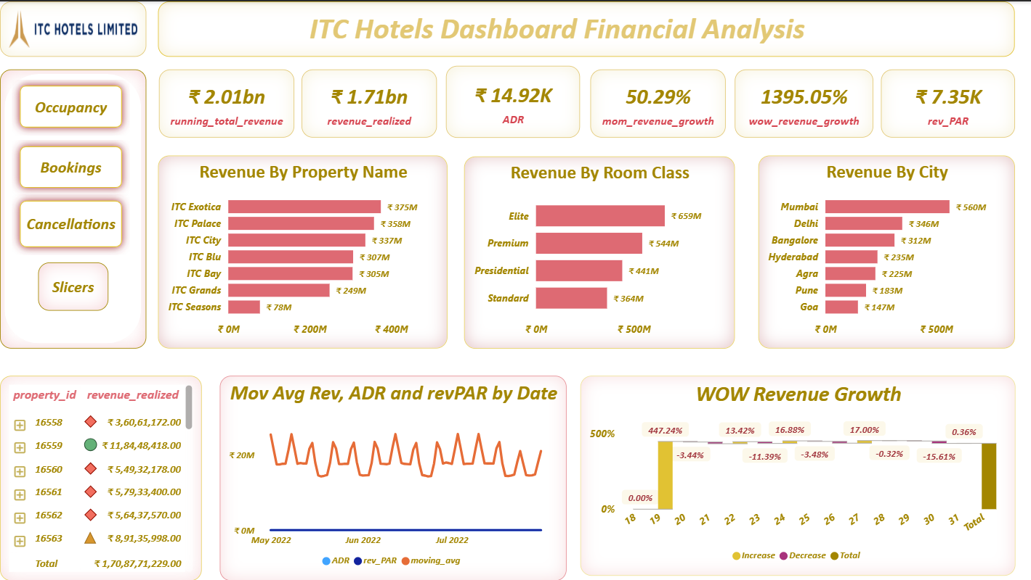

Slide 7
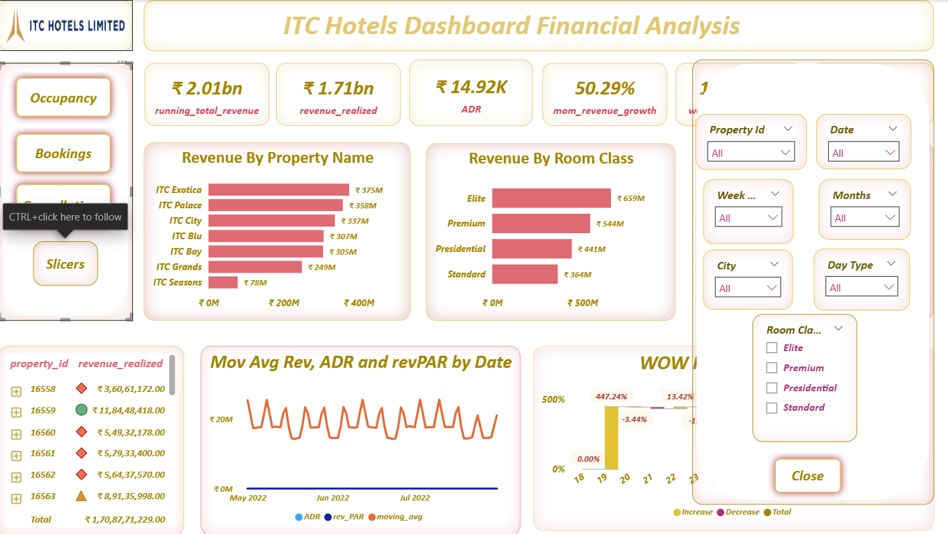

Slide 8
ITC Hotels Occupancy & Capacity Analysis
Occupancy & Capacity Analysis
This page offers an in-depth overview of ITC Hotels' occupancy and capacity performance, including a detailed analysis of occupancy rates across properties and over defined time periods. Key metrics highlighted include:-
Occupancy Rate: 43.50%, indicating potential for growth, particularly during weekdays
MoM and WoW Occupancy Growth: Comprehensive examination of occupancy changes, emphasizing seasonal variations and customer booking trends.
Revenue-Occupancy Correlation: A correlation value of 1.00, suggests a perfect positive correlation, meaning that as the occupancy rate increases, revenue also increases proportionally.
Occupancy rate and RevPar correlation indicates: A correlation value of 1.00, signi ies a perfect positive correlation. This means that any increase in the occupancy rate directly results in a proportional increase in RevPAR.

Slide 9
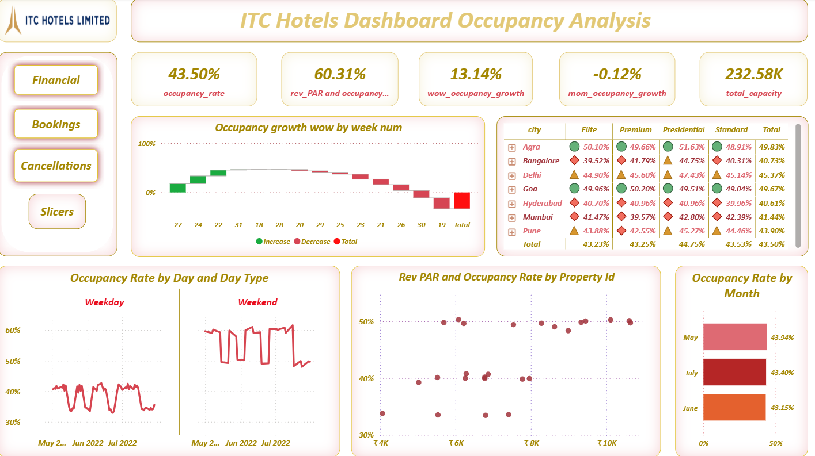

Slide 10
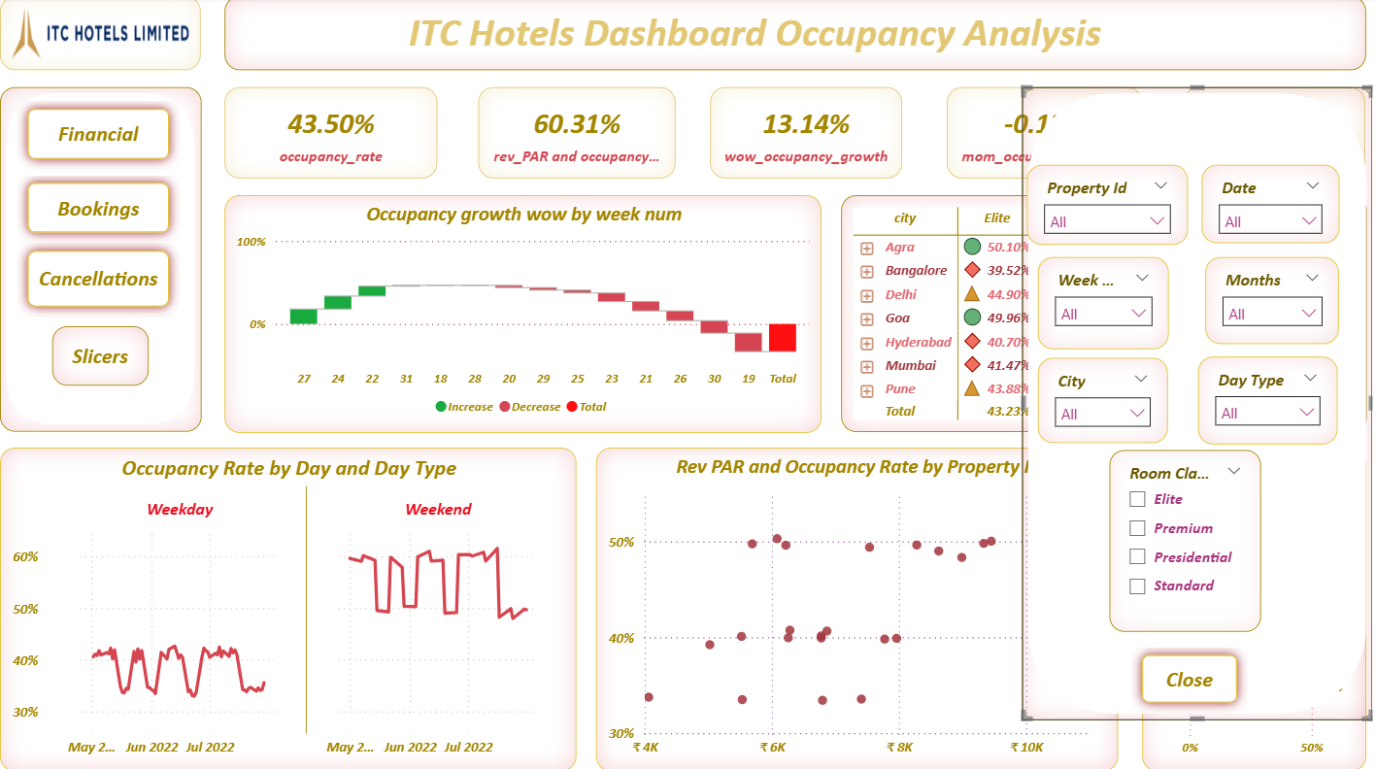

Slide 11
ITC Hotels Room Category Performance & Booking
Room Category Performance & Booking
This section offers a thorough analysis of how different room types impact revenue generation and cater to guest preferences, highlighting their role in driving financial performance and enhancing guest experiences.
Average Length of Stay(ALOS):- 2.37 days, providing valuable information for customizing pricing and promotional strategies.
Revenue by Room Category:- A detailed breakdown of revenue by room type, aiding in more focused marketing and pricing approaches.
Booking Trends:- Examining lead times to gain insights into customer booking behaviors, which can inform adjustments to pricing and promotional tactics.
Analyzing room category performance:- allows for more accurate revenue optimization and improved targeting of customers.

Slide 12
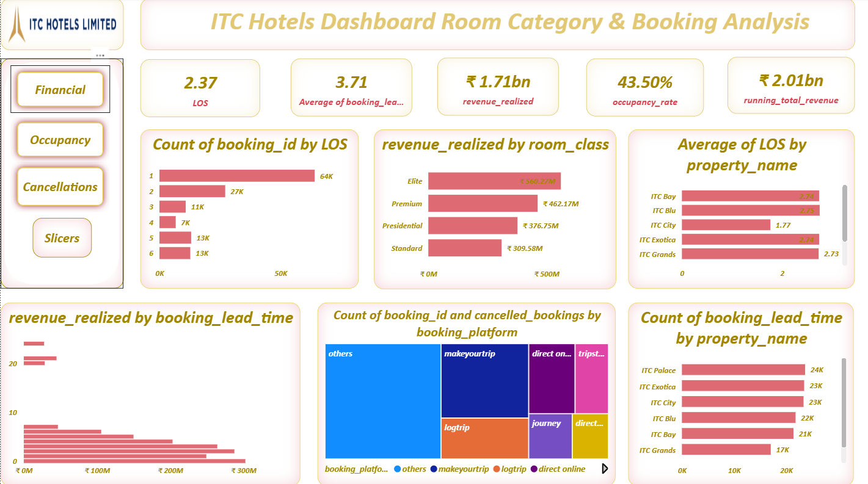

Slide 13
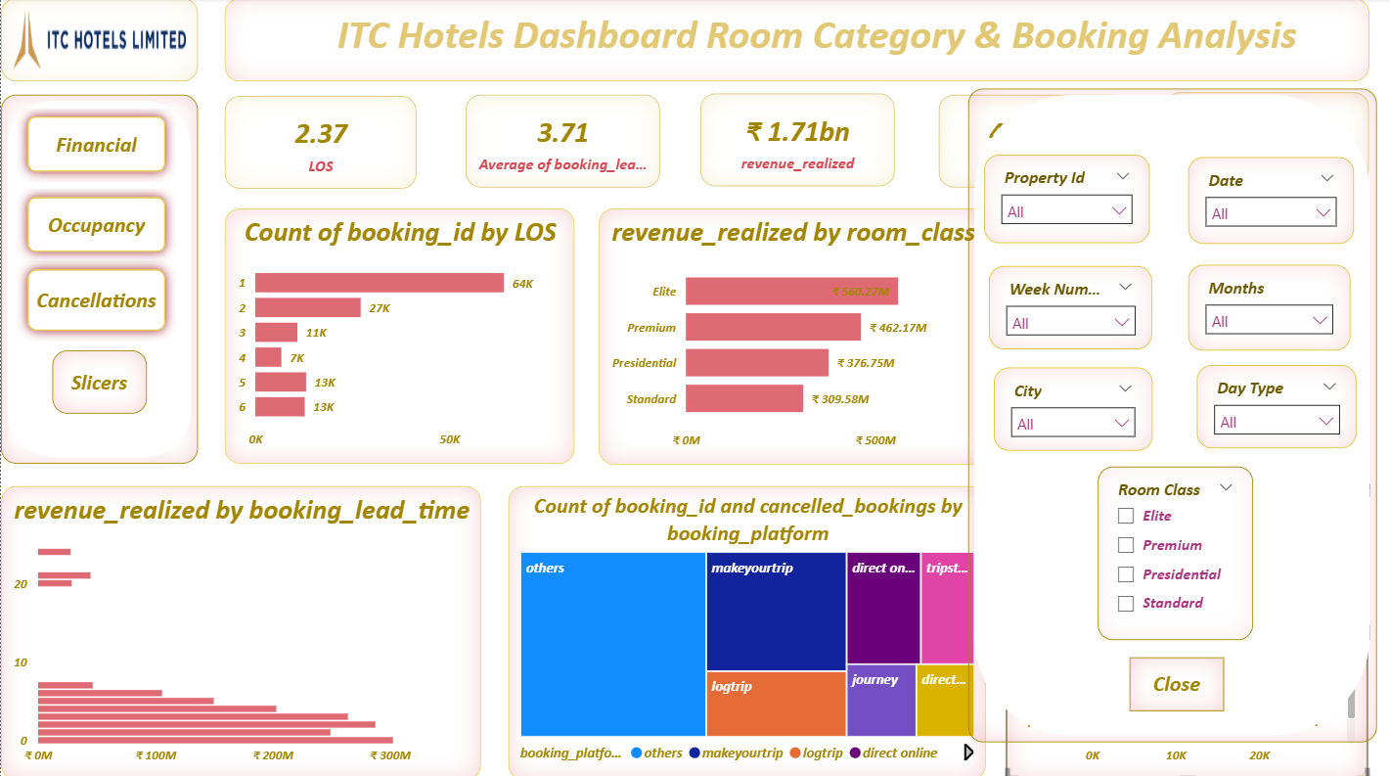

Slide 14
ITC Hotels Cancellations & Lost Revenue Analysis
Cancellations & Lost Revenue Analysis
This comprehensive dashboard highlights key cancellation metrics, revenue loss, and room category performance, offering actionable insights into trends across ITC Hotels' properties to optimize bookings and improve customer retention strategies.
Cancellation Rate:- The 24.83% cancellation rate indicates that approximately one in four bookings were canceled, highlighting a significant challenge for ITC Hotels in retaining confirmed reservations and minimizing revenue losses during the analyzed period.
Revenue Loss Due to Cancellations:- Represents the monetary impact of canceled bookings, crucial for budgeting and efficient resource management.
Cumulative Cancellations and Growth:- Monitors cancellation trends over time, enabling timely actions to reduce potential revenue shortfalls.

Slide 15
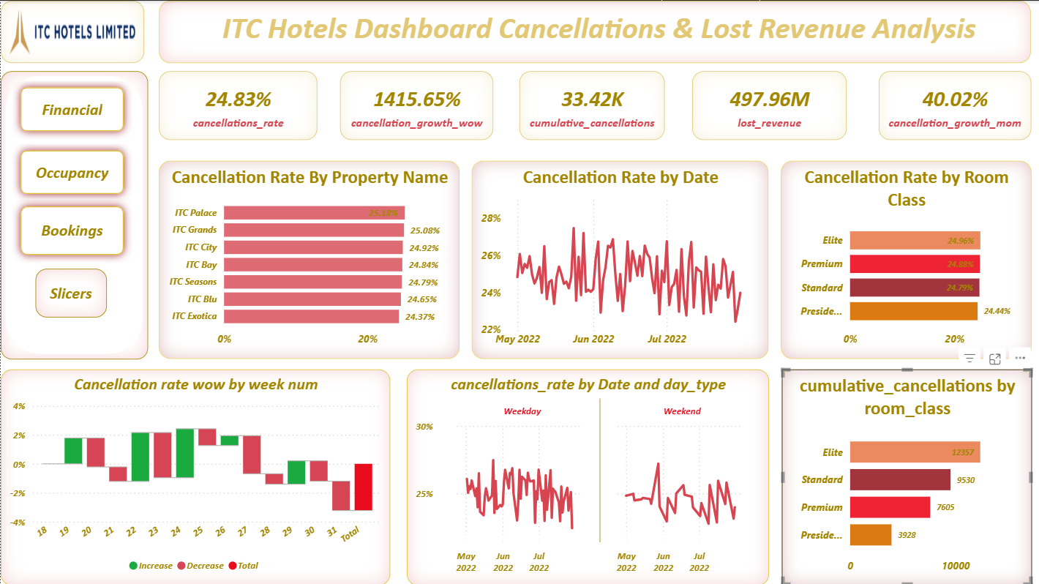

Slide 16
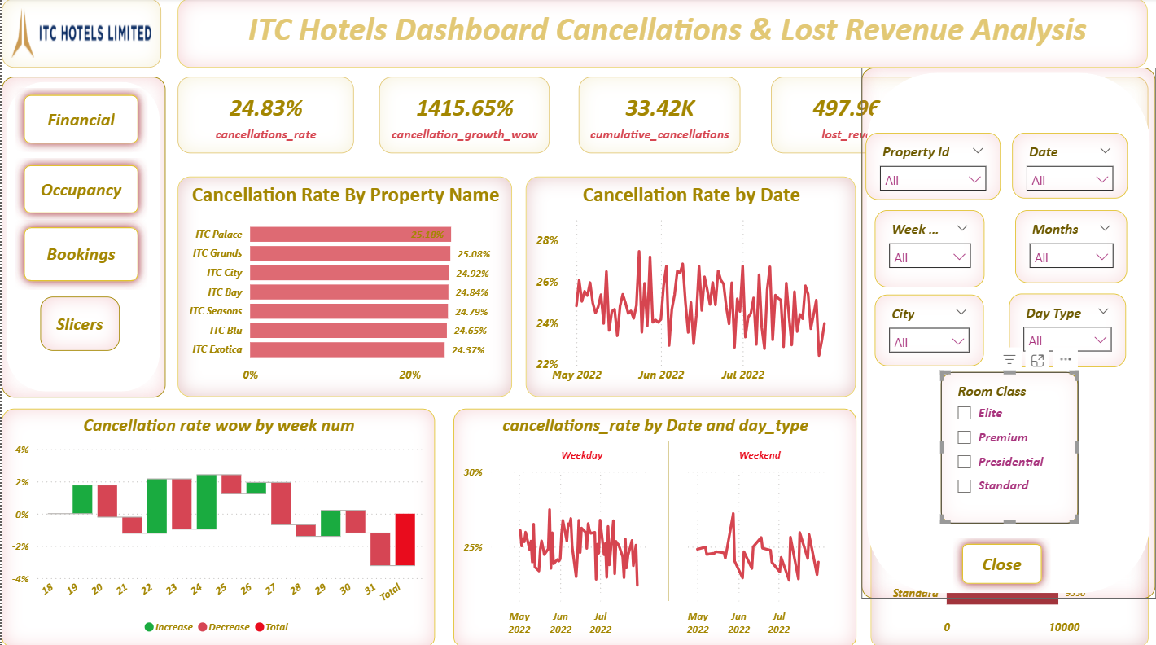

Slide 17
ITC Hotels Conclusion & Recommendations
The ITC Hotels Dashboard provided valuable insights into the hotel’s overall performance across key metrics -
financials, occupancy, bookings, and cancellations.
Financials: Revenue trends indicated stable growth with seasonal fluctuations, highlighting the importance of dynamic pricing and optimized distribution strategies to maximize yield.
Occupancy: Analysis showed healthy occupancy levels with identifiable peak periods, suggesting effective room inventory management. However, certain low-demand periods present opportunities for targeted promotions.
Bookings: Booking data reflected strong reliance on direct channels and repeat customers, emphasizing the success of brand loyalty. At the same time, opportunities exist to diversify through digital and corporate partnerships to reduce dependency on limited sources.

Slide 18
ITC Hotels Conclusion & Recommendations
The ITC Hotels Dashboard provided valuable insights into the hotel’s overall performance across key metrics -
financials, occupancy, bookings, and cancellations.
4. Cancellations: Cancellation trends, though within industry averages, pointed to potential revenue leakage. A stronger cancellation policy, flexible booking options, and customer engagement strategies can help reduce lost revenue. Overall, the dashboard has proven to be a powerful decision-support tool. By integrating real-time data and trend analysis, ITC Hotels can enhance revenue optimization, improve guest satisfaction, and minimize losses. Continuous monitoring through this dashboard will empower management to make data-driven, timely, and strategic decisions for sustained business growth.

Slide 19
ITC Hotels Conclusion & Recommendations
Conclusion
Financials: Stable revenue growth with seasonal patterns → optimize pricing & distribution.
Occupancy: Healthy levels but scope to boost low-demand periods with targeted promotions.
Bookings: Strong repeat & direct bookings → expand via digital & corporate partnerships.
Cancellations: Manageable but cause revenue leakage → refine policies & offer flexible options.
Overall: The dashboard enables data-driven decisions to maximize revenue, enhance guest satisfaction, and reduce losses.

Slide 20

ITC Hotels Conclusion & Recommendations
Thank You!
We Respect your valuable time with ITC Hotels. If you have any questions, please reach us.

