Slide 1
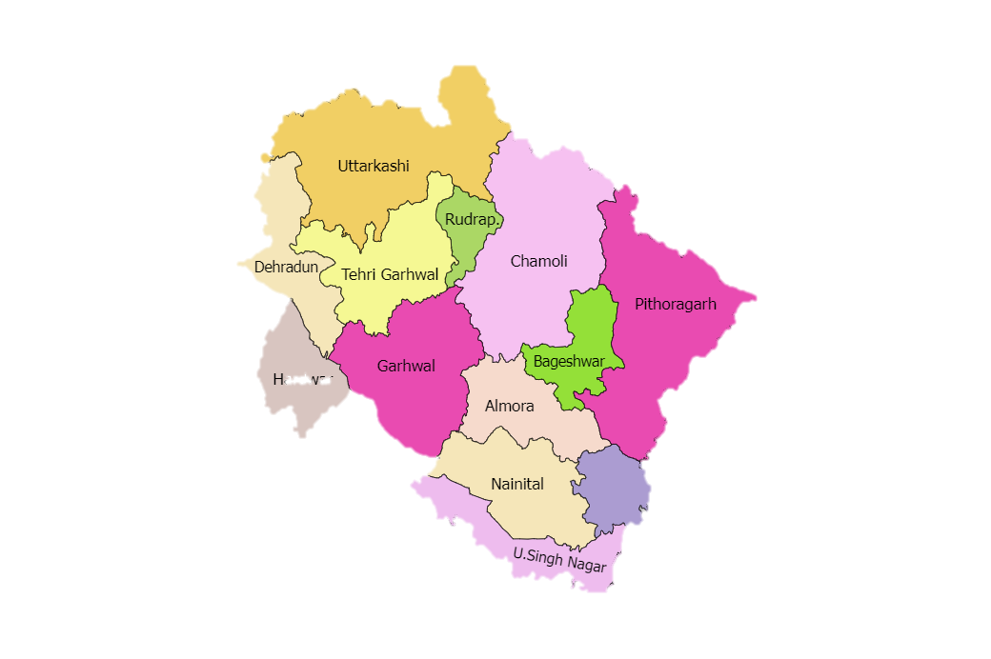
Uttarakhand Elections
Analysis and way ahead
Based on 2022 data
By Mohit Devrari

Slide 2
INDEX
Brief History of elections in Uttarakhand.
Analysis of 2022 elections data.
Manifesto highlights of major parties.
Why BJP won the elections?
Why Opposition lost the elections?
Navigating the election strategy for 2027 elections for INC.
a. Real time data analysis of people of Uttarakhand.
Strategy based on the sample data and recent affairs.
Area-Wise Seat Analysis: Where Congress Won & Where It Lost.
Strategy for strong areas in the state.
Strategy for weak areas in the state.
The End

Slide 3
Brief History of Elections in Uttarakhand
State Formation & First Election (2002):
Uttarakhand was carved out of Uttar Pradesh in 2000. The first Assembly election in 2002 was won by the Indian National Congress.
Alternating Power (2002–2017):
Politics largely revolved around BJP vs Congress, with power alternating almost every election (2002 – Congress, 2007 – BJP, 2012 – Congress).
BJP Dominance Phase (2017):
In 2017, BJP won a landslide majority (57/70 seats), marking a strong consolidation of its vote base across hills and plains.
Breaking the “No Repeat” Pattern (2022):
Historically, voters alternated governments every 5 years, but in 2022 BJP retained power, breaking the state’s trend of anti-incumbency-driven change.

Slide 4
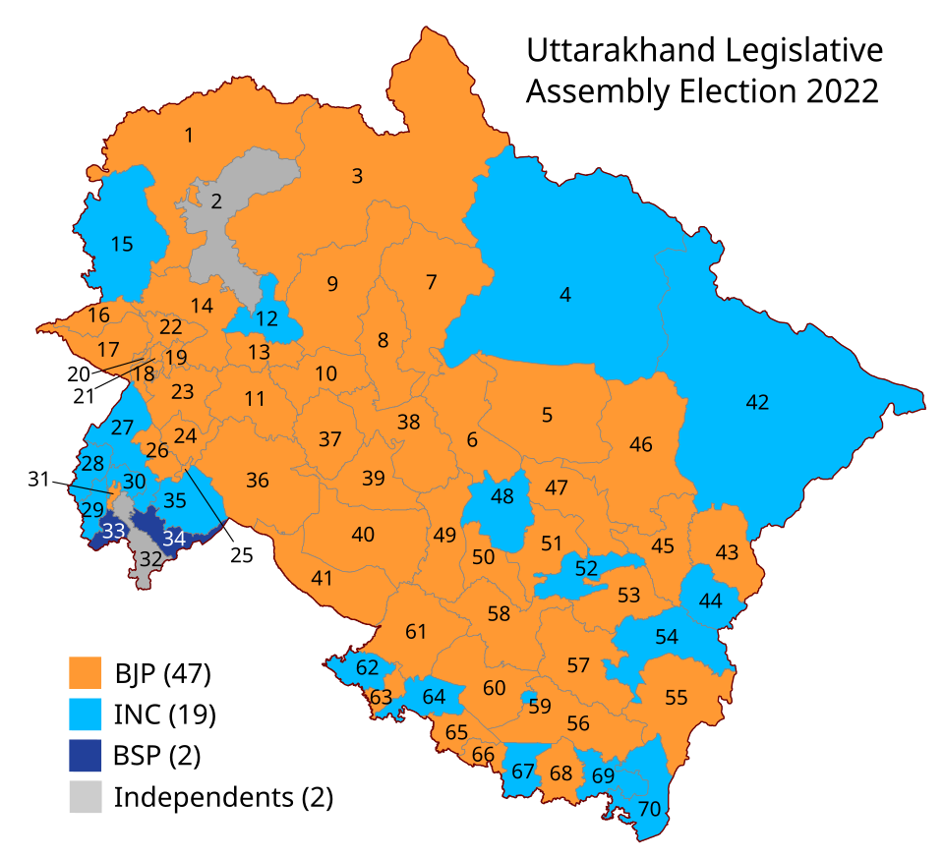
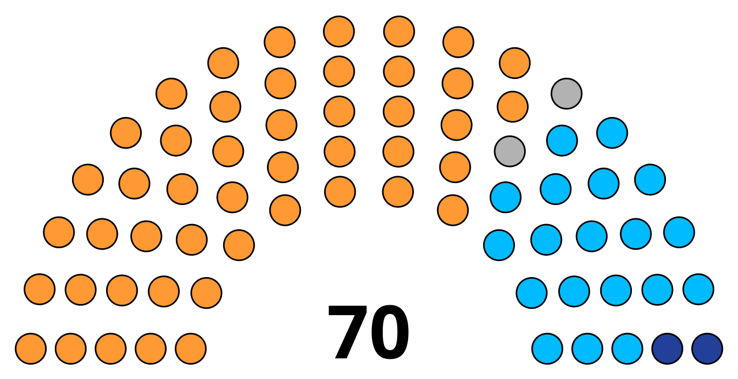
Analysis of 2022 elections data
Distribution of seats of Uttarakhand State Assembly after 2022 elections

Slide 5
Manifesto highlights of major parties
AAP Party
End corruption
24x7 electricity, free electricity up to 300 units
Employment
₹1000/month for women
Education revolution, improvement of government schools.
Healthcare revolution, improvement in health facilities and building Mohalla Clinics in every village.
Revamp roads and build roads to every village
pilgrimage (Teerth Yatra) to the elderly
Making Uttarakhand the spiritual capital for Hindus.
INC
Capping the price of a gas cylinder for consumers at ₹500
Income support of ₹40,000 annually for the poorest five lakh families
Doorstep Medical service under Health facilities ‘Har Gaon Har Dwar’ initiative
Ensuring employment opportunities to 4 lakh youth
Free travel for women in state transport
Setting up of the state’s “first sports university”
Withdrawing cases against farmers filed during protests against the now-repealed farm laws.
Comprehensive educational framework with increased budget allocation
Resume “Mere Bujurg Mere Teerth” (my elders my pilgrimage) along with pension to the senior citizens.

Slide 6
Manifestos highlights of major parties
BJP
45 new tourism spots will be developed.
Rs 6000 from central and Rs 6000 from state government will be given under Kisan Samman Nidhi.
3 cylinders free of cost to poor houses in a year.
Apart from this, Rs 2000 per month will be given to women of BPL family, Rs 1000 per month to poor children.
Trees will not be cut , they will be transplanted.
Mobile hospitals will be developed in every area.
Medical colleges will be developed in every district..
Party promised a stricter law on ‘love jihad’ and necessary measures to stop the demographic changes.
Completing the Char Dham all-weather road project by the end of year of elections and launch seven ropeway projects, including one in Kedarnath and another in Hemkund Sahib.
Connecting all the villages in Uttarakhand with 4G/5G mobile network and high-speed broadband internet.
To improve transport services, procurement of 1,000 electric buses.

Slide 7
Why BJP won the elections?
Hindutva Push: Promises of Uniform Civil Code (UCC) and strict anti-"Love Jihad" law consolidated the core Hindu vote bank.
"Double-Engine" Govt Narrative: Leveraged PM Modi's popularity and the narrative that having BJP at the Centre and State ensures faster development.
Targeted Direct Benefit Schemes: Direct benefit promises like ₹2,000/month to women, free LPG cylinders, and cash for pregnant women swung the female vote.
Infrastructural Developement: Showcased ongoing work on the Char Dham all-weather road project as proof of delivery.
Religion Demography of the state

Slide 8
Why Opposition lost the elections?
INC
Severe Internal challenges: The Congress was plagued by deep factionalism. The mismanagement of its star campaigner, Harish Rawat—denying him a ticket from his preferred seat and asking him to contest from another seat —exemplified the party's lack of internal coordination.
Reactive Messaging: The Congress's campaign seemed reactive, focusing on criticizing the BJP's track record rather than offering a compelling, unified vision for the state's future.
AAP
Lack of Credibility and Ground Connect: The AAP's primary weakness was its perception as an outsider.
Overly Ambitious and Impractical Promises: Eye-catching, promises like doubling the state budget in five years were viewed as fiscally irresponsible and lacking a roadmap for implementation. This undercut their credibility.

Slide 9
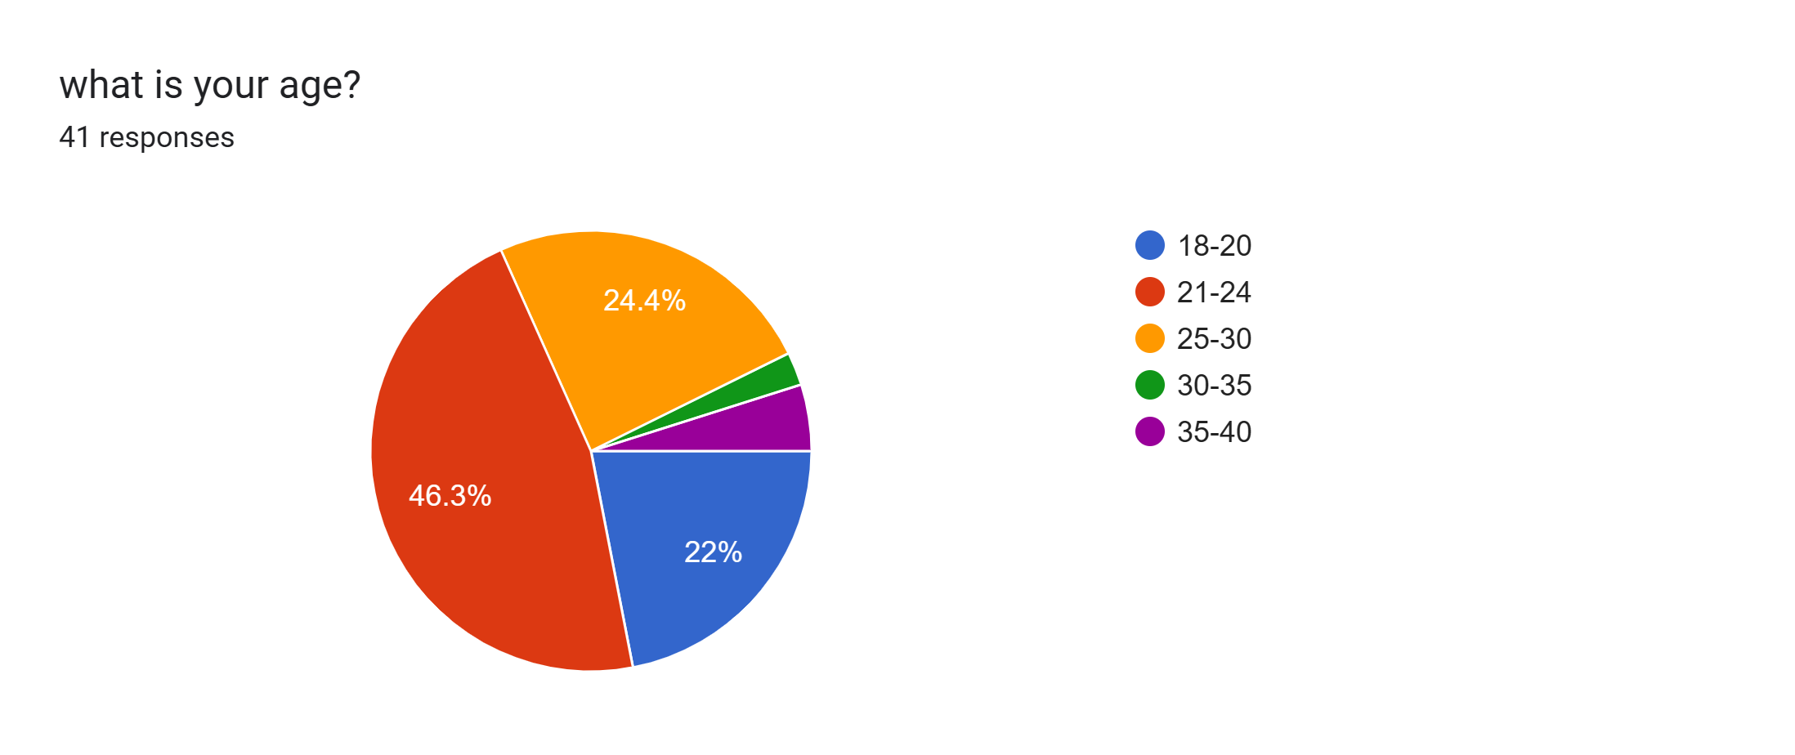
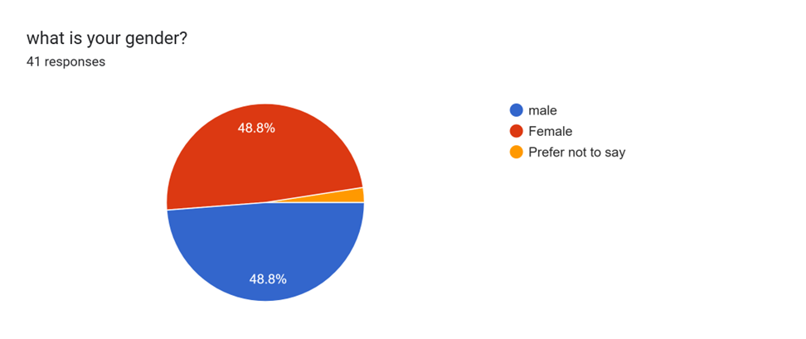
Navigating the election strategy for 2027 elections for INC
After conducting a mini survey of 40+ using google forms among the people of the state on reddit, here are the basic findings we have to take into account before devising a proper strategy for the elections in 2027.
1.Age-wise split of the sample
2. Gender-wise split of the sample

Slide 10
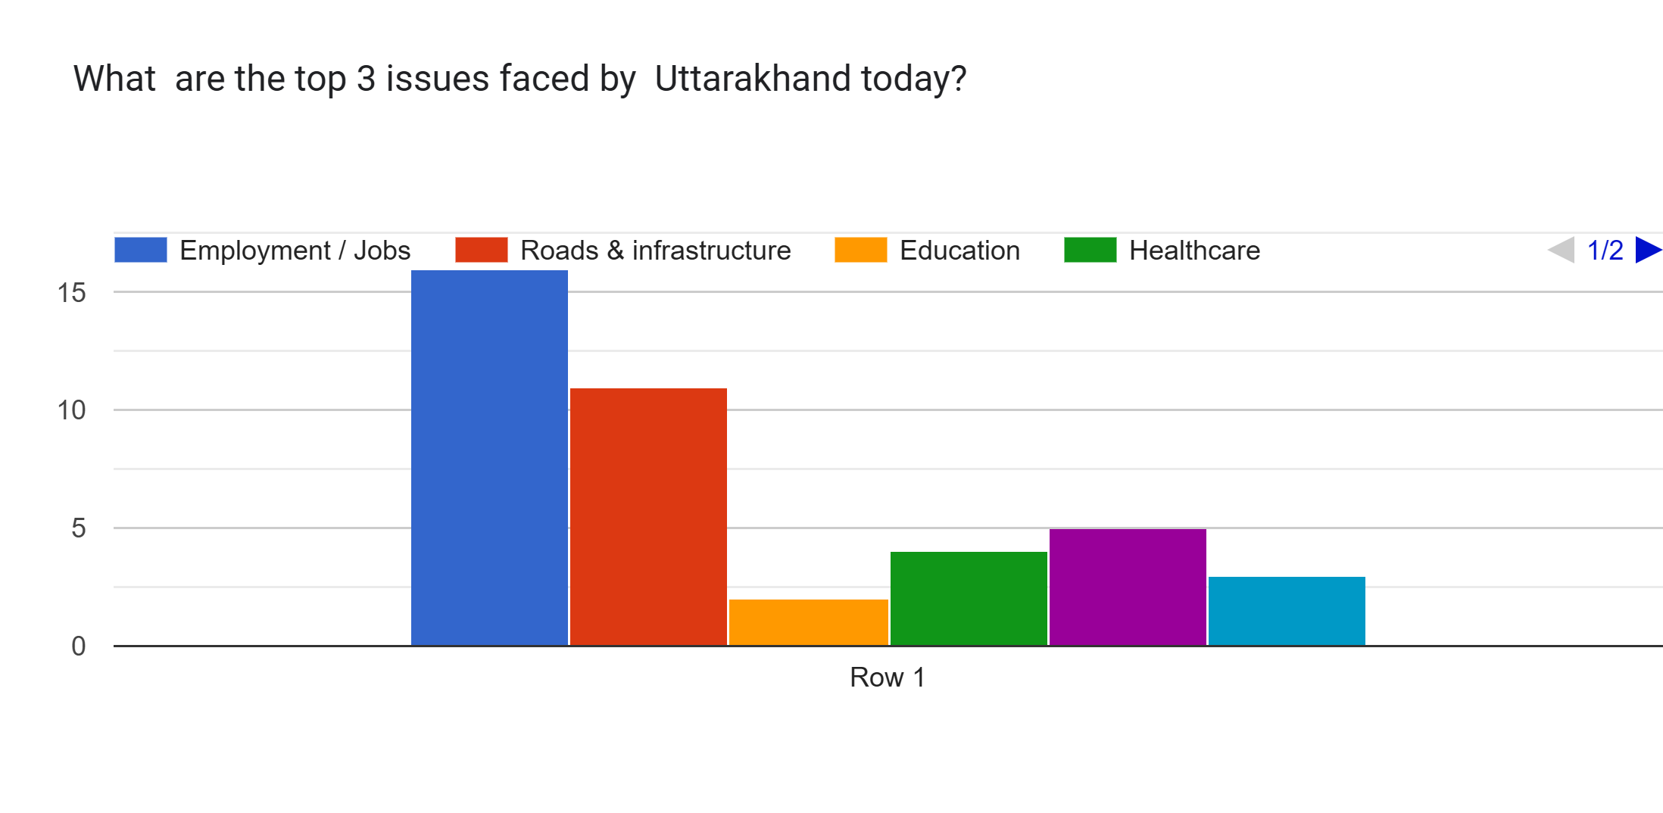
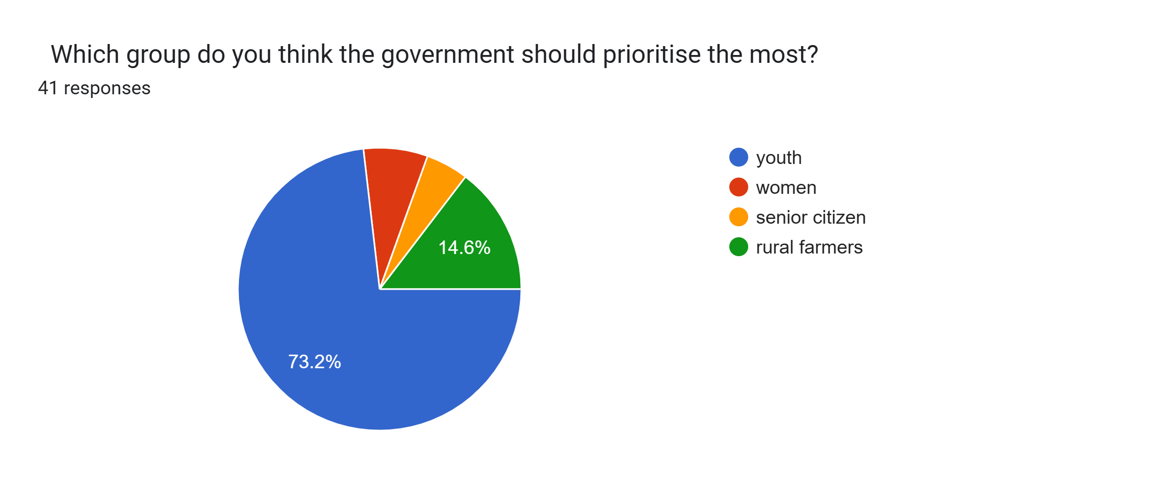
Real time data analysis of people of Uttarakhand
Graph showing the top issues that people face
Pie chart showing the section of the society on which we should keep our focus

Slide 11
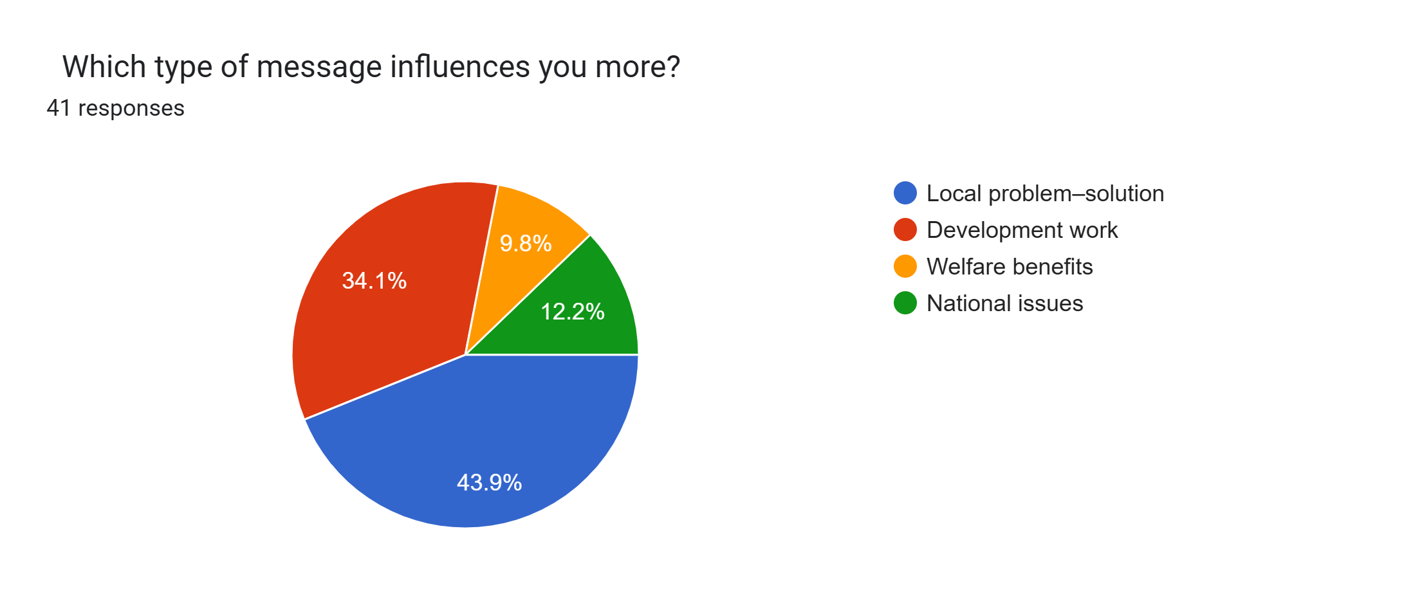
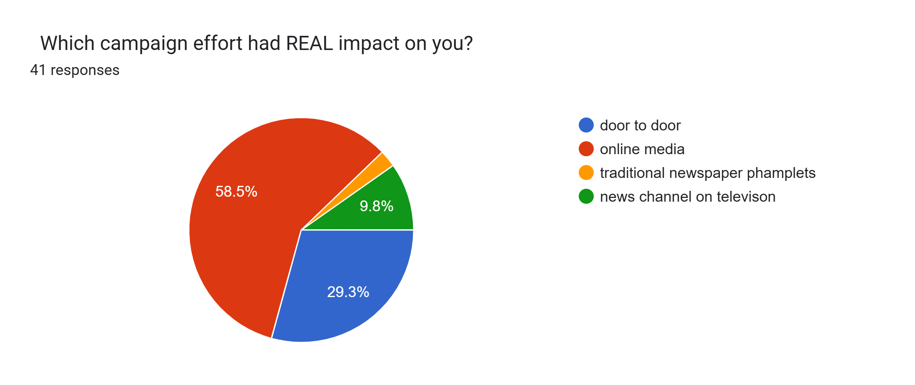
Real time data analysis of people of Uttarakhand
Graph showing that Development work and local problem solutions are the areas where people get influenced
Online media for youth and door to door campaigns for rural areas are the campaigns styles we should adopt

Slide 12
Strategy based on the sample data and recent affairs
1.Leverage Youth Anger on Examination Leak Scams
The state level paper leak scandal has left thousands of youth frustrated and on the streets.
Congress should :
Create viral reels showing genuine protesters.
Share AI-generated videos visualizing how scams are destroying careers.
Launch campaign like honest youth vs corrupt system.
2.Pahad vs Plain Regional Divide Narrative
Congress can use the perceived hill-plain bias.
Create content highlighting how hill districts get ignored in development.
Use local dialect content to make it authentic.

Slide 13
Strategy based on the sample data and recent affairs
3. Prioritizing Unemployment issues
Massive unemployment in the state is a major issue. Congress can play around the issue. Create infographics comparing employment claims vs reality and what they will bring to the table. Use Whatsapp and other social media to show how many jobs created vs how many youth entered workforce.
Use student unions as amplifiers on university campuses across the state.
4. Environment based issues
Congress can use the issues like:
Dharali village (2025) destroyed yet construction continued.
Supreme Court width cap (5.5m) ignored – 10–12m roads built.
Joshimath sinking : warning signs of ecological disaster ignored.

Slide 14
Strategy based on the sample data and recent affairs
5. Fifth schedule Demand
Congress can raise demand of fifth schedule status for all hill areas of Uttarakhand. This will give local communities constitutional rights over land, forests, and water resources.
7.Migration Issues
Manifesto can contain the narrative-reverse migration from hills. Every village will have its own economic plan based on local resources.
Tax holidays will be given to businesses that set up in hill areas.
Local crafts like Aipan art and Kafal fruit products will get government marketing support.
Target to reduce migration by significant numbers in five years.
GI tags promise to local products.

Slide 15
Area-Wise Seat Analysis: Where Congress Won & Where It Lost
Plains(Haridwar, US Nagar, Haldwani):13 seats
Hills :6 seats
In Haridwar district alone, Congress secured 5 seats. From Kumaon region, US Nagar emerged as a strong spot with 4 SC reserved seats

Slide 16
Strategy for strong areas in the state
Key points to take into consideration:
Give tickets to the same winning candidates if they have performed. Avoid changing faces in strong seats.
Target seats that BJP won by narrow margins in these same districts.
Examples: Roorkee, Kashipur.
Deepen Connect with Core Voters
Haridwar: Muslim + Dalit base consolidation.
US Nagar: SC community
Haldwani: Engage urban-rural mix population.

Slide 17
Strategy for weak areas in the state
Remove old faces who have lost elections. Launch new young leaders especially in Garhwal region where presence is weak.
In weak areas, alliances with local independent candidates or small parties are possible. Avoid vote division in such areas.
Connect with the public through channels like WhatsApp. Create sense of belongingness among the people.

Slide 18
The End

