Slide 1
KMS service tooling
- Monashree K

Slide 2



Objective
To develop a springboot web application which will read user name and prints “Hello {username}”.
To understand micro service architecture and containerization - Docker.
To deploy the two sidecar container on k8s and access them with main container.

Slide 3
Introduction
J2EE
- Public specification that embodies several technologies
- Defines a model for multi-tier, web-based, enterprise applications with distributed components.
Technologies:
- Servlet
- JSP

Slide 4
Why Springboot?
Embed tomcat
No clumsy XML Configuration
Uses project management tool like MAVEN or GRADLE
Provides POM(Project Object Model) for Maven configuration.
Helps fast development of application.

Slide 5
Microservice architecture
Microservice Architecture is a Service Oriented Architecture(SOA).
SOA composed of loosely coupled elements that have bounded context.
In the microservice architecture, there are a large number of microservices. By combining all the microservices, it constructs a big service.

Slide 6
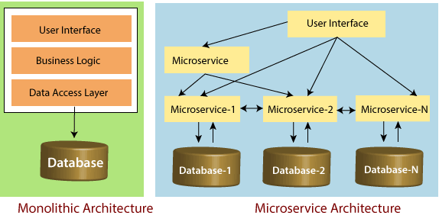
Evolution from Monoliths to Microservices

Slide 7
REST API
- A REST API (also known as RESTful API) is an application programming interface (API or web API) that conforms to the constraints of REST architectural style and allows for interaction with RESTful web services.
REST template
- Rest Template is used to create applications that consume RESTful Web Services.
- We can use the exchange() method to consume the web services for all HTTP methods.

Slide 8
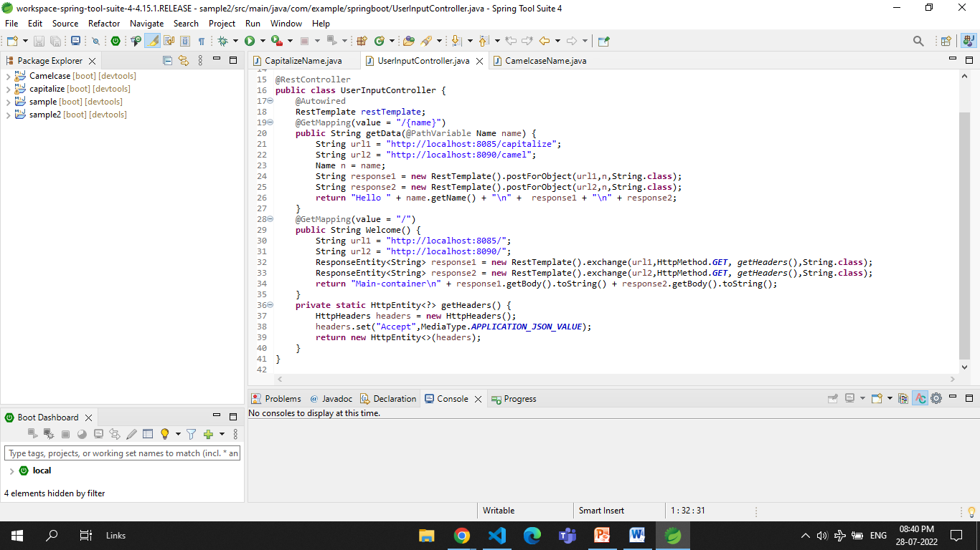

Slide 9
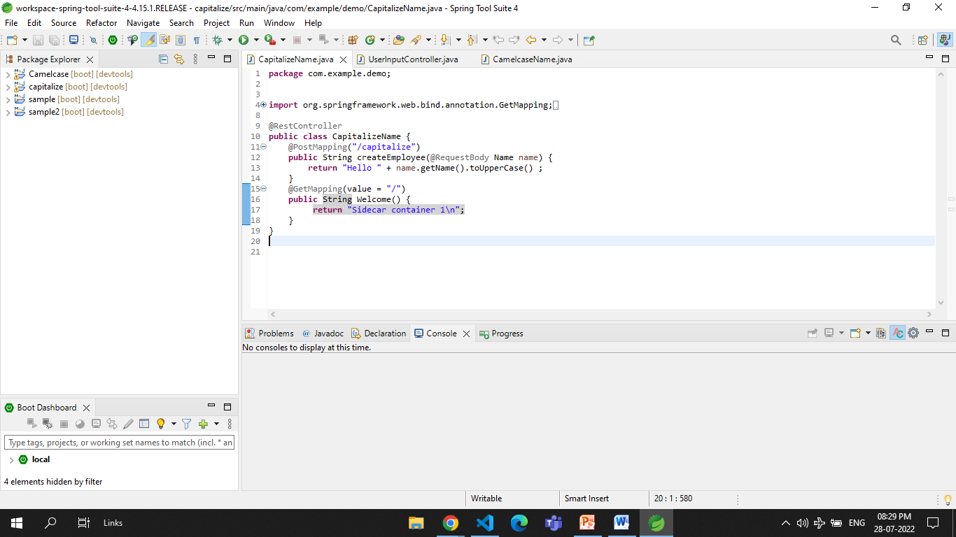

Slide 10
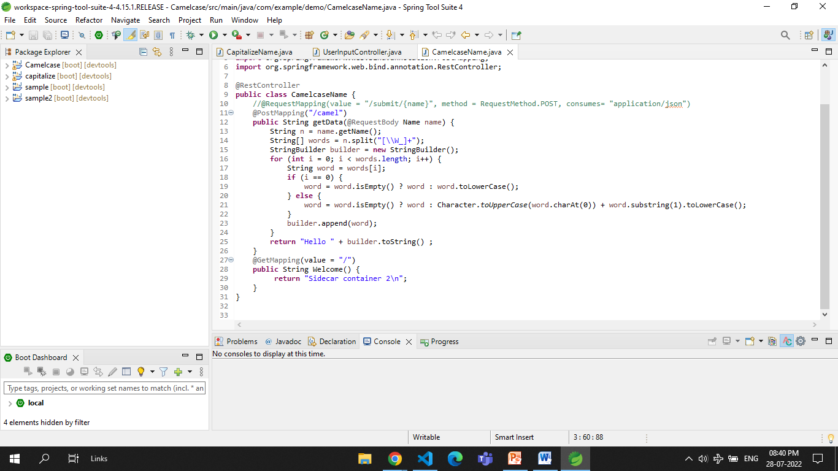

Slide 11
Docker
Docker is a set of platforms as a service (PaaS) products that use the Operating system level visualization to deliver software in packages called containers.
Terminologies
Docker image
Docker container
Docker file
Docker engine
Docker hub

Slide 12
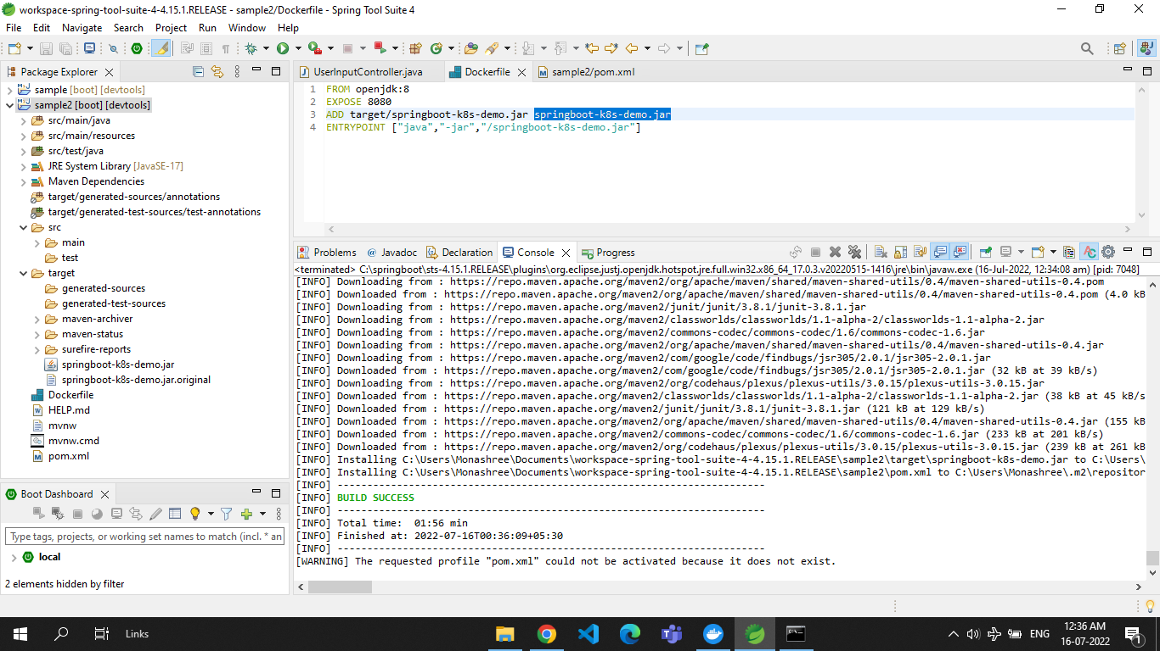

Slide 13
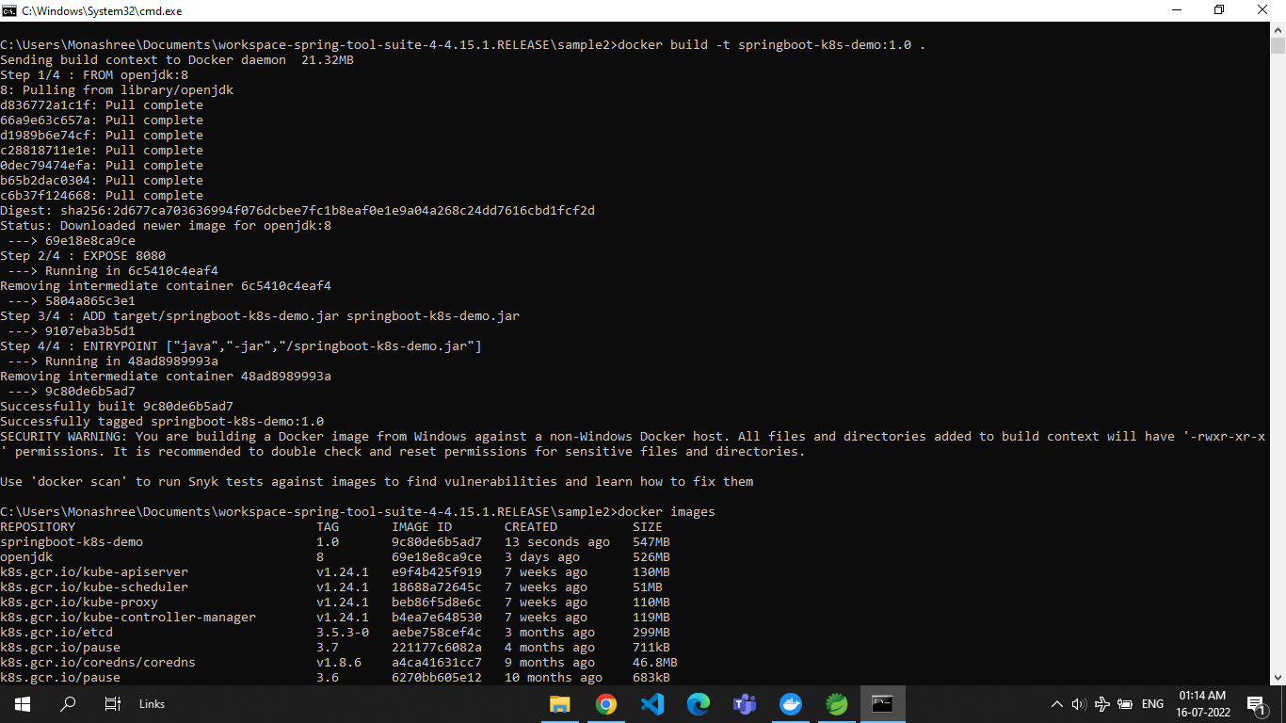

Slide 14
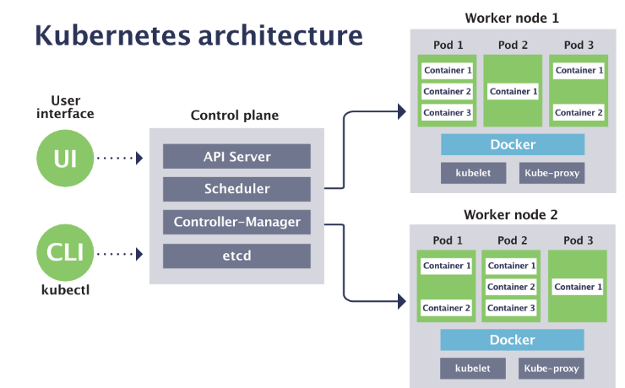
Kubernetes(k8s)
It allows you to deploy and manage applications running on multiple hosts using docker.

Slide 15
Sidecar container
Sidecar containers are containers that are needed to run alongside the main container.
The two containers share resources like pod storage and network interfaces.
The main and sidecar containers also share the pod network, and the pod containers can communicate with each other

Slide 16
Sidecar design pattern
Microservice A
Main container
Microservice B
Capitalize
Microservice C
Camel case
Sidecar 1
Sidecar 2

Slide 17
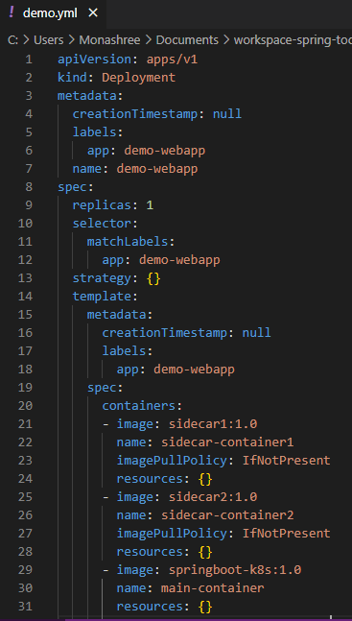
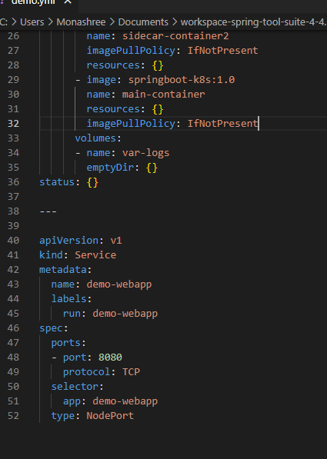

Slide 18
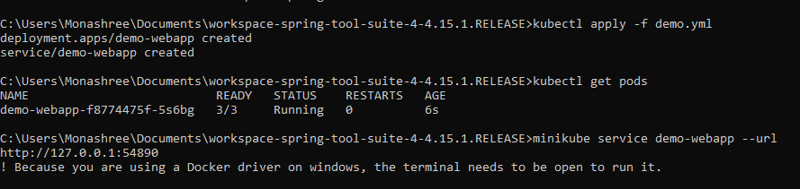
Final Output

Slide 19
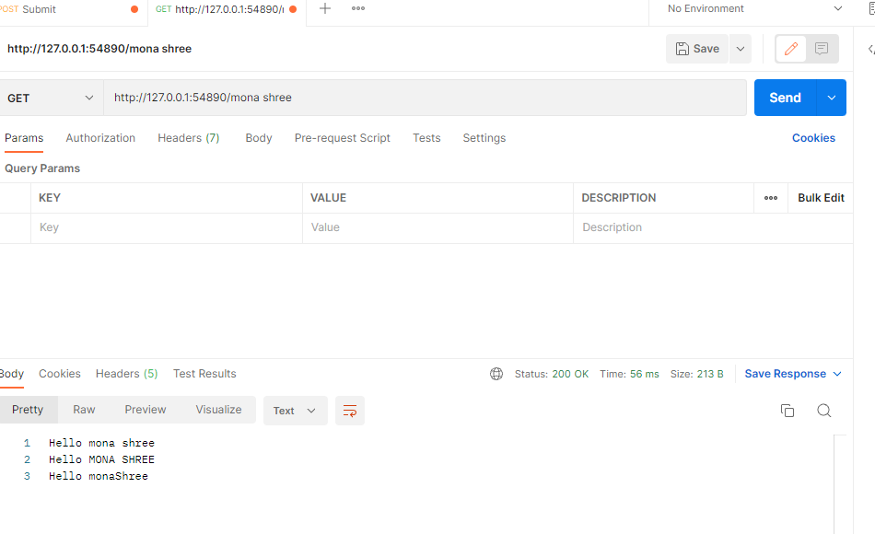

Slide 20
References
https://spring.io/guides/gs/spring-boot/
https://docs.spring.io/spring-framework/docs/current/reference/html/web.html#spring-web
https://docs.spring.io/spring-framework/docs/current/reference/html/index.html

