Slide 1
Computer and Robot Vision I
Chapter 3
Binary Machine Vision:
Region Analysis
Presented by: 傅楸善 & 黃季軒
0935090120
r07944042@ntu.edu.tw
指導教授: 傅楸善 博士
Digital Camera and Computer Vision Laboratory
Department of Computer Science and Information Engineering
National Taiwan University, Taipei, Taiwan, R.O.C.

Slide 2

3.1 Introduction
region: produced by connected components labeling operator
region properties: measurement vector input to classifier
DC & CV Lab.
CSIE NTU

Slide 3



3.2 Region Properties
area:
centroid:
DC & CV Lab.
CSIE NTU

Slide 4



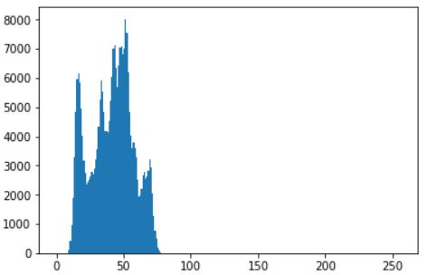
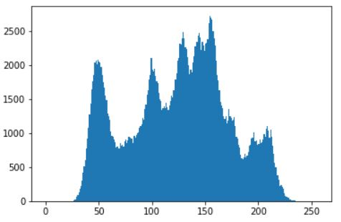
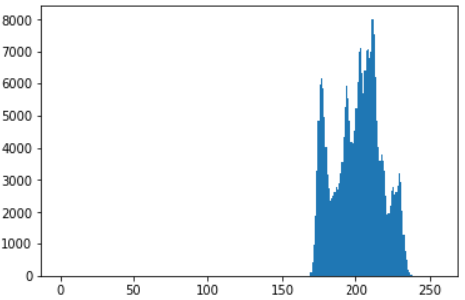
3.2 Region Properties (cont’)
region intensity histogram:
dark and low-contrast
original
bright and low-contrast
DC & CV Lab.
CSIE NTU

Slide 5
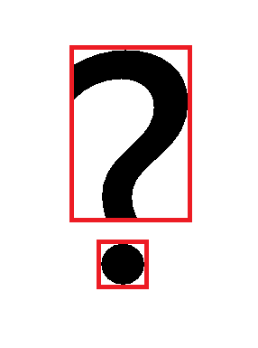
3.2 Region Properties (cont’)
bounding rectangle: smallest rectangle circumscribes the region
DC & CV Lab.
CSIE NTU

Slide 6

3.2 Region Properties (cont’)
border pixel: has some neighboring pixel outside the region
: 4-connected perimeter: if 8-connectivity for inside and outside
: 8-connected perimeter: if 4-connectivity for inside and outside
DC & CV Lab.
CSIE NTU

Slide 7

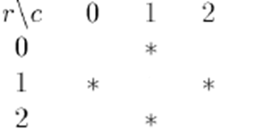
3.2 Region Properties (cont’)
Eg: center is in but not in for
P4
DC & CV Lab.
CSIE NTU
P8

Slide 8
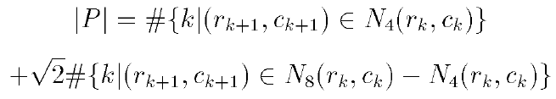


3.2 Region Properties (cont’)
length of perimeter , successive pixels neighbors
where k+1 is computed modulo K i.e.
DC & CV Lab.
CSIE NTU

Slide 9


3.2 Region Properties (cont’)
mean distance R from the centroid to the shape boundary
standard deviation R of distances from centroid to boundary
DC & CV Lab.
CSIE NTU

Slide 10

3.2 Region Properties (cont’)
Haralick shows that has properties:
1. digital shape circular, increases monotonically
2. similar for similar digital/continuous shapes
3. orientation (rotation) and area (scale) independent
DC & CV Lab.
CSIE NTU

Slide 11


3.2 Region Properties (cont’)
Average gray level (intensity)
Gray level (intensity) variance
right hand equation lets us compute variance with only one pass
DC & CV Lab.
CSIE NTU

Slide 12
DC & CV Lab.
CSIE NTU

Slide 13
3.2 Region Properties (cont’)
microtexture properties: used to measure the texture of regions
S: set of pixels in designated spatial relationship
P: region’s co-occurrence matrix
DC & CV Lab.
CSIE NTU

Slide 14
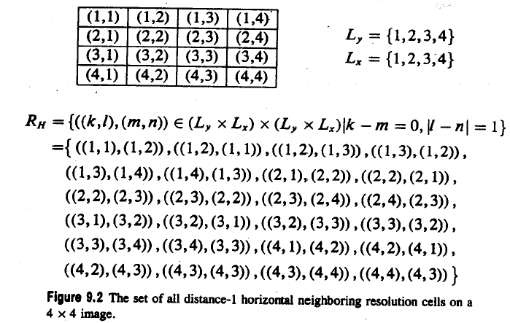
3.2 Region Properties (cont’)
S
DC & CV Lab.
CSIE NTU

Slide 15
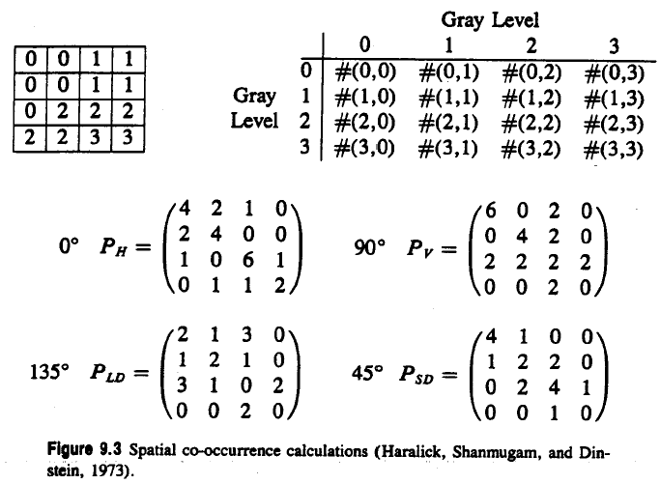
3.2 Region Properties (cont’)
0
DC & CV Lab.
CSIE NTU

Slide 16
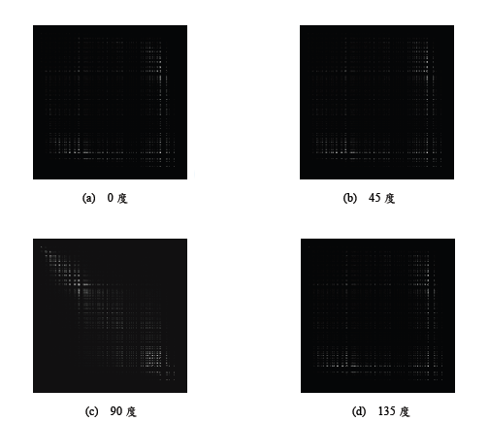
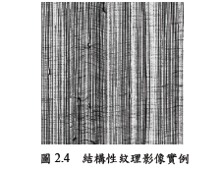
DC & CV Lab.
CSIE NTU
Notes:
Reference
紋理分析於瑕疵檢測的應用
The Application of Texture Analysis on Defect Detection
P.14

Slide 17


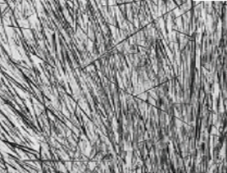

3.2 Region Properties (cont’)
texture second moment (Haralick, Shanmugam, and Dinstein, 1973)
texture entropy
DC & CV Lab.
CSIE NTU
Notes:
複雜小，同種大 (high value when grey level distribution has either a constant or a periodic form)
和1相反 not texturally uniform時大 (largest value when all elements in P matrix are equal)

Slide 18


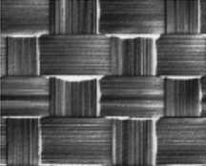

3.2 Region Properties (cont’)
texture homogeneity
where k is some small constant
texture contrast
DC & CV Lab.
CSIE NTU
Notes:
GLCM集中對角線
GLCM遠離對角線

Slide 19
DC & CV Lab.
CSIE NTU

Slide 20
3.2.1 Extremal Points
eight distinct extremal pixels:
topmost right
rightmost top
rightmost bottom
bottommost right
bottommost left
leftmost bottom
leftmost top
topmost left
DC & CV Lab.
CSIE NTU

Slide 21
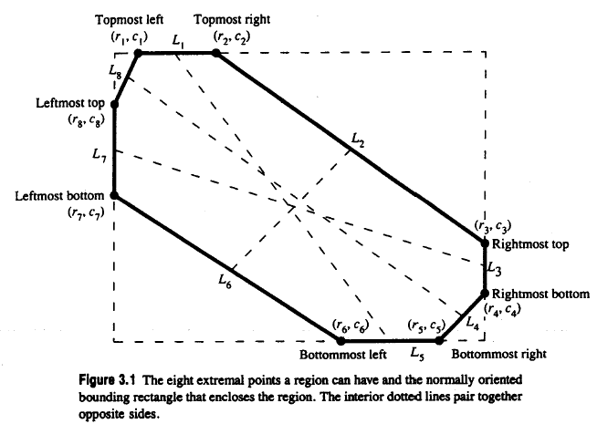
3.2.1 Extremal Points (cont’)
DC & CV Lab.
CSIE NTU

Slide 22
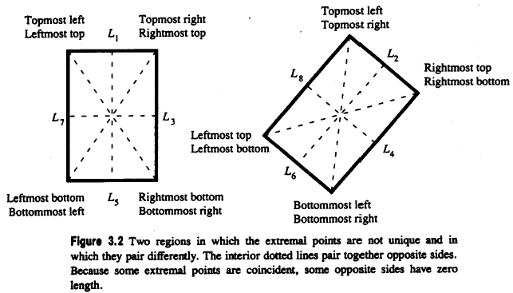
3.2.1 Extremal Points (cont’)
different extremal points may be coincident
DC & CV Lab.
CSIE NTU

Slide 23
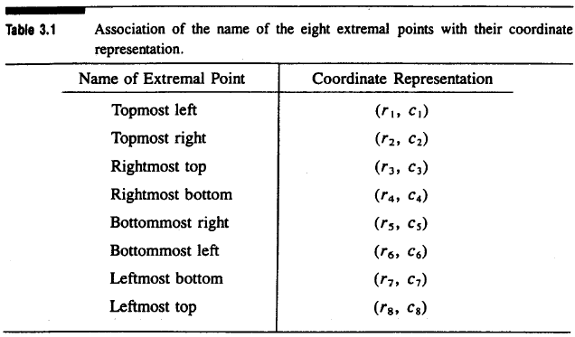
3.2.1 Extremal Points (cont’)
association of the name of the eight extremal points with their coordinates
DC & CV Lab.
CSIE NTU

Slide 24
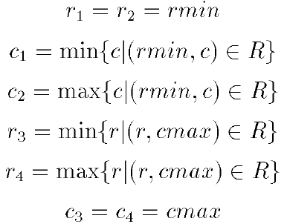
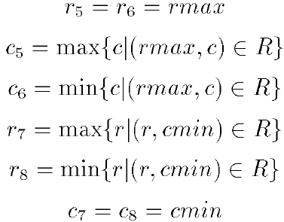
3.2.1 Extremal Points (cont’)
directly define the coordinates of the extremal points:
DC & CV Lab.
CSIE NTU

Slide 25
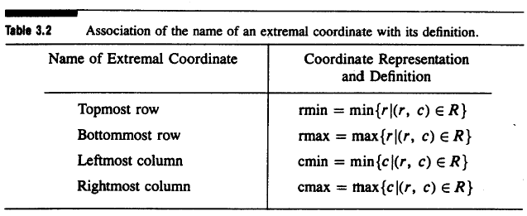
3.2.1 Extremal Points (cont’)
association of the name of an external coordinate with its definition
DC & CV Lab.
CSIE NTU

Slide 26

3.2.1 Extremal Points (cont’)
extremal points occur in opposite pairs:
topmost left bottommost right
topmost right bottommost left
rightmost top leftmost bottom
rightmost bottom leftmost top
each opposite extremal point pair: defines an axis
axis properties: length, orientation
DC & CV Lab.
CSIE NTU

Slide 27
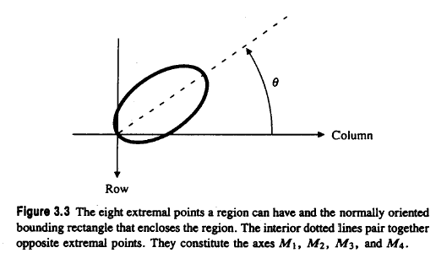
3.2.1 Extremal Points (cont’)
orientation taken counterclockwise w.r.t. column (horizontal) axis
DC & CV Lab.
CSIE NTU

Slide 28


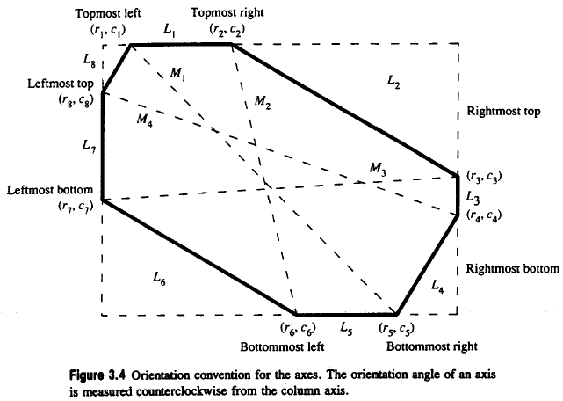
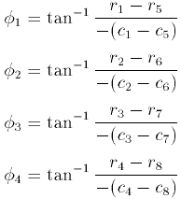
3.2.1 Extremal Points (cont’)
orientation convention for the axes
axes paired: with and with
DC & CV Lab.
CSIE NTU

Slide 29
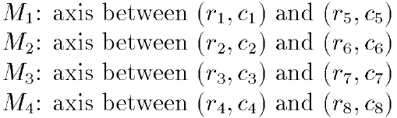
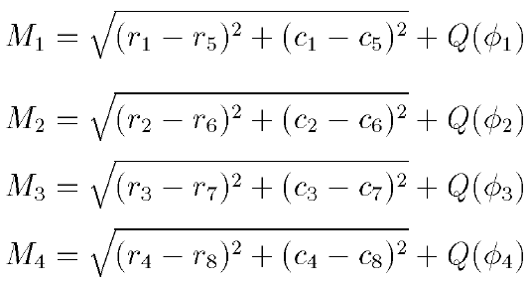
3.2.1 Extremal Points (cont’)
distance calculation: add a small increment to the Euclidean distance
DC & CV Lab.
CSIE NTU

Slide 30
3.2.1 Extremal Points (cont’)
the length covered by two pixels horizontally adjacent
1: distance between pixel centers
2: from left edge of left pixel to right edge of right pixel
DC & CV Lab.
CSIE NTU

Slide 31
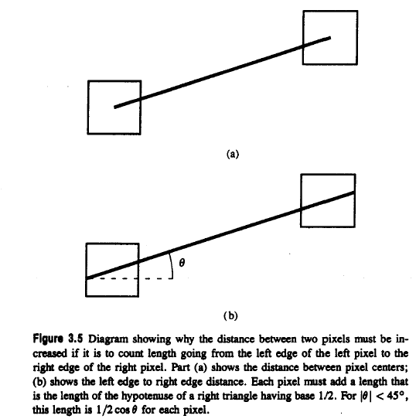

3.2.1 Extremal Points (cont’)
length going from left edge of left pixel to right edge of right pixel
DC & CV Lab.
CSIE NTU

Slide 32



3.2.1 Extremal Points (cont’)
distance between ith and jth extremal point
average value of = 1.12, largest error 0.294 = - 1.12
DC & CV Lab.
CSIE NTU

Slide 33
3.2.1 Extremal Points (cont’)
How can we use extremal points?
1. Line’s length/orientation
2. Triangle’s base/height
3. Rectangle’s orientation
DC & CV Lab.
CSIE NTU

Slide 34
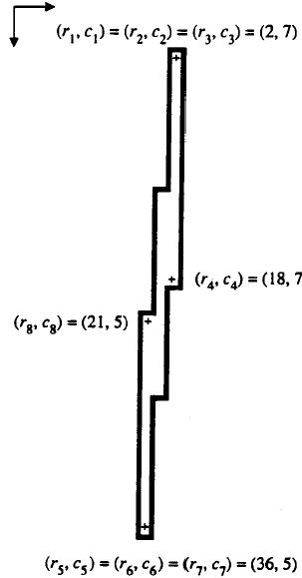
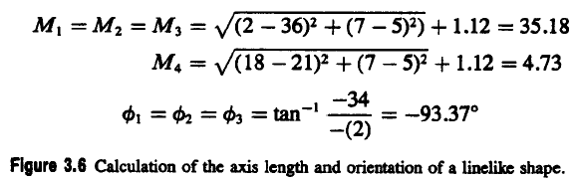
3.2.1 Extremal Points (cont’)
calculation of the axis length and orientation of a linelike shape
DC & CV Lab.
CSIE NTU

Slide 35
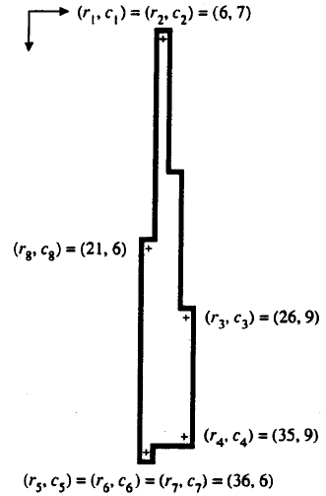
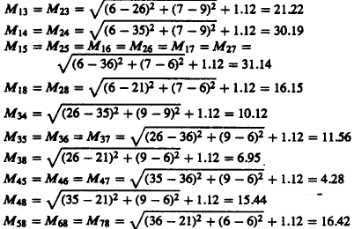
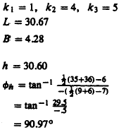
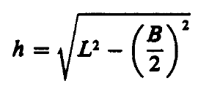
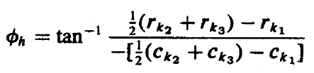
calculations for length of sides base and altitude for a triangle
= (M₁₄ + M₁₅)/2
= M₄₅
DC & CV Lab.
CSIE NTU
Notes:
indices k1 k2 k3 maximize Mk1k2+Mk1k3
L: avg long sides (30.19 + 31.14 )/2
B: Mk2k3

Slide 36

DC & CV Lab.
CSIE NTU

Slide 37
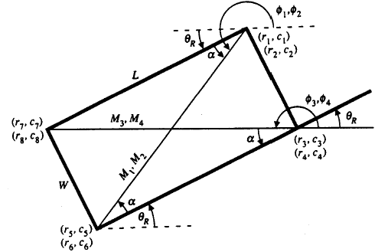


3.2.1 Extremal Points (cont’)
geometry of the tilted rectangle
DC & CV Lab.
CSIE NTU

Slide 38
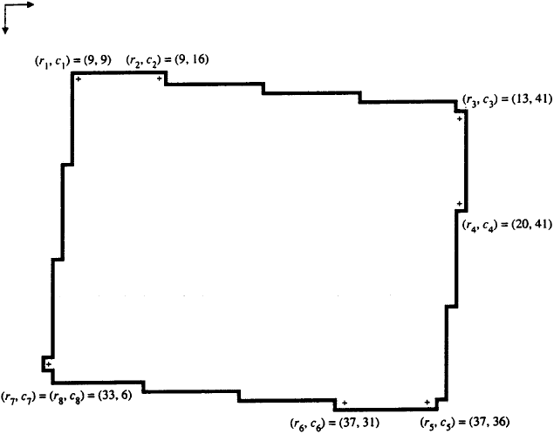
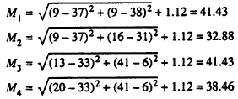
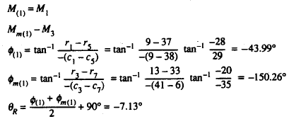
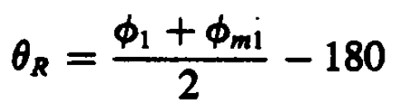
calculation for the orientation of an example rectangle
38
-
-180º = 82.86º
DC & CV Lab.
CSIE NTU
Notes:
In M1,M2,M3,M4, two longest are mate.
+360

Slide 39
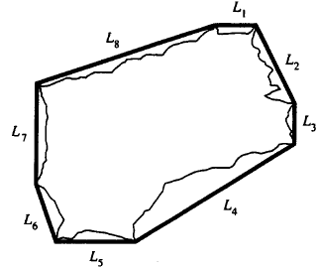
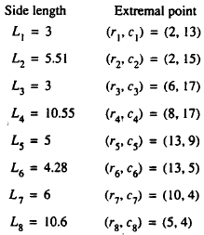
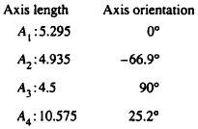
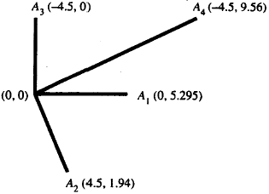
3.2.1 Extremal Points (cont’)
axes and their mates that arise from octagonal-shaped regions
DC & CV Lab.
CSIE NTU
Notes:
A1, A3
A2, A4
Major: largest length
Minor: Its mate

Slide 40
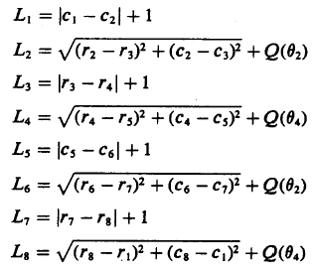
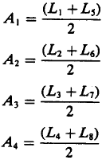
3.2.1 Extremal Points (cont’)
DC & CV Lab.
CSIE NTU

Slide 41



3.2.2 Spatial Moments
Second-order row moment
Second-order mixed moment
Second-order column moment
DC & CV Lab.
CSIE NTU

Slide 42
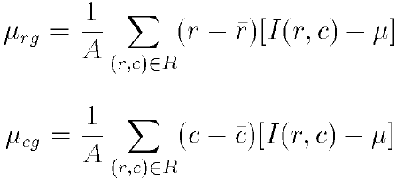
3.2.3 Mixed Spatial Gray Level Moments
region properties: position, extent, shape, gray level properties
Second-order mixed gray level spatial moments
DC & CV Lab.
CSIE NTU

Slide 43
DC & CV Lab.
CSIE NTU

Slide 44
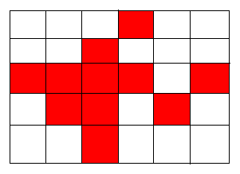
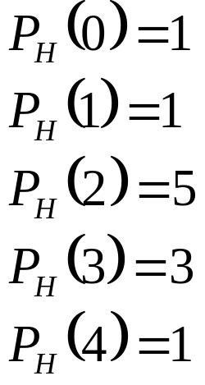
3.3 Signature Properties
vertical projection
horizontal projection
DC & CV Lab.
CSIE NTU

Slide 45

3.3 Signature Properties (cont’)
diagonal projection from lower left to upper right
diagonal projection from upper left to lower right
area
DC & CV Lab.
CSIE NTU

Slide 46
3.3 Signature Properties (cont’)
rmin: top row of bounding rectangle
rmax; bottom row of bounding rectangle
cmin: leftmost column of bounding rectangle
cmax: rightmost column of bounding rectangle
DC & CV Lab.
CSIE NTU

Slide 47
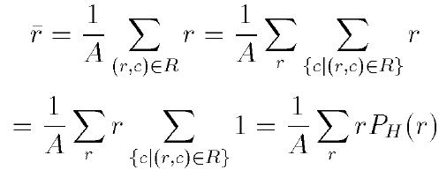
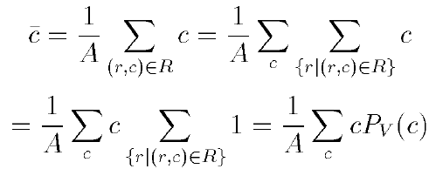


3.3 Signature Properties (cont’)
row centroid
column centroid
diagonal centroid
another diagonal centroid
DC & CV Lab.
CSIE NTU

Slide 48



3.3 Signature Properties (cont’)
second row moment from horizontal projection
second column moment from vertical projection
second diagonal moment
DC & CV Lab.
CSIE NTU

Slide 49

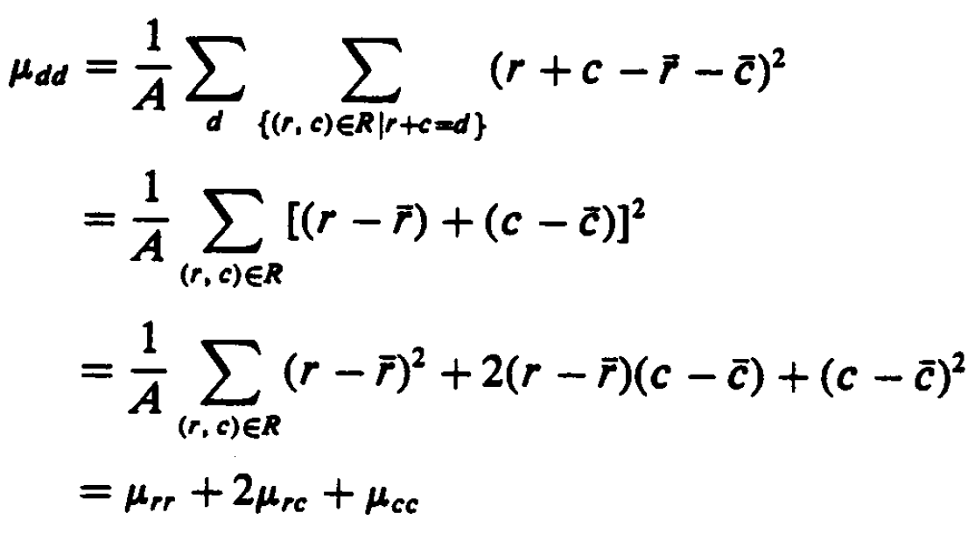

3.3 Signature Properties (cont’)
second diagonal moment related to
second mixed moment can be obtained from projection
DC & CV Lab.
CSIE NTU

Slide 50


3.3 Signature Properties (cont’)
second diagonal moment related to
second mixed moment can be obtained from projection
mixed moment obtained directly from and
DC & CV Lab.
CSIE NTU

Slide 51
DC & CV Lab.
CSIE NTU

Slide 52
3.3.1 Signature Analysis to Determine the Center and Orientation of a Rectangle
signature analysis: important because of easy, fast implementation
surface mount device (SMD) placement: position and orientation of parts
DC & CV Lab.
CSIE NTU

Slide 53


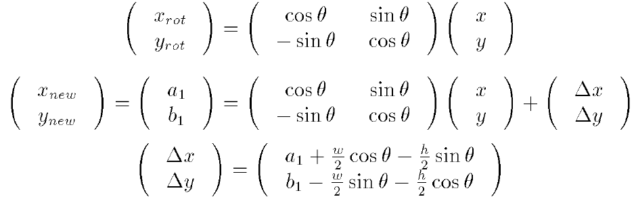
3.3.1 Signature Analysis to Determine the Center and Orientation of a Rectangle (cont’)
determine center of rectangle by corner location
side lengths w, h orientation angle
DC & CV Lab.
CSIE NTU

Slide 54
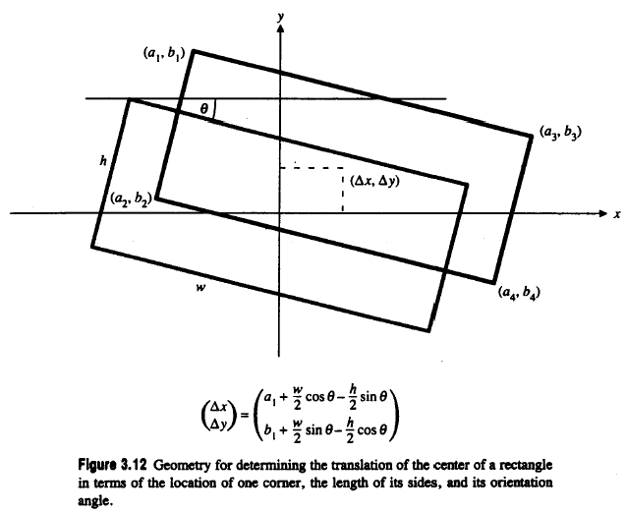
geometry for determining the translation of the center of a rectangle
DC & CV Lab.
CSIE NTU

Slide 55

partition rectangle into six regions formed by two vertical lines
a known distance g apart and one horizontal line
DC & CV Lab.
CSIE NTU

Slide 56





3.3.1 Signature Analysis to Determine the Center and Orientation of a Rectangle (cont’)
DC & CV Lab.
CSIE NTU

Slide 57







DC & CV Lab.
CSIE NTU

Slide 58



3.3.1 Signature Analysis to Determine the Center and Orientation of a Rectangle (cont’)
where rotation angle
DC & CV Lab.
CSIE NTU

Slide 59
DC & CV Lab.
CSIE NTU

Slide 60


3.3.2 Using Signature to Determine the Center of a Circle
partition the circle into four quadrants formed by two orthogonal lines which meet inside the circle
geometry for the circle, its center, and a chord
DC & CV Lab.
CSIE NTU

Slide 61







3.3.2 Using Signature to Determine the Center of a Circle
=
=
= r² [θ - cosθsinθ]
DC & CV Lab.
CSIE NTU

Slide 62

3.3.2 Using Signature to Determine the Center of a Circle (cont’)
circle projected onto the four quadrants of the projection index image
DC & CV Lab.
CSIE NTU

Slide 63



3.3.2 Using Signature to Determine the Center of a Circle (cont’)
each quadrant area from histogram of the masked projection
positive if A + B > C + D negative otherwise where
positive if B + D > A + C, negative otherwise
DC & CV Lab.
CSIE NTU

Slide 64
3.4 Summary
region properties from connected components or signature analysis
DC & CV Lab.
CSIE NTU

Slide 65



Histogram Equalization
(Homework)
pixel transformation
r, s: original, new intensity, T: transformation
T( r ) single-valued, monotonically increasing
for
DC & CV Lab.
CSIE NTU

Slide 66


DC & CV Lab.
CSIE NTU

Slide 67




Histogram Equalization
(Homework)
histogram equalization histogram linearization
number of pixels with intensity j
n: total number of pixels
for every pixel if then
DC & CV Lab.
CSIE NTU

Slide 68
Histogram Equalization
(Homework)
Project due Oct. 9:
Write a program to do histogram equalization
DC & CV Lab.
CSIE NTU

