Slide 1
Review on Towards 1 Gbps/UE in Cellular Systems: Understanding Ultra-Dense Small Cell Deployments
Name: Sai Narsi Reddy Donthi Reddy
UMKC ID: 16186610

Slide 2
The Introduction
It is estimated that by 2020, the number of wireless smart devices connected to internet increase to 25 Billion [1].
The number of connected devices per person like to be an average of 5.1 [2].
To meet this demands, it is forecasted to increase the network capacity by at least 100 folds by 2020 [3].
It is not possible to meet the trend with current generation wireless communication technology.
[1] Gartner. (2014, nov) Gartner says 4.9 billion connected things will be in use in 2015. [Online]. Available: http://www.gartner.com/newsroom/id/2905717
[2] F. . Sullivan. (2015, apr) Power management in internet of things (iot) and connected devices. [Online]. Available: https://www.frost.com/sublib/display-market-insight.do?id=294383010
[3] D. Lpez-Prez, M. Ding, H. Claussen, and A. H. Jafari, “Towards 1 gbps/ue in cellular systems: Understanding ultra-dense small cell deployments,” IEEE Communications Surveys Tutorials, vol. 17, no. 4, pp. 2078–2101, Fourthquarter 2015.

Slide 3
The Problem
The current generation wireless network consists of macro cells covering long distances with type-2 small cells providing high speed connection.
These type-2 small cells use co-channel deployments which leads into inter-tire interference which can lead to coverage and hand over issues.
Lower frequency bands which are currently used in network have low bandwidths and achieve low through put.
It is important to address these issues to increase the network capacity to meet the future demands.
All the tools available can be divided into three categories; network densification, the use of higher frequency bands and spectral efficiency enhancement techniques

Slide 4
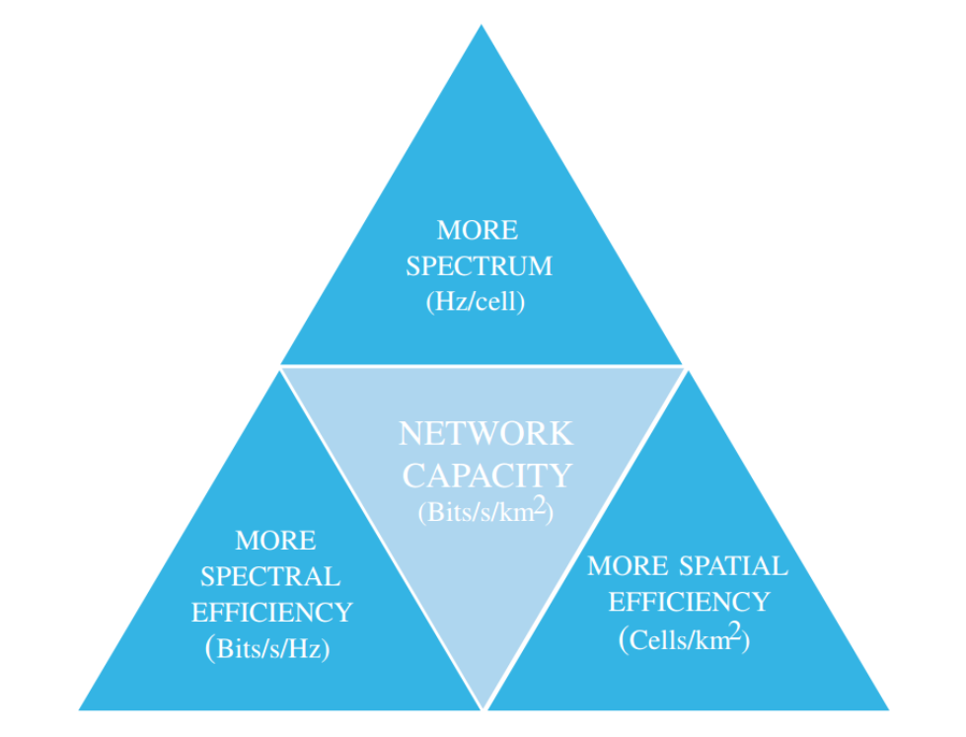
Three categories of existing tools to improve Network capacity.

Slide 5
The Categories
Three categories of existing tools to improve Network capacity:
More Spatial Efficiency - Network Densification
More Spectrum - High carrier frequencies
More Spectral Efficiency - Multi-antenna and Scheduling's

Slide 6
More Spatial Efficiency - Network Densification
Changing the co-channel type-2 small cell deployment with type-3 small cells with high frequency non-co-channel deployments.
Unlike type-2 small cells there are no Close Subscriber Group (CSG) deployments. So there is no inter-tire interference in type-3 cells.
As the size of the cell reduces, the transmission power can be reduced by maintain the same SINR.
With decrease in cell size, the Line of Sight(LOS) of the transmitted signal is more dominant than Non-Line of Sight(NLOS) signal.

Slide 7
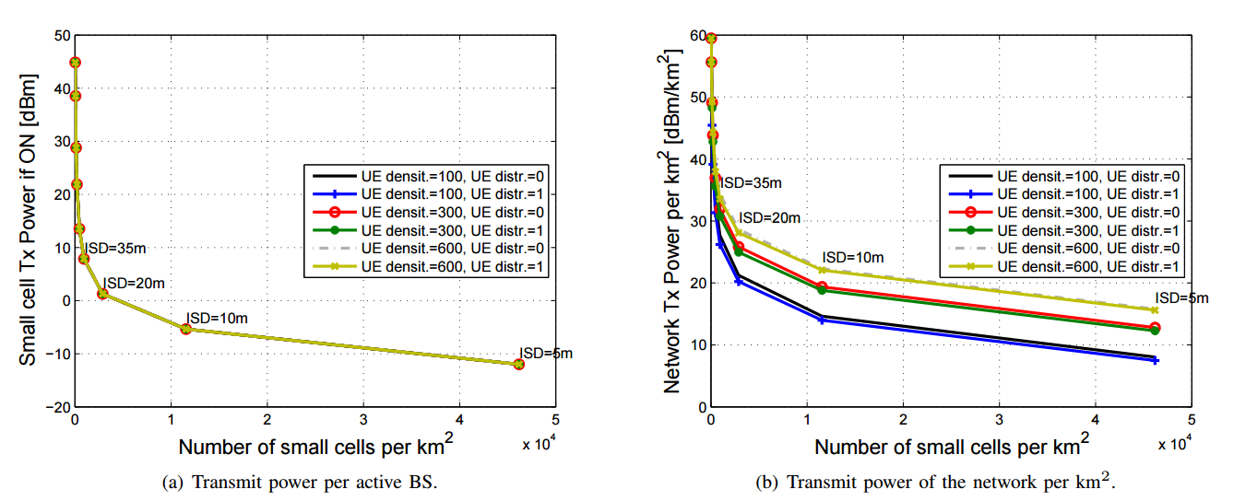
Transmission power of active BS and the total transmission power of the network

Slide 8
More Spectrum - High carrier frequencies
The current generation frequency bands 500MHz to 2600MHz which are used in wide range of wireless applications.
These frequencies have better long distances propagation properties.
Unlike lower frequencies, higher frequencies have large propagation loss.
With network densification, the cell size reduces and the propagation loss also reduces.
With increase in the frequency band from 2GHz to 10Ghz increases the bandwidth from 100MHz to 500MHz, which increases the throughput of the cell.

Slide 9
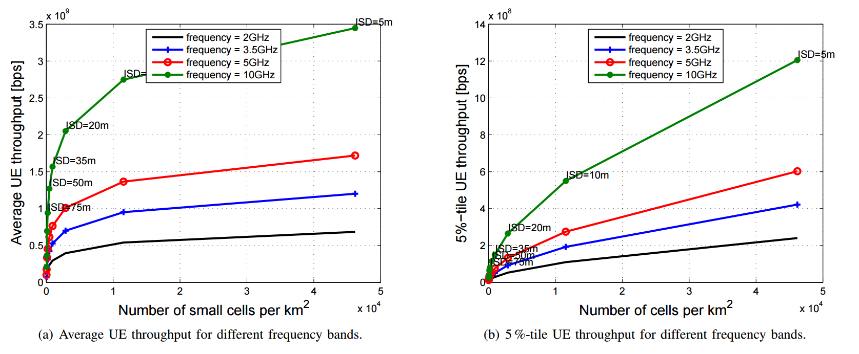
Average and 5% UE through for different frequency bands

Slide 10
More Spectral Efficiency - Multi-antenna and Scheduling's
With the increase in the frequency bands, the propagation loss increase drastically.
This can be overcome by using multi-antenna systems.
Using beamforming technology and by increasing the number of antennas from 1 to 4 increases by 28.11%.
Where as the edge of the cell, 5%-tile, throughput increases by 103%.
As the size of the cell reduces the number of UEs reduces, which in turn reduces for the need of complex scheduling techniques.
Between Round Robin and Proportional Fair for ISD of 20m, the difference is of only 10.3%.

Slide 11
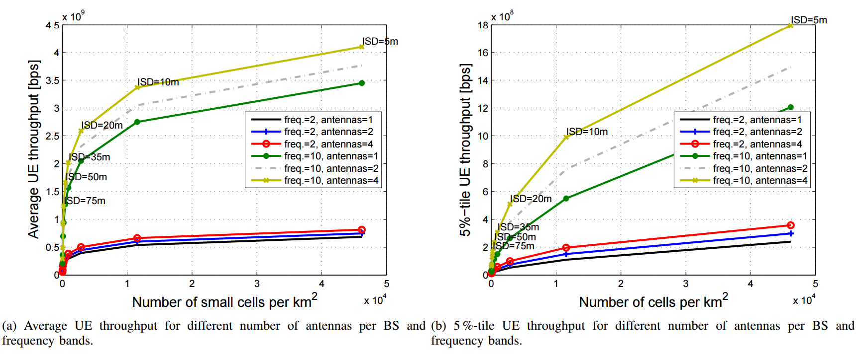
Average and 5% UE through for 2Ghz and 10Ghz with beam forming using 1,2 and 4 antenna at BS.

Slide 12
Increment in network capacity in each Category
Considering 100MHz as bandwidth, ISD of 200m as the base.
Three categories of existing tools to improve Network capacity:
More Spatial Efficiency - Network Densification
There is a 7.65 folds increasing using 35m ISD.
More Spectrum - High carrier frequencies
There is a 5 folds increase using 10GHz.
More Spectral Efficiency - Multi-antenna and Scheduling's
There is 2 folds increase using beamforming and simple scheduling techniques.

Slide 13
The Applications
Smart devices and Internet of Things (IOT) - UE Density.
Virtual Reality (VR) and Augmented Reality (AR) applications – High throughput and low latency.
Higher resolution video technologies such as 4K and 8K resolutions - very high data rates.
Autonomous driving cars – Device – to – Device data transmissions.

Slide 14
The Future
2020 and beyond, the number of devices increases exponentially.
To increase the network capacity the cell size should be reduces more and increase the network densification.
Using mmWaves to achieve higher bandwidths and increase the average throughput.
Using multi-antenna technologies such as spatial multiplexing increases the throughput of the cell.

Slide 15
What we Learned?
How important it is to increase the network capacity to meet the feature demands.
To meet these demands the current generation technology are not even close to serve the coming network usage and it need to be improved.
I got to learn how the technologies I use in my day to day life work.
the recent development in wireless industry and what vendor and network providers are doing to increase the network capacity

Slide 16
Five most important points
Importance of increasing the network capacity for the future demand.
Network Densification is the major paradigm for increasing the network capacity in large increments.
How higher frequencies and smaller cell sizes are more beneficial and have different propagation effects than lower frequencies and macro cells.
In small cells LOS signal dominates compare to NLOS signal.
Inefficiencies of today’s small cell network for providing higher throughput.

Slide 17
Thank You
Name: Sai Narsi Reddy Donthi Reddy
UMKC ID: 16186610

