Slide 1

MOTILAL NEHRU NATIONAL INSTITUTE OF TECHNOLOGY PRAYAGRAJ : INDIA (211004)
SmartAttendance.Pi
(An Automatic Face-Based Attendance System)
Under the guidance of
Dr. Shailendra Shukla
MNNIT Allahabad(CSED)
Submitted By :
Aditya Maurya 2023CA09 Shishupal Sahu 2023CA90 Somenath Singh 2023CA99

Slide 2
Introduction
The SmartAttendance.Pi (An Automatic Face-Based Attendance System) is a software which is designed to automate the process of attendance marking using facial recognition technology.
It is especially tailored for educational institutions like MNNIT ALLAHABAD that aim to digitize and simplify classroom attendance management.
The system enables students to register using their face, ensuring a contactless and quick check-in process.
It enables course-wise attendance tracking and generates time-stamped XLS reports.
It also helps administrators manage attendance records, send attendance files via email, and make real-time announcements — all through an easy-to-use, offline-ready interface.

Slide 3
Motivation behind the topic
Time-Efficient Attendance Process: Traditional attendance methods are time-consuming and interrupt classroom flow, Automating this process saves valuable teaching time.
Accuracy and Transparency: Eliminates human error and ensures transparent, tamper-proof attendance records.
Offline Functionality: Designed to function without internet, making it ideal for institutions with limited connectivity.
Privacy-Focused: No cloud-based storage; all student data and images are stored and processed locally to maintain privacy.
Student and Admin Convenience: Provides a seamless experience for both students and administrators with voice announcements, email reporting, and user-friendly interfaces.

Slide 4
Proposed Solution
Face Recognition-Based Attendance: Automates the entire attendance process using Dlib and OpenCV for real-time facial recognition.
Compact and Offline-First System: Designed to run efficiently even without internet, suitable for offline environments like classrooms.
User-Friendly Interface: Built using Tkinter to enable easy interaction for both students and staff.
Automatic XLS Report Generation: Attendance is recorded and organized in Excel files course-wise with timestamps.
Email Integration: Attendance reports can be emailed directly to the concerned faculty/admin.
Raspberry Pi Compatible: Lightweight enough to run on Raspberry Pi for portable and cost-effective setups.

Slide 5
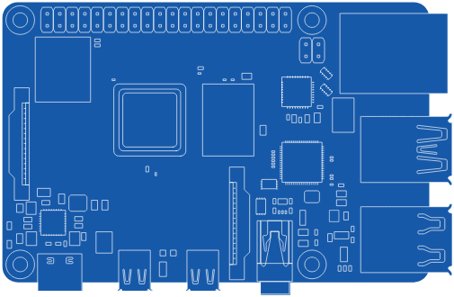

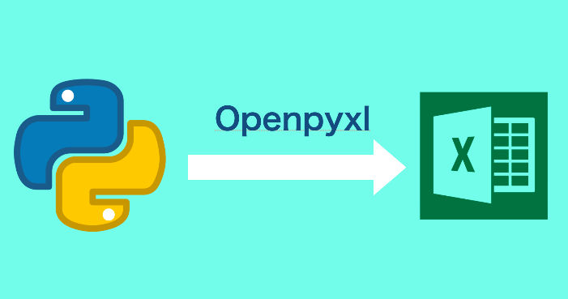


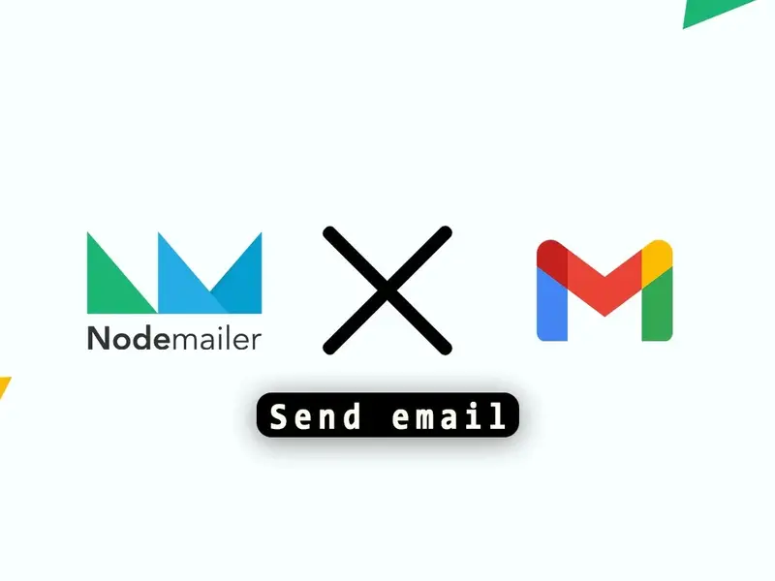

Tech Stack

Slide 6
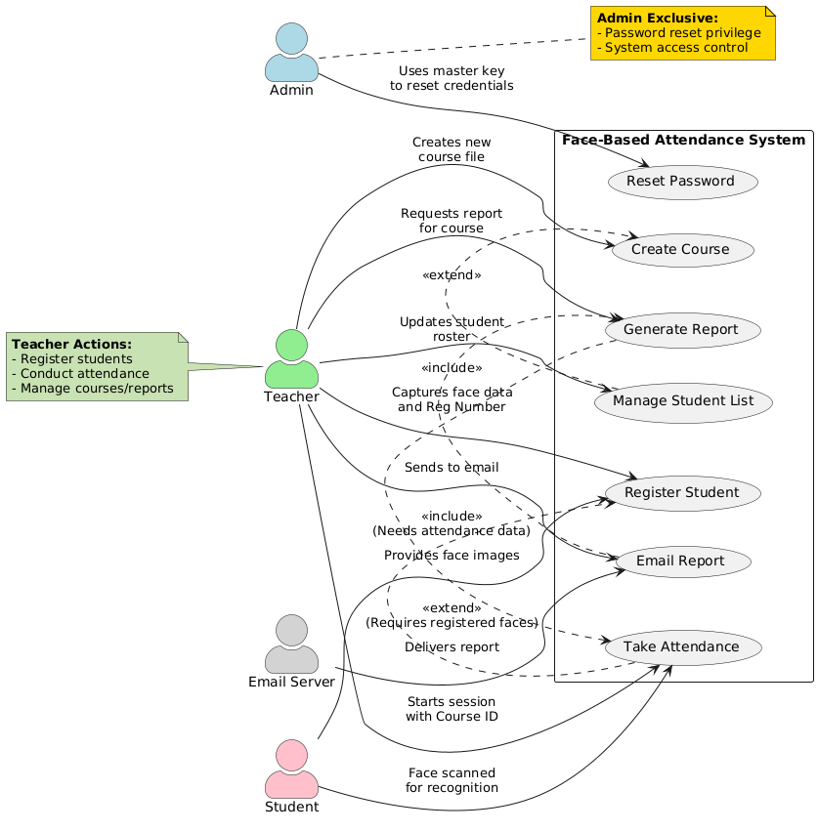
Use Case Diagram

Slide 7
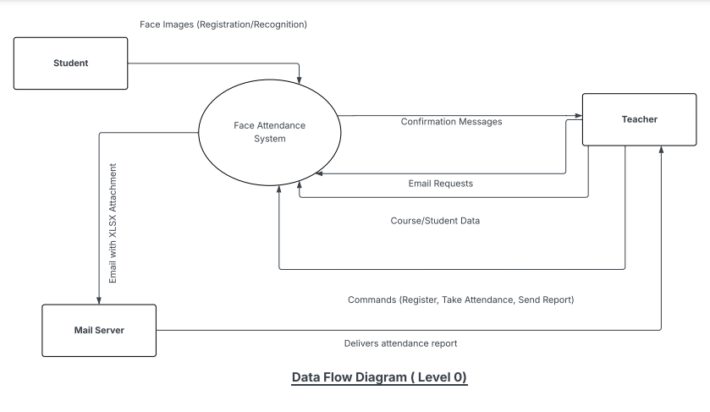
DFD Level 0

Slide 8
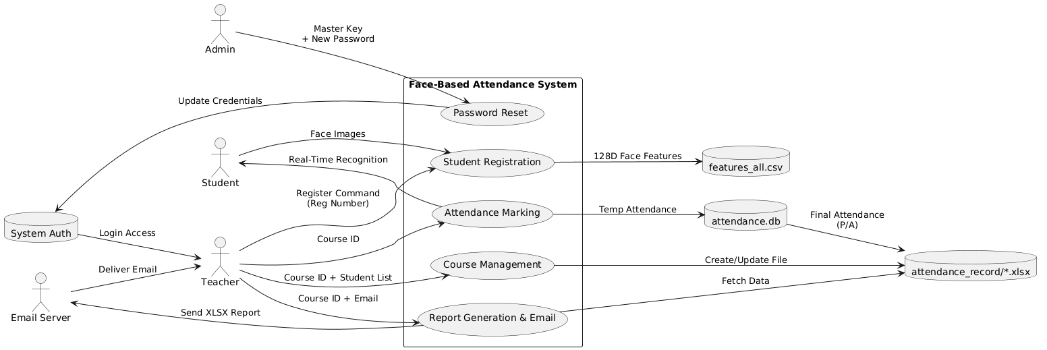
DFD Level 1

Slide 9
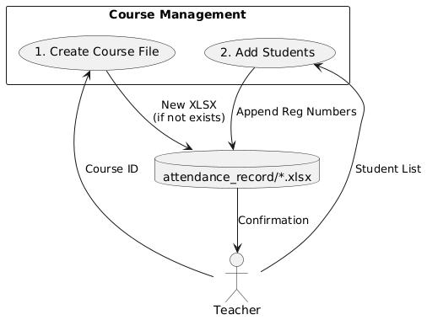
DFD Level 2

Slide 10
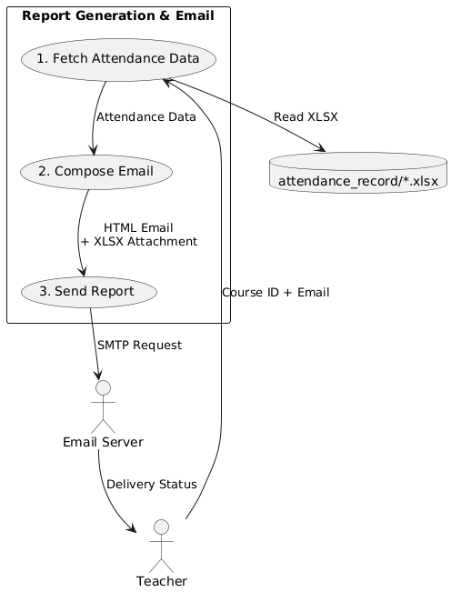
DFD Level 2

Slide 11
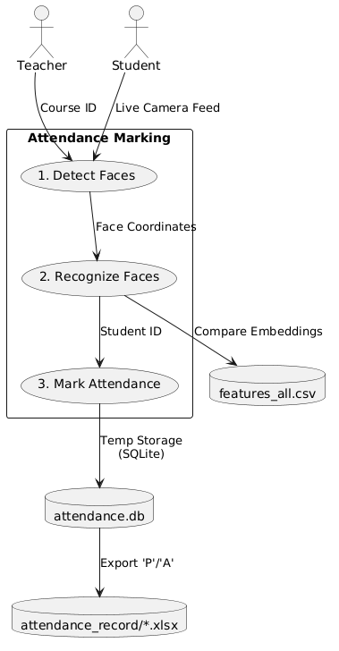
DFD Level 2

Slide 12
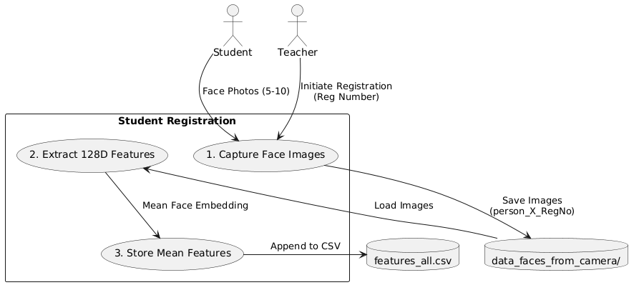
DFD Level 2

Slide 13
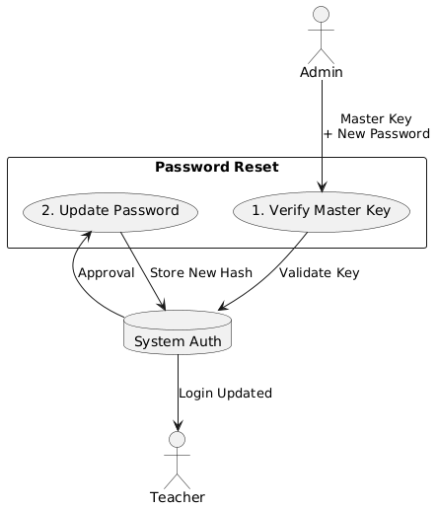
DFD Level 2

Slide 14
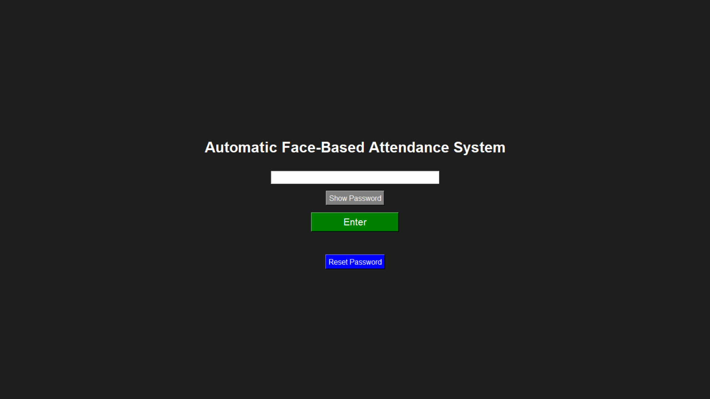
Login

Slide 15
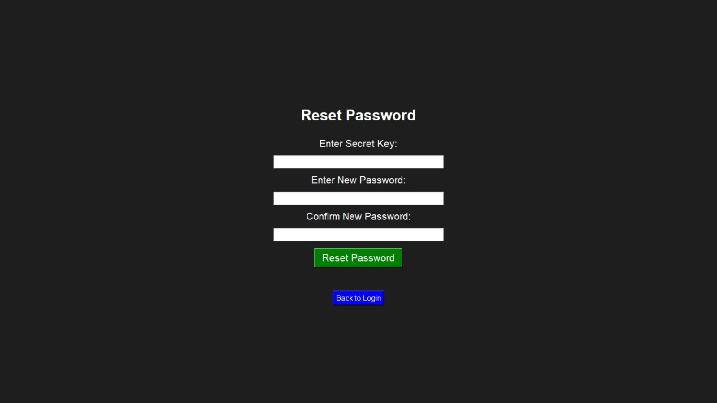
Change Password

Slide 16
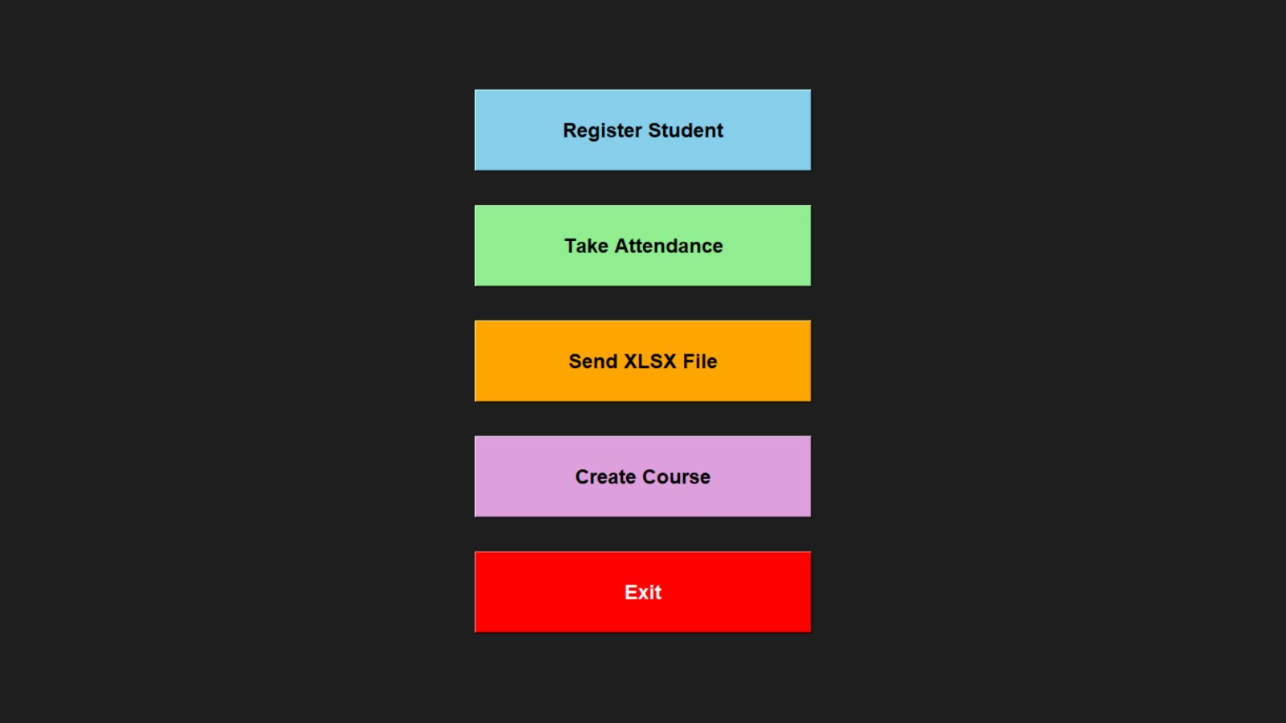
Home Page

Slide 17
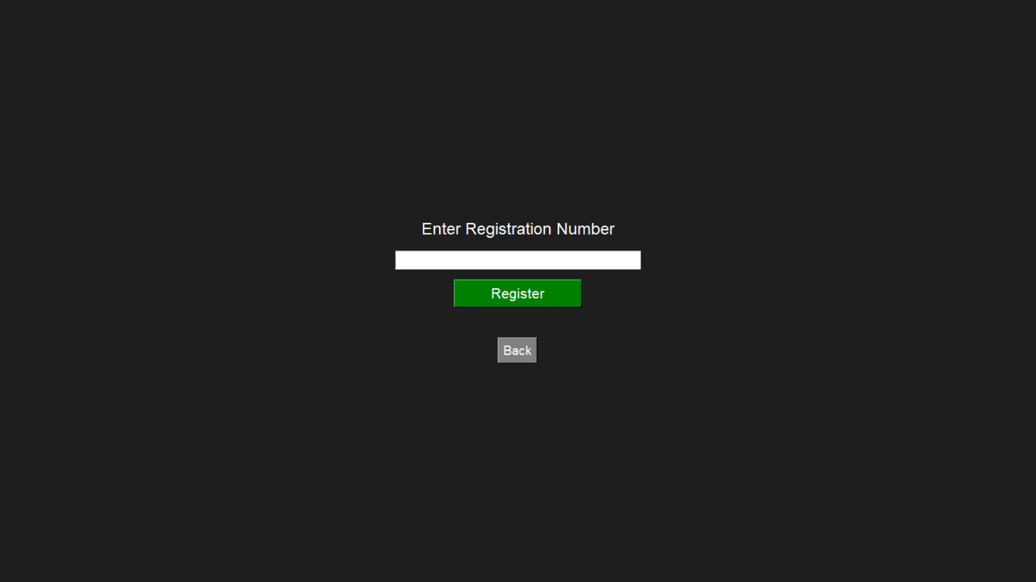
Register student

Slide 18
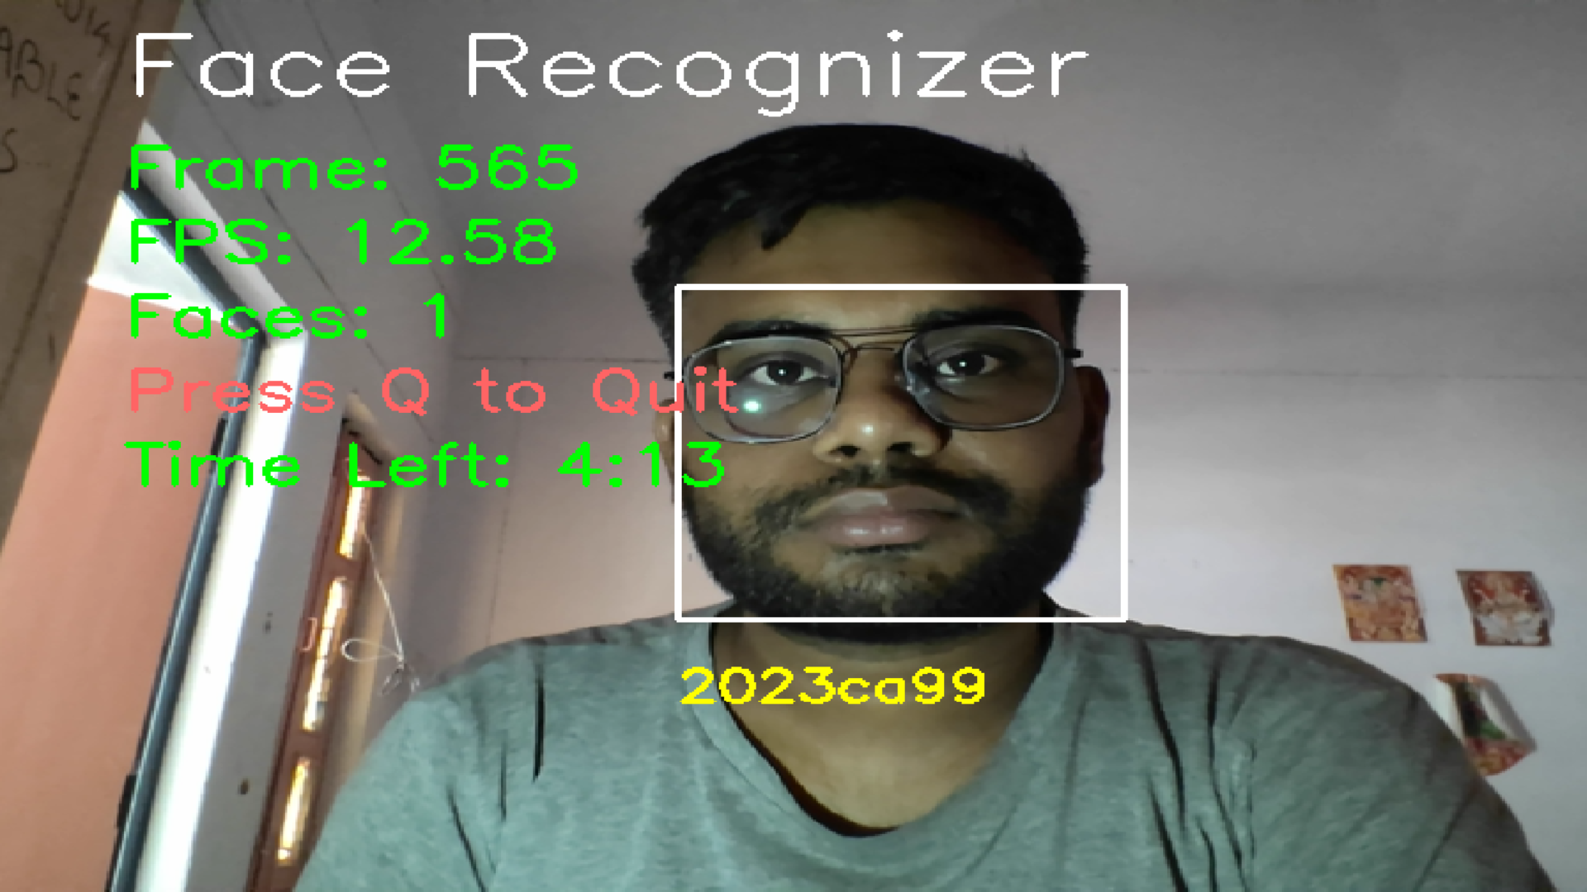
Register student ( Continue )

Slide 19
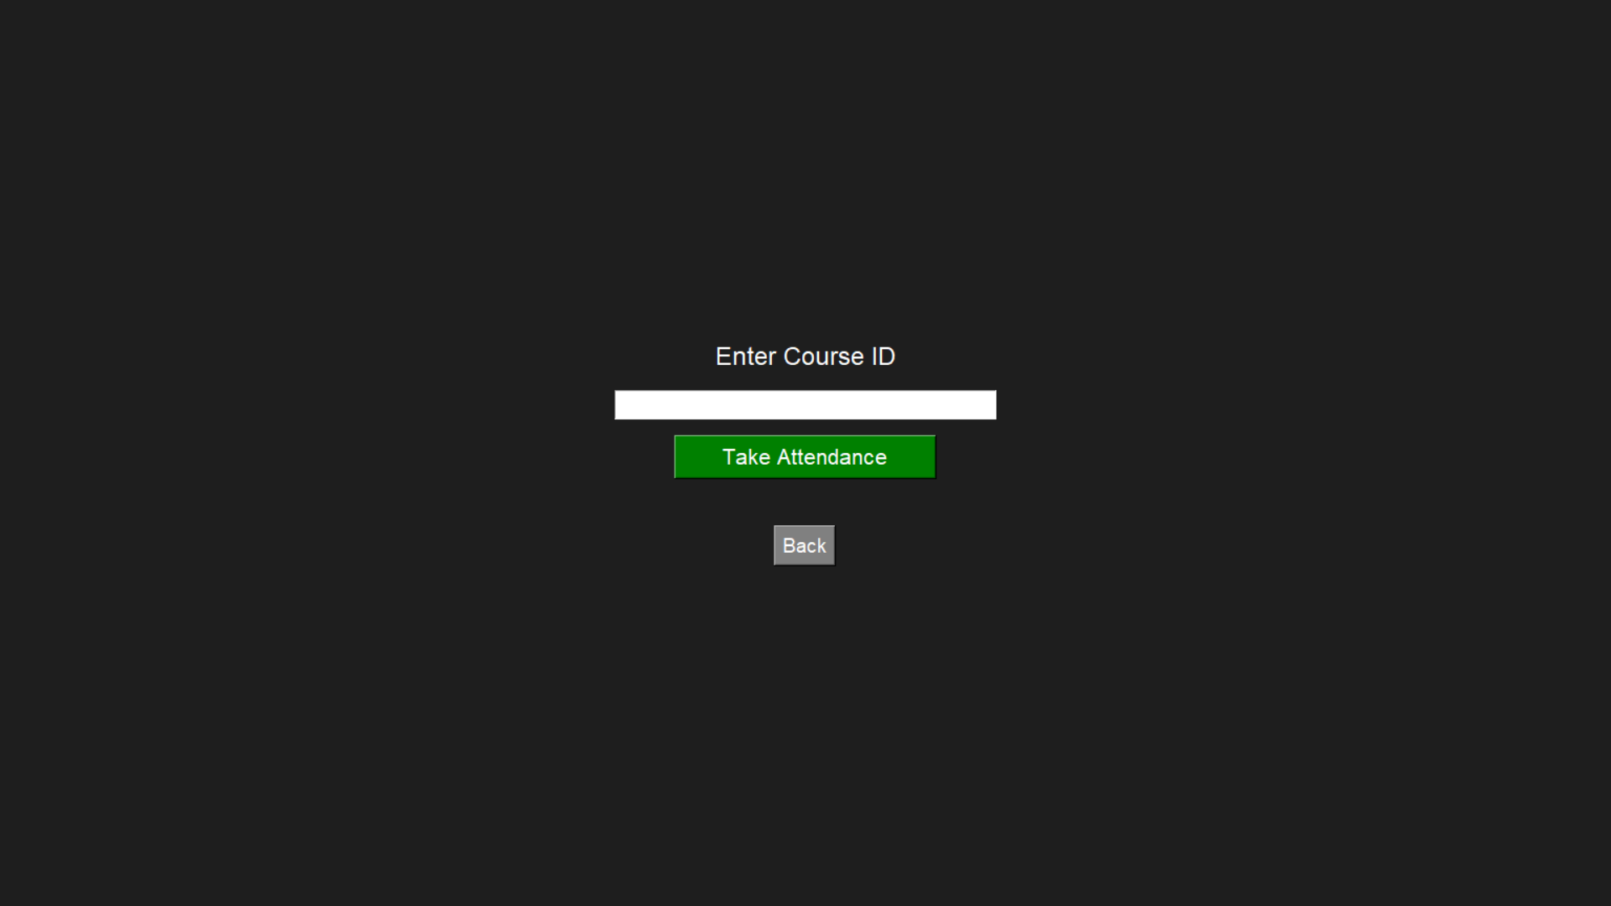
Mark Attendance

Slide 20
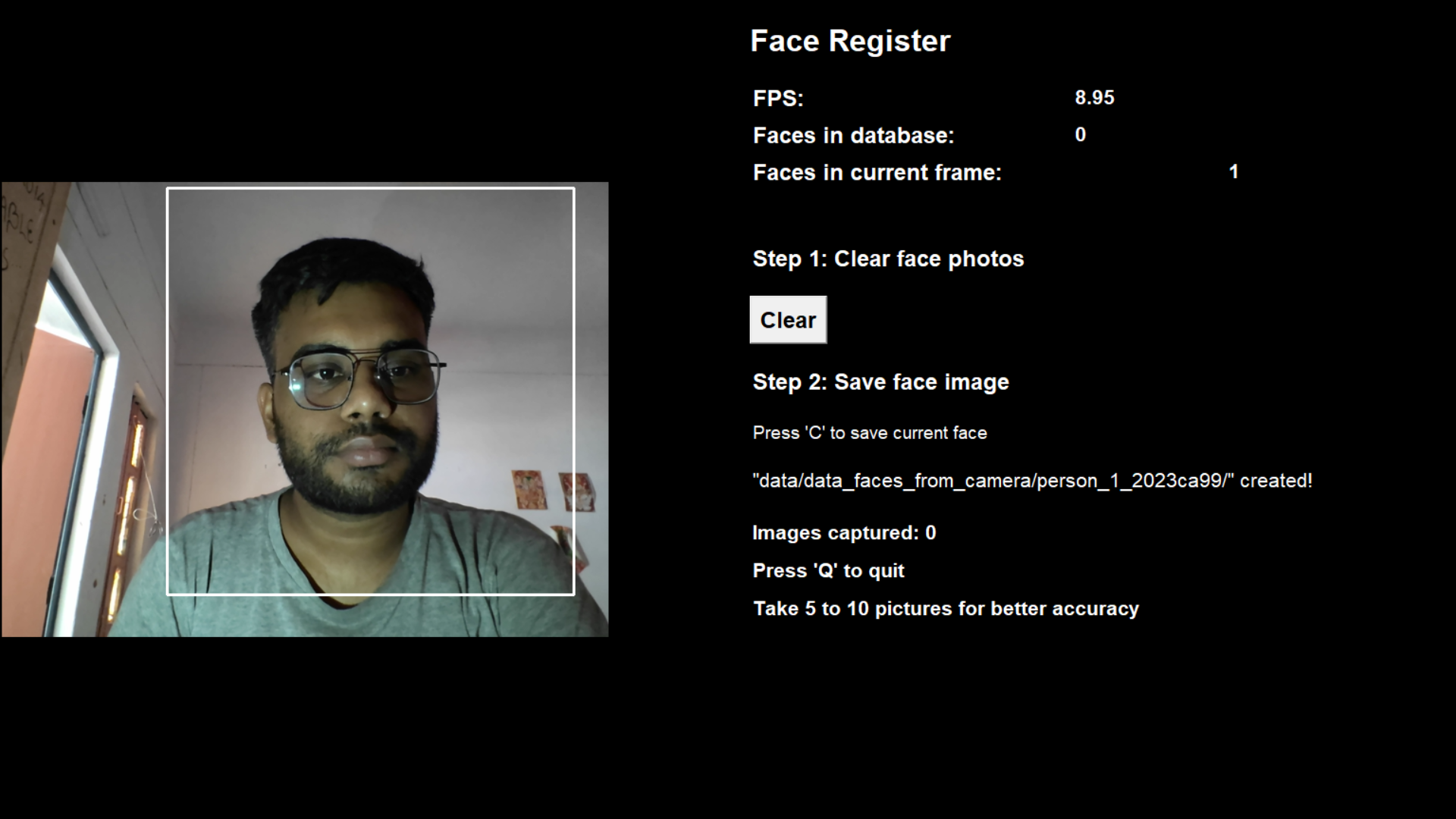
Mark Attendance ( Continue )

Slide 21
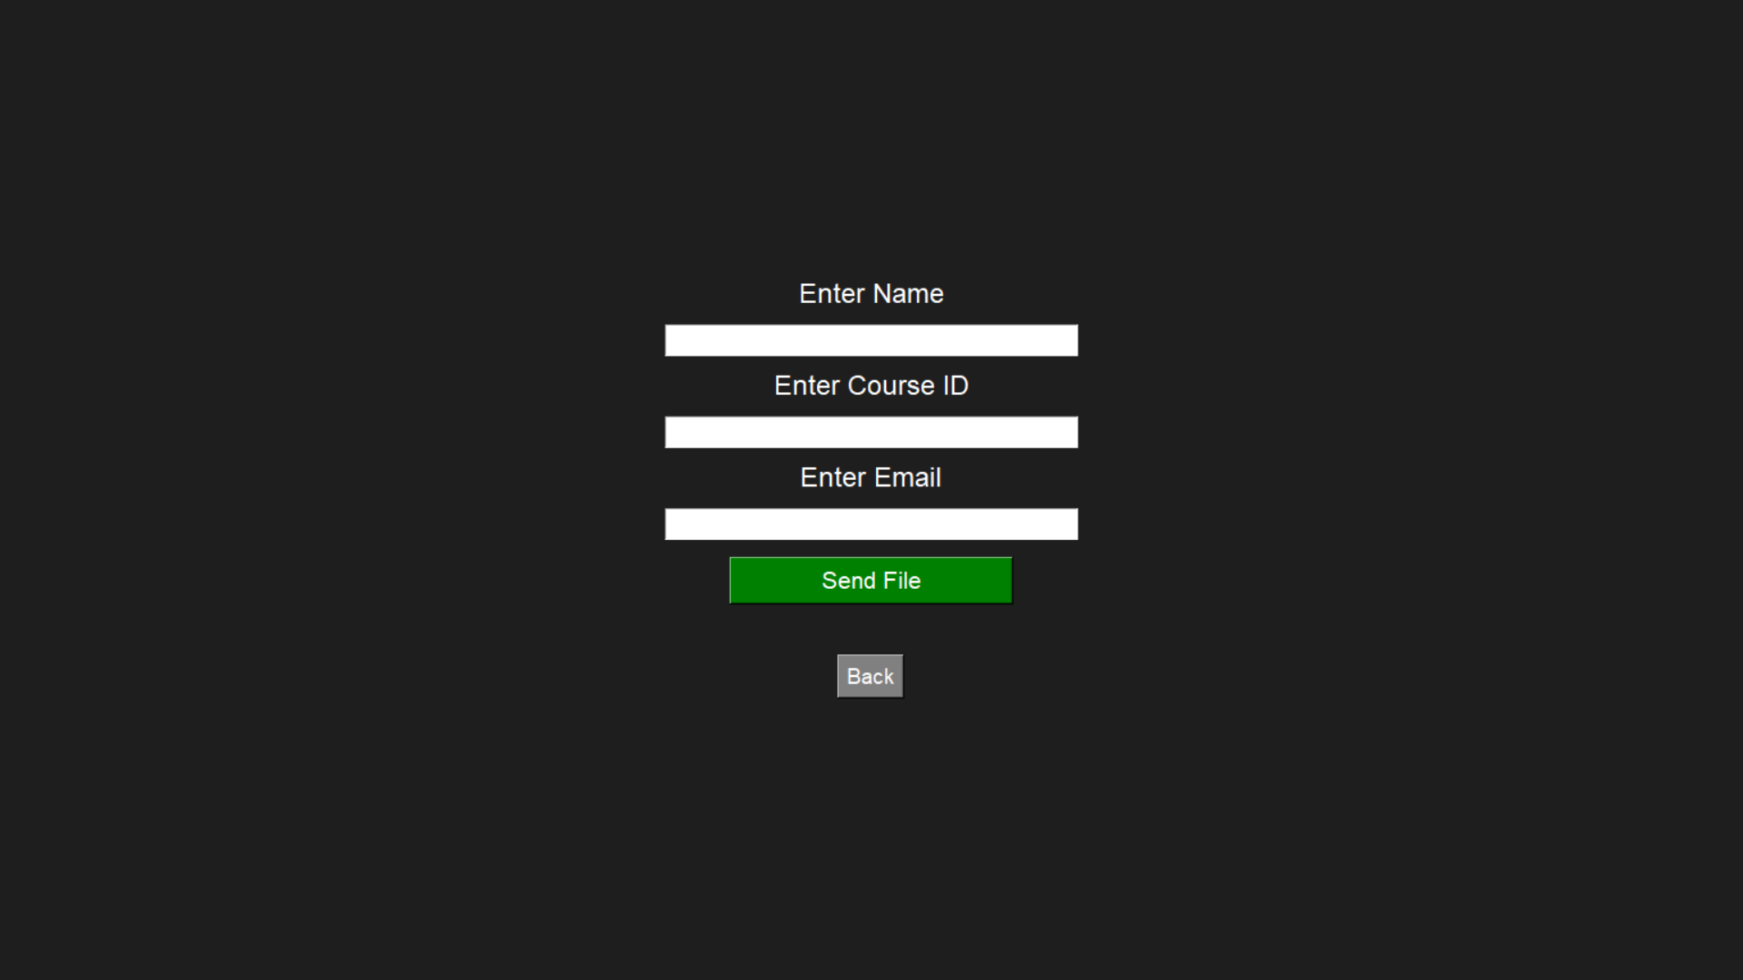
Send XLSX File

Slide 22
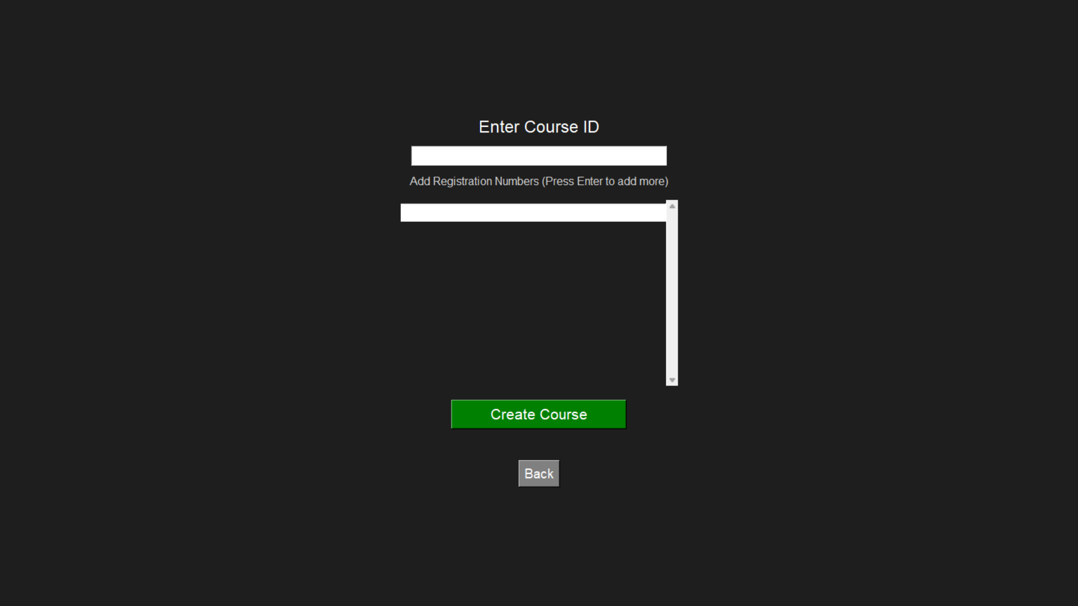
Course Creation

Slide 23
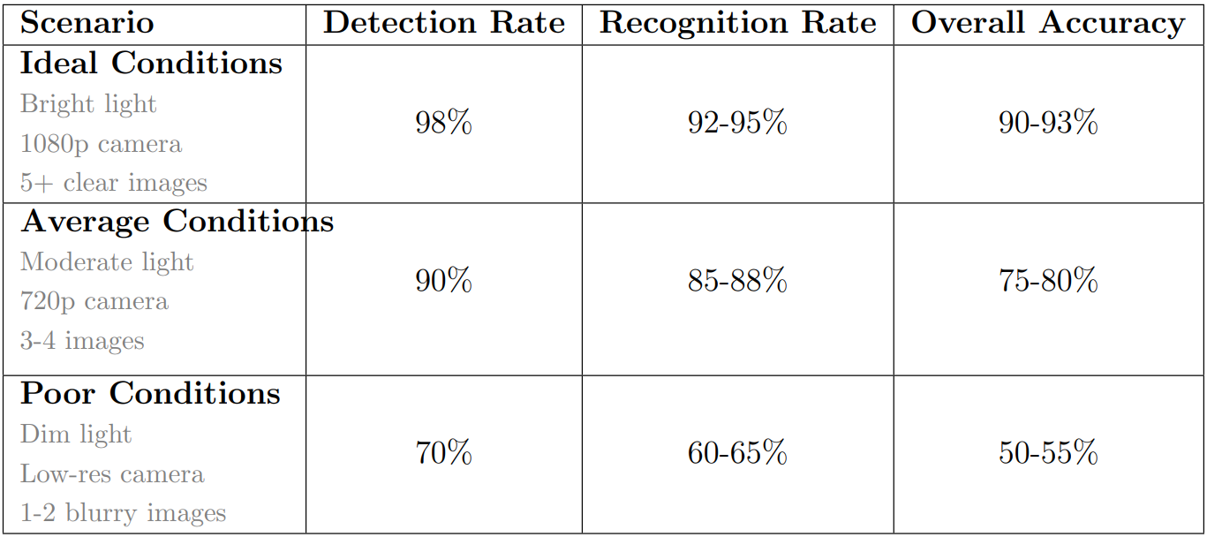
Accuracy

Slide 24
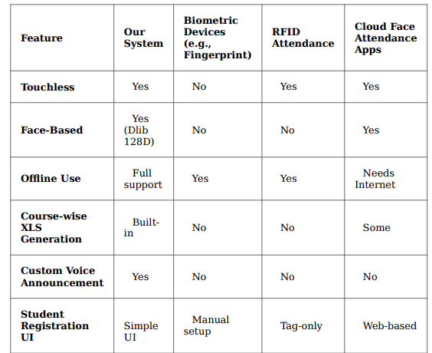
Comparison with Other Market Solutions

Slide 25
Limitations
Lighting and Camera Quality Dependency: Accurate face recognition may be affected in low-light conditions or with poor-quality cameras.
Limited Hardware Support: Though compatible with Raspberry Pi, performance may degrade on older systems with limited processing power.
Initial Setup Required: Registering all students with multiple face angles can be time-consuming initially.
Privacy and Security Concerns: Although images are deleted post-processing, facial data still requires secure storage and access control.
Email Feature Needs Internet: Emailing attendance reports requires a stable internet connection, limiting full offline functionality.

Slide 26
Conclusion
Purpose: To simplify and automate attendance management in classrooms using face recognition technology, while ensuring privacy, accuracy, and ease of use.
Benefits:
Automated attendance marking with face recognition for accuracy and speed.
Course-wise attendance records in XLS format for organized tracking, Suggested removal unless you're
tracking mess attendance too.
Email integration for sending attendance reports directly.
Offline functionality ideal for environments with limited internet access.
Technologies:
Programming Language : Python 3.
Libraries & Tools : OpenCV, dlib, Tkinter, pandas, openpyxl, pyttsx3.
Optional Hardware:Raspberry Pi 4 Model B (for portability and cost-efficiency).

Slide 27
Future Scope
Multi-Course Attendance Management: Supports attendance tracking for multiple courses with automatic XLS report generation and organization.
Email Integration: Sends attendance reports directly via email, eliminating the need for physical transfers or USBs.
Raspberry Pi Support: Designed to run smoothly on compact, low-cost Raspberry Pi devices, making it ideal for offline and portable setups.
Advanced Face Recognition: Utilizes dlib’s 128D facial features for high-accuracy recognition even in different angles and lighting conditions.
Privacy and Security Features: Automatically deletes captured face images after extracting features to ensure user privacy.
Offline Functionality: Fully functional without internet access, except during email sending, making it suitable for low-connectivity environments.

Slide 28
THANK YOU

