Slide 1
हाम्रो प्राचीन सम्पदा
Hamro Prachin Sampada
A 3D heritage explorer and quiz game for Nepal
BCA Project III (CACS452) | Tribhuvan University | Pashupati Multiple Campus
Niranjan Katwal | Symbol No. 27802063 | Reg. No. 6-2-278-18-2022
Supervisor: ______________________
Notes:
Introduce yourself and the project: a free bilingual web app for exploring Nepal's heritage, with a 3D model for every site and games on top.

Slide 2
Problem and objectives
The problem
Objectives
Heritage information is scattered across books, photo pages and tourism sites
Few sites can be seen in 3D, and none are playable
Young learners get no feedback, no goals and no way to play together
Little of it is bilingual or free of cost
Cover 116 verified sites in all 7 provinces
Give every site a 3D model, a story and photographs
Plan a yatra route inside a time budget
Teach with an adaptive quiz, photo game and live hunts
Run in a normal browser at zero cost
Hamro Prachin Sampada | Niranjan Katwal | 2
Notes:
State the gap in one breath, then map each objective to a feature shown later.

Slide 3
What the system does
Explore
3D models
Yatra planner
MapLibre map, provinces, search, bilingual stories, photo gallery
One hand-built low-poly model per site, day and dusk lighting
Best route through chosen sites within your time, walk or taxi
Adaptive quiz
Find the Monument
Live hunts
1,160 questions, Elo difficulty, spaced repetition for misses
Guess on the map; score by distance and speed
Multiplayer rooms, server-timed rounds, leaderboard
Hamro Prachin Sampada | Niranjan Katwal | 3
Notes:
Also: recommender, heritage passport with GPS stamps and badges, leaderboard, email.

Slide 4
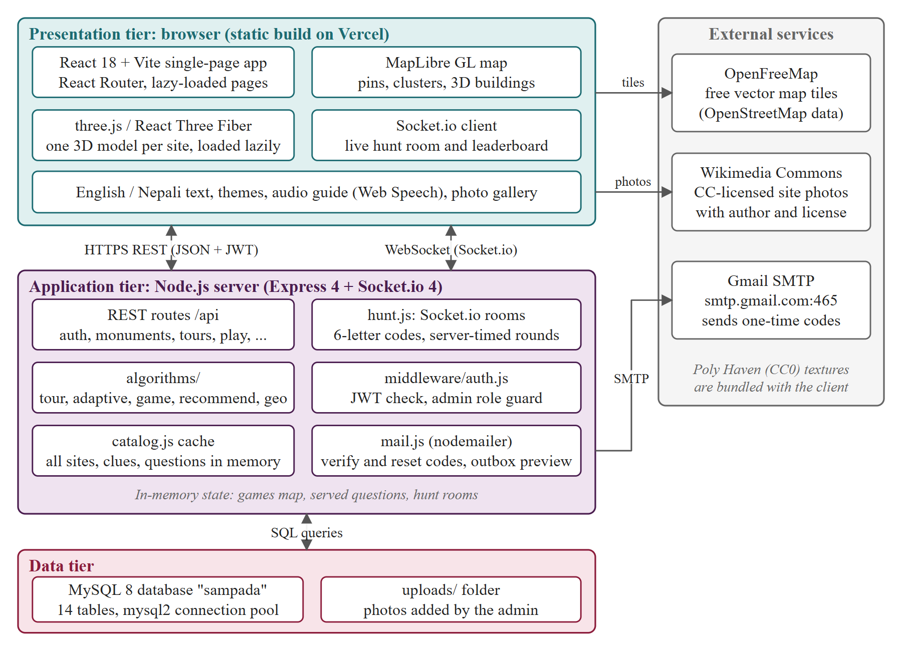
Architecture and technology
Client: React 18, Vite, React Router, Framer Motion
3D: three.js, React Three Fiber, per-site files loaded on demand
Server: Express 4 REST API, Socket.io for live hunts
Data: MySQL 8.4, 116 sites, 1,160 questions, 696 clues
Security: JWT, bcrypt, server-held quiz answers
Hamro Prachin Sampada | Niranjan Katwal | 4
Notes:
Three tiers. Answers to quiz and find rounds never leave the server until a round is scored.

Slide 5
Algorithms behind the games
Yatra planner
Orienteering problem with time windows: greedy value-per-minute insertion, 2-opt, re-insertion
Adaptive quiz
Elo rating for player and question, next question near 70% predicted success; SM-2 for misses
Find the Monument
Haversine distance, exponential distance score plus speed bonus
Live hunt
Socket.io rooms, 6-letter codes, server-timed rounds, points then time
Recommender
Tag cosine, Bayesian rating, novelty, nearness, city diversity re-ranking
Hamro Prachin Sampada | Niranjan Katwal | 5
Notes:
Verified against a brute-force planner in the unit tests.

Slide 6
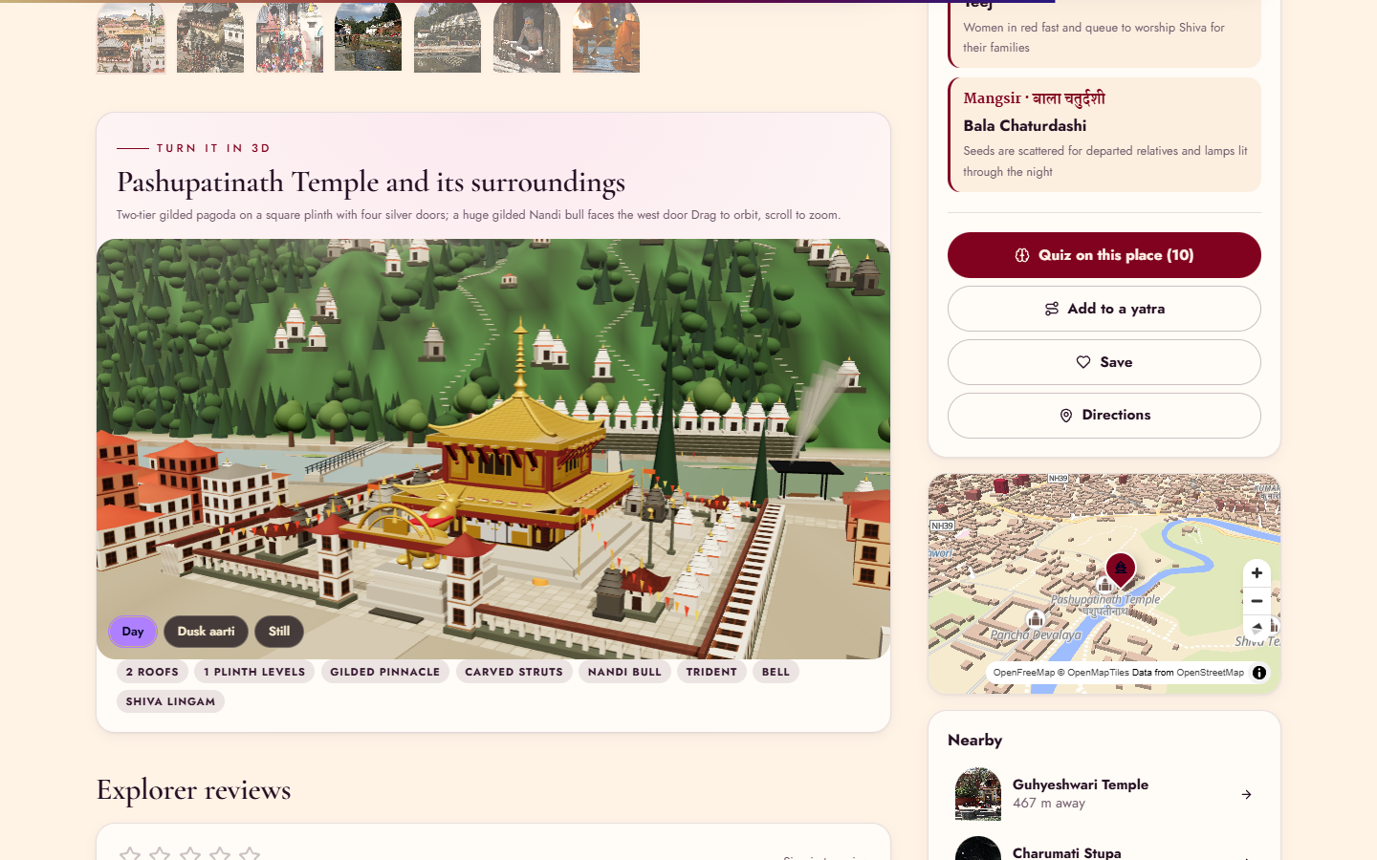
3D models for every site
116 per-site models built from photographs and fact sheets
Landmark-specific: Pashupatinath terraces and Bagmati, Kathmandu Durbar Square vs Hanuman Dhoka, Kal Bhairav niche
Lazy loaded: only the opened site's file is fetched
Day and dusk (aarti) lighting
Honest limit: stylized approximations, not scans.
Hamro Prachin Sampada | Niranjan Katwal | 6
Notes:
Explain why procedural: no licensed scans for most sites, small download, works offline of any 3D vendor.

Slide 7
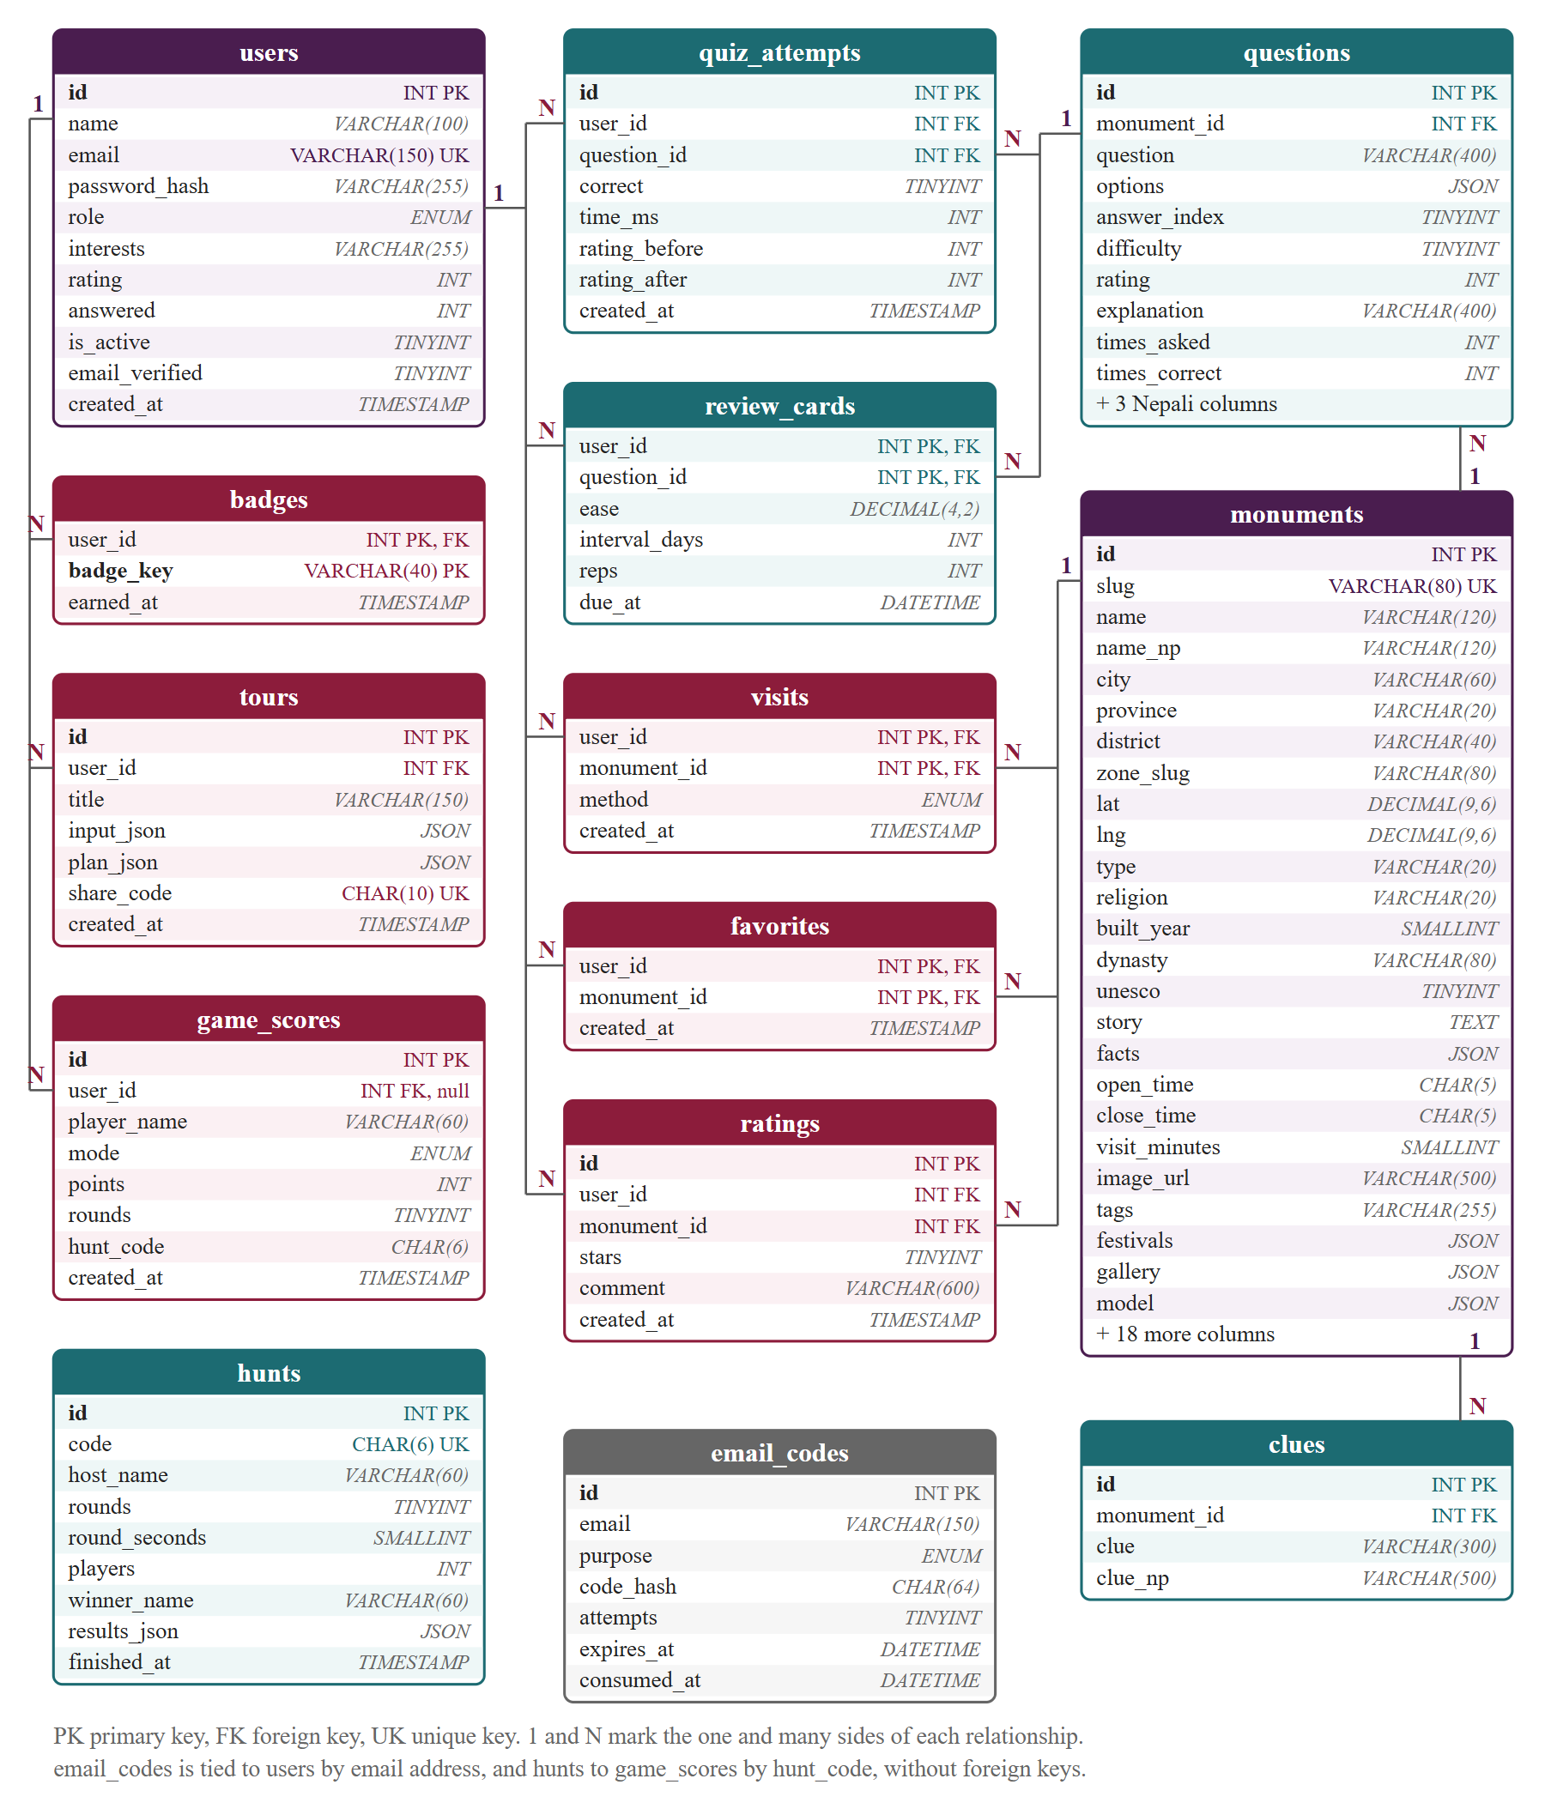
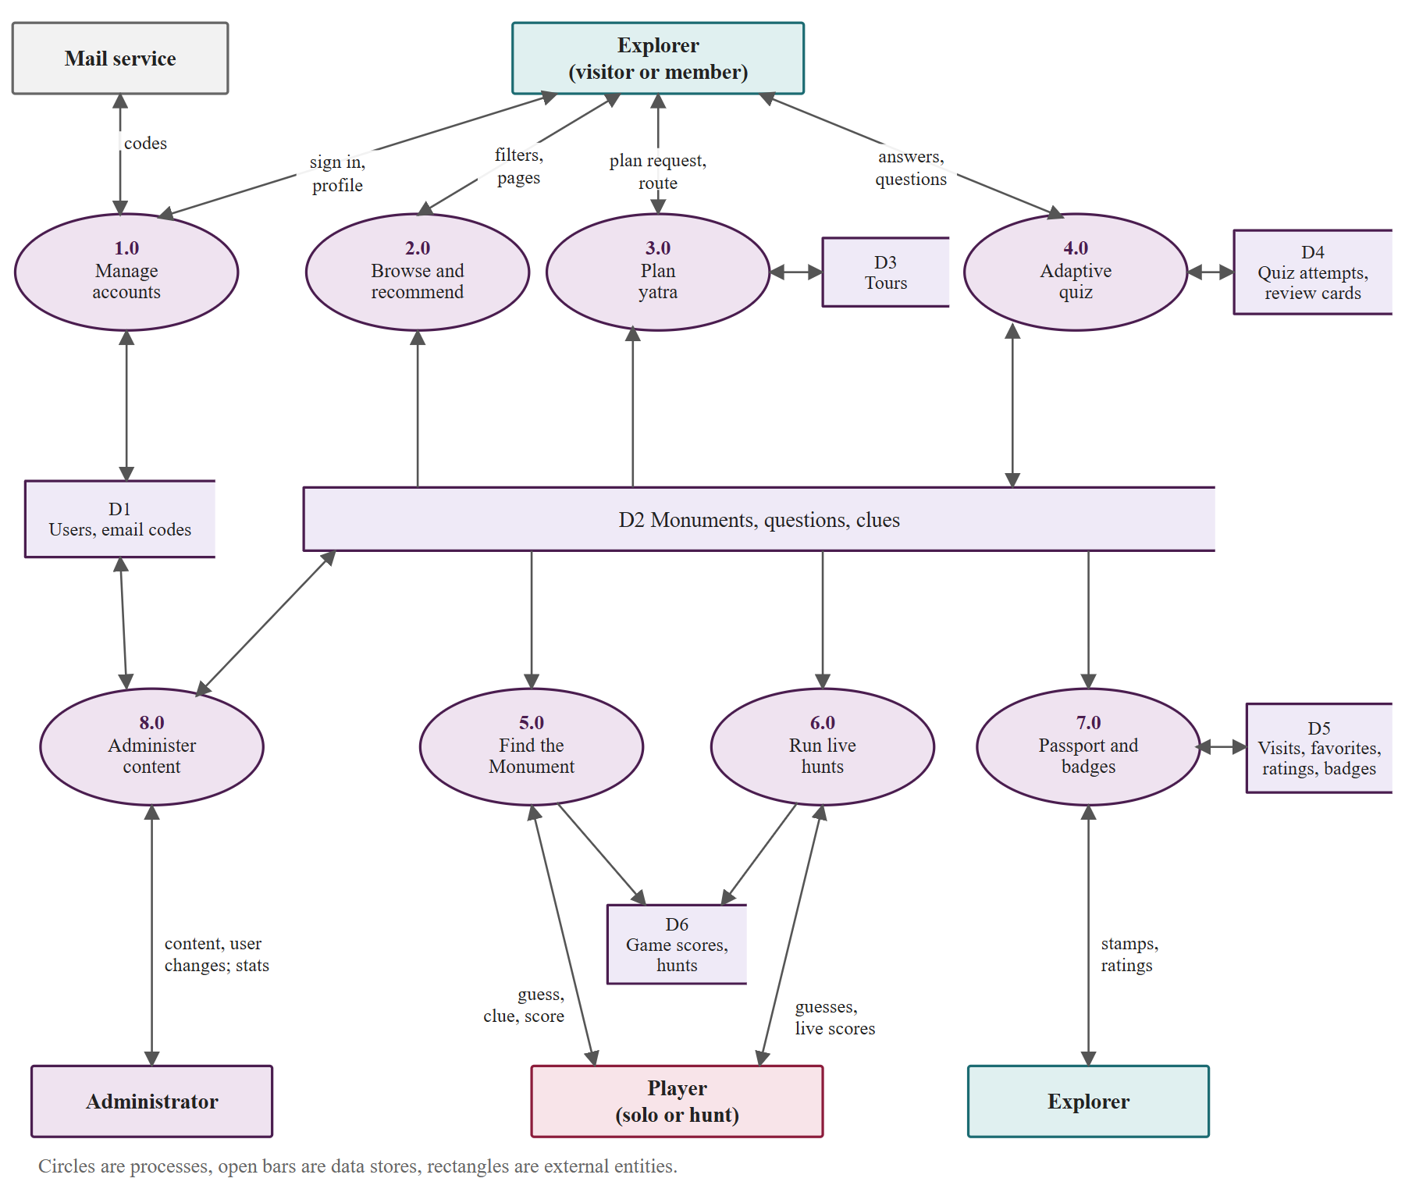
Data model and flows
Hamro Prachin Sampada | Niranjan Katwal | 7
Notes:
ER diagram on the left, level-1 data flow on the right.

Slide 8
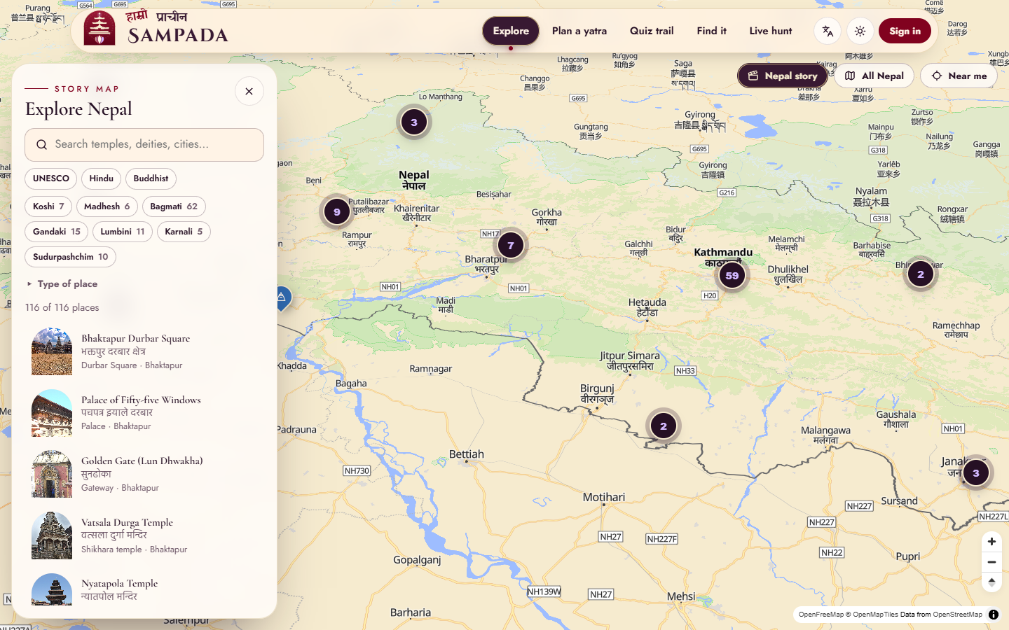
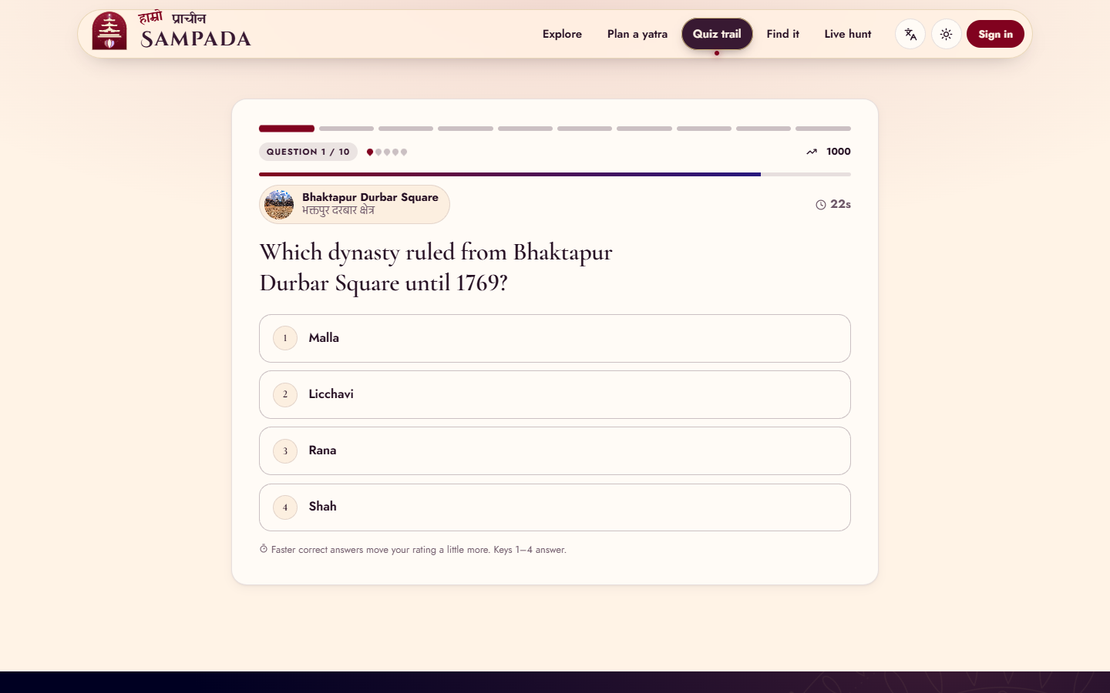
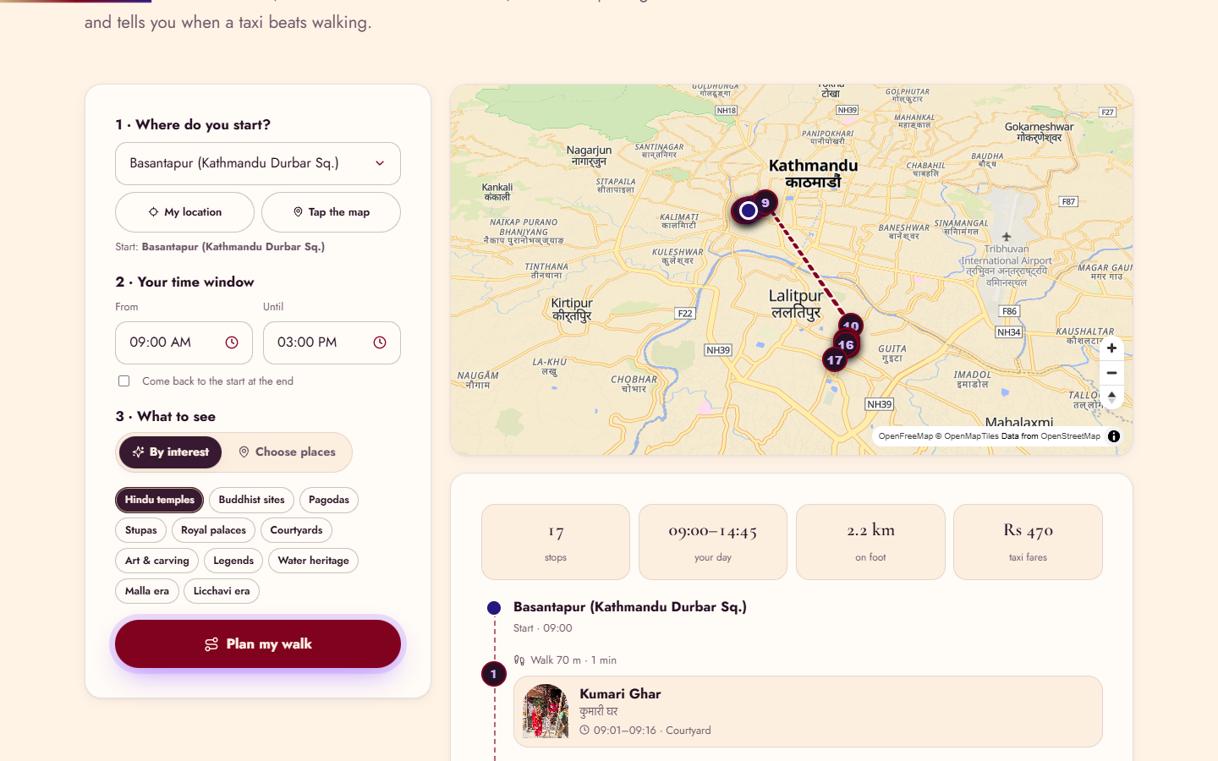
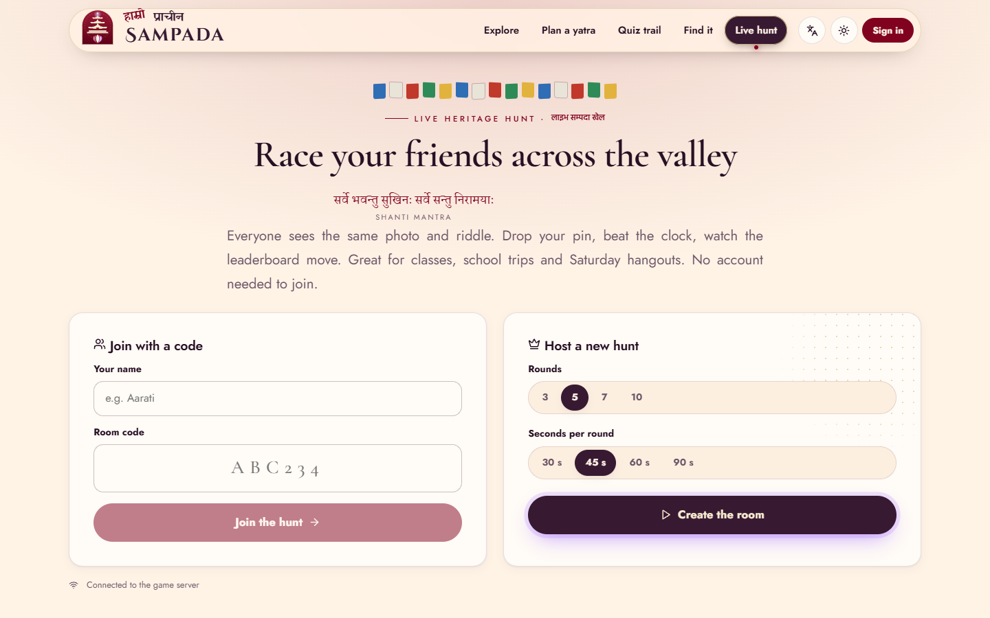
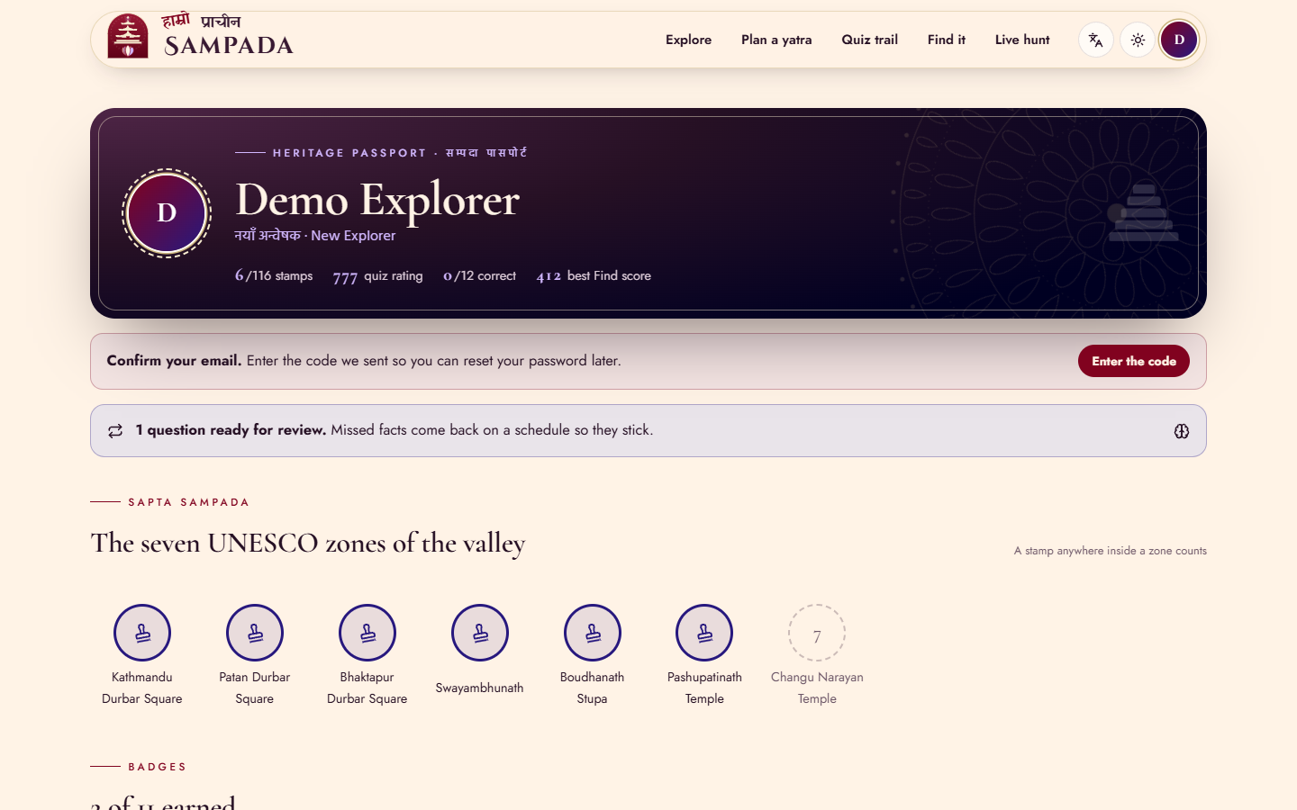
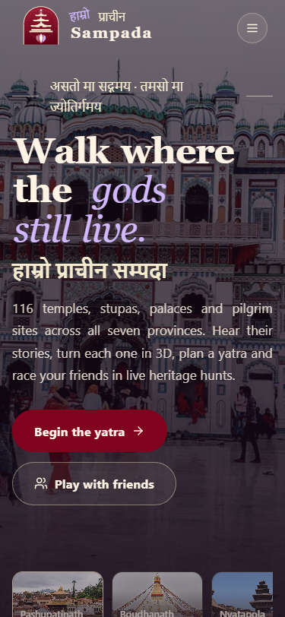
The product
Hamro Prachin Sampada | Niranjan Katwal | 8
Notes:
Live demo here: explore map, open Pashupatinath in 3D, run one quiz question, show a hunt lobby.

Slide 9
Testing and results
12
18
26
116
unit tests (algorithms)
API flow tests
browser flow cases
models render, 0 console errors
Planner checked against brute force; Elo, SM-2 and scoring have unit tests
Hunt simulation: 3 players over Socket.io
Browser suite drives the real pages at desktop and 375 px
Result: 26 of 26 browser cases pass
Hamro Prachin Sampada | Niranjan Katwal | 9
Notes:
Bugs found and fixed during the flow test are listed in the report, chapter 5.

Slide 10
Limits, future work, conclusion
Limits
Next
3D models are approximations
Nepali text and quiz content are AI-drafted and need expert review
Hosted demo depends on free tiers
Native-speaker and curator review
Offline PWA, AR on site
More sites and schools' classroom mode
A free, playable, bilingual window into Nepal's heritage. Thank you. Questions?
Hamro Prachin Sampada | Niranjan Katwal | 10
Notes:
Close with the repository link: github.com/itsniranjannn/Prachin-Sampada

