Slide 1
PROJECT III (CACS452) | BCA EIGHTH SEMESTER
Anka
Student Result Analysis and Ranking System
Results, back papers, ranking, insights and daily classes for institutions of any level
Niranjan Katwal
TU Symbol No. 27802063 | Regd. No. 6-2-278-18-2022
Pashupati Multiple Campus, Tribhuvan University
Notes:
Introduce yourself and the project. Anka means number or mark. One sentence: it turns marks into trustworthy results for any institution.

Slide 2
The problem
Marks are copied by hand between registers and spreadsheets, so errors reach students.
Back papers are hard to track and their effect on GPA and CGPA is unclear.
Each program has different grading rules, but most tools allow only one.
Printed marksheets cannot be verified.
Weak students are noticed after the final exam, not before it.
Class timetables, diaries and assignments live in notebooks and chat groups.
Local software is often tied to one institution's name or rules.
Anka: Student Result Analysis and Ranking System
2
Notes:
Describe the manual chain: register, spreadsheet, notice board. Mention back papers and forged marksheets, which are the two points panelists relate to most.

Slide 3
Objectives
Calculate
Track
Rank and analyze
Configurable grading engine: TU GPA, NEB grade points, divisions; SGPA and CGPA
Back papers as separate sittings with full history
Merge sort ranking, heap, statistics, regression, correlation, k-means
Protect
Communicate
Run the class
Role based access, QR verified marksheets, explainable risk score
Email queue with retries; notices; audit log
Timetable, class diary, assignments; unbranded for any institution
Anka: Student Result Analysis and Ranking System
3
Notes:
Read the objectives quickly. Each one maps to a module you will demonstrate.

Slide 4
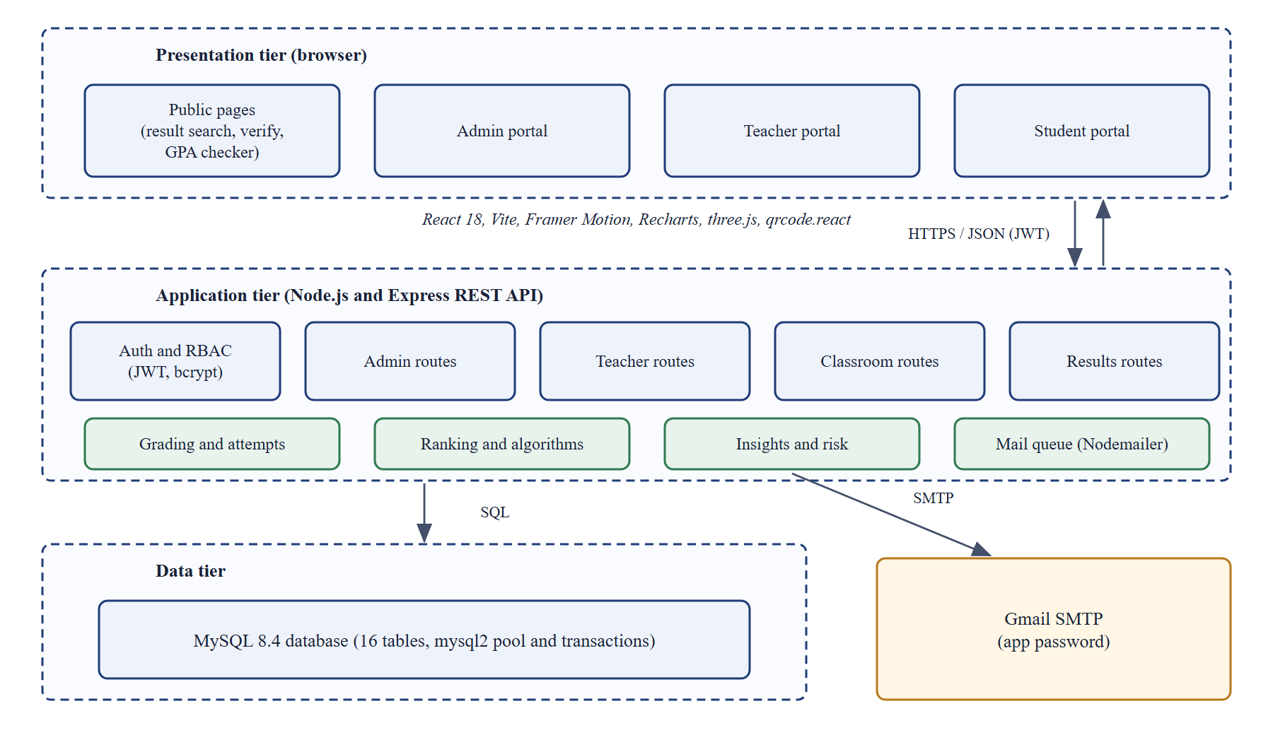
System architecture
React 18 client with a shared design system
Express REST API: 82 endpoints, 5 routers
MySQL 8.4: 16 tables, transactions, foreign keys
Gmail SMTP through a retrying queue
JWT sessions, bcrypt, role checks, rate limits
Anka: Student Result Analysis and Ranking System
4
Notes:
Three tiers. The mail worker reads a queue in the database so a slow mail server never blocks the administrator. The API is stateless, JWT on every request.

Slide 5
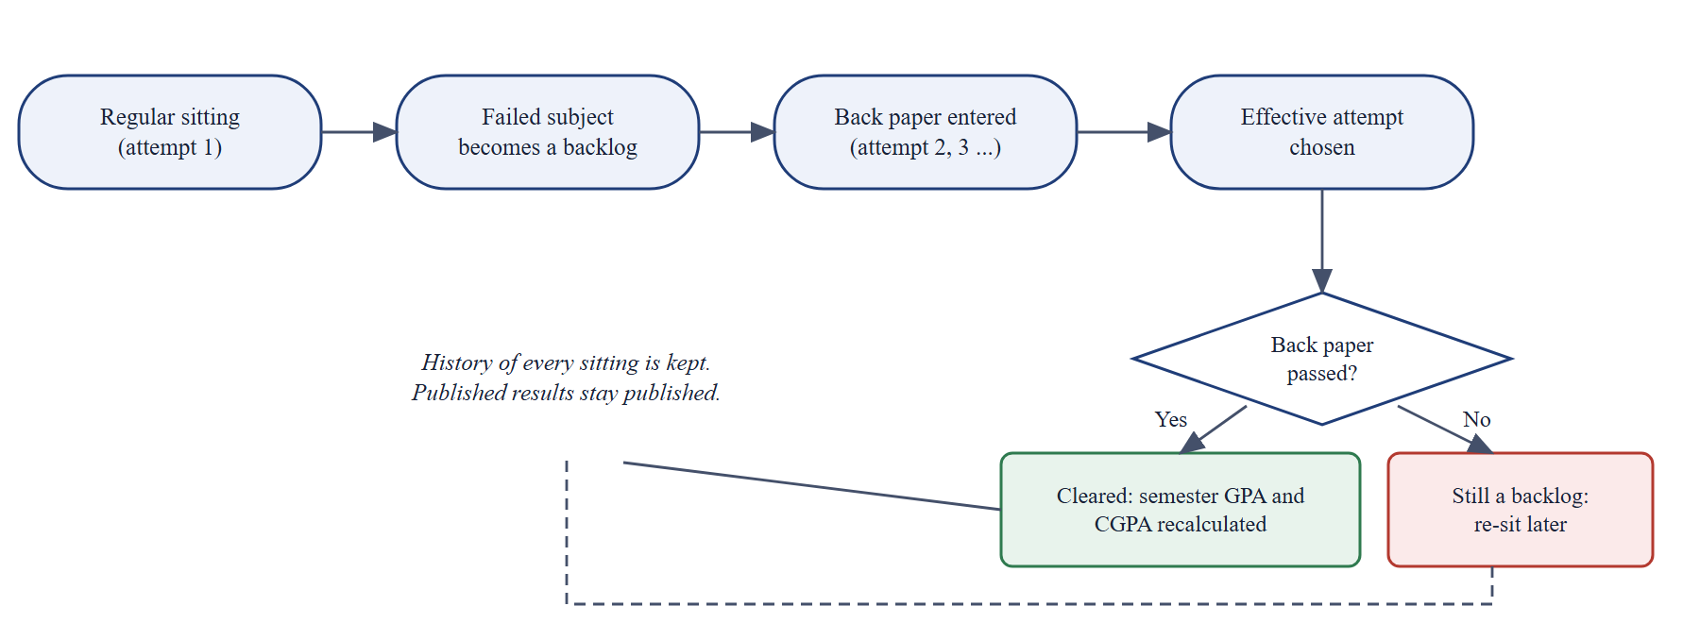
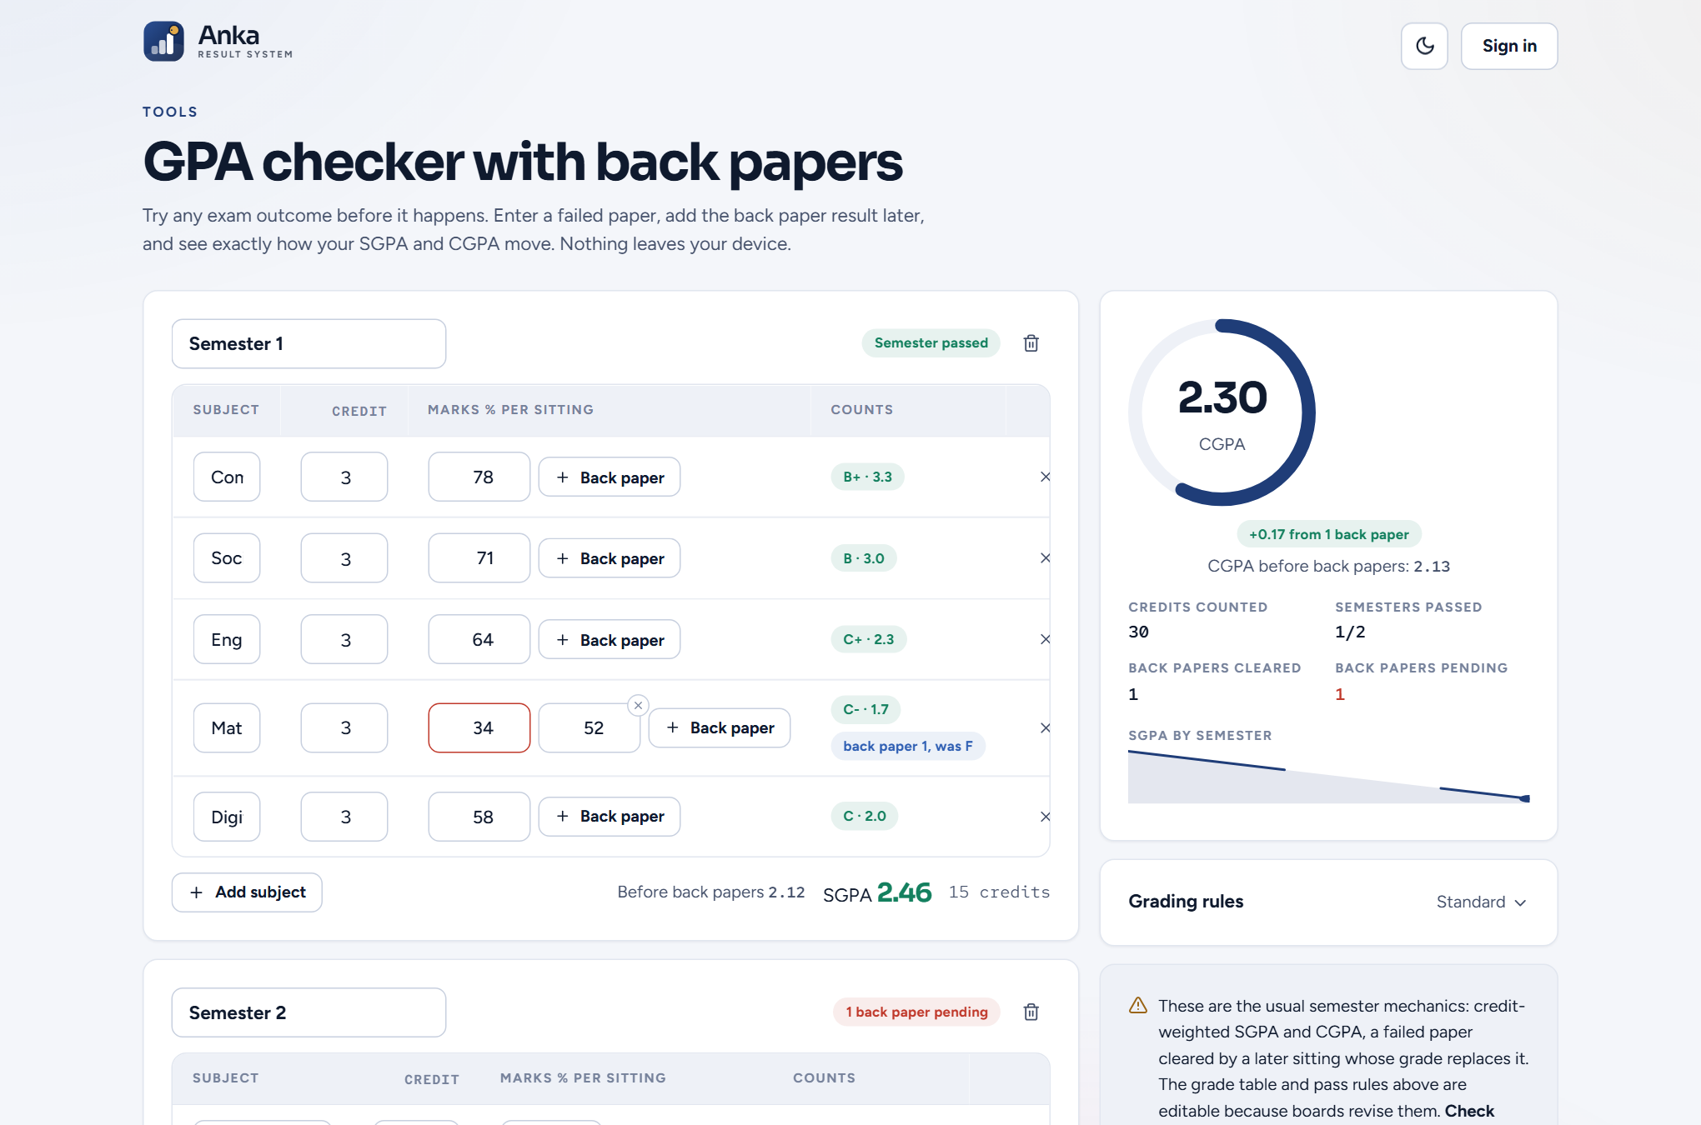
Grading engine and back papers
SGPA = sum(point x credit) / sum(credit); CGPA over semesters
Pass needs the pass mark overall and in the external part
Grade lookup by binary search over editable bands
Back paper = new attempt row; effective attempt chosen; semester result recalculated; history kept
Anka: Student Result Analysis and Ranking System
5
Notes:
Explain the effective attempt: first pass, otherwise latest. Then show the GPA checker for a student who passes a back paper.

Slide 6
Algorithms implemented from scratch
Algorithm | Used for | Cost
Binary search | Grade band, percentile | O(log n)
Merge sort + competition rank | Merit list, class rank with ties | O(n log n)
Binary min-heap | Top performers (top-k) | O(n log k)
Statistics, z-score | Mean, median, deviation, pass rate | O(n log n)
Linear regression | GPA trend and forecast | O(n)
Pearson correlation | Attendance vs GPA | O(n)
K-means (farthest-first start) | Support groups | O(n k i)
Weighted risk score | Explainable early warning | O(1)
Anka: Student Result Analysis and Ranking System
6
Notes:
All of these are in backend/utils with no libraries. The /algorithms page lets the panel run them live.

Slide 7
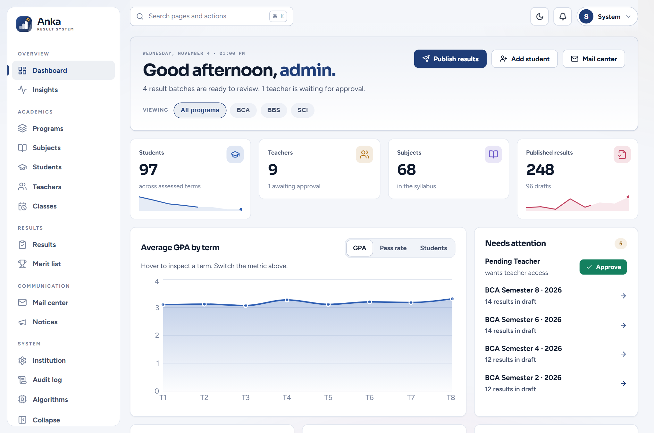
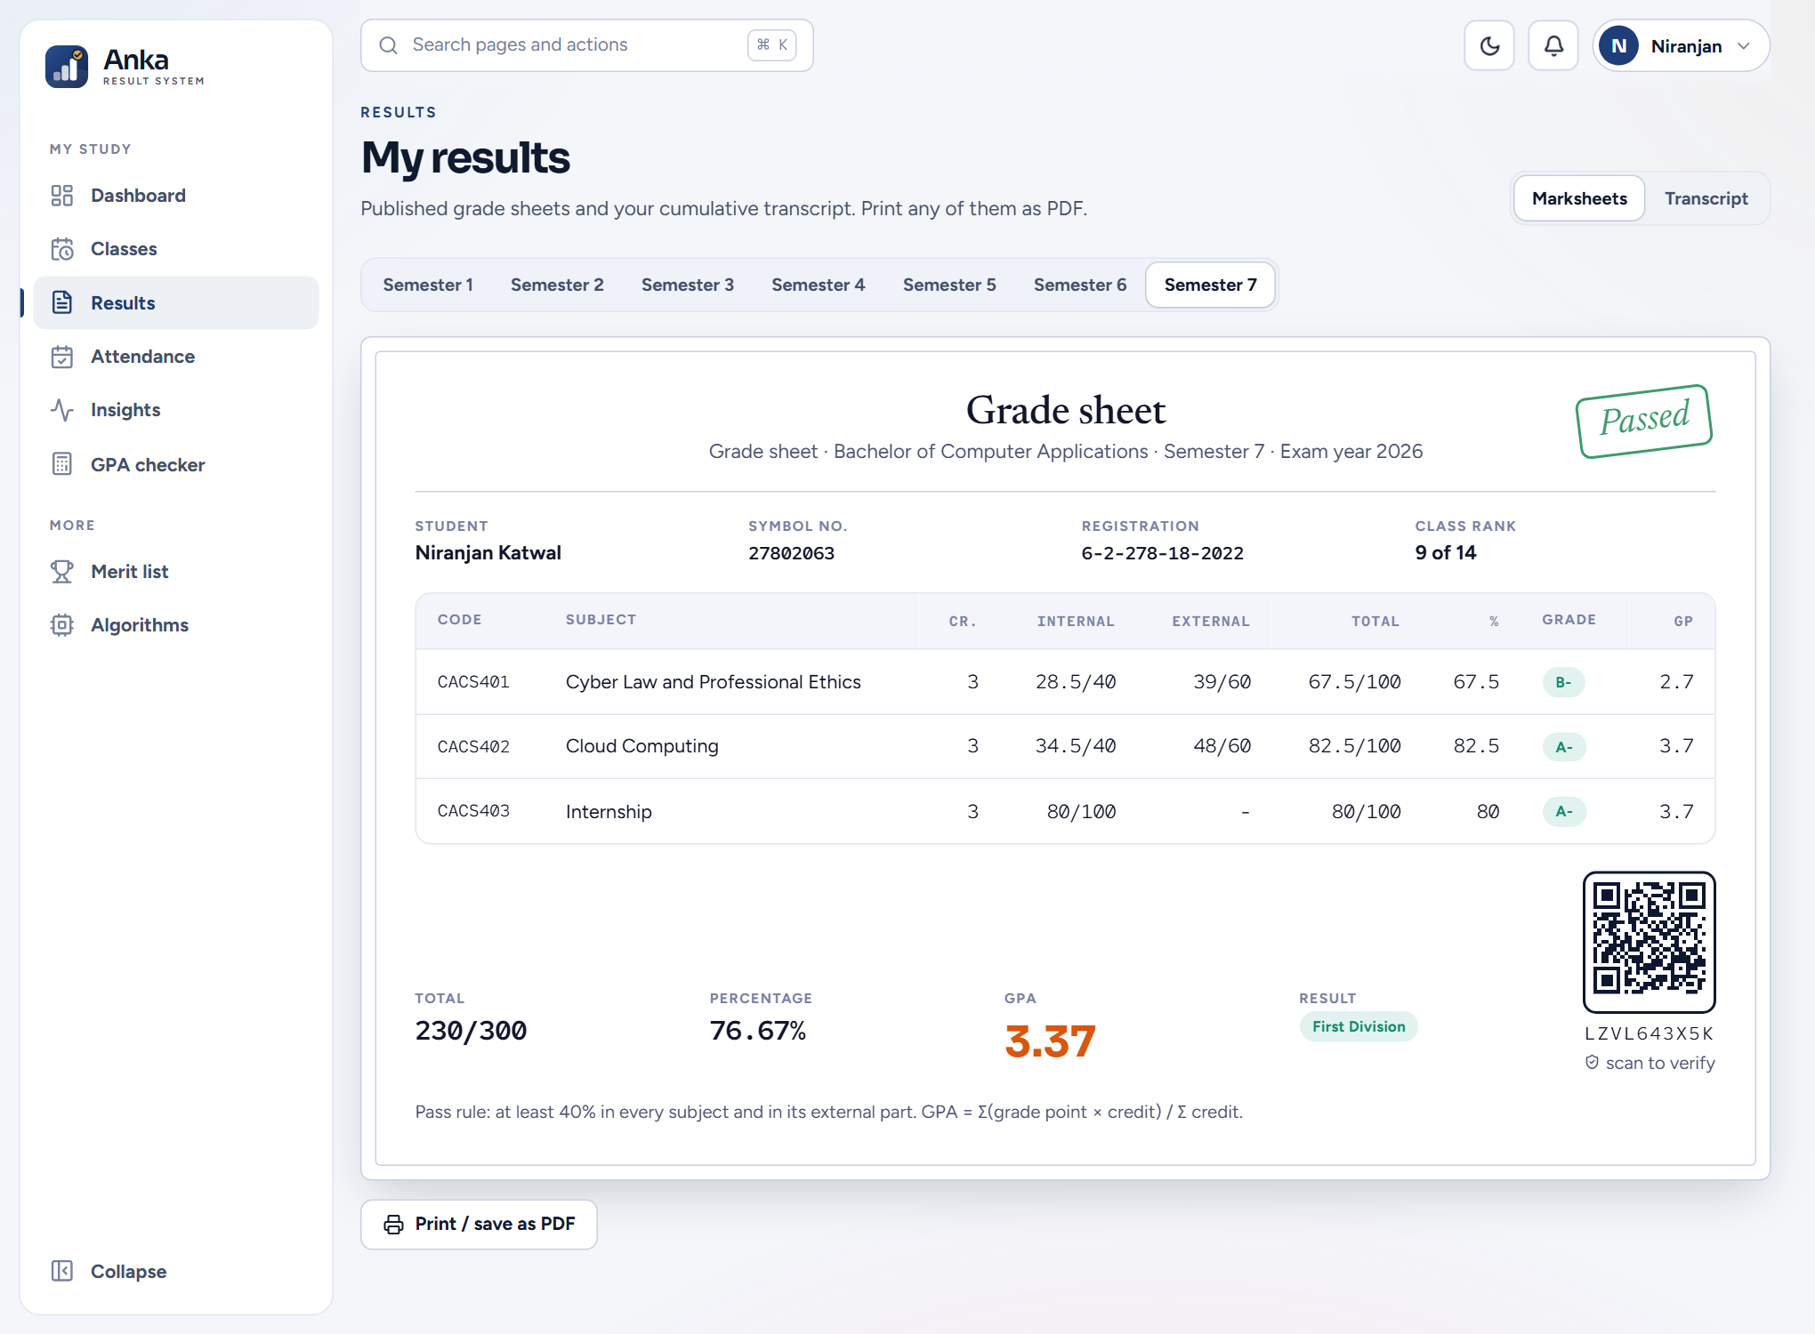
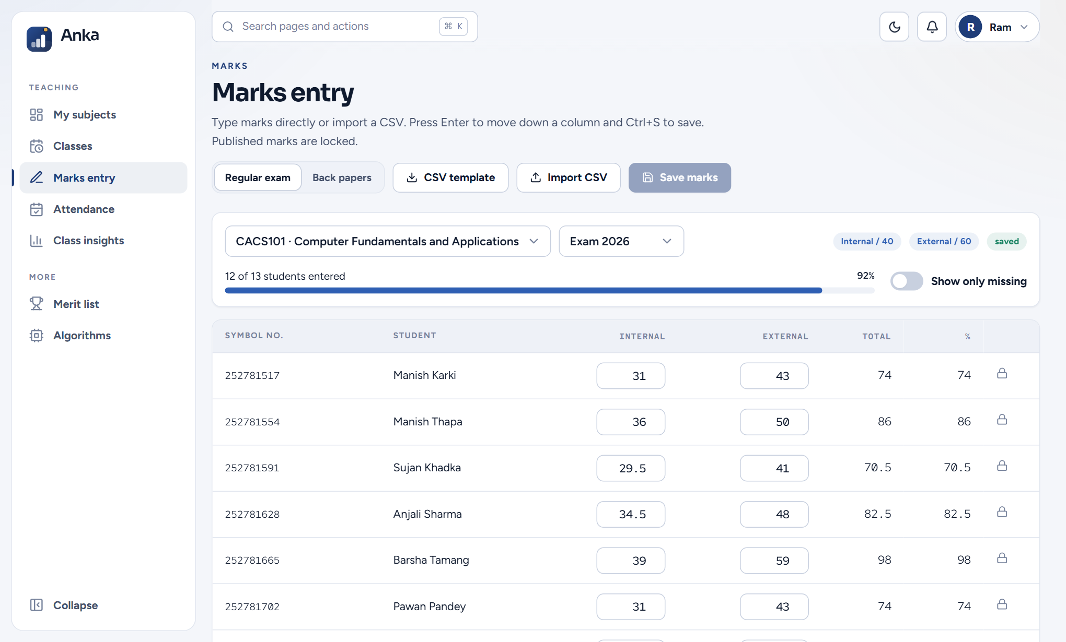
The system at work
Administrator dashboard
Marks entry grid
Marksheet with QR code
Neutral navy design system, light and dark themes, command palette, responsive down to phone width.
Anka: Student Result Analysis and Ranking System
7
Notes:
Demo order: admin dashboard, teacher marks, student marksheet with QR. Switch to the live system here if time allows.

Slide 8
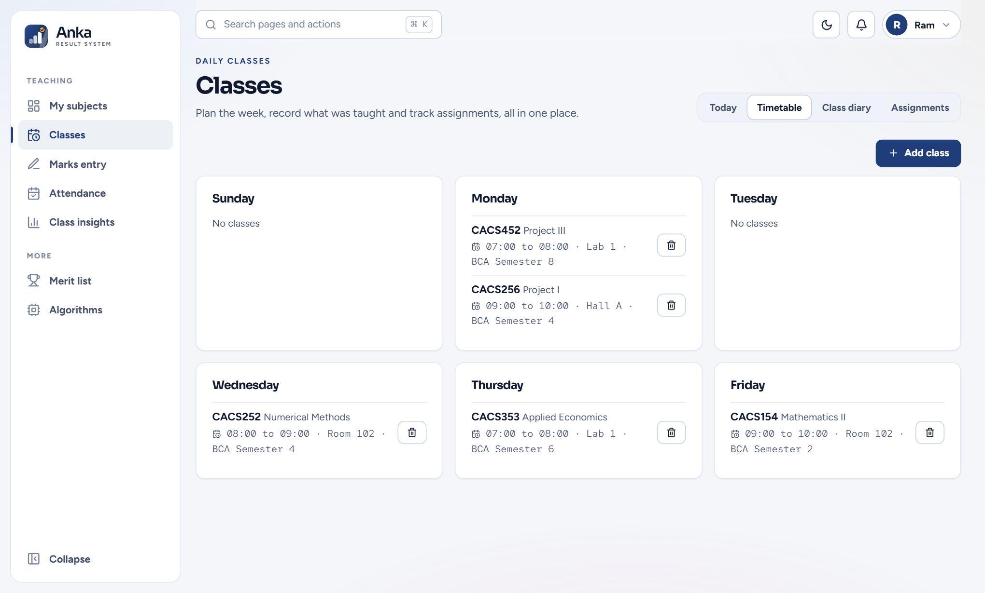
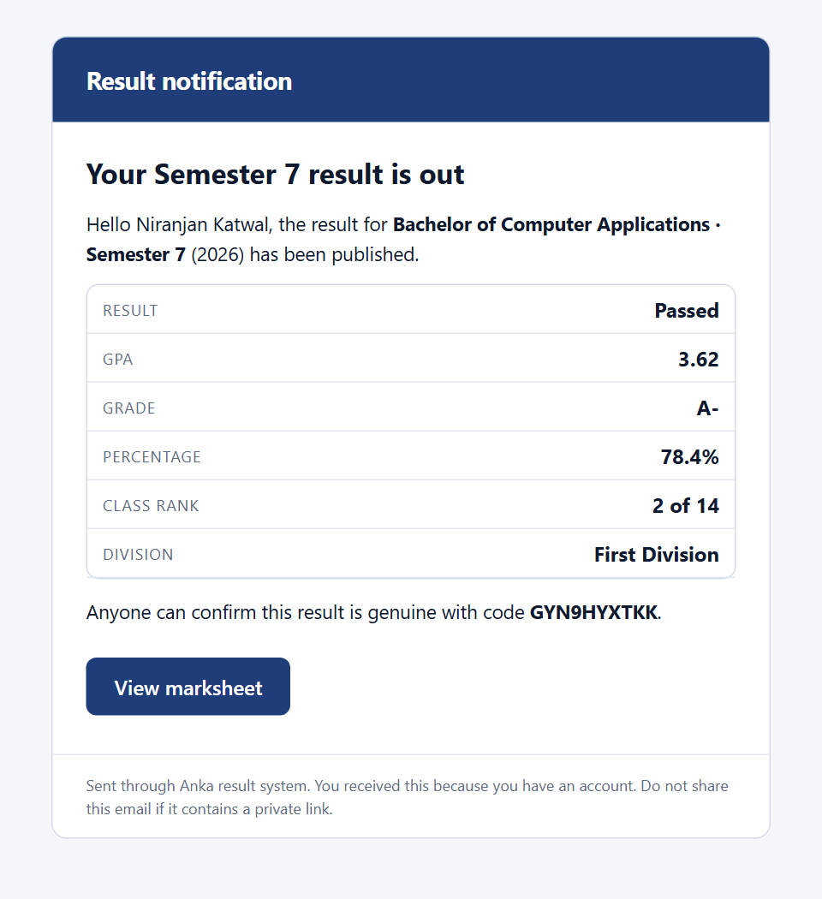
Email and daily classes
Eight HTML templates in the web palette
Queue, 3 attempts, full log and preview
Timetable rejects teacher and class clashes
Class diary and assignment tracking
Result email as received (rendered)
Anka: Student Result Analysis and Ranking System
8
Notes:
Email is queued, retried up to three times and logged. Demo addresses are never delivered. Show the timetable clash message.

Slide 9
Testing and results
18
58
43
32
unit tests
API flow checks
smoke checks
classroom checks
Browser end-to-end suite drives the real pages: 56 of 58 steps passed on the best clean run
It found real defects: command palette stuck open, two screens with a missing import
59 endpoints x 4 roles permission matrix; email tested against a local SMTP server
Grade table and back paper rules are editable: to be confirmed against the official TU regulation
Anka: Student Result Analysis and Ranking System
9
Notes:
Be honest about the browser suite: 56 of 58 on a clean run, slower machines time out. The real defects it found were fixed.

Slide 10
Conclusion and future work
Delivered
Next
Configurable grading with back papers
Ranking, analytics, risk score
QR verified marksheets, email queue
Timetable, diary, assignments
Unbranded: any institution
Confirm rules with the official TU regulation
Several institutions on one server
Mobile app and SMS
File upload for assignments
Signed PDF marksheets
Thank you. Questions? github.com/itsniranjannn/StuResSystem
Anka: Student Result Analysis and Ranking System
10
Notes:
Close with the main point: one platform, any institution. Then invite questions.

