Slide 1
Element Fleet Management
Element Supplier API – Proposed Solution Architecture
Dec 2017

Slide 2
Background
Element Fleet Management wants to build a core system/common platform for Inbound and Outbound Files Processing. These will be build on common Java/J2EE based framework. This new API Platform will help Element to modernize their existing Inbound and Outbound applications and will also eliminate the need for any manual intervention as is the case currently for HR Feeds Inbound, Maintenance Inbound and Outbound Billing.
Element Fleet Management has asked Tata Consultancy Services to understand their Outbound Billing, Maintenance Inbound and HR Feed Inbound processes and provide solution for integrating these Inbound and Outbound processes.
When completely transformed, the new application is expected to provide following Business Benefits:
Provide Improved Quality of Services
Reduce Total Cost of Ownership (TCO) and Dependencies
Increase Business User Productivity through UI Modernization
Reduce Time to Delivery
Enforce Enterprise Standardization and Compliance

Slide 3













Reduce Total Cost of Ownership
APIfication of Data Ingestion and Feed process
Scalability
Improve Quality of Services
TCS Understanding
High Availability
Automation
BUSINESS DRIVERS
TECHNOLOGY DRIVERS
Modernize business and IT process
Establish Enterprise Architecture Standards
Leverage Cost Effective Solutions
Leverage Open Source Software Components
Uniform and Standard access mechanism to Data Services
Adhere to Regulatory Compliance

Slide 4








Solution Highlights
Architecture & Design Principles
Server-Less Process Model
Distributed, shared nothing, reactive microservice based multi-tiered and multi-layered architecture with broken down granular process models
Audit Enabled APIs
Maximum accountability and information tracing, with ability for Event Logging
Self Healing Application
Cloud-Native, 12-Factor App compliant anti-fragile application, for an unbreakable system with zero downtime.
Leverage Open Source Technologies
Use all standard and open source technologies for client side and server side development.
Domain Driven Design
Isolation of Data, Bounded Context, anaemic and immutable Domain Model, for zero concurrency issues
Automated Deployment Process
Streamlined & Agile Continuous Deployment Process without any significant downtime.
Event driven transaction management
Avoid blocking and time-consuming operations
Responsive Web Design
Rich UX, Enhance UI sensuality, Device agonistic design, asynchronous server side communication
Stateless Components
Load-balanced Stateless Server Side Component for Auto-Scaling, Discoverable and commodity hardware deployable
Applying CQRS Pattern
Reuse of existing enterprise information systems and data but applying proper CQRS pattern for better scalability and security.
4

Slide 5





Information System Architecture Diagram
Domain Microservices
Client Tier
Web Tier
ServiceTier
Information Tier
GUI for Data Feed, single page web application
Web Container
HR Feed Inbound Service
DNS
RDBMS (POSTGRE)
Apache Cassandra
Web application
Maintenance Inbound Service
Browser enabled devices
MainFrame DB
Sybase SPIN
SFTP Server
Billing Outbound Service
HTTPS
File Polling
DNS
Security-service
SMTP
ReST/JSON
Load Balancer (KEMP)
Service Registry Server
Config Server
Code Repository
GIT/GITHUB
ReST/JSON
Rest enabled
client devices
API Gateway Server
Log Aggregator
Authenticate
Monitoring
New
Web
Authorization Server
Core Services
Existing System
Web Service

Slide 6
Design Considerations | Microservices Architecture Pattern
Application Configuration Management
Application Security
Service Level Fall-back
Log Aggregation
Service Discovery
Centralized Configuration Management System
Version Management System
Tracking & Auditing
Service Registry Mechanism
Automatic handle on the registered instances of services
Auto-Discovery
Load-Balancing
Fail-Over
Fall-back to default behavior if the targeted service is unresponsive or in error state
Circuit Breaker pattern will be implemented for all services
02
Log Unifier Solution
Logs to be made available to monitoring, altering & statistical analytic systems
Stateless Security Mechanism
OAuth2 and JWT Usage
Notes:
#
Area
Challenge
Possible Mitigation
1
Application Configuration Management
Because there could be multiple instances of given processes running at one time, it's impossible for operators to manage and modify the configuration details of applications by navigating into the application directories.
To overcome this issue, a centralised configuration management system will be used. The system will not only make the configuration information available to all distributed applications, but also help in version management of configuration changes, so that tracking and auditing of configuration changes will be possible.
2
Service Discovery
With hundreds of processes running and applications in auto recovery mode, it becomes essential in a Microservice architecture to have a reliable mechanism for discovery of running instances of various processes.
The design envisages a 'Service Registry' and client and server side discovery mechanisms to handle these challenges.
Services will register themselves to a central service directory on start-up, so that consumer services and clients can get an automatic handle on the registered instances of various services. Along with auto-discovery, load-balancing and fail-over will be supported.
3
Service Level Fall-back
Any error-condition arising out of service unavailability, endpoint exceptions, or service latency will not be allowed to bubble-up to the level of user views.
In most cases, wherever applicable, the services will fall-back to a default behaviour if the targeted service is unresponsive, taking time to respond, or is in error-state.
4
Log Aggregation
As the various processes will run in containerized environments, manual log monitoring will be an impossible task. In addition, to make an informed decision on various aspects of the Application, such as capacity planning, service-health monitoring, and the logs need to be analysed differently depending upon the need of the moment.
To address to these necessities, implement an industry-standard Log Unifier solution. This will enable the logs to be made available to monitoring, altering, as well as statistical analytic systems
5
Application Security
Because of the stateless nature of the processes involved in a Microservices architecture, maintaining the application in a consistent security state, as per the roles and privileges of the intended user, throws a lot of security related challenges, for HTTP Session cannot be maintained on the server side.
To handle these challenges, the system will implement a Stateless security mechanism – using OAuth2 and JWT – leveraging the Enterprise user databases (e.g Active Directory and HR database)

Slide 7


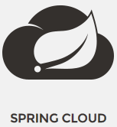



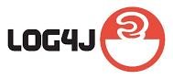



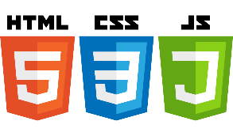











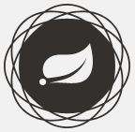



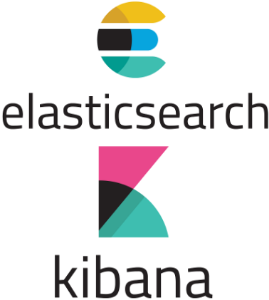


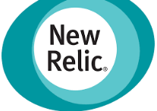

Technology Architecture Diagram – Spring Boot based approach
Static Web Content
Web Container
API Gateway Server
Microservice
RDBMS
Spring Cloud Netflix Zuul
WF-framework
Spring-data-rest
images
ForgeRock
Spring Integration sftp
Logging & Monitoring
Spring Cloud Netflix Eureka
data
Web service
Service Registry Server
SpringBoot Admin
cloud
framework
Spring Cloud Netflix Eureka
(Embedded)
Config Server
Spring Cloud Config & Bus
Revision Control System
Config Repository

Slide 8

Design Considerations| Application Architecture
Single Codebase per App
Export Services via Port Binding
Centralised Configuration Management
Modules as Stateless Processes
Logs as Streams of Events
Continuous Development and Deployment
Dev/Prod Parity
Scale-out via Process Model
Enterprise Resources as HTTP Services
Loosely Coupled and Explicitly Declared Dependencies
Administration and Quality Control coded into Application Lifecycle
Disposability: Fast Start-up and Graceful Shutdown
Notes:
#
Considerations
Solution Approach
1
Single Codebase per App
Each running process - a module having its own http port - will be considered an App.
For maximum reusability, and efficient release management, each App will be mapped to a separate codebase.
2
Loosely Coupled and Explicitly Declared Dependencies
Every process in the GEMS ecosystem will be an independent and stateless App, handling a unit of responsibility. The GEMS system will be an aggregation of the process units, composed through an orchestration process. Docker or equivalent container technology will be used manage the independent processes.
3
Centralised Configuration Management
All the independent processes, as well as the dependent enterprise systems, will be control through centralised configuration management tools. This will not only help to maintain maximum parity between Dev and Prod environments, but also will provide ways to alter the state of an Application at runtime, helping in eliminating any downtime for application maintenance.
4
Enterprise Resources as HTTP Services
To build an enterprise resource (Message Queue, SMTP, etc.) agnostic system, Enterprise resources will treat as Attached services, just like any other Stateless process, and hence shall NOT be exposed to the core services as-is. Necessary Http Edge Services and Edge Clients (Equivalent of an API gateway) will create as a bridge between the Core services and Enterprise resources.
5
Modules as Stateless Processes
Each module will be an independent, stateless App, whose services are accessible only through Http REST endpoints.
6
Export Services via Port Binding
Each process will be self-contained and will not demand a separate web-container at runtime to render its services. The GEMS processes will export Http as a service by binding to an Http Port. Docker as a process container fits well into this architecture.
7
Scale-out via Process Model
With processes being stateless, scaling out an individual process in response to an increased demand will be a matter a adding more copies of the process into operation. The process formation will be managed through a Container Orchestration Mechanism or a Network Load balancer
8
Disposability: Fast Start-up and Graceful Shutdown
Each process in the GEMS system will be disposable, meaning a starting new process instantaneously, and killing a faulty process and be replaced by a new healthy process immediately. Since all the processes are Stateless, hence data loss worries can be rest assured.
9
Dev/Prod Parity
Dev and Prod Systems will resemble each other – in terms of process model – as much as possible, to avoid any 'Worked in My Dev environment' syndrome. The two environments might differ only in scale, but all other parameters in the process model will be the same.
10
Logs as Streams of Events
The GEMS systems will NOT generate any log files. The log files, of traditional architecture, render themselves unusable in a micro-services architecture, as there could be hundreds of processes running at any given time on a distributed system, presenting an impossible task for human users to monitor those logs. Instead, the logs of the GEMS system will be treated as a Stream of Events, which eventually can be directed to a variety of Monitoring systems
11
Administration and Quality Control coded into Application Lifecycle.
The GEMS systems will require little or no-documentation to maintain for Administration and Quality Control procedures.
Administrative Activities, such as Database Schema update, data migration, Environment creation, will be packaged into the Application lifecycle, and the task related artefacts will live alongside the Application code.
Managing of Quality Control activities, such as Code Quality review, Unit & Integration Testing, UI testing, through Application lifecycle maintenance, requiring no manual intervention.
12
Continuous Development and Deployment
Build, Deployment, and Collaboration activities will be automated using appropriate Agile and DevOps tools and methodologies.

Slide 9
Potential Improvement on Quality of Services
Performance
Use of Lightweight ReST/JSON and CQRS pattern
Leverage Parallel processing of data
Scalability
All processing components are stateless
Auto-scaling of microservices and cloud native architecture
Security
Security component decoupled from business components
All environment and system credentials are configurable and encrypted
Maintainability
All system and application configuration would be externalised and maintained from outside the core system
By use of DevOps and operations the upgrade of system would be easier
Reliability
Declarative exception handling framework
High available distributed architecture with no-single point of failure.
Using load balancer and Spring Boot Health Indicator Rest APIs
Usability
New lightweight SPA and RWD web based application
Better navigation features
More user productivity
Implement circuit breaker pattern using Spring Cloud Netflix Hystrix
Adhering to Element’s established security standards

Slide 10


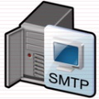
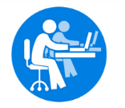
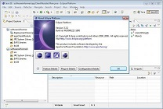




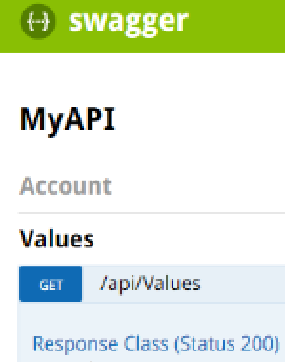
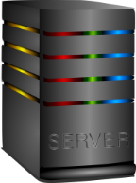

DevOps and Continuous Deployment
Revision Control System
Build Artifact Repository
Code Quality Dashboard
1. Check-in source-code
7. Publish Code Quality Report
5. Upload/Download artifact
Developers
Build System
9. Download Deployment Artifact
6. Notify
Deployment System
Babel
3. Build and Execute Unit Test
Eclipse (IDE)
2. Download changes
4. Execute Security Scan
Test
Execute
8. Trigger Deployment
Tosca : Automation test tool
11. Execute automated test
Testers
Environments
10. Deploy Docker Image
Monitoring System
DEV
QA
PRD
Test

Slide 11
Thank You

