Slide 1
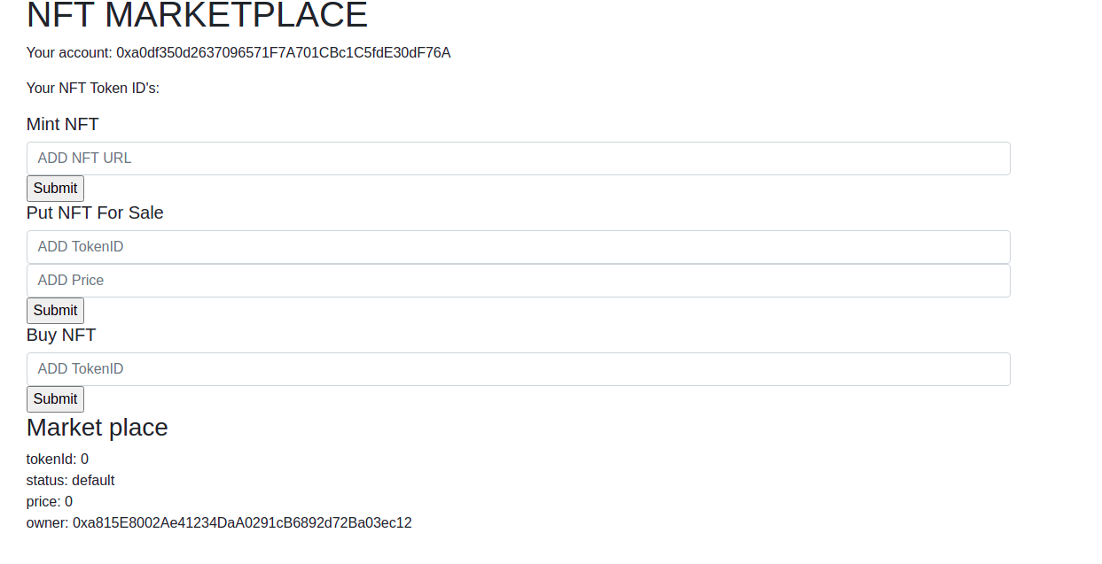
User 1 logins and account address is visible

Slide 2
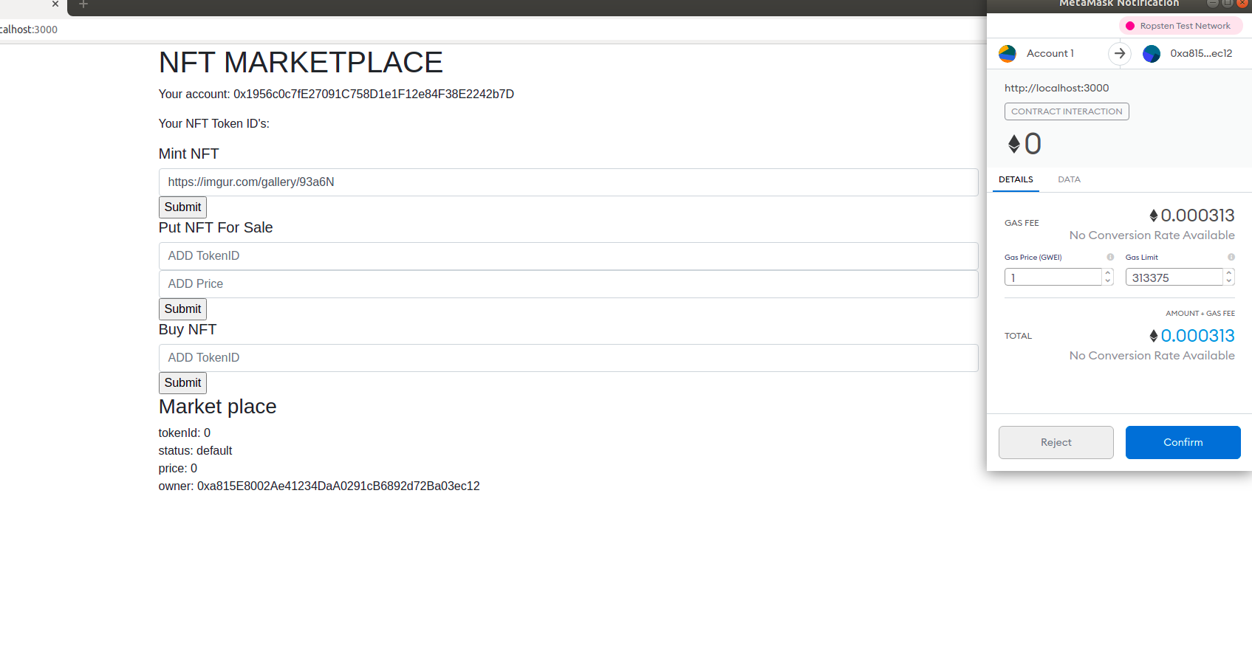
User 1 add the Url and selects mint-nft

Slide 3
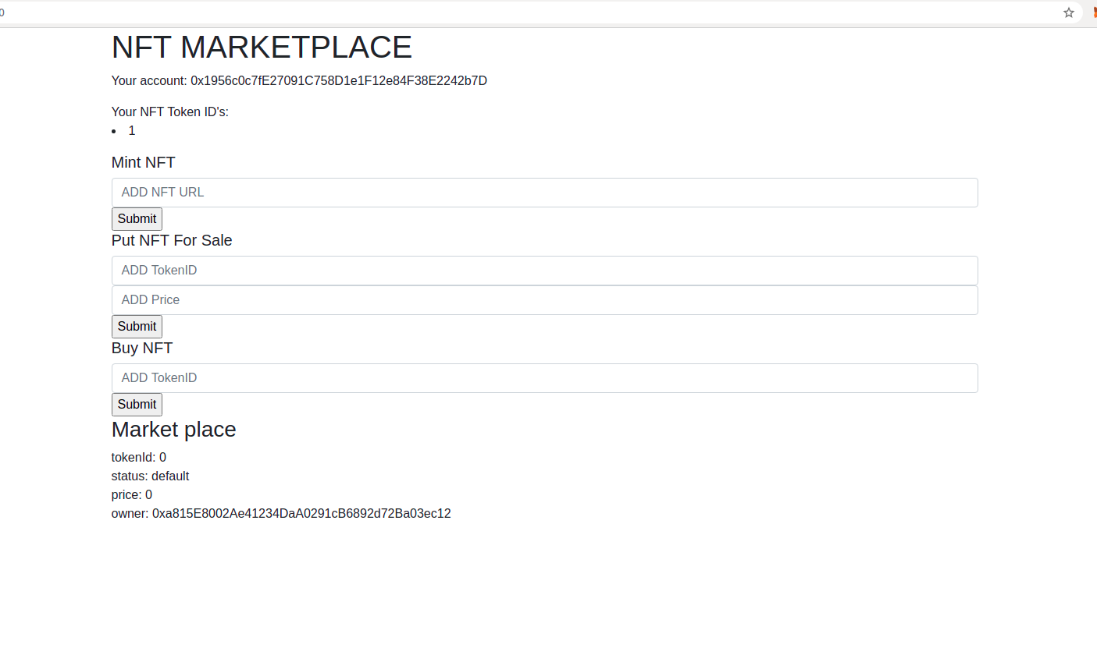
NFT is minted and User 1 nft token id is visible

Slide 4
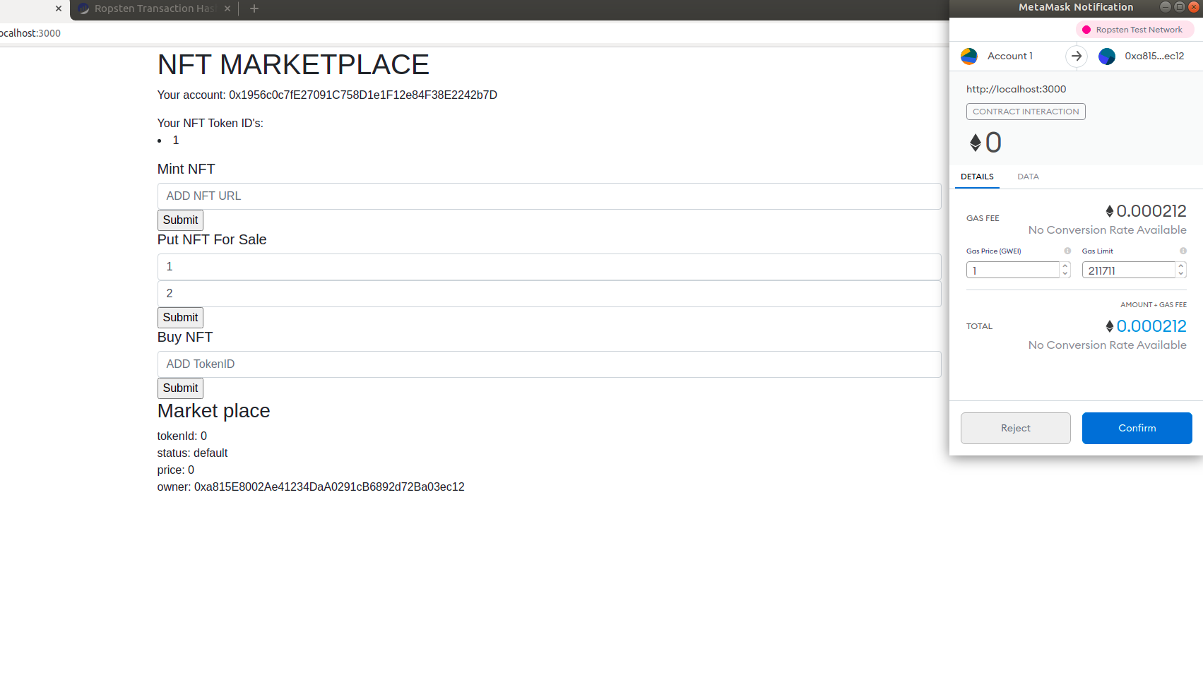
User 1 puts his nft for sale

Slide 5
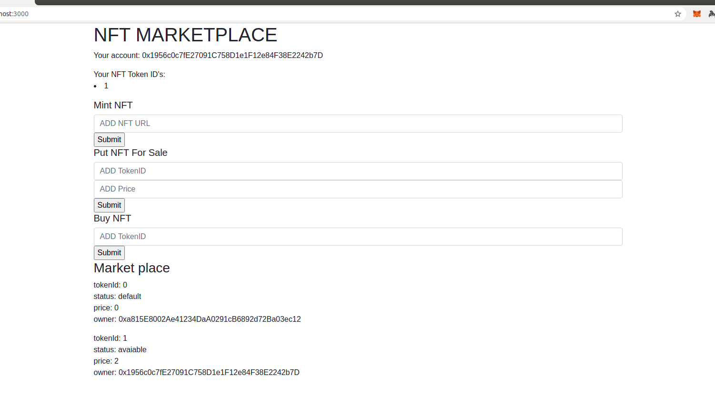
Market place is updated with latest nft

Slide 6
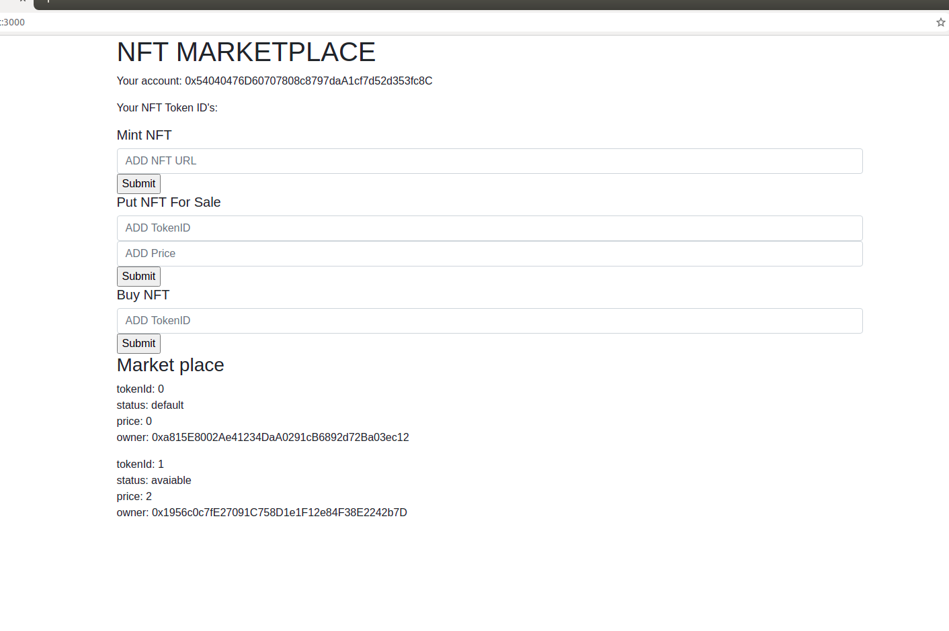
User 2 login and sees the nft marktplace

Slide 7
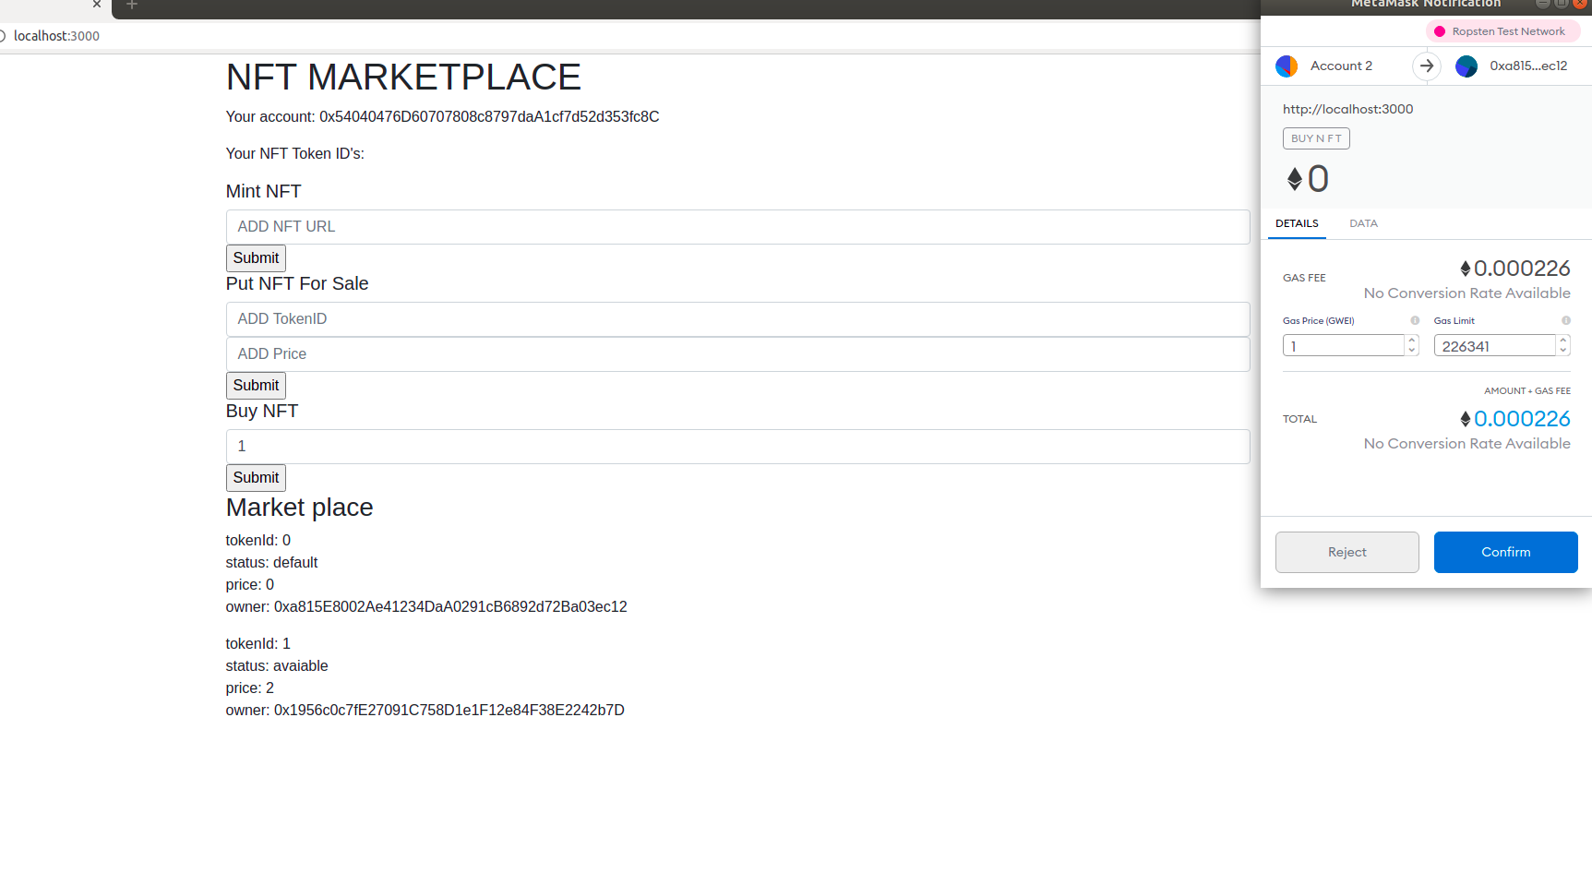
User 2 buys nft

Slide 8
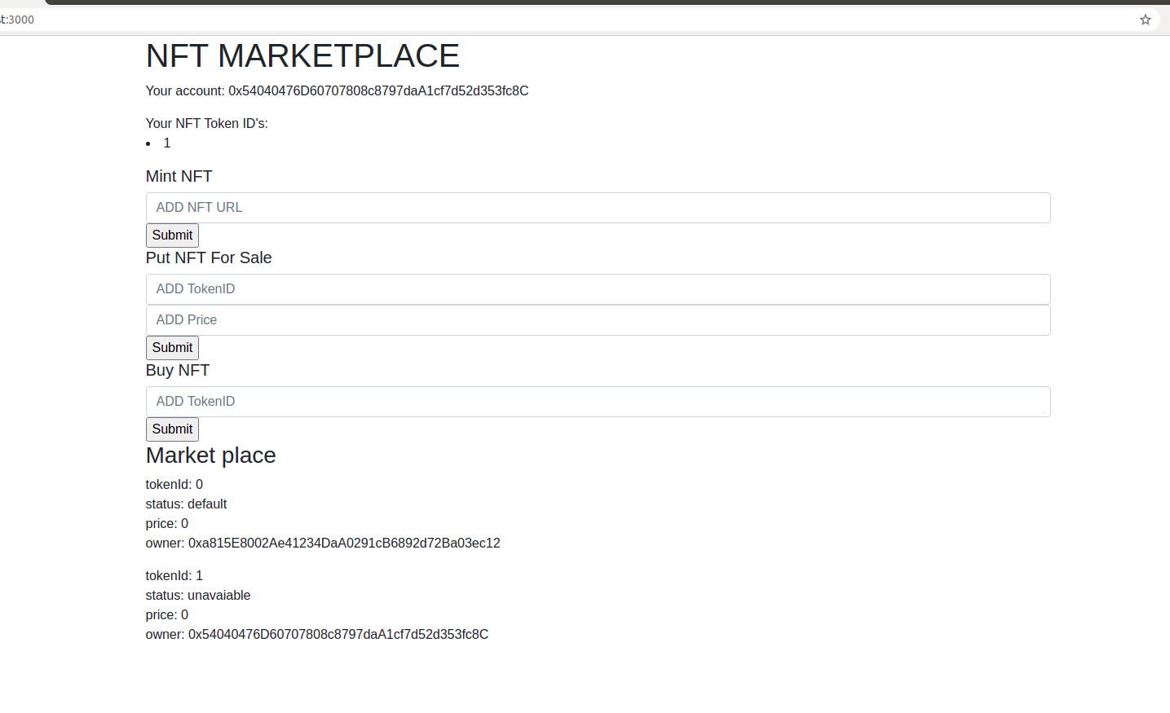
Changes is reflected in user 2 holding and marekt place

Slide 9
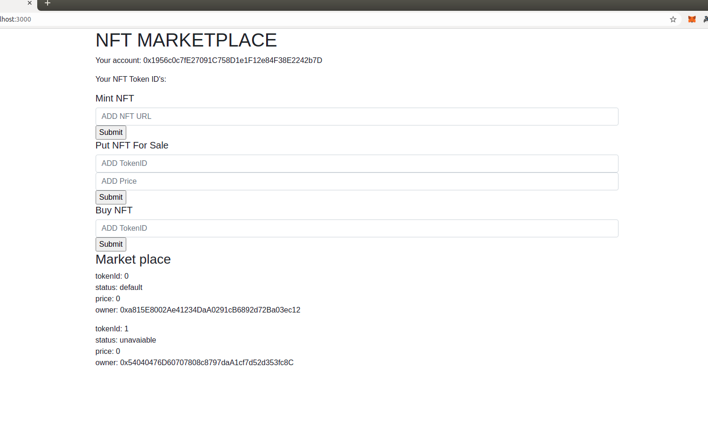
Chnages is reflected in User 1 nft holdings

