Slide 1
Amboss Exercise
1) CreateEdge
2) GetEdges
3) GetEdges

Slide 2
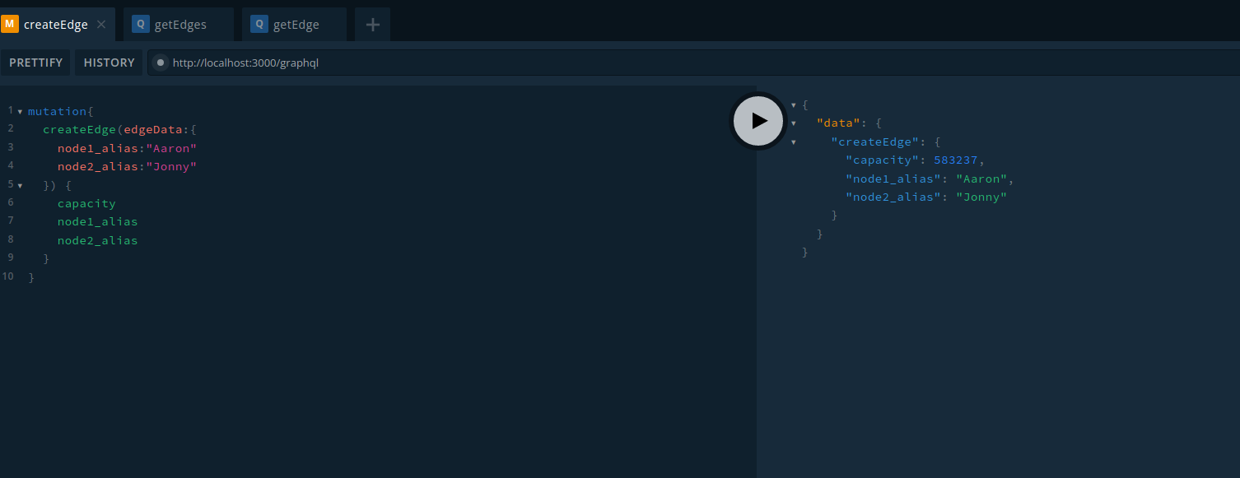
CreateEdge

Slide 3
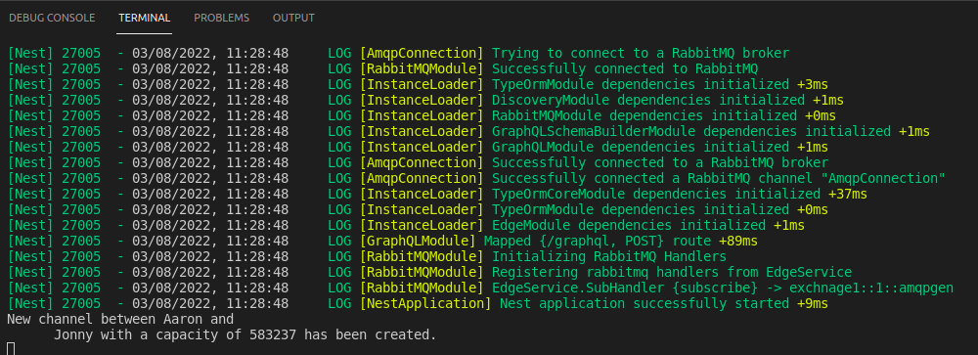

Slide 4
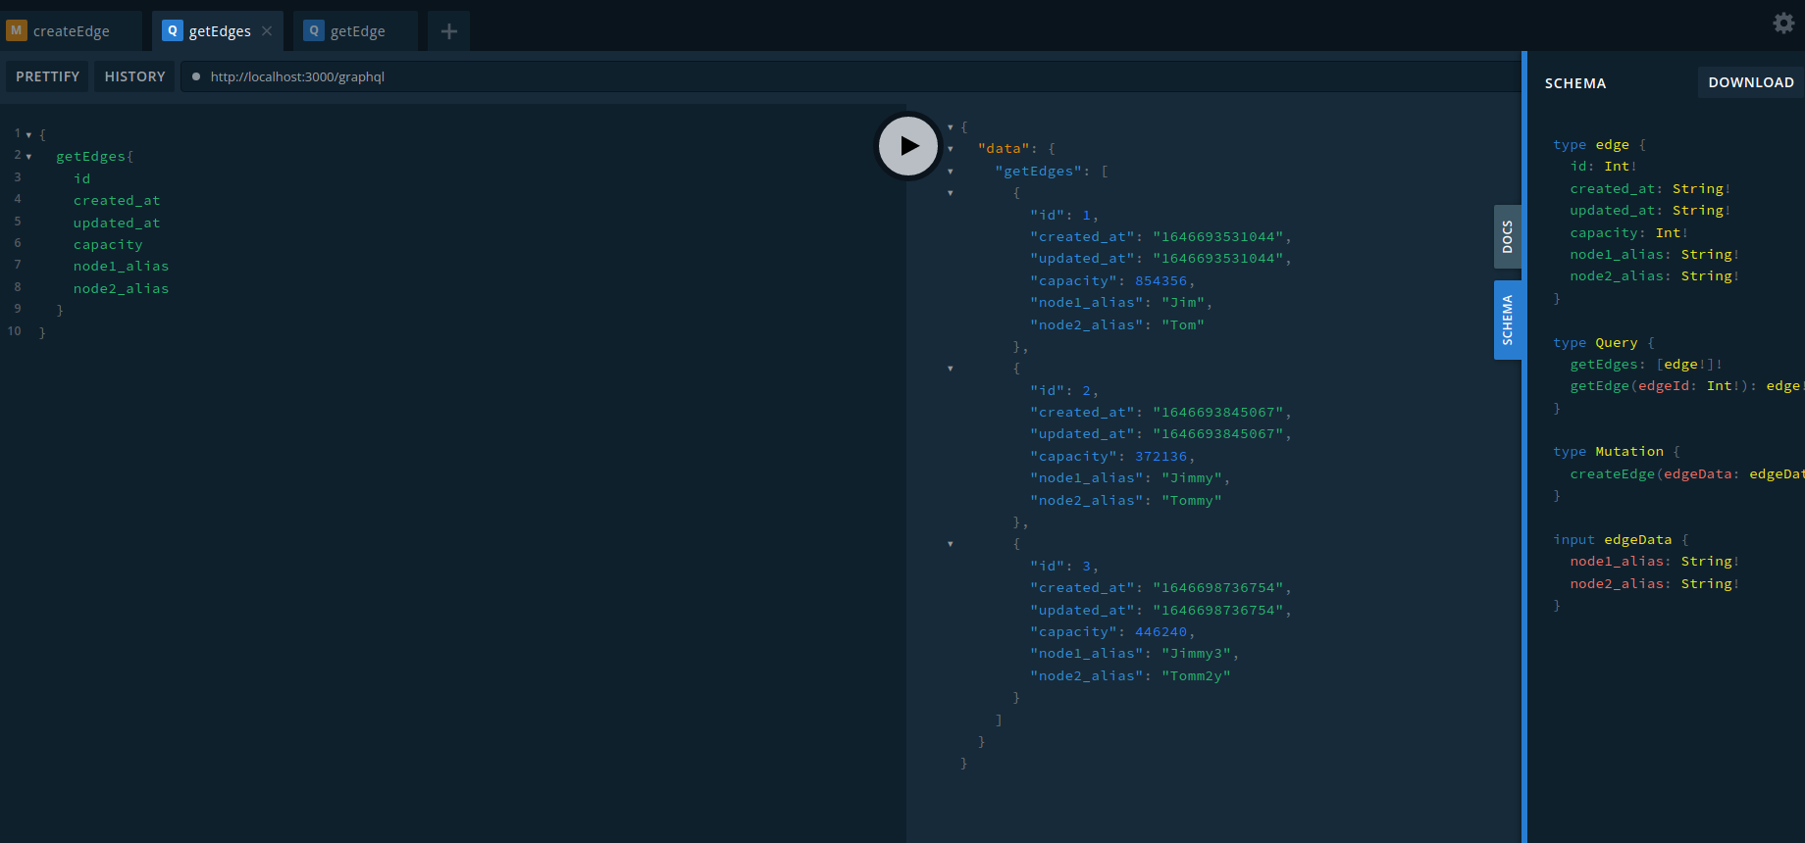
GetEdges

Slide 5
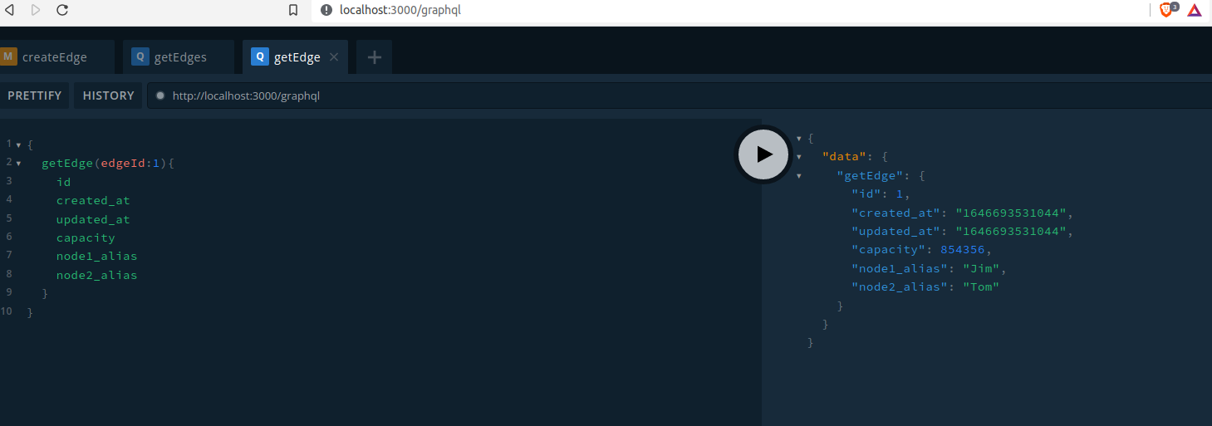
GetEdge

