Slide 1
NES Tech Project
IPFS + smart contract User Management flow
I have deployed it in ganache local network. For polygon you need to change truffle.config

Slide 2
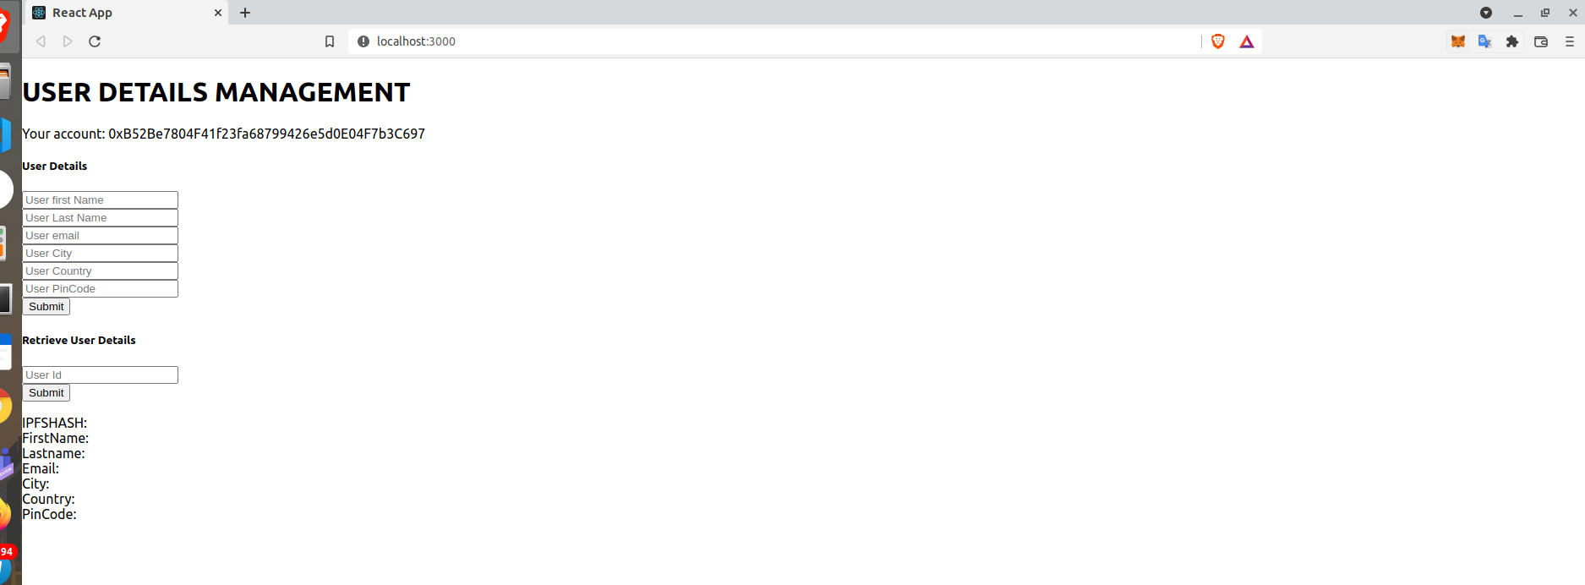
Frontend with wallet connected

Slide 3
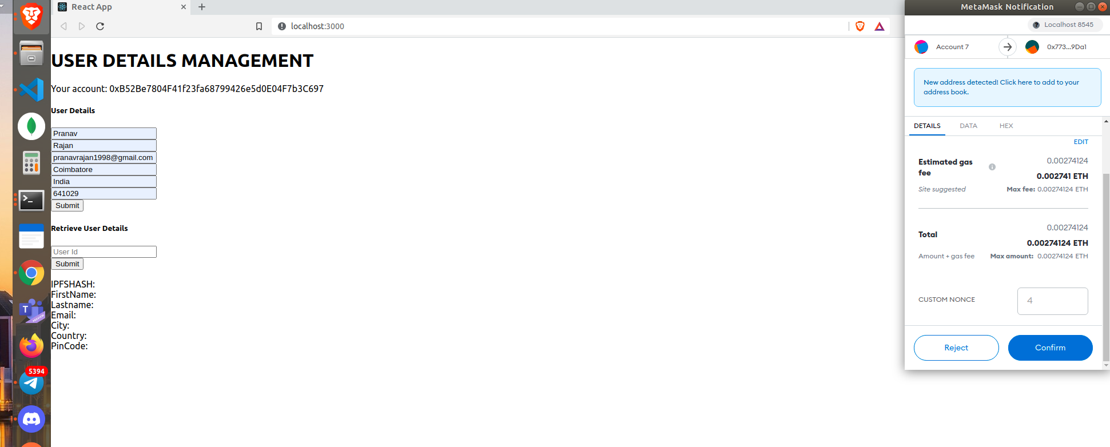
Populate the details and sign with metamsk

Slide 4
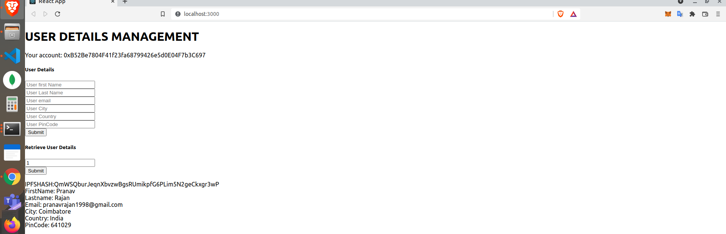
Retrieve the data via userId

