Slide 1
To become familiar with parsing, classification and sentiment analysis

Slide 2
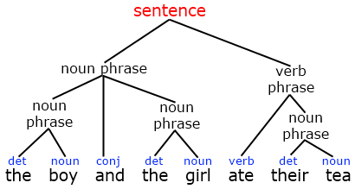
Parsing
Parsing ensures that the computer understands the precise function of each word in a sentence and its relation with other words in the sentence.
In this process sentence is converted into a hierarchical structure that corresponds to the units of meaning in the sentence.
A parser processes an input string by using a set of grammatical rules and builds one or more rules that construct a grammar concept.

Slide 3
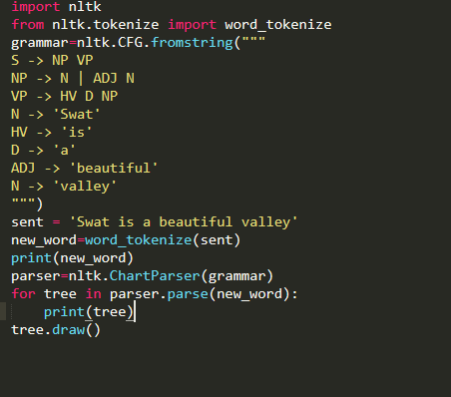
Parsing code example

Slide 4

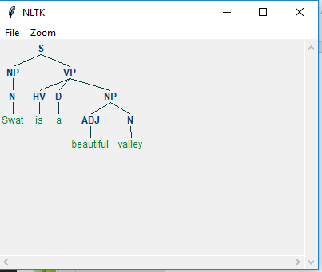
Output of Code

Slide 5
What is classification?
Choosing class for given input is called classification
In basic classification tasks, each input is considered in isolation from all other inputs, and the set of labels is defined in advance. Some examples of classification tasks are Deciding whether an email is spam or not. Deciding what the topic of a news article is, from a fixed list of topic areas such as "sports," "technology," and "politics."

Slide 6
What is supervised Machine Learning
Supervised learning is where you have input variables (x) and an output variable (Y) and you use an algorithm to learn the mapping function from the input to the output.
Y = f(x)
The goal is to approximate the mapping function so well that when you have new input data (x) that you can predict the output variables (Y) for that data
In Supervised Learning, algorithms learn from labeled data. After understanding the data, the algorithm determines which label should be given to new data based on pattern and associating the patterns to the unlabeled new data

Slide 7
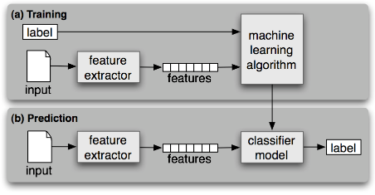
Process of Classification

Slide 8
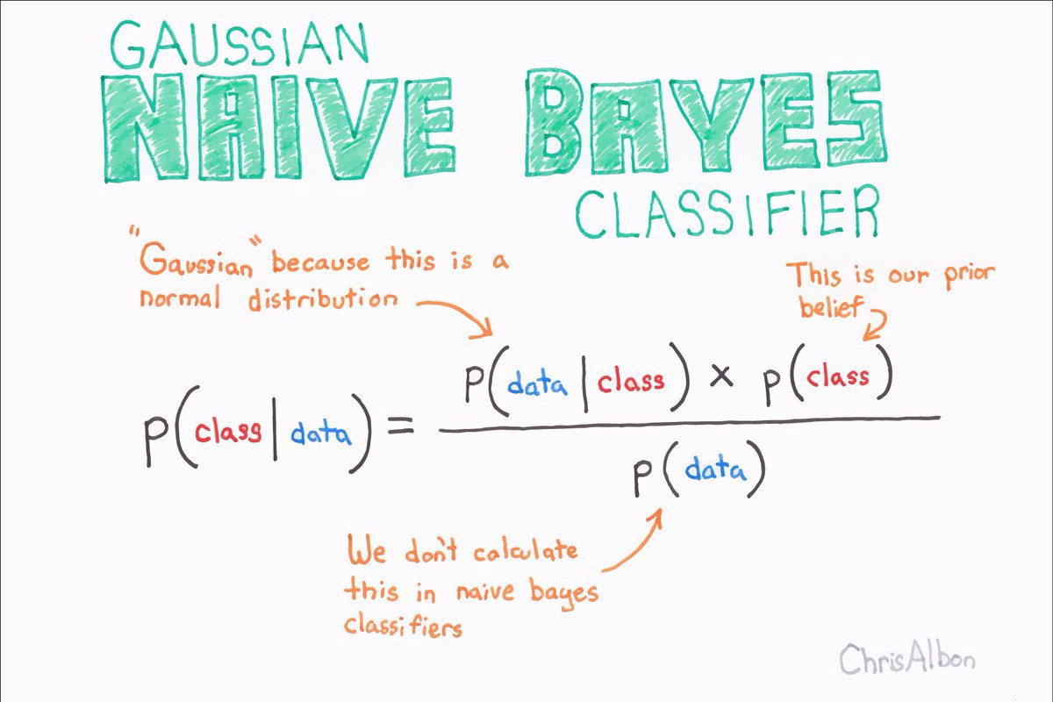
Naïve Bayes

Slide 9
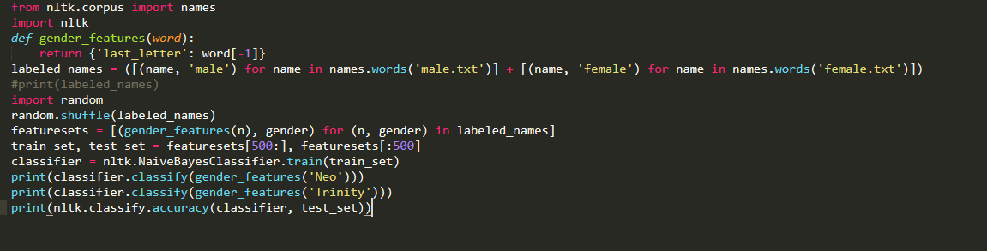
Code

Slide 10
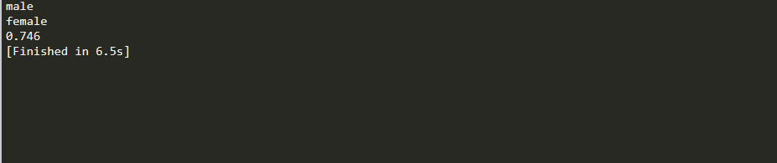
Output

Slide 11
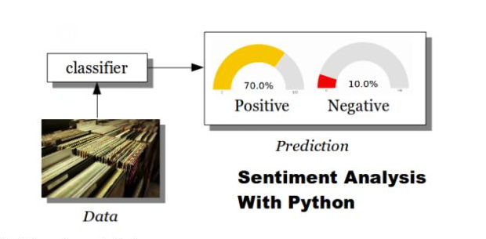
Sentiment Analysis

Slide 12
Sentiment Analysis

Slide 13
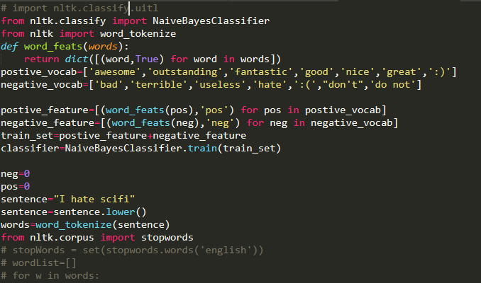
Sentiment Analysis code

Slide 14
Sentiment Analysis code

Slide 15
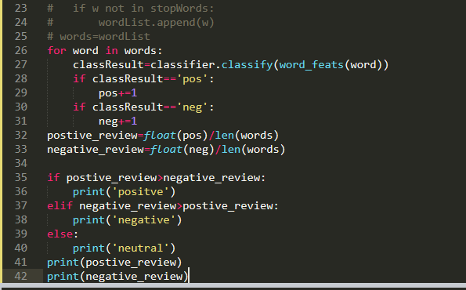
Sentiment Analysis code

Slide 16
Supplementary Readings
https://www.youtube.com/watch?v=sjUDlJfdnKM
https://www.datacamp.com/community/tutorials/text-analytics-beginners-nltk
https://www.nltk.org/api/nltk.sentiment.html
https://www.nltk.org/book/ch06.html

