Slide 1

Recursion

Slide 2
What is Recursion?
Recursion is a computer science technique used to solve a repetition-type problem.
“Recursion in computer science is a method where the solution to a problem depends on solutions to smaller instances of the same problem (as opposed to iteration)”.

Slide 3
Why Recursion?
Recursion often offers a simpler and cleaner-looking solution at the expense of memory consumption.
We can use recursion to solve problems that we do not know the exact number of repetitions (which cannot be done with a “for loop” but can be done with a “while loop”).

Slide 4
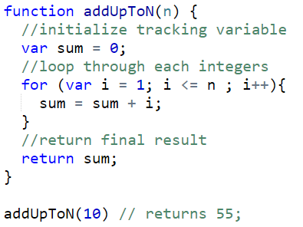
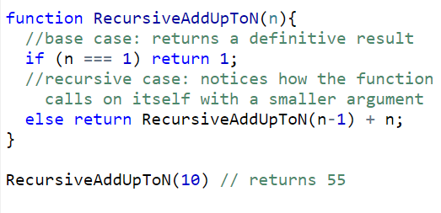
Two ways of solving the same problem
Example: write a function thats add up integers from 1 to N, where N is 1 or larger.

Slide 5
What is going on !?
Recursive problem-solving asks the computer to divide a problem into smaller version(s) of the same and combine the results
RecursiveAddUpToN(1) = 1 // base case.
RecursiveAddUpToN(2)
= RecursiveAddUpToN(1) + 2
= 1 + 2
= 3
RecursiveAddUpToN(3)
= RecursiveAddUpToN(2) + 3
= ( RecursiveAddUpToN(1) + 2 ) + 3
= (1 + 2) + 3
= 6

Slide 6
Recursion Gotcha!
Recursive algorithm must have a “base case” and a “recursive case”.
Base case stops the recursion.
The recursive case describes how to break the problem down into a small version of the same problem (“divide-and-conquer”).
You must have both to avoid “infinite recursion”, where the recursion does not stop and the computer eventually runs out of memory (this is called a “stack overflow”).

Slide 7
Famous Recursive Algorithms
Towers of Hanoi
Quick sort
Tree Traversal, such as Binary Search
N-queens (chess problem)

Slide 8
Recursion Resources
Codecademy course
Understand Recursion in Javascript in depth

Slide 9
Questions?

Slide 10
More JavaScript Resources
Codecademy has a JS course.
Khan Academy has a JS course.
W3schools has tons of info.
JavaScript for Cats for foundational concepts (and cats).
Eloquent JavaScript is a free online book. JavaScript: The Good Parts is one of the most famous JS books.
JavaScript Garden has more advanced topics.

