Slide 1
SDLC
Software Development Life Cycle

Slide 2
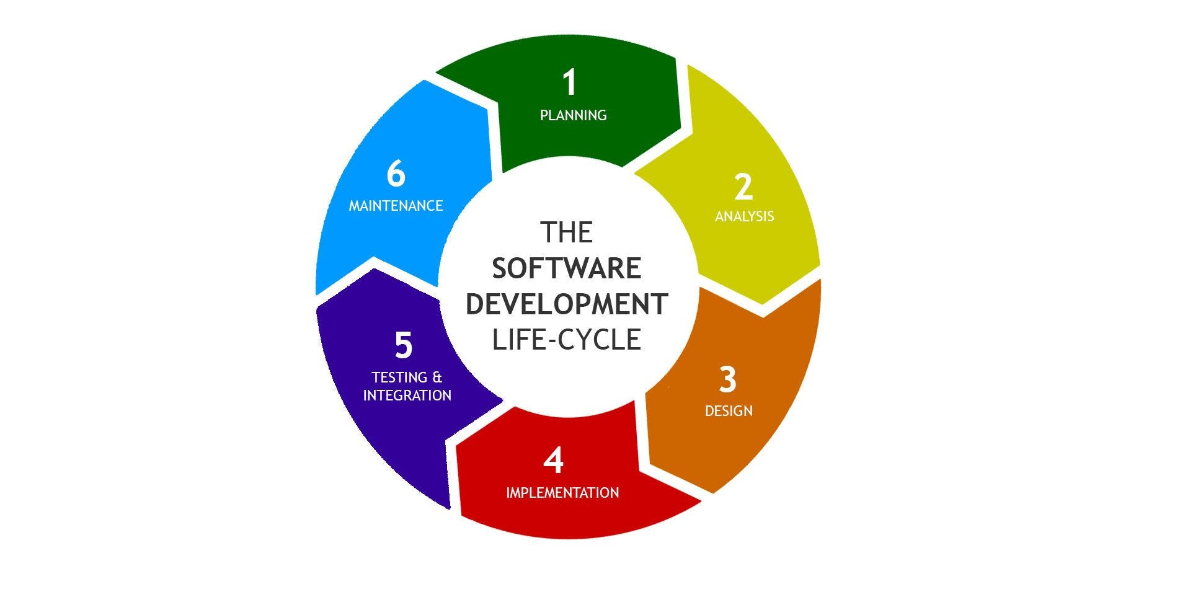

Slide 3
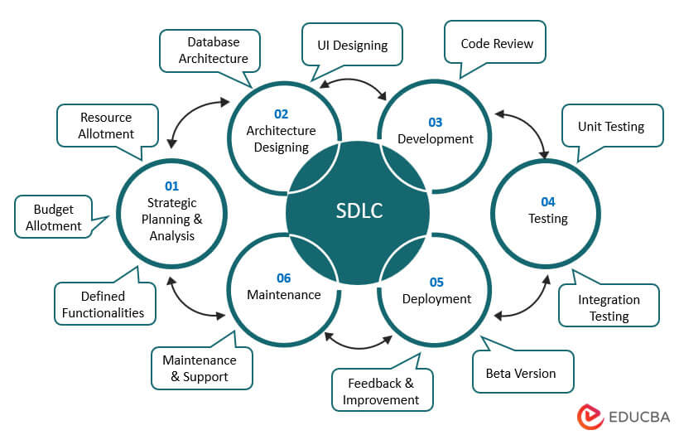
SDLC Is Not Linear
Phases often overlap
Feedback loops exist throughout
Agile, DevOps, and CI/CD compress multiple stages

Slide 4
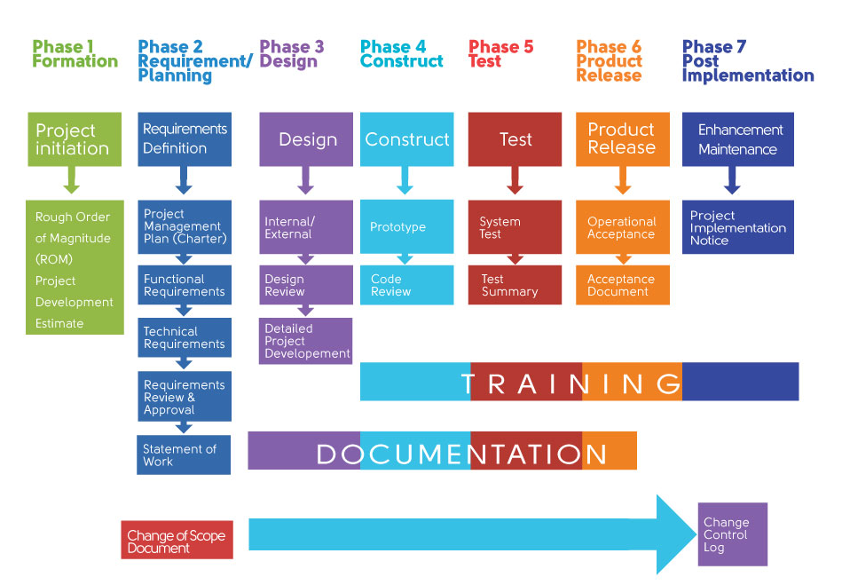

Slide 5
Planning Discovery and Ideation
Key Activities
Business problem identification
Stakeholder interviews
Market and user research
Pain-point analysis
Initial solution brainstorming
Outputs
Problem Statement
High-level Vision
Success Criteria
Identify the problem worth solving

Slide 6
Analysis Opportunity Assessment or Feasibility
Key Activities
Technical feasibility analysis
Business feasibility & ROI estimation
Risk identification
Build vs. buy analysis
Outputs
Feasibility Report
Cost/Benefit Analysis
Go/No-Go Decision
Decide whether the idea is viable

Slide 7
Requirements Gathering
Key Activities
Functional requirements gathering
Non-functional requirements (security, performance, compliance)
User interviews & workshops
Regulatory and policy constraints
Outputs
Requirements catalog
Initial backlog
Understand what the users and the business need

Slide 8
Requirements Analysis & Validation
Key Activities
Requirements prioritization
Dependency analysis
Acceptance criteria definition
Stakeholder validation
Outputs
Approved requirements
Refined product backlog
Refine and validate requirements

Slide 9

Business and Product Titles/Roles
Project Manager (PM) Oversees the entire project, sets timelines, budgets, and resource allocation.
Business Analyst (BA) Gathers, analyzes, and documents functional/non-functional requirements.
Product Owner/Product Manager Defines product vision, sets priorities, and manages the backlog.
Systems Analyst Translates business needs into technical specifications and system requirements.

Slide 10
Solution Architecture & Design
Key Activities
High-level system architecture
Data models
Integration design
Technology stack selection
Security architecture
Outputs
Architecture diagrams
Design specifications
Define how the system will work

Slide 11

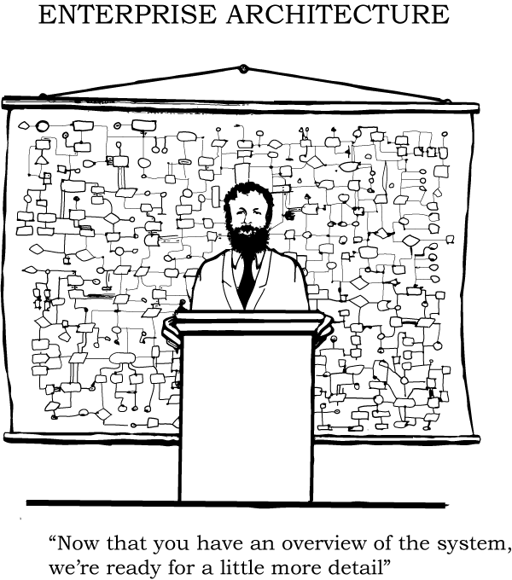
Systems Architecture Titles/Roles
Software Architect: Defines the technical vision, high-level structure, and coding standards for applications.
Solution Architect: Focuses on designing specific technical solutions to solve business problems, integrating multiple systems.
Enterprise Architect: Aligns the entire organization's IT infrastructure and long-term technology strategy with business goals.
Technical Architect: Concentrates on technical issues, including performance, security, and scalability within projects.
Chief Architect: Provides leadership and strategic oversight for the entire architectural team and technical direction.

Slide 12
Specialized Architecture Roles
Cloud Architect: Manages and designs cloud-based computing strategies, infrastructure, and application deployment.
Data Architect: Defines data models, storage structures, and policies to ensure data integrity and security.
Security Architect: Identifies risks and designs security measures into systems to protect against threats.
System Architect: Works on the technical design and planning of system solutions, often focused on software-hardware interaction.

Slide 13
UX / UI Design
Key Activities
User journey mapping
Wireframes and prototypes
Usability testing
Accessibility considerations
Outputs
Wireframes
UI designs
Design system components
Design the user experience

Slide 14

Architecture and Design Titles/Roles
Technical Product Manager / Product Owner Oversees the product strategy, balancing technical system constraints with user experience goals.
Information Architect, UX Designer Focuses on organizing, structuring, and labeling content to ensure usability and findability, creating sitemaps and wireframes
UI Designer / Visual Designer Translates the architectural wireframes into high-fidelity, polished visual interfaces.

Slide 15
Planning & Estimation
Key activities
Sprint or milestone planning
Effort estimation
Resource allocation
Delivery roadmap
Outputs
Delivery plan
Release roadmap
Prepare for execution

Slide 16
Development / Implementation
Key activities
Frontend development
Backend development
API development
Configuration and feature toggles
Secure coding practices
Deployment scripts
Outputs
Working software increments
Source code
Build It!

Slide 17
Continuous Integration
Key activities
Automated builds
Code reviews
Static code analysis
Dependency scanning
Outputs
CI/CD Configuration/Scripts
Build artifacts
Quality reports
Support Engineering and Quality Efforts

Slide 18
Testing & Quality Assurance
Key activities
Unit testing
Integration testing
System testing
User acceptance testing (UAT)
Performance & security testing
Outputs
Testing plans
Test results
Defect logs
UAT sign-off
Regression Plans
Validate functionality and quality

Slide 19
Release Preparation
Key activities
Release notes
Deployment scripts
Rollback planning
Change management approvals
Outputs
Release package
Deployment plan
Get ready to deploy

Slide 20
Deployment
Key activities
Environment provisioning
Production deployment
Smoke testing
Feature enablement
Configuration Management
Outputs
Live system
Deployment confirmation
Deliver to target environments

Slide 21

Engineering Titles/Roles
Core Engineering Software Developer, Software Engineer, Software Development Engineer (SDE), Programmer.
Specialized Engineering Frontend/Backend/Full-Stack Developer, DevOps Engineer, Mobile Engineer, Embedded/Firmware Engineer, Data Engineer, Site Reliability Engineer (SRE), Software Engineer in Test (SDET).
Professional Services Solution Engineer, Integration Engineer, Client Solutions Specialist

Slide 22
Post-Release Validation
Key activities
Production monitoring
Incident triage
User feedback review
Hotfixes if needed
Outputs
Stabilized release
Initial metrics
Ensure stability after launch

Slide 23
Operations & Maintenance
Key activities
Monitoring & alerting
Performance tuning
Security patching
Incident & problem management
Outputs
Operational dashboards
SLA reports
Cost & Utilization Reports
Keep the system running effectively

Slide 24
User Support
Key activities
Monitoring Support Channels
Bug Triage
Outputs
Bug Reports
Root Cause Analyses (RCA) are often generated by either SRE or Software Engineers.
Make sure the user is happy!

Slide 25
