Slide 1
Speech to Text Converter
Submitted by:
Parth Patel (ru7853)
Naitik Patel(qx6995)
Submitted to:
Dan Marconett

Slide 2
Contents
Speech Recognition
Process of Speech Recognition
Approaches to Speech Recognition
Sphinx
Architecture of Sphinx
Sphinx Grammar Format
Demo

Slide 3
Speech Recognition
Speech is mainly composed of two type.
voice part: contain most of the information.
unvoice part: High frequency component which is usually neglected in speech recognition.
There is basically three approaches.
HMM (Hidden Markov Models)
Neural Network
Pattern Recognition
Also known as Automatic speech Recognition or computer speech Recognition.
Speech Recognition is enables humans to communicate with computer through speaking.

Slide 4
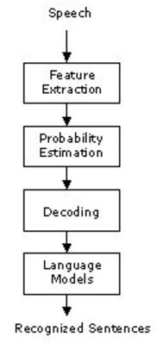
process of Speech recognition

Slide 5
process of Speech recognition Cont...
Speech
which consists of the acoustic environment plus the transduction equipment (microphone, preamplifier, filtering, A/D converter) can have a strong effect on the generated speech representations. For instance, additive noise, room reverberation, microphone position and type of microphone can all be associated with this part of the process.
Feature Extraction
Divide the speech in two part. Voice and unvoice and transfer the voice part to probability estimation.
Probability Estimation and Decoding:
Estimate the probability of word and set priority to that word. After that, that word give to the decoder. Decoder to find an ideally to the most likely sequence of words.

Slide 6
process of Speech recognition Cont...
Language Model
The recognition process is based on statistical models (Hidden Markov Models, HMMs) that are now widely used in speech recognition. A hidden Markov model (HMM) is typically defines as finite state automaton. which is assumed to be built up from a finite set of possible states, each of those states being associated with a specific probability distribution (or probability density function, in the case of likelihoods).
Recognized Sentences
After completing whole process, using HHM and words whole sentence would be created.

Slide 7
Approaches to Speech Recognition
Template-based
approach, where incoming speech is compared with stored units in an effort to find the best match.
Knowledge-based
approach that emulate human expert ability to recognize speech.
Statistical-based
approach, which exploit the inherent statistical properties of the occurrence and co-occurrence of individual speech sounds.
Connectionist
approach that use networks of interconnected nodes, which are trained to recognize speech.

Slide 8
sphinx
Sphinx is java library for speech recognition.
Sphinx content the api for speech to text converter.
Sphinx use the grammar for speech recognition.
Sphinx content three primary models.
The Front End
The Decoder
The knowledge Base

Slide 9
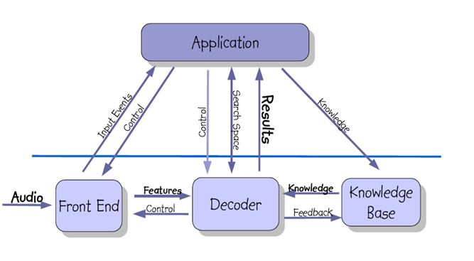
architecture of Sphinx

Slide 10
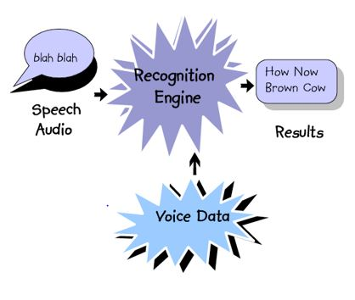
How Recognizer Work?

Slide 11
Sphinx Grammar Format
Variables go in angle brackets, e.g. <city>
Terminals must be appear in your pronunciation dictionary.
XY is concatenation -- e.g. , I want.
(X|Y) means X or Y -- e.g. , (He|She).
Square brackets mean optional -- eg., [On] Friday.
* means that word will be spoken Zero or more times.
+ means one or more times.

Slide 12
Application Grammer
public <command> = ( Open | Close ) (command| calculator |word | access |pad | paint |Browser );
public <action> = (start | stop ) (excel |word pad);
public <absoluteTime> = <firstdigit> (plus| multiply | divide | minus) <seconddigit>;
<firstdigit> =
( one
| two
| three)

