Slide 1

Perpal
Personalized
A Friend
A Social Networking Site
Life is shared by expressing it!
The Team:
Mitesh.S. Rathod (11012022012)
Parth.N. Patel(11012022010)
Department:
Information Technology

Slide 2
Abstract
The web application focuses on how to improve the social experience as well as bring a new flavor in existing systems, To get the Social networking to new “Personalized social networking”

Slide 3
Scope
This system is intended for online communication and create network between the people belonging to various cultures,countries,backgrounds. It could be used as a platform for promoting business, for political campaigns, marketing, knowledge sharing and various other purposes.

Slide 4
What System can be do..??
The system provides log in facility to the users.
Users can edit profile, upload photos, videos, update status, communicate with other users .
The system enables users to deactivate their account, change account password and maintain the security level of their account.
Continue....

Slide 5
What System can be do..??
Users can post messages at any time as the website will be available for 24 hours and every day.
The system enables admin to make system announcements,release system
updates,monitor user data,send warning or suspend user account and send feedback to the users.

Slide 6
How it Differ from others..??
Let see that how is different from the other social networking Systems,

Slide 7
Features | Perpal | Facebook | MySpace | Google+
Workspaces | Yes | No | No | No
Announcements | Yes | Yes | Yes | Yes
Like, Comments | No, No | Yes, Yes | No, Yes | No(+1), Yes
Captions | Yes | No | No | No
Emblems | Yes | No | No | No
Outgoing Mails | Yes | No | No | No
Emotions | Yes | As Mood | No | No
Celebrations & Virtual Gifts | Yes , Yes | Yes, No | No, No | Yes, No
Photos & Collages | Yes, Yes | Yes, No(Albums) | Yes, No | Yes, No

Slide 8
Admin Module
Register Profile
Edit Profile
Check User Account
Delete User Profile
Send/Receive Message
Make System Announcement
Release System Updates
Send User Warning
Suspend User Account

Slide 9
User Module
Register Profile
Edit Profile
Delete Profile
Check User Account
Send Friend
Request
Send and receive message
Upload Photos and videos
Post Message
Report Content

Slide 10
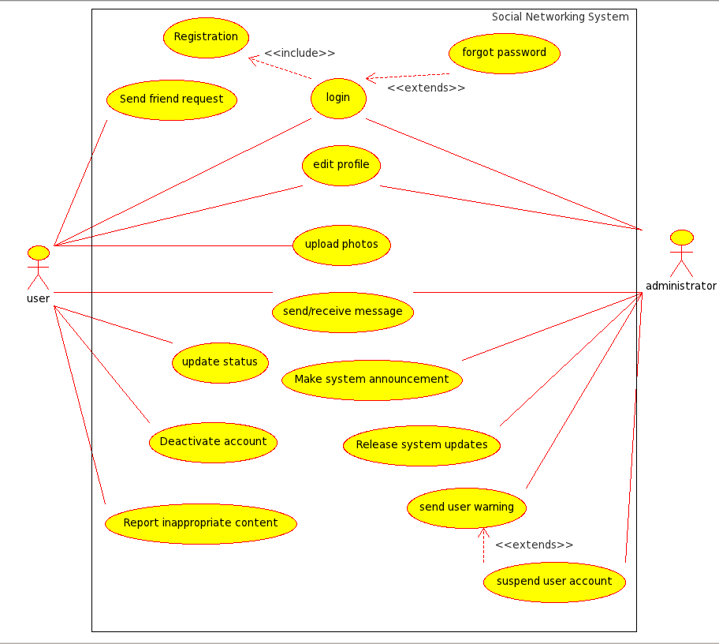
Usecase Diagram :

Slide 11
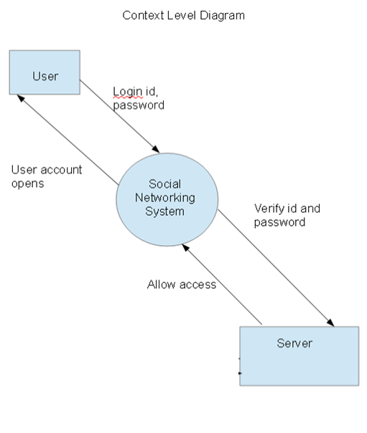
DFD Context level :

Slide 12
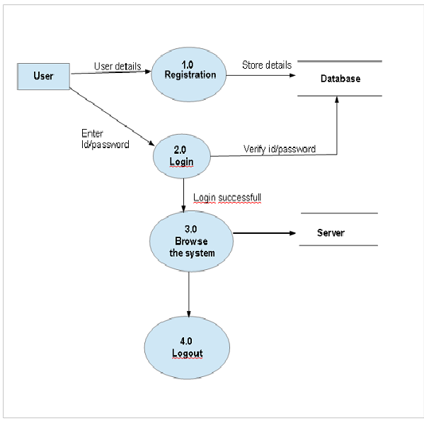
DFD Level 0

Slide 13
Future Aspects
Build for mobile platforms
Add cloud facilities
Integration of Commercial world

Slide 14
Tools and Technologies
> IDE
  Visual Studio 2010
> Front End
  Asp. Net, framework 4.0
  Programming : C#
> Back End
  SQL Server 2008

Slide 15
References
Facebook
Google+
My Space
Flickr
Picasa

Slide 16
Now it’s time not just to
connect but,
express yourselves

