Slide 1
IPL SQL PROJECT
PRESENTED BY :-
1.PETER MONDOL

Slide 2
What is Indian Premier League (IPL) ?
Indian Premier League (IPL) is a professional Twenty20 cricket league in India contested during March or April and May of every year by eight teams representing eight different cities or states in India.
The league was founded by the Board of Control for Cricket in India (BCCI) in 2007.
The IPL is the most-attended cricket league in the world and in 2014 ranked sixth by average attendance among all sports leagues.
In 2010, the IPL became the first sporting event in the world to be broadcast live on YouTube.
The brand value of IPL in 2020 was estimated to be around ₹475 billion (US$6.7 billion), according to Duff & Phelps.

Slide 3
CREATE TABLE QUERIES
CREATE TABLE deliveries (
id int,
inning int,
over int,
ball int,
batsman varchar(255),
non_striker varchar(255),
bowler varchar(255),
batsman_runs int,
extra_runs int,
total_runs int,
is_wicket int,
dismissal_kind varchar(255),
player_dismissed varchar(255),
fielder varchar(255),
extras_type varchar(255),
batting_team varchar(255),
bowling_team varchar(255)
);
CREATE TABLE matches (
id int,city varchar(255),
date date,
player_of_match varchar(255),
venue varchar(255),
neutral_venue int,
team1 varchar(255),
team2 varchar(255),
toss_winner varchar(255),
toss_decision varchar(255),
winner varchar(255),
result varchar(255),
result_margin int,
eliminator varchar(255),
method varchar(255),
umpire1 varchar(255),
umpire2 varchar(255)
);

Slide 4
IMPORT DATA QUERIES
COPY matches
FROM 'C:\Program Files\PostgreSQL\16\data\IPL Dataset\IPL_matches.csv’
DELIMITER ',’
CSV HEADER;
select * from matches;
COPY deliveries
FROM 'C:\Program Files\PostgreSQL\16\data\IPL Dataset\IPL_Ball.csv’
DELIMITER ',’
CSV HEADER;
select * from deliveries;

Slide 5
BATSMAN WITH HIGH STRIKE RATE
select batsman_name, runs_scored, balls_faced,
round((cast(runs_scored as decimal)/balls_faced)*100, 0) as strike_rate
from
(
select batsman as batsman_name,
sum(batsman_runs) as runs_scored,
count(*) as balls_faced
from deliveries
where extras_type != 'wides’
group by 1
) as a
where balls_faced >= 500
order by 4 desc
limit 10;

Slide 6
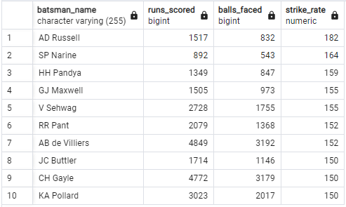
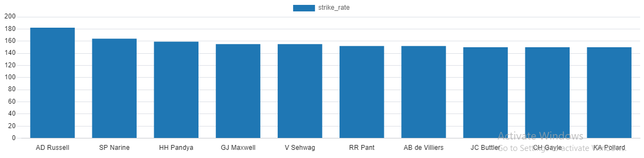
TABLE WITH VISUALISATION [S.R]

Slide 7
BATSMAN WITH GOOD AVERAGE
select batsman_name, runs_scored,
no_dismissal, (runs_scored/no_dismissal) as average, season
From
(
select batsman as batsman_name, sum(batsman_runs) as runs_scored,
sum(is_wicket) as no_dismissal ,
count(distinct(extract('year' from date))) as season
from deliveries as a
left join matches as b
on a.id = b.id
group by 1
) as c
where c.season > 2
order by average desc
limit 10;

Slide 8
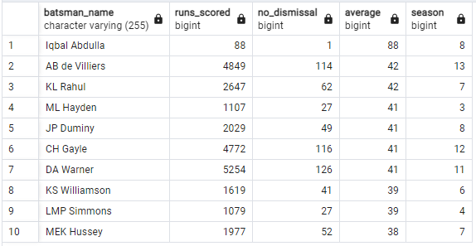
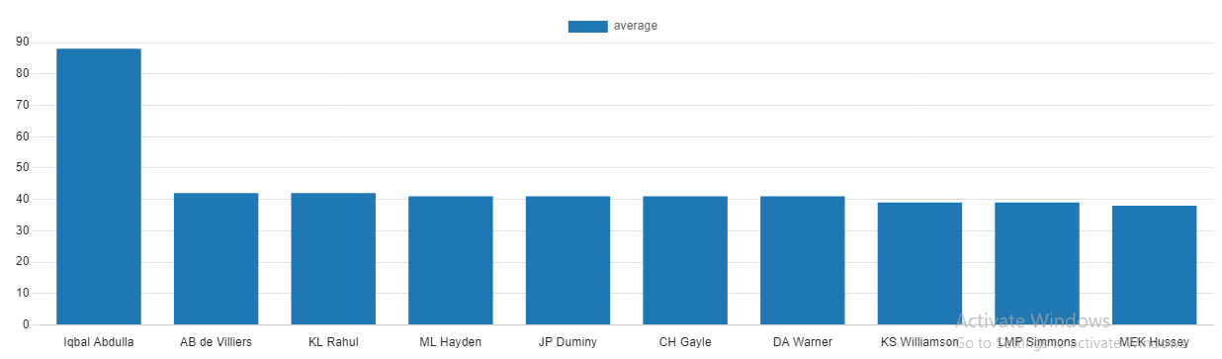
TABLE WITH VISUALISATION [AVG]

Slide 9
HARD HITTING BATSMAN
select batsman_name, total_runs, runs_boundary,
round((cast(runs_boundary as decimal)/total_runs)*100, 2) as boundary_percent, season
From
(
select batsman as batsman_name, sum(batsman_runs) as total_runs,
sum(case when batsman_runs = 4 then 4
when batsman_runs = 6 then 6
else 0
end
) as runs_boundary,
count(distinct(extract('year' from date))) as season
from deliveries as a
left join matches as b
on a.id = b.id
group by 1) as c
where c. season > 2
order by 4 desc
limit 10;

Slide 10
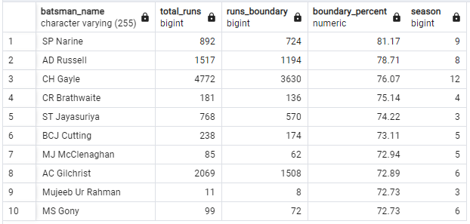
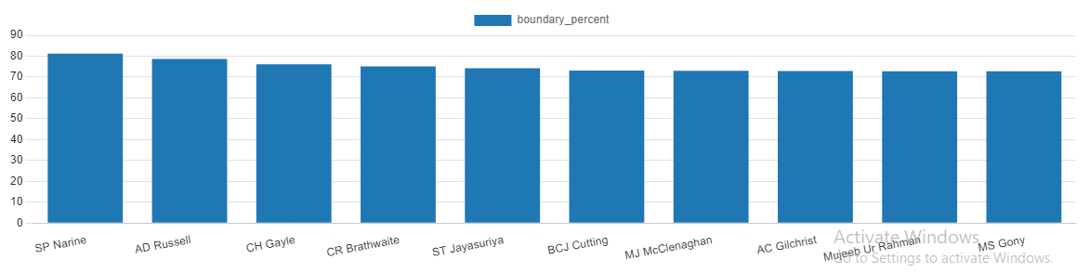
TABLE WITH VISUALISATION [HARD HITTING BATSMAN]

Slide 11
BOWLERS WITH GOOD ECONOMY
select
bowler as bowler_name,
(sum(total_runs) / (count(over)/6.0)) as economy
from deliveries
group by 1
having count(bowler) >= 500
order by economy asc
limit 10;

Slide 12
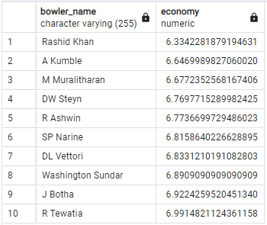
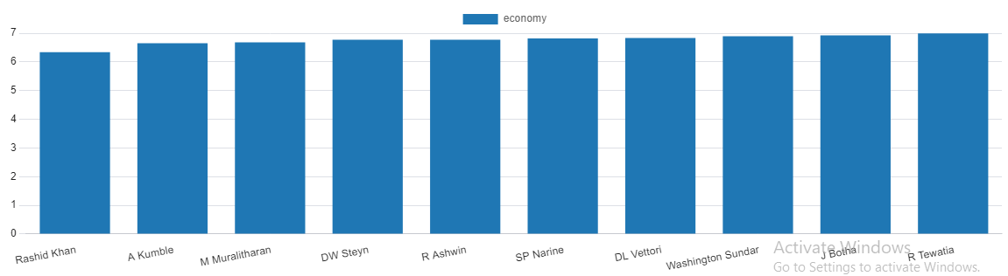
TABLE WITH VISUALISATION [ECONOMY]

Slide 13
BOWLERS WITH BEST STRIKE RATE
select
bowler as bowler_name,
(count(bowler) / sum(is_wicket)) as strike_rate
from deliveries
group by 1
having count(bowler) >= 500
order by strike_rate asc
limit 10;

Slide 14
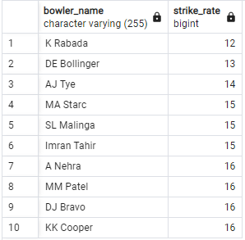
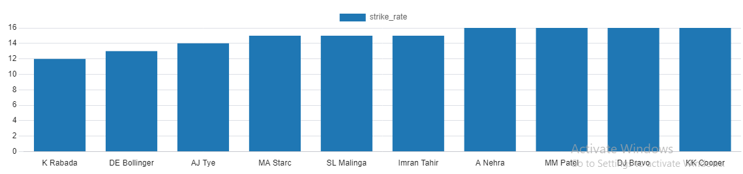
TABLE WITH VISUALISATION [BOWLER WITH BEST S.R]

Slide 15
ALL-ROUNDERS WITH BEST BOWLING AND BATTING S.R
select
Allrounder_name, runs_scored, balls_faced ,balls_bowled, bowler_strike_rate,
round((cast(runs_scored as decimal)/balls_faced)*100, 0) as batsman_strike_rate
from (
select batsman as Allrounder_name, sum(batsman_runs) as runs_scored,
count(batsman_runs) as balls_faced , count(bowler) as balls_bowled,
(count(bowler) / sum(is_wicket)) as bowler_strike_rate
from deliveries
where extras_type != 'wides’
group by 1
having sum(is_wicket) != 0) as a
where balls_faced >= 500 and balls_bowled >= 300
order by 6 desc, 5 asc
limit 10;

Slide 16
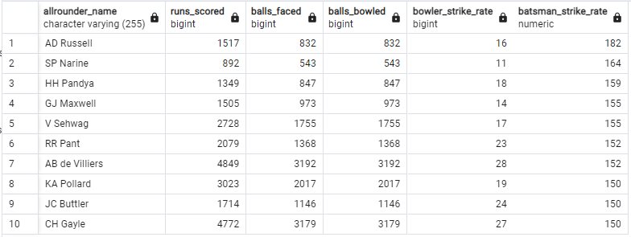
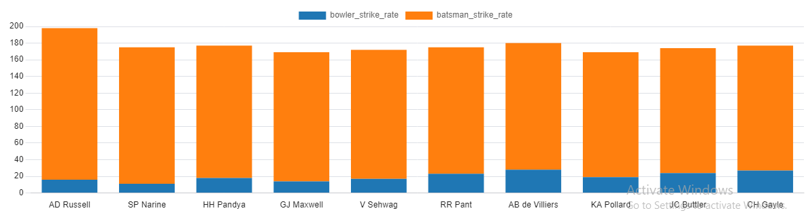
TABLE WITH VISUALISATION [ALL - ROUNDERS]

Slide 17
CRITERIA FOR SELECTING BEST WICKET KEEPER
CRITERIA
CATEGORIES
A Wicket Keeper should be able to bat and bowl as and when required by the team i.e he should have all rounder capabilities.
Fielding behind the wicket should be among the best.
To have all rounder capabilities we need to select on criteria of bowling strike rate and batting strike rate. In short strike rate for batting and bowling should be good.
For fielding we need to group by on fielder’s name and find out who takes the most catches and makes the most stumpings.

Slide 18
ADDITIONAL QUESTION FOR FINAL ASSESSMENT
1. Get the count of cities that have hosted an IPL match
select count(distinct(city)) from matches;
2. Create table deliveries_v02 with all the columns of the table ‘deliveries’ and an additional column ball_result containing values boundary, dot or other depending on the total_run
Create table deliveries_v02 as
select *,
case when total_runs >= 4 then 'Boundary'
when total_runs = 0 then 'Dot'
else 'Other'
end ball_result
from deliveries;
select * from deliveries_v02;

Slide 19
ADDITIONAL QUESTION FOR FINAL ASSESSMENT
3. Write a query to fetch the total number of boundaries and dot balls from thedeliveries_v02 table.
select count(ball_result)
from deliveries_v02
where ball_result = 'Boundary' or ball_result = 'Dot’ ;
4. Write a query to fetch the total number of boundaries scored by each team from thedeliveries_v02 table and order it in descending order of the number of boundaries scored.
select batting_team,
count(ball_result) as boundaries_num
from deliveries_v02
where ball_result = 'Boundary’
group by 1
order by 2 desc;

Slide 20
ADDITIONAL QUESTION FOR FINAL ASSESSMENT
5. Write a query to fetch the total number of dot balls bowled by each team and order it in descending order of the total number of dot balls bowled.
select batting_team, count(ball_result) as dot_balls
from deliveries_v02
where ball_result = 'Dot’
group by 1
order by 2 desc;
6. Write a query to fetch the total number of dismissals by dismissal kinds where dismissal kind is not NA
select dismissal_kind, count(dismissal_kind)
from deliveries_v02
where dismissal_kind != 'NA’
group by 1
order by 2 desc;

Slide 21
ADDITIONAL QUESTION FOR FINAL ASSESSMENT
7. Write a query to get the top 5 bowlers who conceded maximum extra runs from the deliveries table
select bowler as bowler_name, sum(extra_runs) as total_extras
from deliveries_v02
group by 1
order by 2 desc
limit 5;
8. Write a query to create a table named deliveries_v03 with all the columns ofdeliveries_v02 table and two additional column (named venue and match_date) of venue and date from table matches
Create table deliveries_v03 as
(select a.*, b.date as match_date, b.venue as venue
from deliveries_v02 as a
left join matches as b
on a.id = b.id);
select * from deliveries_v03;

Slide 22
ADDITIONAL QUESTION FOR FINAL ASSESSMENT
9. Write a query to fetch the total runs scored for each venue and order it in the descending order of total runs scored.
select venue as venue_name, sum(total_runs) as total_runs_venue
from deliveries_v03
group by 1
order by 2 desc;
10. Write a query to fetch the year-wise total runs scored at Eden Gardens and order it in the descending order of total runs scored.
select venue as venue_name, sum(total_runs) as total_runs, extract('year' from match_date) as Year_wise
from deliveries_v03
where venue = 'Eden Gardens’
group by 3,1
order by 2 desc;

Slide 23
THANK YOU

