Slide 1

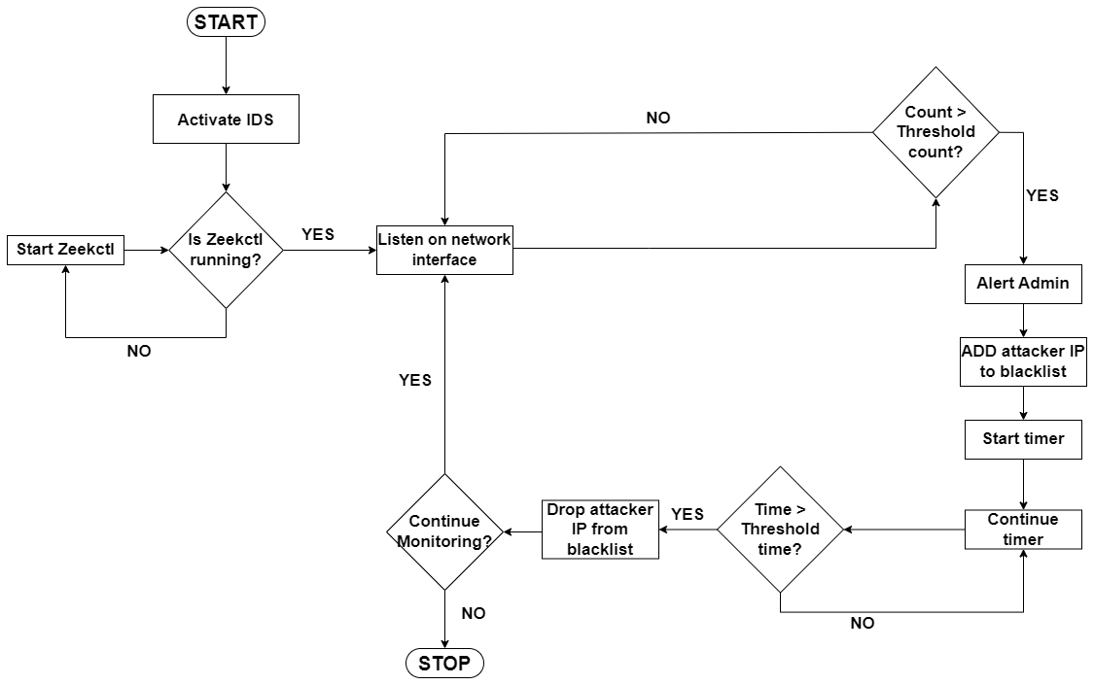
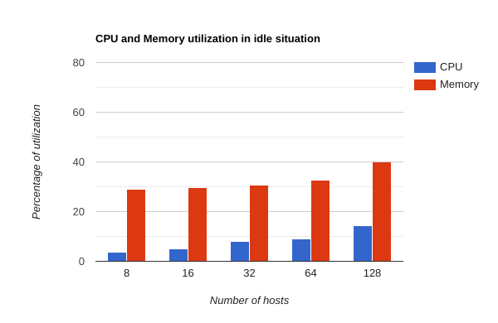
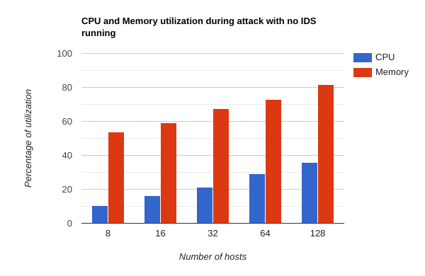
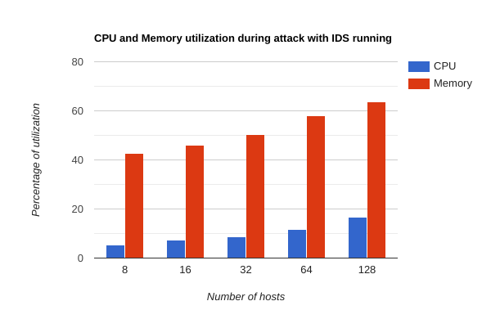
Detection and Mitigation of SSH and FTP Attack
Using Intrusion Detection System
Team Members: Prajwal(01FE20BCS166), Nikhil(01FE20BCS213),
Vishal(01FE20BCS221), Manvanth(01FE20BCS223)
Guide: Ms M M Raikar
Team No: N-9 Mini-Project, 5th Sem, 2022-2023
Problem Domain
Methodology
First activate Intrusion Detection System (IDS) on the server.
Check if IDS is running (Zeekctl) else again try restarting it.
If it is running then listen on network interface to capture all the incoming packets.
For every connection request, keep failure counts and if the count is less than the threshold then accept connection request.
If the failure count is greater than threshold then alert admin using the alert box and block IP address of the attacker.
Set the blocked IP address in blocklist for the duration for which the user has set.
Continue listening on network interface.
Results
Networking
Under conditions where attack takes without IDS running, we observe that as number of hosts increase, both CPU utilization and memory utilization increases and both are maximum as compared to normal situation and condition where IDS is running.
Problem Definition
To design a mechanism for detection and mitigation of SSH and FTP Brute-Force attacks using Intrusion Detection System.
Objectives
To design a network activity monitoring component for observing the traffic flow of the network topology.
To develop an algorithm for detecting suspicious behavior in the network.
To design a mitigation module for SSH brute-force attack and FTP brute-force attack in the network.
To analyze the performance of the proposed mitigation module.
Motivation
Many devices connected to the internet are still vulnerable to attacks because they can be accessed using their default passwords.
An Intrusion Detection System (IDS) is a system that monitors network traffic for suspicious activity and issues alerts when such activity is detected.
Brute force attacks, also known as high-level attacks, are a common and challenging type of attack on computer systems.
In brute force attacks, attackers attempt to guess passwords or other sensitive information by trying a large number of possibilities, which can exhaust hardware resources and make data vulnerable.
It is important to detect and prevent brute force attacks in order to protect against unauthorized access and maintain the security of the network.
Conclusions
Using above mentioned proposed system, we can successfully detect and mitigate brute force attacks on SSH and FTP attacks using Intrusion Detection System like Zeek. This system can run on all the networks.
Future work includes integration of this system with machine learning models to achieve detection with higher accuracy by classifying the network traffic into legitimate traffic and attacker traffic.
Mini-Project(15ECSW301) – 2022-23

