Slide 1

DETECTION AND MITIGATION OF SSH AND FTP ATTACK USING INTRUSION DETECTION SYSTEM
Prajwal N Shavi 01fe20bcs166
Manvanth B S 01fe20bcs223
Vishal V J 01fe20bcs221
Nikhil Dhupadal 01fe20bcs213
Under the Guidance of
Ms. M M Raikar
Team No :- N9

Slide 2
Contents
Problem Statement
Motivation
Why Brute Force Attack?
Objective
Why SSH?
Proposed system
Results
Performance analysis
Conclusion

Slide 3
Problem Statement
To design a mechanism for detection and mitigation of SSH and FTP Brute-Force attacks using Intrusion Detection System.

Slide 4
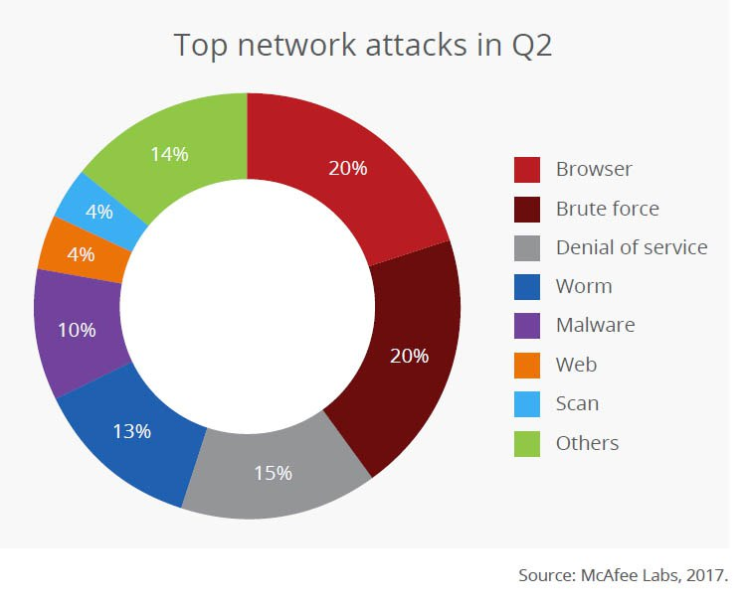
Why brute force attack?
4

Slide 5
Why brute force attack?
Statistics from google cloud
Source: https://services.google.com/fh/files/blogs/gcat_threathorizons_full_july2022.pdf
5
3

Slide 6
Motivation
Many devices connected to the internet are still vulnerable to attacks because they can be accessed using their default passwords.
An Intrusion Detection System (IDS) is a system that monitors network traffic for suspicious activity and issues alerts when such activity is detected.
Brute force attacks, also known as high-level attacks, are a common and challenging type of attack on computer systems.
In brute force attacks, attackers attempt to guess passwords or other sensitive information by trying a large number of possibilities, which can exhaust hardware resources and make data vulnerable.
It is important to detect and prevent brute force attacks in order to protect against unauthorized access and maintain the security of the network.

Slide 7
Objectives
To design a network activity monitoring component for observing the traffic flow of the network topology.
To develop an algorithm for detecting suspicious behavior in the network.
To design a mitigation module for SSH brute-force attack and FTP brute-force attack in the network.
To analyze the performance of the proposed mitigation module

Slide 8
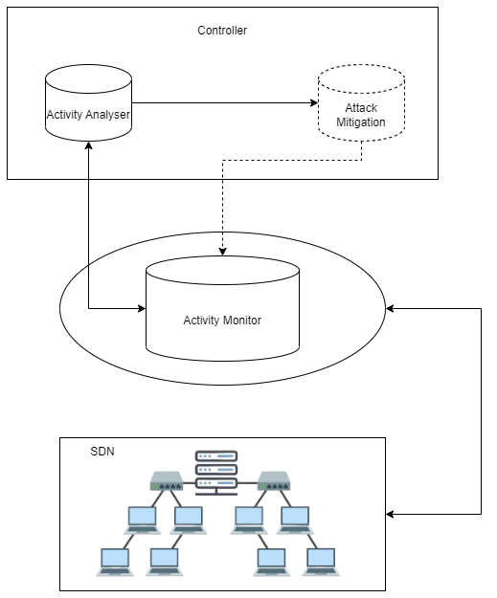
Proposed system
Block Diagram :
IDS: An Intrusion Detection System is a system that monitors network traffic for suspicious activity and issues alerts when such activity is discovered. It is a software application that scans a network or a system for the harmful activity or policy breaching.
Activity Monitor: Activity monitor is the component responsible for observing the traffic flow. The activity monitor gathers information needed for finding any abnormal behavior within the network.
Activity Analyser: Detect any suspicious behaviour in the network. Based on the statistics information collected by Activity Monitor, any abnormal behaviour of the network is detected.
Attack Mitigation: If a bruteforce attack is found, measures to mitigate the attacks are carried out.

Slide 9
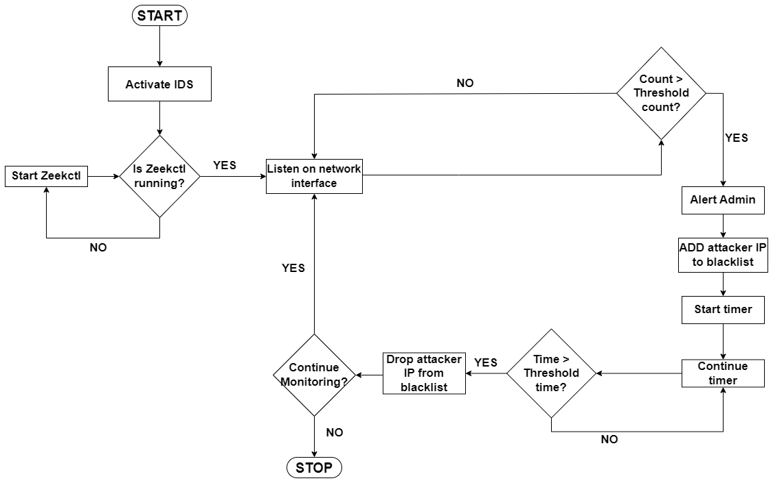
Proposed system
Flowchart:

Slide 10
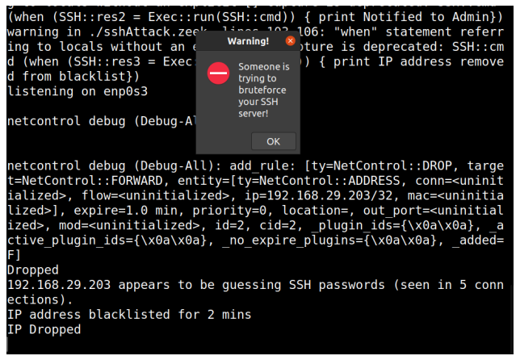
Expected Results
Brute Force attack on SSH

Slide 11
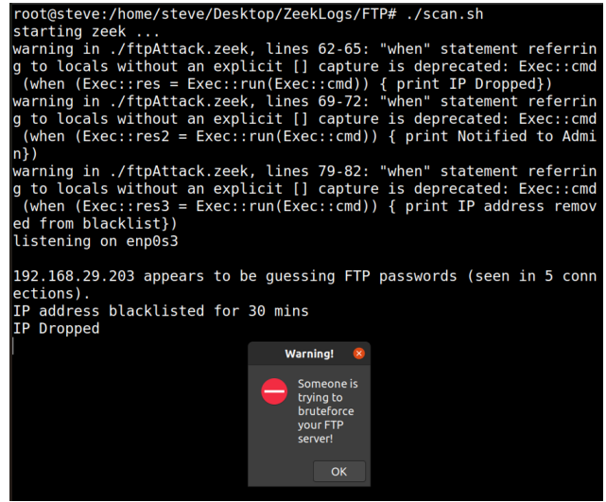
Expected Results
Brute Force attack on FTP

Slide 12
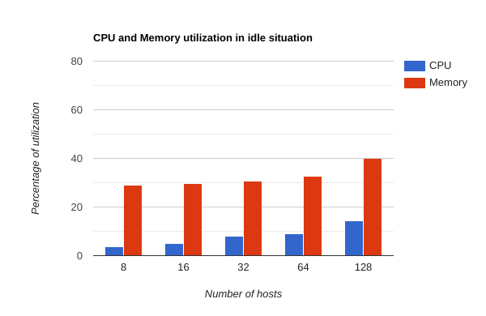
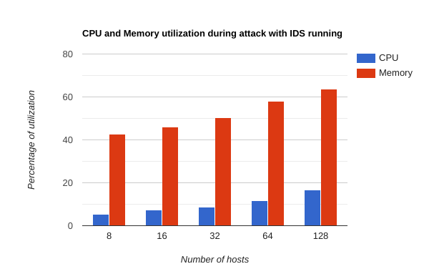
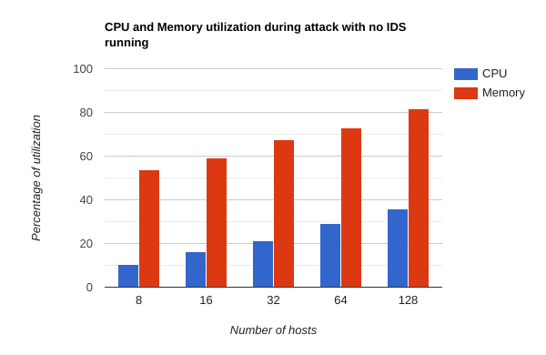
Performance Analysis
Conclusion : Under conditions where attack takes without IDS running, we observe that as number of hosts increase, both CPU utilization and memory utilization increases and both are maximum as compared to normal situation and condition where IDS is running.

Slide 13
Conclusion
Using the proposed system, we can successfully detect and mitigate brute force attacks on SSH and FTP attacks using Intrusion Detection System like Zeek. This system can run on all the networks.

Slide 14
THANK YOU

