Slide 1
EDB SUPPORT PACKAGE FOR AI COE · RESEARCH INCENTIVE SCHEME (RIS(C))
EDB Grant Claim Automation
Manpower claims — prepared, verified, audit-ready
ST Engineering · Human Resources
Application No. S26-10249-RIS(C) | Qualifying Period 01 Jan 2026 – 31 Dec 2028 | 17 participating entities
Stakeholder briefing · Confidential

Slide 2
THE CHALLENGE
Grant claims are high-stakes and manual
▸ Scale. 17 participating entities, a three-year qualifying period, and a grant worth up to S$42 million — manpower only.
▸ Manual & error-prone. Each claim is hand-built from timesheets, payroll registers and ECMF lists; one wrong rate or a missed exclusion can sink it.
▸ Heavily audited. An external Public Accountant verifies under SSRS 4400 and samples at least 85% of the claimed value — every figure must trace to a source document.
▸ Hard deadlines. Per-entity audits from Oct 2026, group submission to EDB by end Nov 2026, final audited claim within 183 days of the period end.
EDB RIS(C) Grant Claim Automation · ST Engineering HR · Confidential

Slide 3
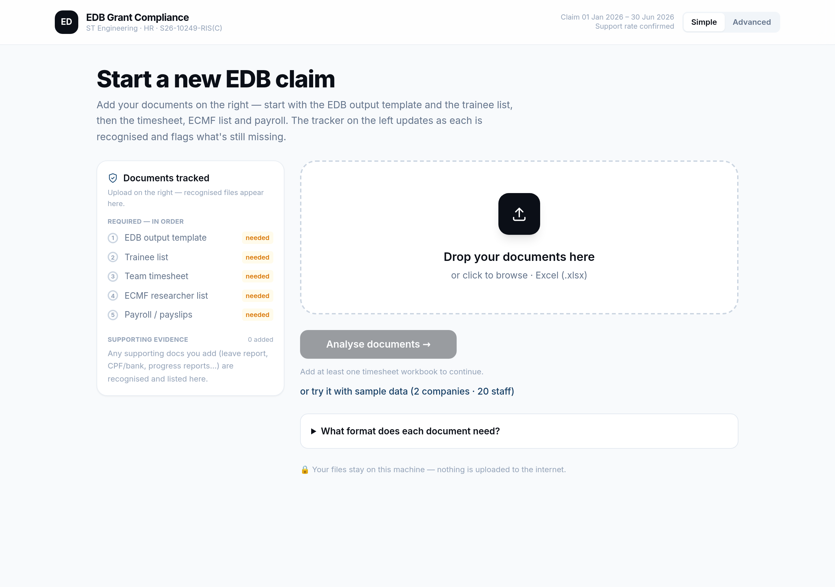
THE SOLUTION
An HR-first portal that does the heavy lifting
▸ Upload, and it takes over. Drop the HR records; the system reads them, applies EDB's rules, and prepares the claim.
▸ End to end. Eligibility checks → per-person calculation → the EDB submission pack — in one guided flow.
▸ Private by design. Runs entirely on your machine; salary data never leaves the building.
▸ Deterministic. The same inputs always produce identical outputs — a hard audit requirement.
EDB RIS(C) Grant Claim Automation · ST Engineering HR · Confidential

Slide 4
WHY THIS SYSTEM
The advantages at a glance
▸ Faster. Weeks of manual spreadsheet work per claim become minutes — upload to audit-ready pack.
▸ Accurate. Rules applied the same way every time; reconciles to the cent and removes rate, cap and exclusion mistakes.
▸ Audit-ready. Every figure is one click from its source cell — a smoother, faster, lower-cost SSRS 4400 audit.
▸ Compliant. The 60% rate, 9-month cap, S$42m ceiling and reporting deadlines are enforced, not remembered.
▸ Transparent. No black box: full workings are shown and nobody is silently dropped — every decision has a reason.
▸ Secure & scalable. Runs 100% on-premise (salary data never leaves), and applies one consistent method across all 17 entities.
EDB RIS(C) Grant Claim Automation · ST Engineering HR · Confidential

Slide 5
THE ADVANTAGES
Before vs after
Manual today
With this system
▸ Weeks of spreadsheet work per claim
▸ Easy to mis-apply the rate, cap or an exclusion
▸ Audit prep: hunting for source documents by hand
▸ Hard to keep 17 entities consistent
▸ A rejected claim risks delay or clawback
▸ Salary data scattered across files
▸ Minutes: upload → audit-ready submission pack
▸ Rules enforced automatically; cent-exact
▸ Every figure one click from its source cell
▸ One consistent method across all 17 entities
▸ Defensible, traceable, deterministic outputs
▸ All processing on-premise — nothing leaves
EDB RIS(C) Grant Claim Automation · ST Engineering HR · Confidential

Slide 6
THE PROCESS
How a claim flows through the system
1. Upload
2. Auto-check
3. Eligibility
4. Calculate
5. Submission pack
6. Audit
Drop the HR documents (timesheets, ECMF list, payroll, supporting evidence).
System tracks them against the required list and flags what's missing.
Each person tested against EDB gates G1–G7.
Method A claim per person + internal cross-check.
EDB template, SOE and issues list generated.
Practitioner verifies under SSRS 4400; report goes to EDB.
Upload once → the system checks, calculates and assembles the audit-ready pack. HR stays in control; every figure is traceable and nobody is silently dropped.
EDB RIS(C) Grant Claim Automation · ST Engineering HR · Confidential

Slide 7
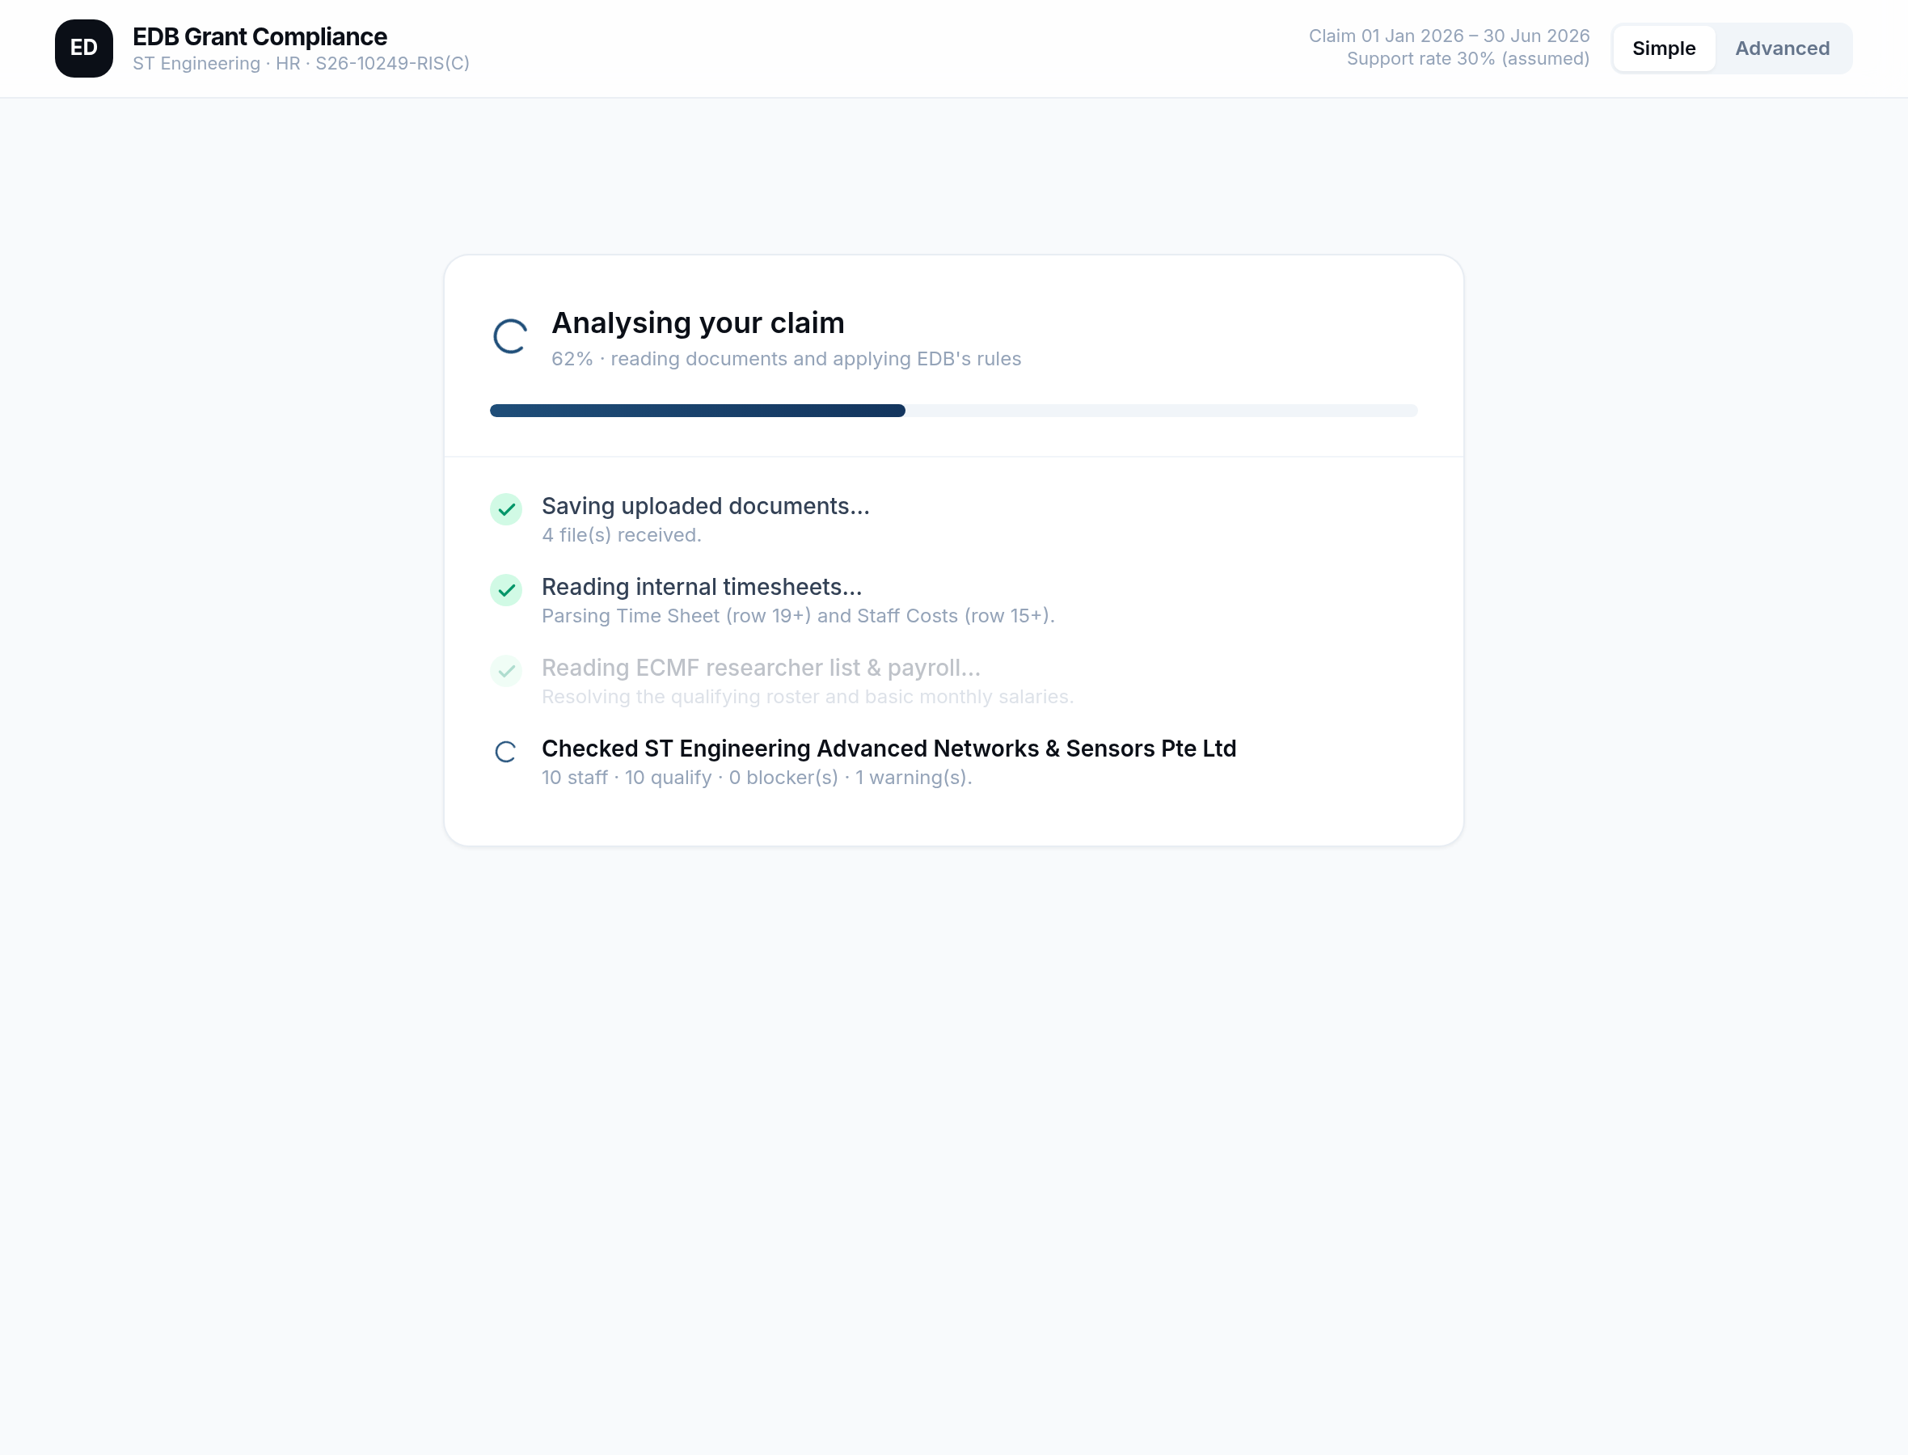
HOW IT WORKS
Five guided, transparent steps
▸ Documents. Upload timesheets, the ECMF list and payroll; tick the supporting evidence.
▸ Document check. Missing-document validation per company and per person.
▸ Eligibility. Every person checked against EDB's criteria.
▸ Claim amount. Each claim calculated and shown in full.
▸ Submission pack. The audit-ready outputs, generated.
▸ Verbose & re-runnable. You see exactly what it's doing; fix a document and re-run.
EDB RIS(C) Grant Claim Automation · ST Engineering HR · Confidential

Slide 8
TRUST BY DESIGN
The AI assists — the maths is deterministic
▸ The model never computes a claim figure. All arithmetic is pure, auditable Python. The AI only reads documents and explains.
▸ Full traceability. Every number links to its exact source cell — payslip, timesheet, ECMF list.
▸ Nobody is silently dropped. Excluded and blocked people are always listed with the reason.
▸ Proven. 115 automated tests; reconciles to the cent against EDB's own worked example.
EDB RIS(C) Grant Claim Automation · ST Engineering HR · Confidential

Slide 9
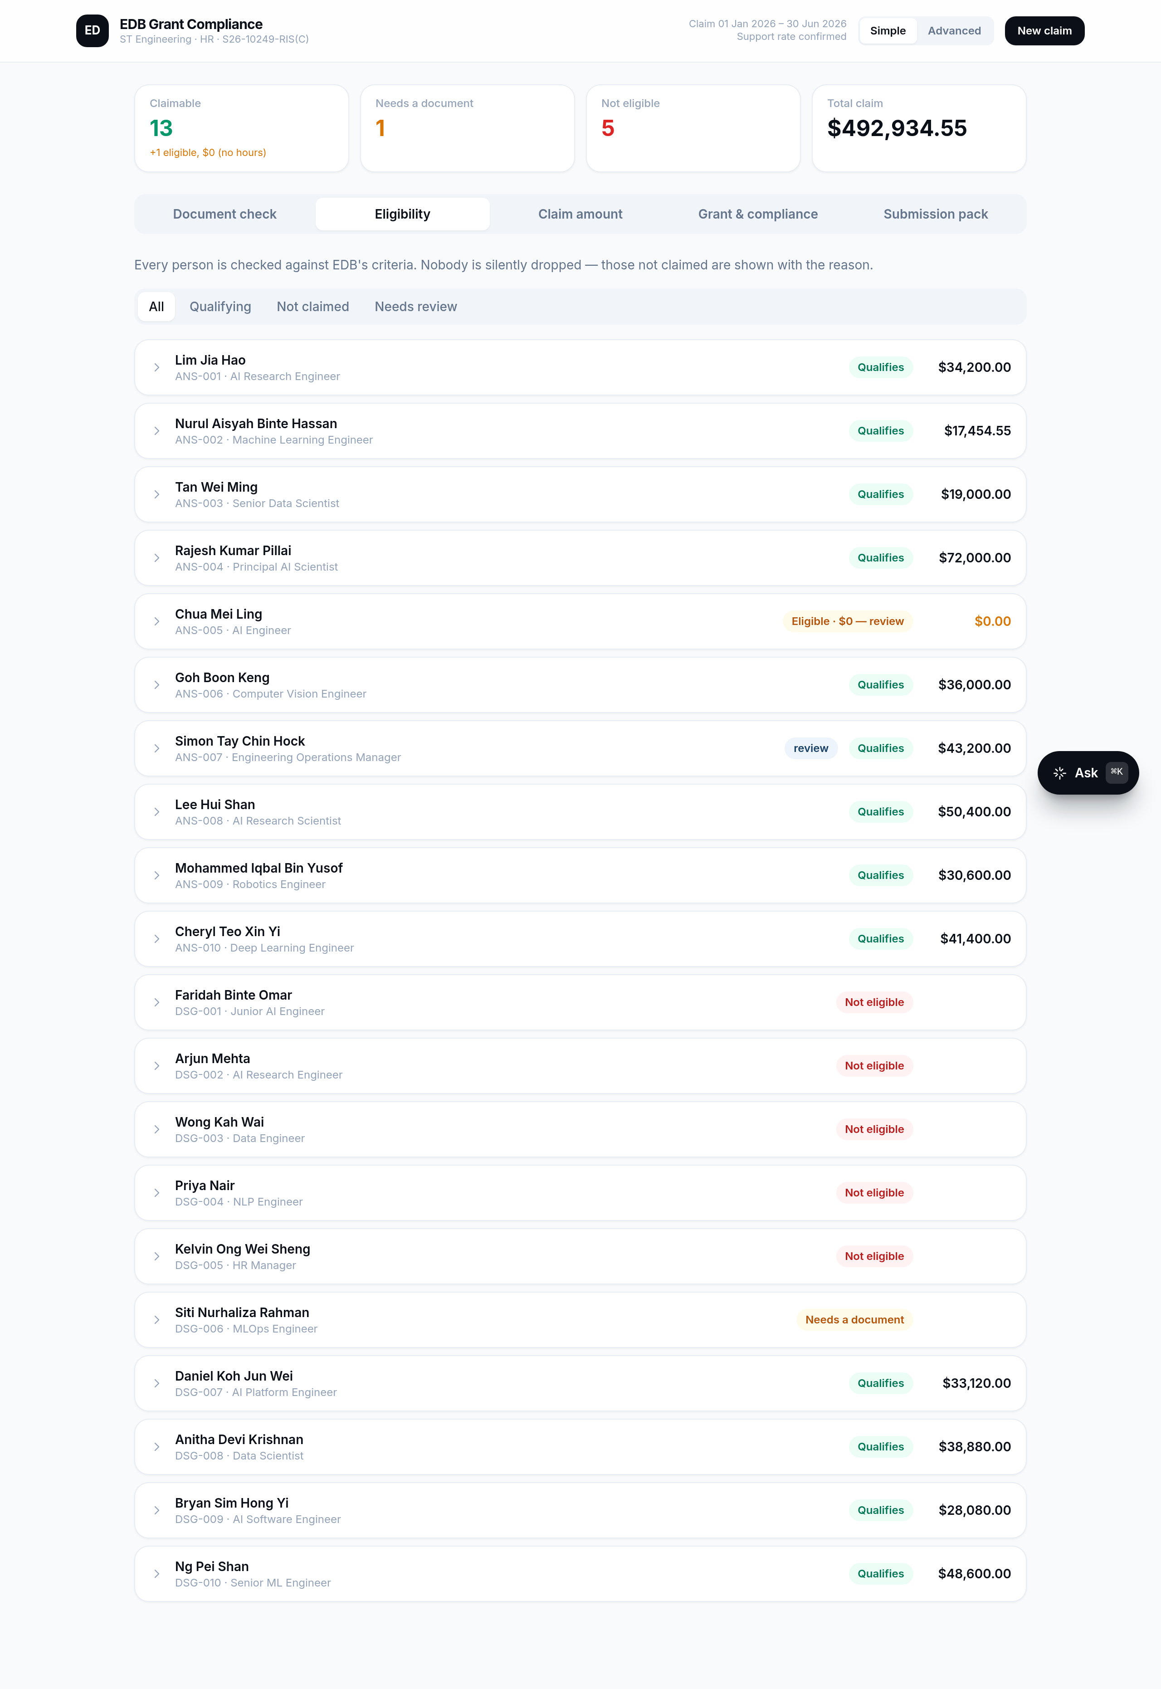
ELIGIBILITY
Seven EDB gates, applied to every person
▸ The checks. Citizen/PR · ECMF-validated · no other grant · salary ≥ S$5,000 · eligible R&D role · active in period · payslip present.
▸ Clear verdicts. Qualifies · Not eligible · Needs a document — with the reason behind each.
▸ Human in the loop. Borderline roles are flagged for HR to confirm, not auto-decided.
EDB RIS(C) Grant Claim Automation · ST Engineering HR · Confidential

Slide 10
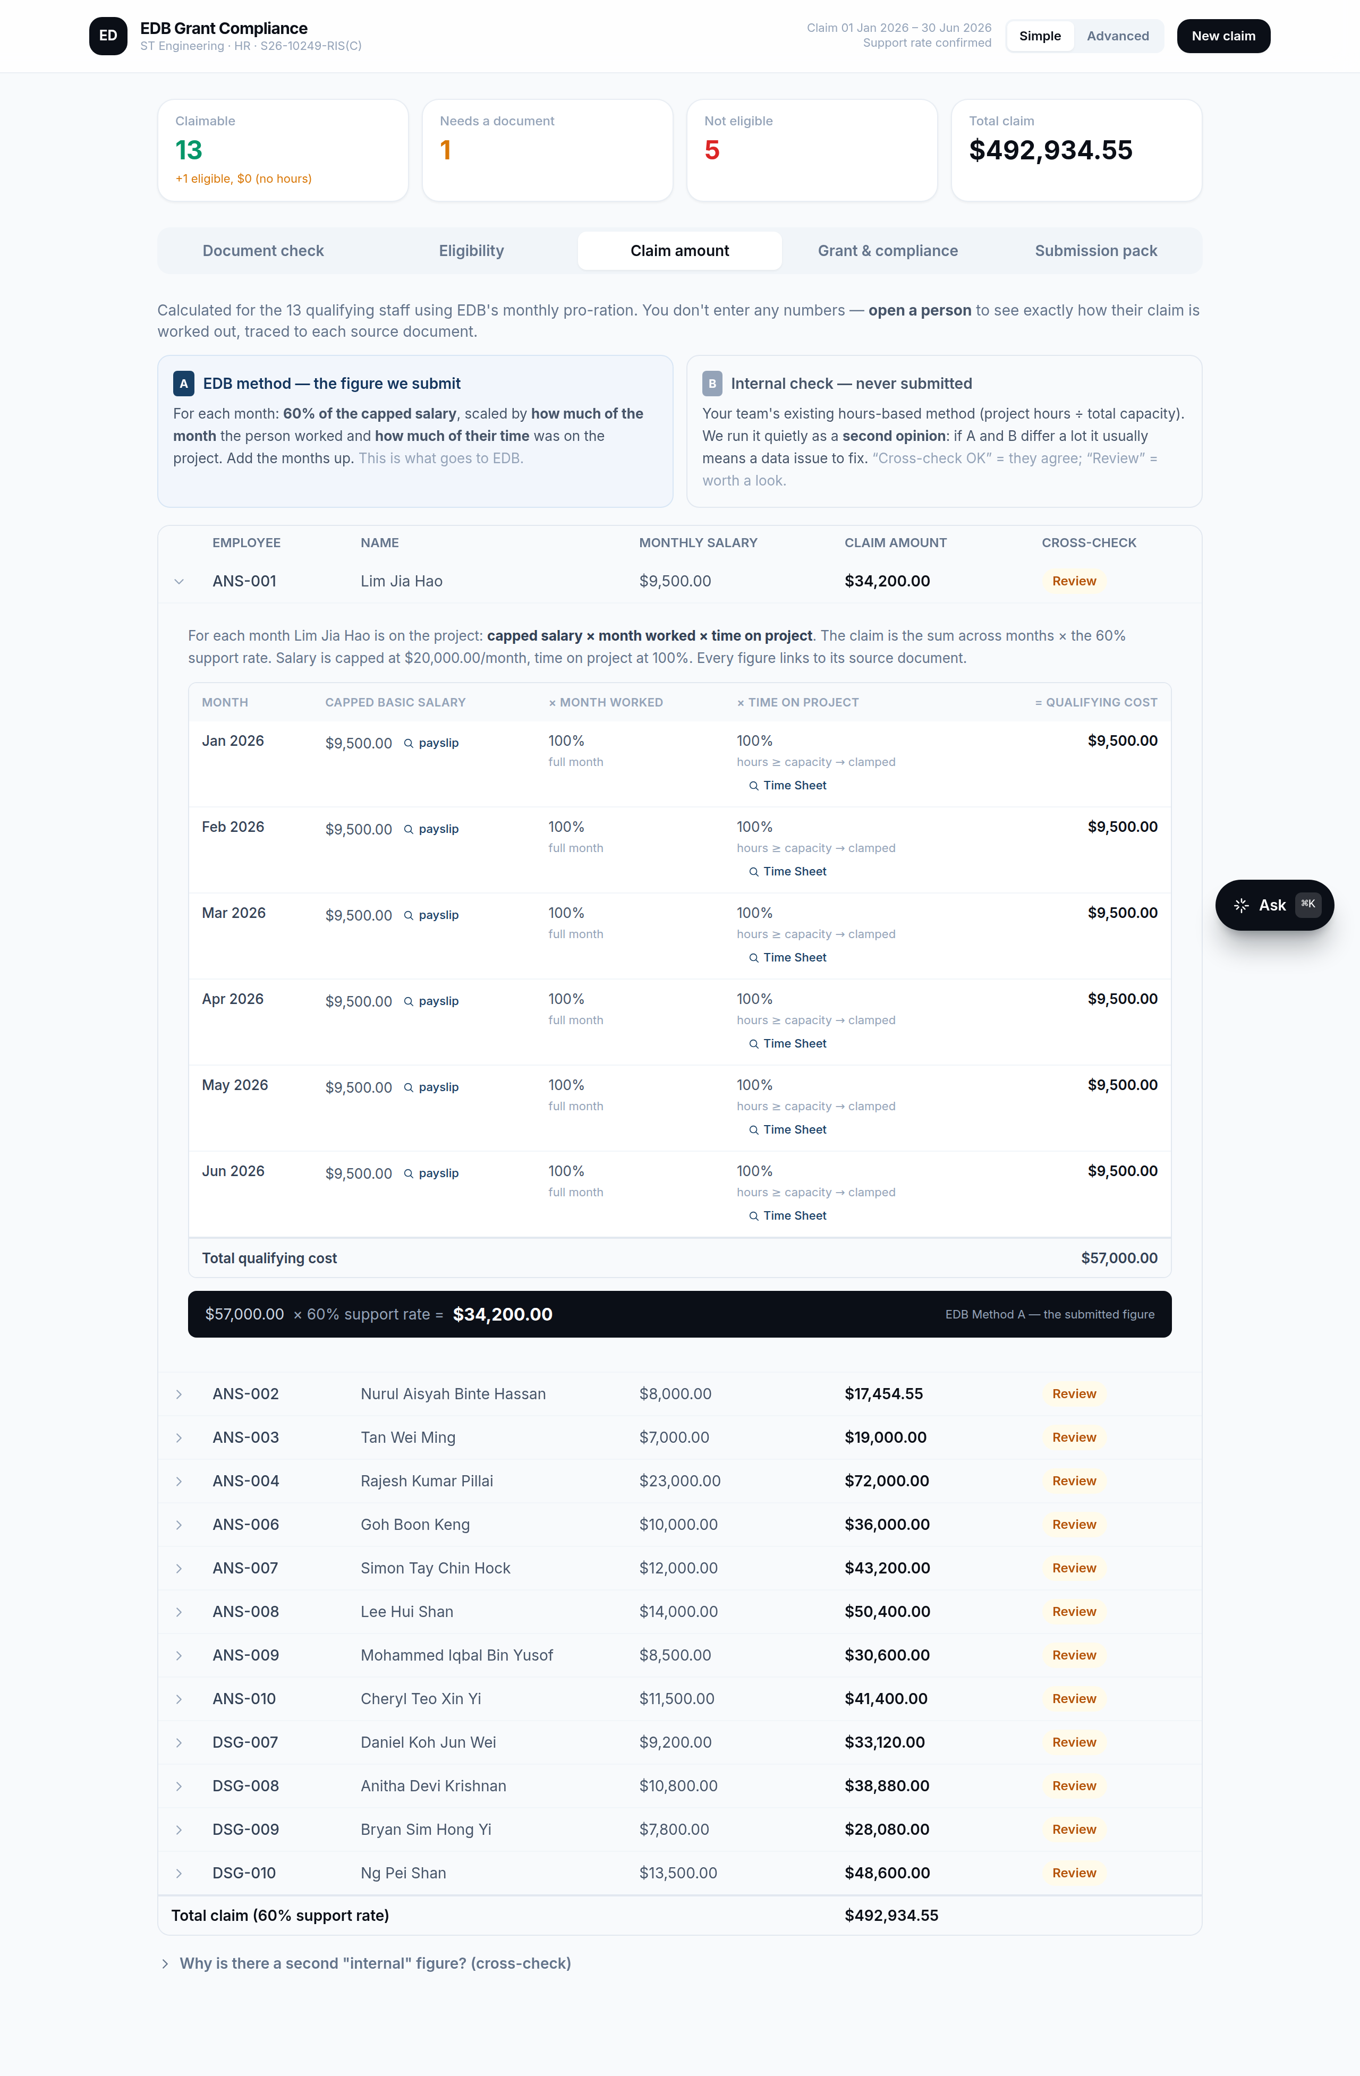
THE CALCULATION
Every claim, shown in full
▸ EDB monthly pro-ration (Method A). Capped salary × month involved × time on project, summed × the support rate. This is the figure submitted.
▸ Open any person. See the month-by-month working, each input linked to its source document.
▸ Silent cross-check (Method B). An internal hours-based method runs in the background; differences are flagged, never hidden.
EDB RIS(C) Grant Claim Automation · ST Engineering HR · Confidential

Slide 11
EDB SCHEME RULES, ENCODED
The support package, enforced automatically
▸ Support rate 60% of the qualifying monthly salary (EDB Support Package).
▸ Basic salary only. No CPF, bonus, AWS, allowances, COLA or airfare.
▸ Floor S$5,000 · Cap S$20,000/month → at most S$12,000 funded per person per month.
▸ New hire vs upskill. New hires funded across the qualifying period; upskilling to PL3 funded for up to 9 months.
▸ Ceiling S$42m, claim ≥ 3 months. Manpower-only grant cap, with a minimum claim period.
EDB RIS(C) Grant Claim Automation · ST Engineering HR · Confidential

Slide 12
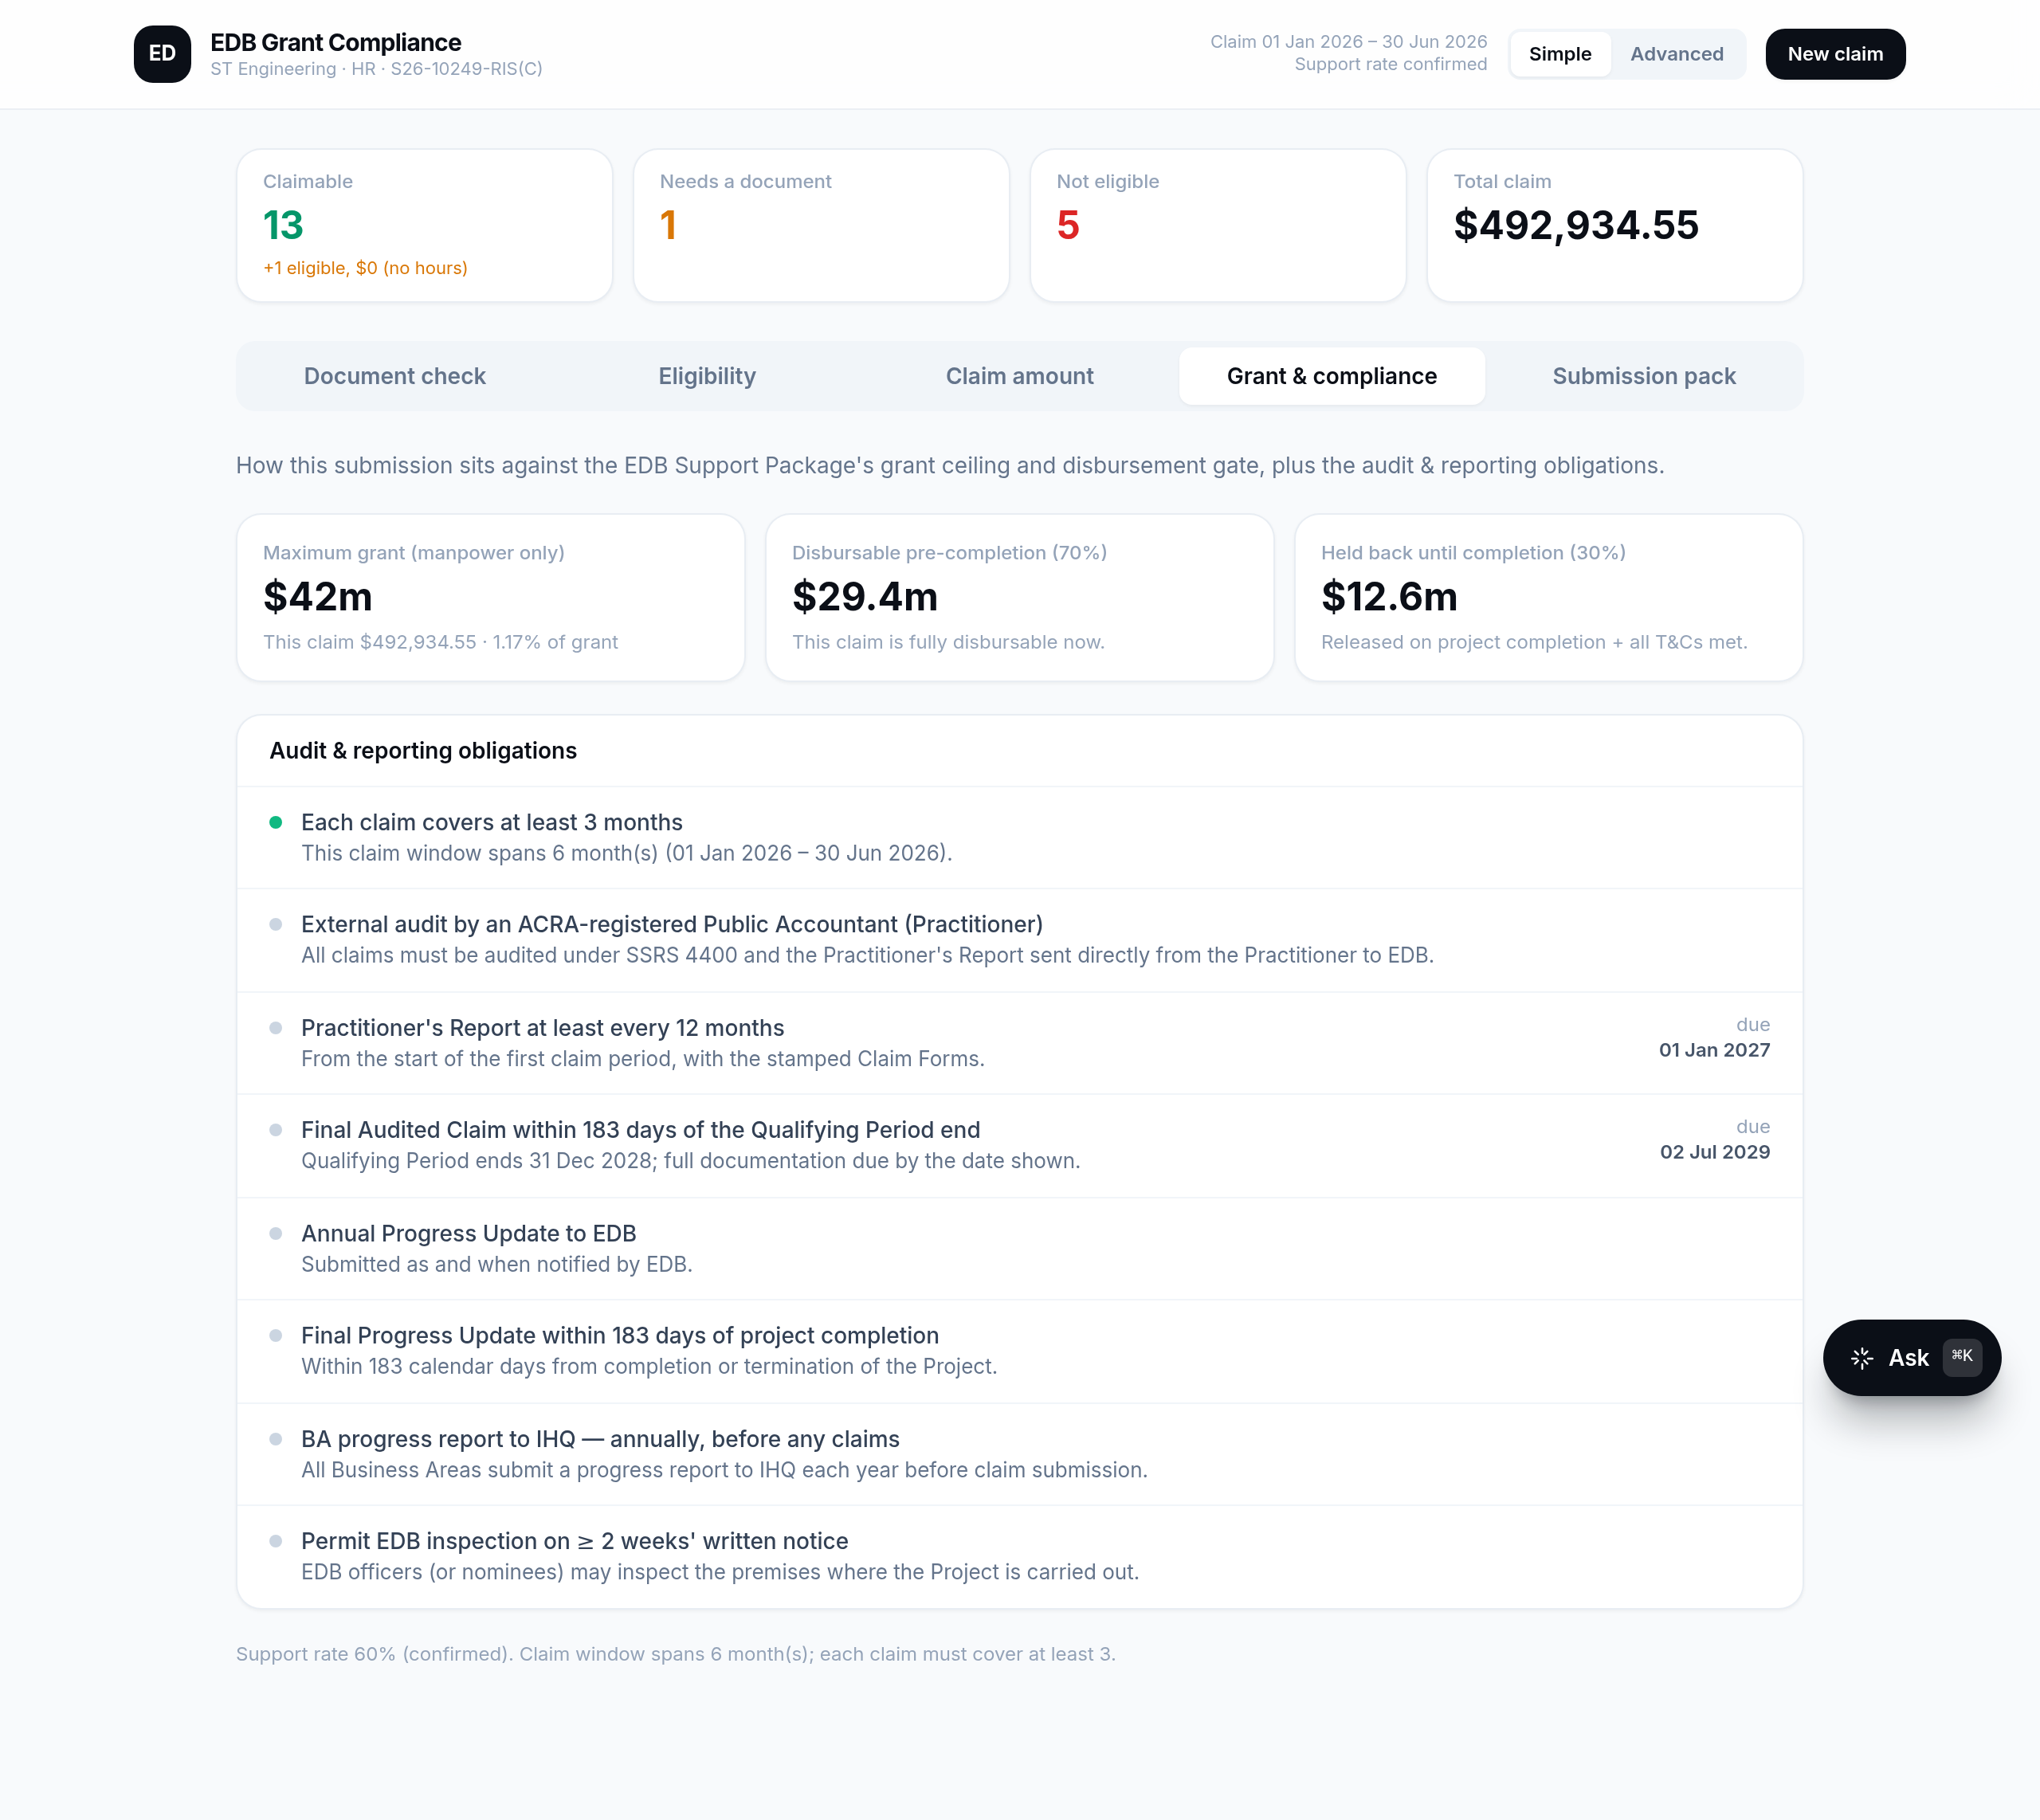
GRANT & COMPLIANCE
Ceiling, disbursement and deadlines — tracked
▸ Against the S$42m ceiling. Every submission is measured against the manpower grant cap.
▸ 70 / 30 disbursement gate. Up to 70% disbursed before completion; the final 30% on project completion + T&Cs.
▸ Deadlines computed for you. 12-month Practitioner's Report, 183-day final claim, progress updates, inspection rights.
EDB RIS(C) Grant Claim Automation · ST Engineering HR · Confidential

Slide 13
INTELLIGENT DOCUMENT INTAKE
Upload anything reasonable — the system sorts it out
▸ Guided, in order. EDB output template and trainee list first, then timesheet / ECMF / payroll — a live tracker ticks each off and shows what's still missing.
▸ Auto-categorised. Files are recognised by name; a leave report or CPF statement is never mistaken for the core timesheet.
▸ Flexible formats. Synonym headers ('Emp No', 'Salary'), a Period/Pay-Date column, or one payslip per file with the month in its name — all parse and merge.
▸ Clear reasons when rejected. If a file can't be read it explains why (missing sheet/column, wrong period) and how to fix it — never a stack trace.
EDB RIS(C) Grant Claim Automation · ST Engineering HR · Confidential

Slide 14
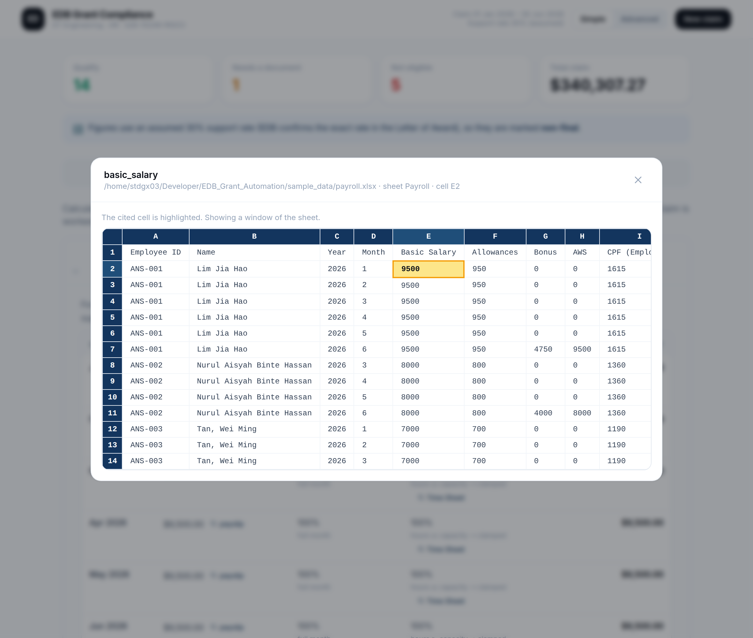
AUDIT-READY EVIDENCE
From any figure to its source, in one click
▸ One-click traceability. Click a number → the exact cell in the original payslip or timesheet, highlighted.
▸ Three outputs, one per reader. EDB submission template · Statement of Expenditure (auditor) · Issues list (HR).
▸ Built for SSRS 4400. Designed for the auditor's ≥85% value sampling — every claimed dollar is traceable.
EDB RIS(C) Grant Claim Automation · ST Engineering HR · Confidential

Slide 15
HOW CLAIMS ARE VERIFIED
The audit explained — SSRS 4400
▸ Agreed-upon procedures — not an audit or a review. An ACRA-registered Public Accountant (the “Practitioner”) performs a set of procedures agreed with EDB and reports factual findings only — no opinion or assurance is given; EDB draws its own conclusions.
▸ At least 85% of claimed value is sampled. The Practitioner tests ≥ 85% of the claimed value against the Statement of Expenditure (SOE), vouching each sampled figure to its source document.
▸ Direct to EDB, on a cadence. The Practitioner’s Report goes straight from the Practitioner to EDB — at least every 12 months, with the final audited claim within 183 days of the qualifying-period end.
▸ What we built for it. One-click traceability and the SOE output make this engagement fast and clean; outputs stay labelled “UnauditedClaim” until the Practitioner completes their procedures.
EDB RIS(C) Grant Claim Automation · ST Engineering HR · Confidential

Slide 16
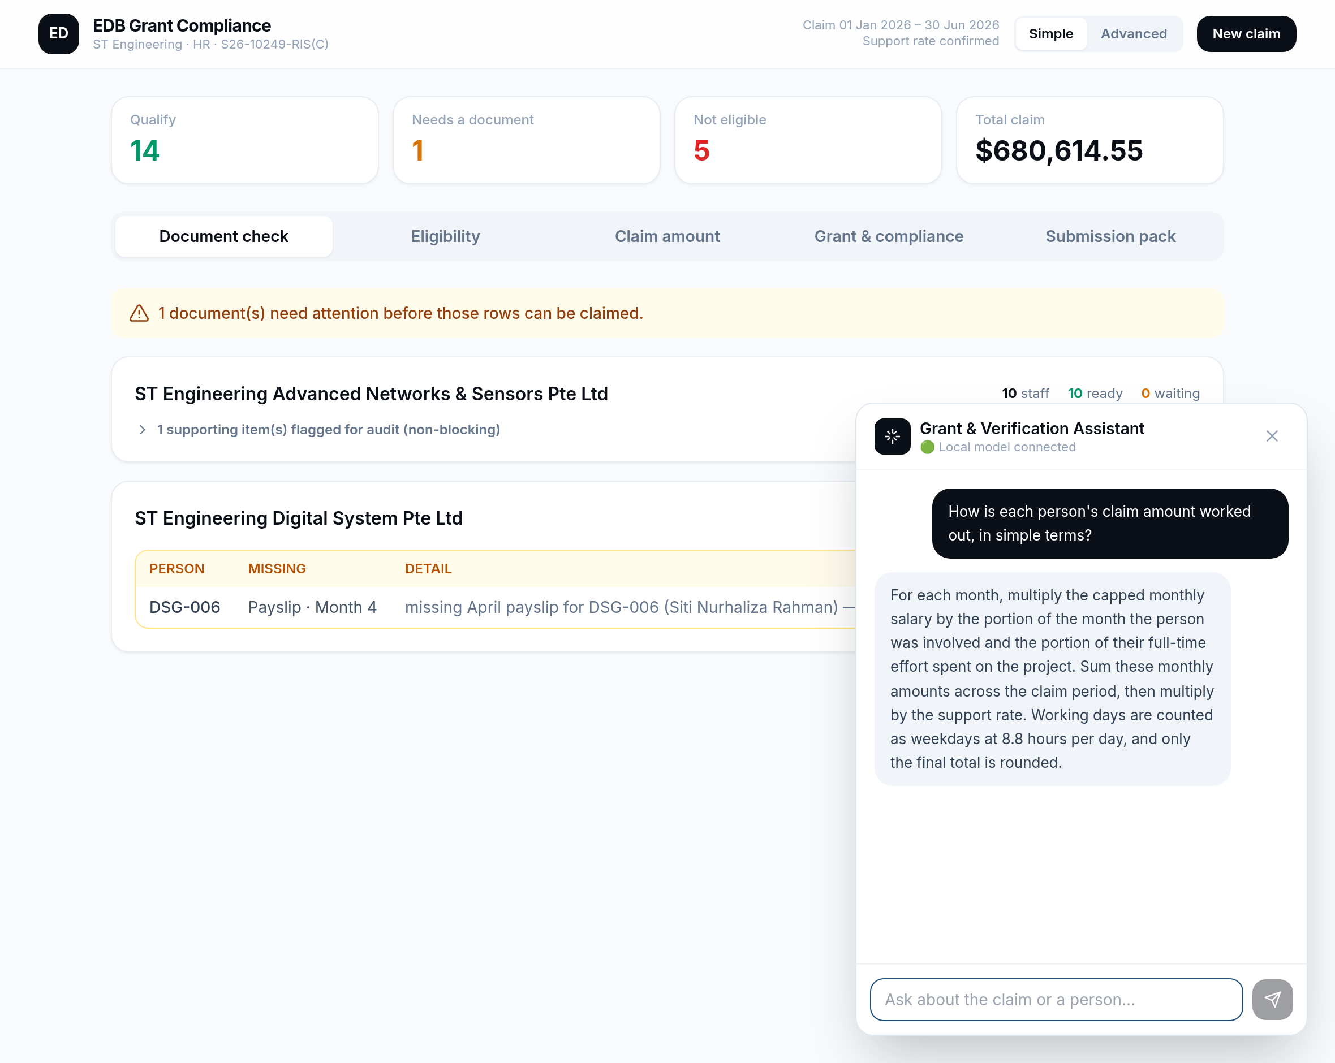
THE BUILT-IN ASSISTANT
Ask the claim anything, in plain English
▸ Natural-language Q&A. “Why is this person excluded?”, “How is the claim calculated?”, “What's the 9-month rule?”
▸ Recall across claims. “What documents do we have for E001?” fetches that person's saved document checklist from an earlier claim — with citations — even in a new session.
▸ Local AI. Powered by a model running on ST Engineering's own DGX — private, no external calls.
▸ Grounded. It explains and reasons, but never invents a figure — answers cite the source.
EDB RIS(C) Grant Claim Automation · ST Engineering HR · Confidential

Slide 17
ARCHITECTURE & SECURITY
Modern, on-premise, auditable
▸ Web app on a Python engine. A clean React interface over the deterministic calculation core.
▸ Local AI + local data. Qwen model on the DGX; a per-employee SQLite store on the machine.
▸ Nothing leaves the building. All salary and claim data processed on-premise; no internet calls.
▸ Auditable AI. Every model call is temperature-0, schema-constrained, cached and logged.
EDB RIS(C) Grant Claim Automation · ST Engineering HR · Confidential

Slide 18
STATUS & NEXT STEPS
POC complete — ready to pilot
▸ Built and verified. Full pipeline end-to-end on synthetic data; 115 automated tests passing.
▸ Pending confirmation. Exact support rate & 9-month anchoring (Letter of Award); the auditor's final document list.
▸ Next. Pilot on a real entity's data; connect to live payroll and timesheet exports; finalise outputs with the appointed auditor.
EDB RIS(C) Grant Claim Automation · ST Engineering HR · Confidential

Slide 19
Thank you
Questions & discussion
EDB Grant Claim Automation · ST Engineering HR · S26-10249-RIS(C)

